Slide 1


Slide 2
INTRO
Play the video
Notes:
Add note to this slide

Slide 3






OUR
ACTIVITIES
transport
Rail
Aviation
Mobility
Road
Water, environment,
waterway transport
Sustainable cities
Water & energy
Buildings
Cities
Water
Energy
Fields of activity underpinned by cross-group areas of expertise
Environment ● Mobility and Systems ● Geotechnical & Complex Structures ● Digital

Slide 4

Egis,
A global OFFER
Urban planning,
architecture & landscaping
Consultancy
Engineering
Project structuring
Mobility services
Turnkey
Operations
Roads
Transportation
Aviation
15,800
Rail
Buildings
Urban development
Mobility
Water & Ports
Environment & Energy
Major structures
Imagine. Create. Achieve.

Slide 5
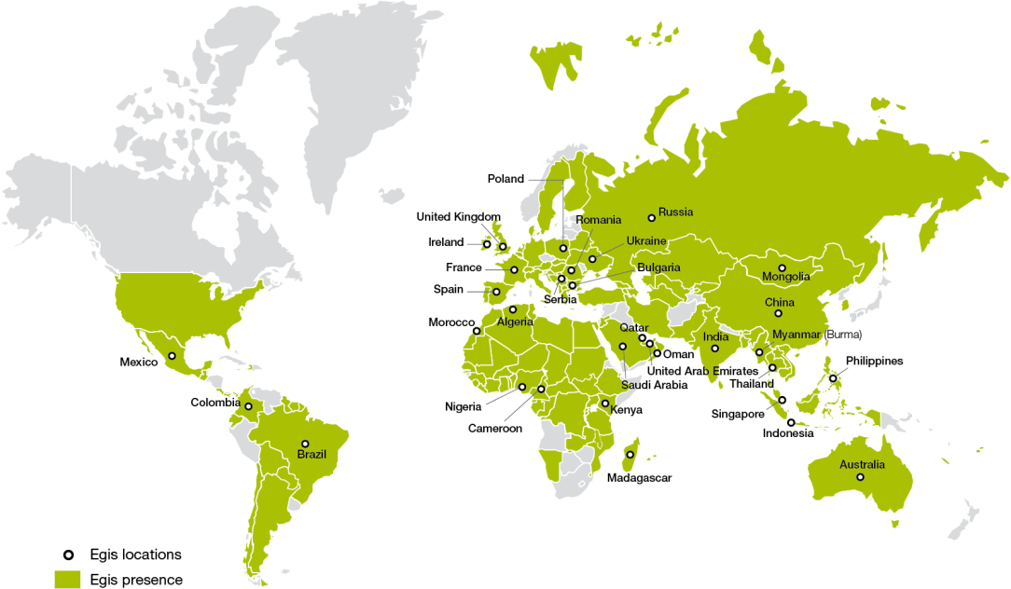








PRESENCE WORLDWIDE
ROADS & MAJOR STRUCTURES
RAIL
BUILDINGS
MOBILITY
30%
23%
17%
8%
AVIATION
WATER & PORTS
ENERGY & ENVIRONMENT
URBAN DEVELOPMENT
7%
6%
5%
4%
58% Engineering
42% Investment, Operation and Mobility Services
Imagine. Create. Achieve.

Slide 6
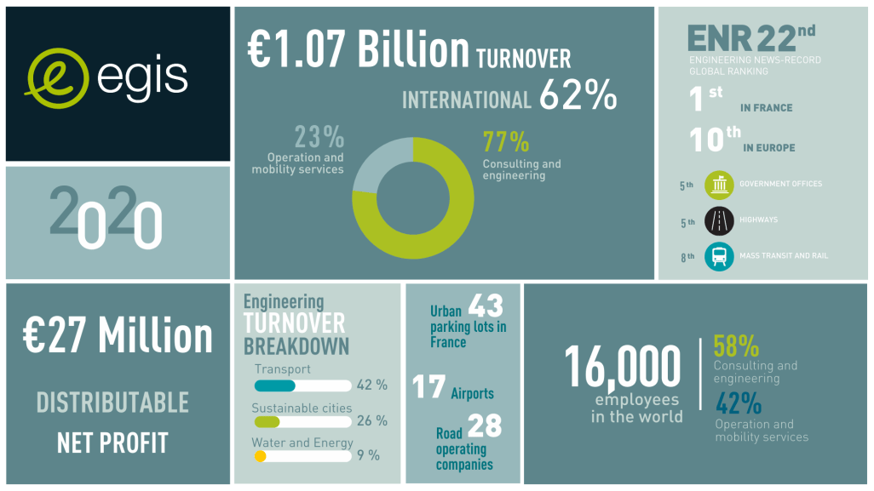
KEY
FIGURES
2020

Slide 7
A sustainable, digital and innovative future
02.
Notes:
Type your notes

Slide 8


SUSTAINABILITY : Part of our DNA & ACTIVELY LED FROM THE TOP
Develop solutions and bids that meet the challenges of Ecological and Energy Transition
Integrating the digital transformation,
Integrating Corporate Social Responsibility (CRS) into the heart of Egis
Aligning our Sustainability plans with our client’s ambitions
Addressing four major challenges today to create a sustainable future :
    Climate and energy
    Biodiversity and resources
    Mobility
    Sustainable cities
Notes:
Type your notes

Slide 9
Business unit
PPP INVESTMENT operation and services
03.

Slide 10
OUR Road NETWORK
+20
COUNTRIES
47
contracts covering
a wide range of activities
28
operating subsidiaries
in different countries
4,500 km
used daily
by 2 600 000 vehicles
and 92 km of tunnels
OPERATION
LOCAL OFFICE
10

Slide 11

OUR markets AND SERVICES
The Business Unit PPP INVESTMENT, OPERATION & SERVICES
designs, invests and operates complex transport infrastructure and intelligent mobility services to create value for communities.
01
02
03
INFRASTRUCTURE
MANAGEMENT
to develop territories
MOBILITY &
URBAN SERVICES
TO PACIFY THE CITIES
ROAD USERS SERVICES
By Easytrip
TO IMPROVE ROAD USERS JOURNEY
PPP Investment
Enforcement
Heavy good vehicles
Operation and maintenance
Electronic payment
Light vehicles and commercial fleets
Turnkey systems
On-street parking management | Free-flow tolling and tolling enforcement | Speed enforcement | Enforcement for urban cleanliness and safety | Car pooling lanes enforcement | Low emission zone and clean air zone
Toll payment solutions | Parking payment | VAT & excise | Train & ferry booking I Fuel & LNG | Telematics | Insurance
Asset management
Road | Airport | Other infrastructure:
Rail transport, Cable car, Ports, Urban

Slide 12
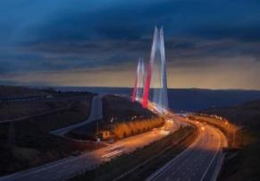
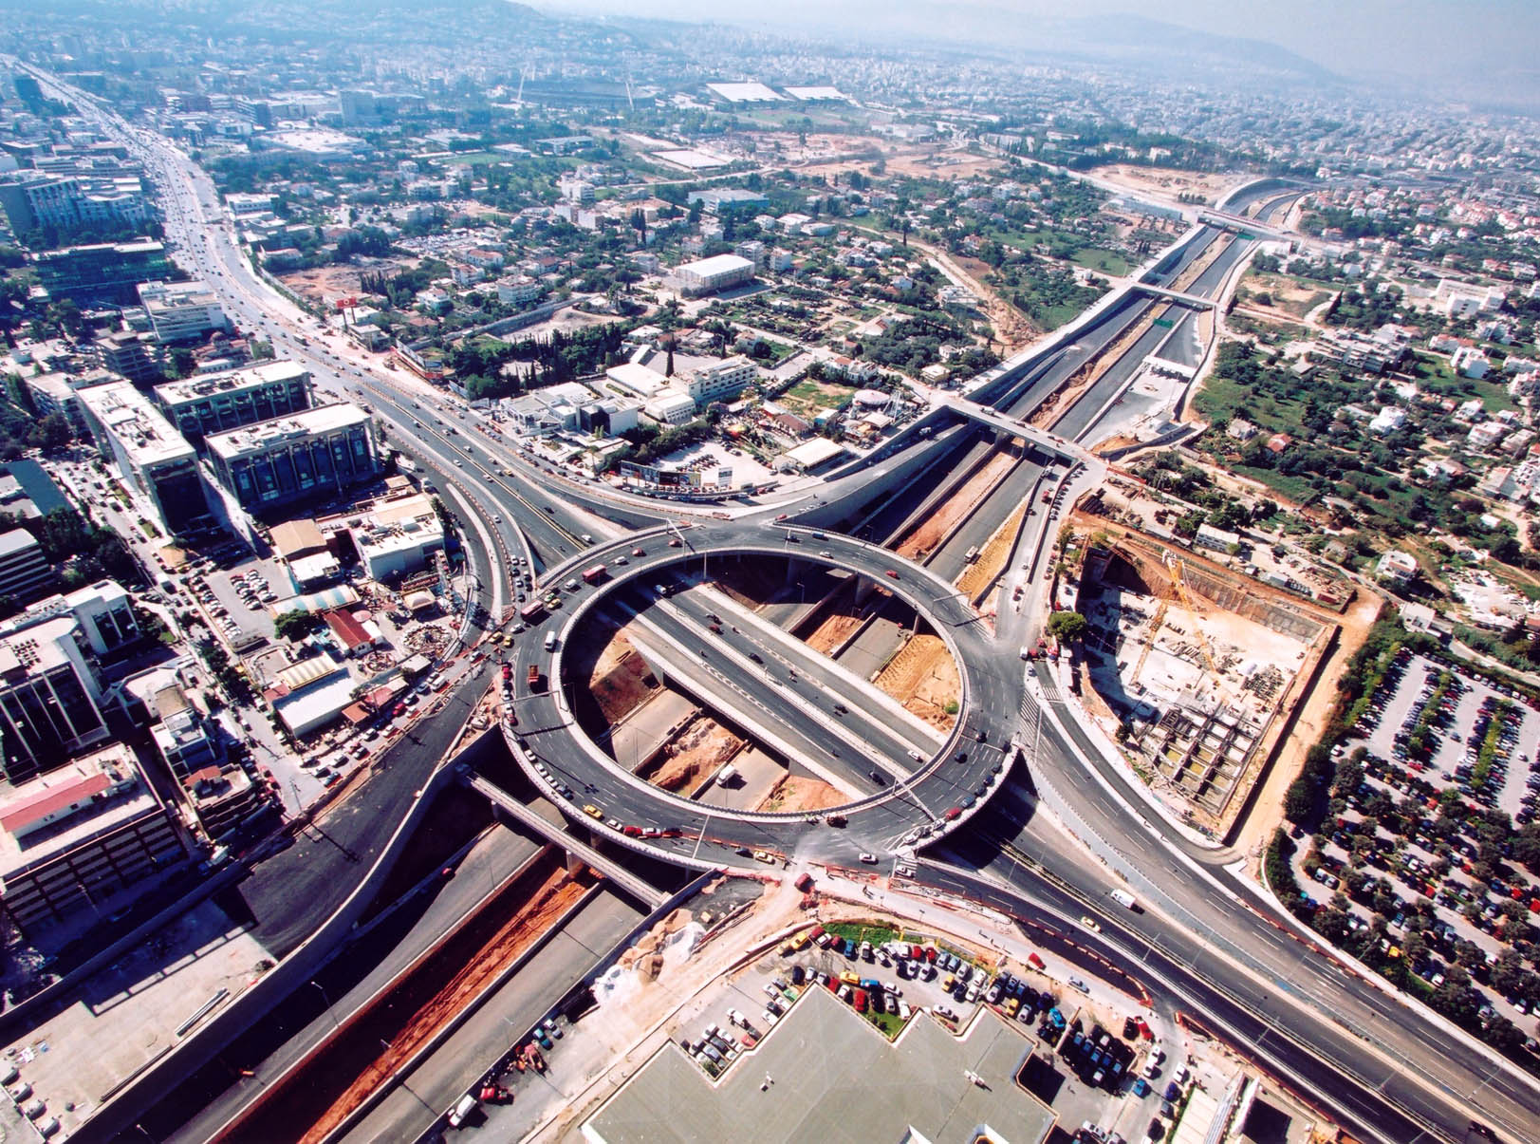
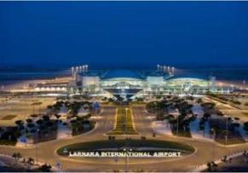
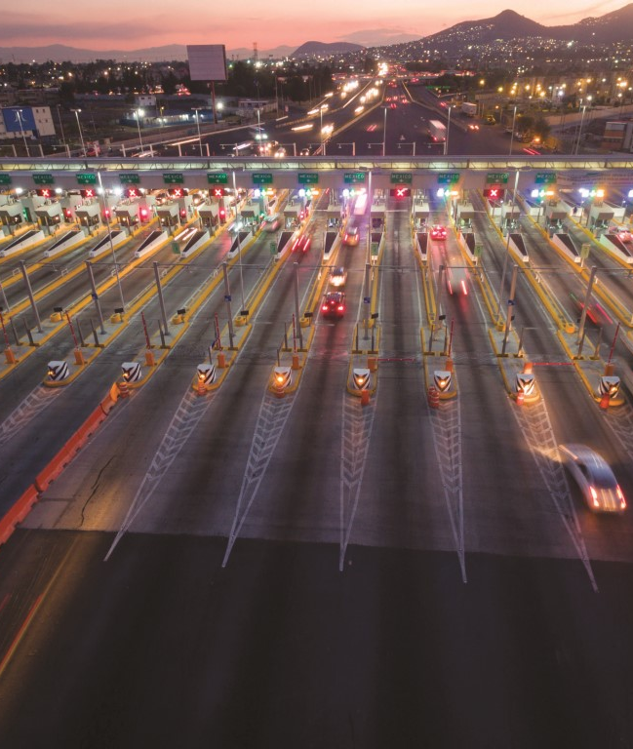
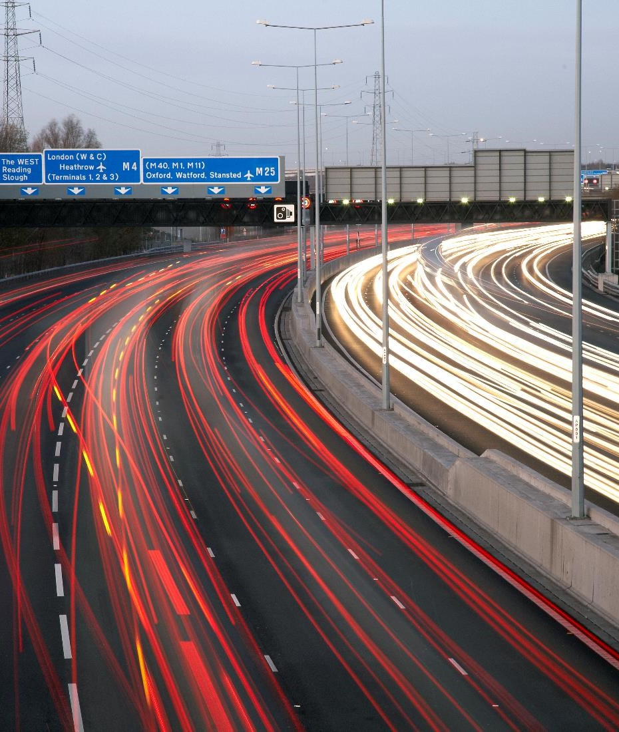
ROAD flagship projects
01. Istanbul-Izmir Otoyol, Turkey
  GIIB - O&M for 15 years // TURKEY
02. Attiki odos Motorway, Greece
  Attikes Diadromes O&M partner-23years
03. Larnaka & Pafos International Airports
  Operation of 2 airports for 25 years // CYPRUS
04. Golfo Centro, Mexico
  Operation for 13 years // MEXICO
05. M25 motorway - UK
  Concession of 30 years // UNITED-KINGDOM

Slide 13

Thank You
Contact : Jean Harito
Director Egis for Greece-Turkey
Jean.harito@egis.fr
www.egis-group.com
December 2021
Notes:
Type your notes

