Slide 1
Closing speaking
CCIFG MARITIME FORUM
December 4th 2024

Slide 2
Recent measures provide a clear framework and objectives
Background to the decarbonization of maritime transport:
The maritime sector accounts for around 2-3% of global CO₂ emissions
Strategic importance of the sector for the global economy → 90% of international trade
Commitment by international organizations and governments to ambitious emission reduction trajectories in the maritime sector:
Revised IMO strategy adopted in 2023 with strengthened targets for decarbonization of shipping:
Objective: zero net GHG emissions in international shipping by 2050
Some ambitious measures proposed: fuel standards and emissions pricing mechanism

Slide 3
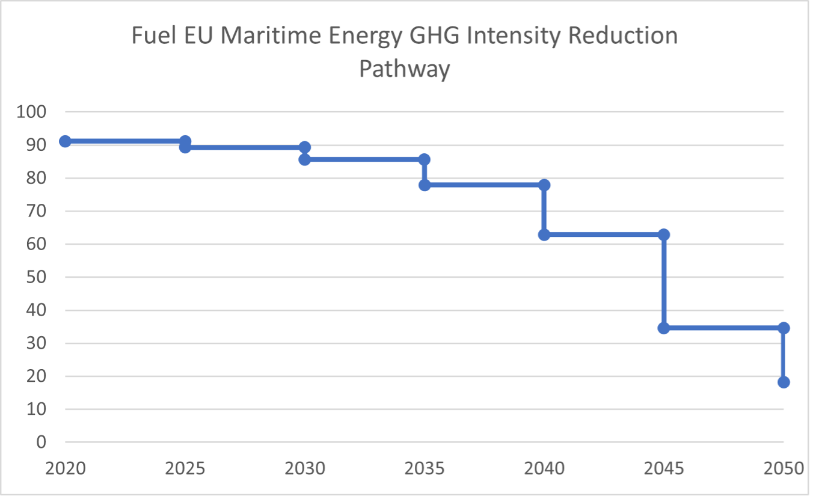
Recent measures provide a clear framework and objectives
Maritime FuelEU Regulation of July 2023, stemming from the Fit for 55 package of the European Green Deal:
Aims as a priority to decarbonize the maritime sector by reducing the intensity of GHG emissions from ships;
Seeks to promote the development and use of alternative fuels, such as e-fuels (synthetic fuels), biofuels and hydrogen;
Promotes the maritime sector's energy transition, while maintaining the competitiveness of European shipowners, by providing incentives and supporting innovation.

Slide 4
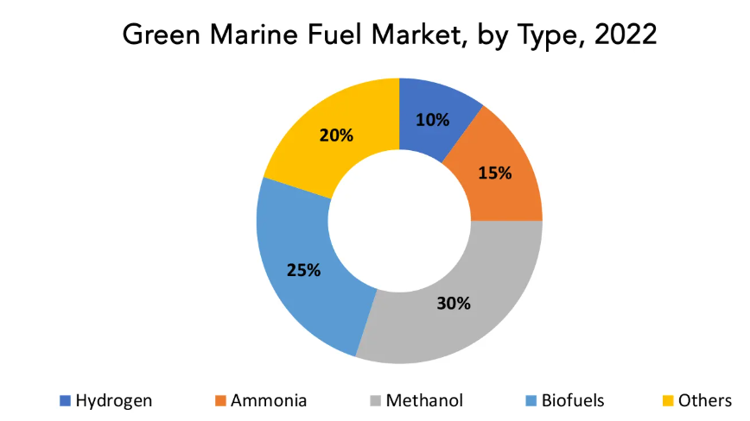
The major challenges of decarbonizing maritime transport
Decarbonization poses many challenges today:
High cost of alternative fuels: e-fuels, hydrogen and other low-carbon fuels are still much more expensive than traditional fossil fuels, posing a challenge to their widespread adoption;
Incomplete technological maturity: production of these fuels is still limited on an industrial scale, and much investment and innovation will be needed to achieve large-scale production;
Supply of low-carbon fuels still too limited: the availability and supply of alternative fuels at competitive prices represent a logistical and economic challenge, not least because of competition between the various energy sectors
Source: Exactitude Consultancy, 2023

Slide 5
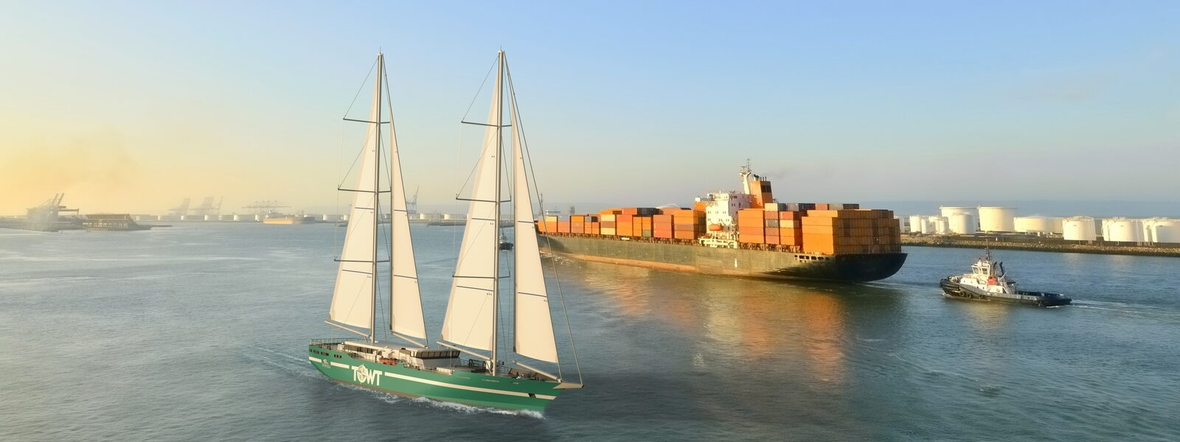
The major challenges of decarbonizing maritime transport
Nevertheless, real and credible prospects in the medium/long term:
Necessary partnerships and collaborations between states, as illustrated by the Franco-Hellenic Maritime Committee since 2022
Development of a public-private collaboration that is as essential as it is conducive to generating tomorrow's innovations.
Growth of the sailing shipping:
Pilot projects in Europe, and particularly in France, with companies and startups developing innovative vessels;
An innovative solution that is growing rapidly, but still requires investment in research, development and infrastructure to become a viable large-scale solution for decarbonizing the maritime sector.

Slide 6
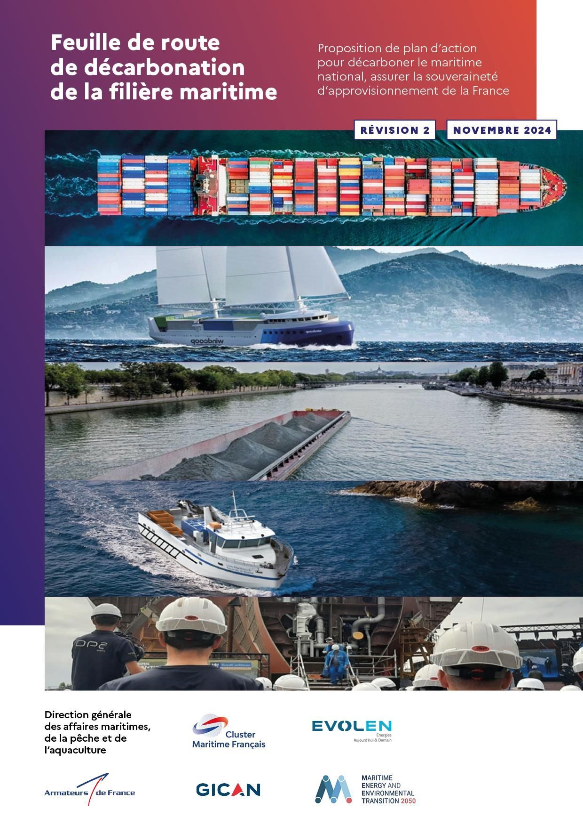
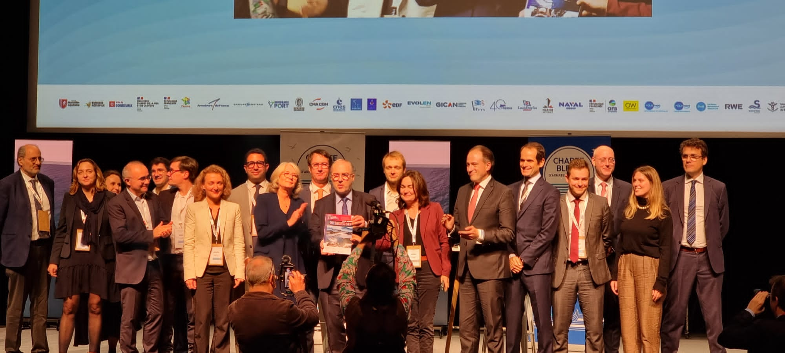
The major challenges of decarbonizing maritime transport
Update on the French decarbonization roadmap:
Between private and public players, co-piloted by the French Directorate-General for Maritime Affairs, Fisheries and Aquaculture and the French Maritime Cluster, supported by the expertise of the MEET2050 Institute.
It responds to a legislative requirement for sectors with high greenhouse gas emissions: to identify the path to follow to achieve their eco-energy transition.
In its initial version of April 2023, the roadmap set out essential findings for the French fleet, identifying the brakes and levers for decarbonization, as well as an initial action plan.
The updated version presented at the Assises de l'économie de la mer 2024 takes the analysis a step further, exploring the specific needs of certain fleet segments on the basis of more precise and robust data.

Slide 7
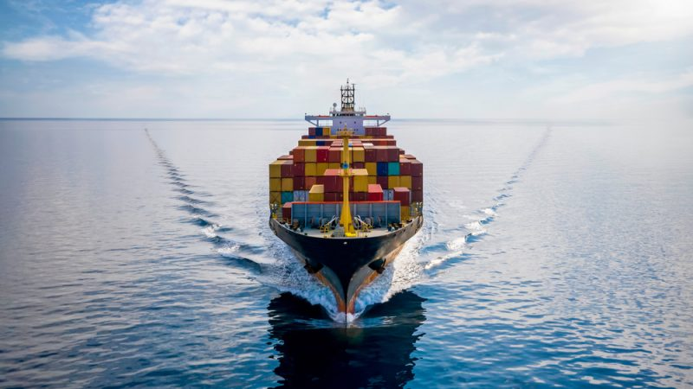
Conclusion
The decarbonization of the maritime sector represents tremendous challenge that will considerably transform maritime transport as it has developed since the 1970s.
It nevertheless represents a unique opportunity through which the combination of policies, innovations and investments that can (and must) lead the maritime sector to become a key player in the fight against climate change, while opening economic opportunities for the industry.
This means strengthening cooperation between public and private players, who must explore all the solutions that already exist, while supporting the innovations of tomorrow, which together will enable us to achieve this major eco-energy transition.

