Slide 1






The Third Industrial Revolution in Hauts-de-France
15/09/2016
Cédric van Riel

Slide 2
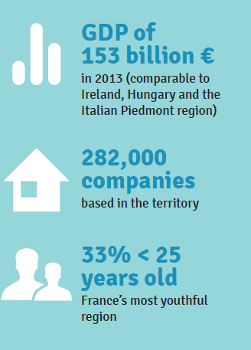
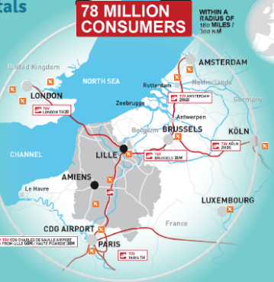


Hauts de France
Les Hauts de France

Slide 3
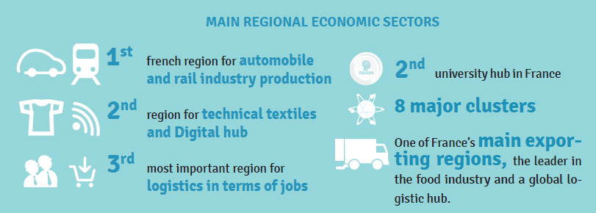
Hauts de France
Les Hauts de France

Slide 4
2. The master plan
Coal and steam engine
The 3 industrial revolution
1st industrial revolution
Printing and capitalism
Railway and water way
Petrol and electricity
2nd industrial revolution
Television and telephone
roads, telecomunication
Renewable energies
Local resources
Recycling
Internet
Sustainable development
Collaborative and participative model
3rd industrial revolution
datacenters

Slide 5
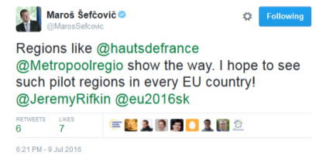
The european pionneer region
implementing the third industrial revolution
Maroš Šefčovič, vice president of the European Commission, declared, during the 7th European Summit of Regions and Cities in Bratislava, that Hauts-de-France shows the way and he hopes to see such pilot region in every EU country.

Slide 6




3. Rev3
Key numbers
350 projects across the region
11,5 million euro transferred by citizens in the rev3 saving account
24 companies financed by rev3 loans
500 million euro investments needed for rev3
A new investment fund of 50 million euro

Slide 7
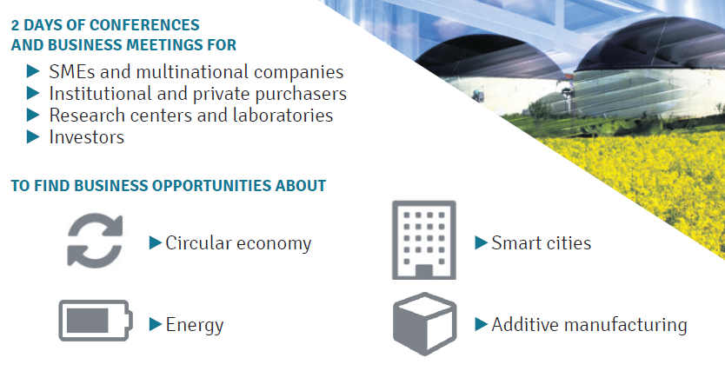
3. Rev3
Key numbers

Slide 8
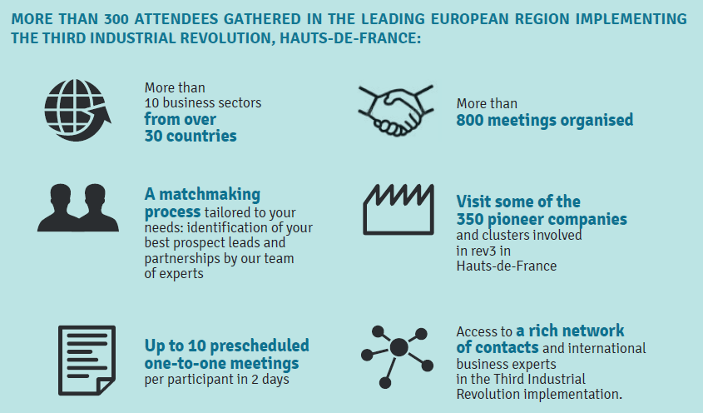
3. Rev3
Key numbers

Slide 9
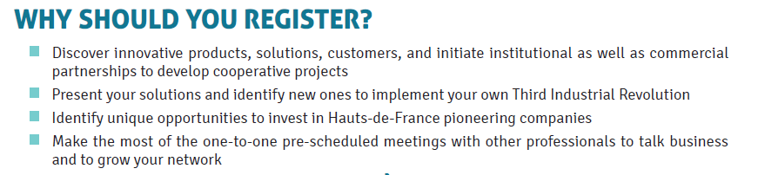

Slide 10
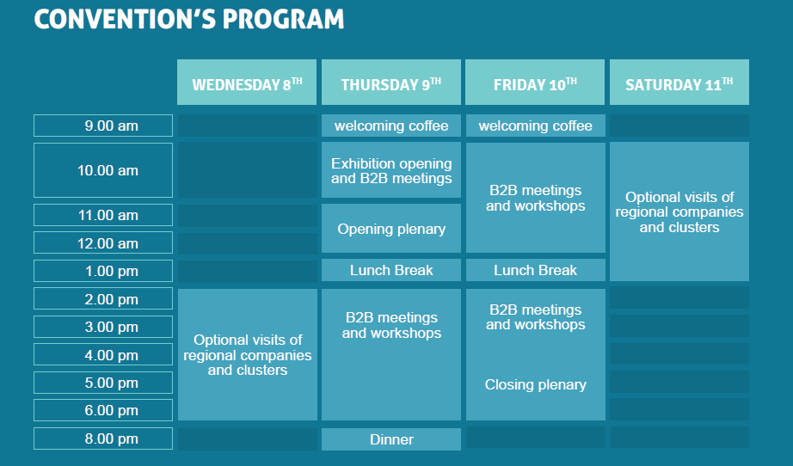
3. Rev3
Key numbers

Slide 11
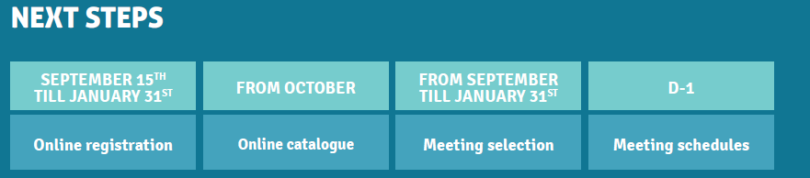
8th
For registration and tarif please contact your delegation leader

Slide 12





Let’s develop projects together
technical and commercial cooperation
We are a multi-disciplinary team of rev3 and international experts from the Hauts de France Chamber of Commerce and Industry, and we are able to:
Help you raise financing for the development of your projects
Offer tailor-made assistance to elaborate your legal agreements and partnerships
Support the internationalisation of your project and company
Put you in touch with our technical experts and commercial partners to prepare technical studies, project engineering, and transfer of expertise
Identify suitable technological and commercial projects according to your needs

Slide 13




Cédric van Riel
+33 (0)3 59 26 21 48
c.vanriel@cci-international.net
www.rev3.fr

