Slide 1


Company
Overview
www.chimica.ro

Slide 2

About Us
Almost A Century of Experience
Chimica Group has a rich history of over 80 years in manufacturing, evolving to become a trusted TIER 1 supplier in the mobility industry.
With a rich legacy of craftsmanship, we’ve grown into a comprehensive industrial partner, offering services that span the entire product development cycle.

Slide 3


What Drives Us
Established in 1938 in Orăștie, Romania, we have developed decades of expertise in the Automotive, Bikes, and Home & Garden industries.
Our vision is that our business as a gift to the human spirit. It is a vibrant, strong, and self-driven business that continuously transforms and evolves by integrating
future technologies and addressing the concerns of future generations.
Our mission is to transform our products, performance model, leadership, conversations, and production systems into meaningful contributions to society, inspiring a positive impact on people and the planet.

Slide 4




Our Values
Our values serve as the foundation of our work, guiding our actions and commitments every day.
Integrity
We uphold integrity by keeping our commitments to colleagues and partners, embedding honesty and accountability in every interaction.
Authenticity
We practice authenticity by openly acknowledging our challenges. Staying true to our values helps us respond with fairness and integrity in all situations.
Commitment to a bigger cause
Our commitment extends beyond individual goals, embracing interconnected interests with nature, our community, customers, partners, and colleagues.
Co-Creators
We focus on learning from challenges and moving forward, fostering a supportive environment that encourages collaboration and innovation.

Slide 5




Our Capabilities
We offer a full spectrum of services, from initial concept to mass production. Our integrated approach allows clients to rely on us for all aspects of product development, tailored specifically to the mobility industry.
Co-product
design
Molds production & stamping
Prototyping, testing, and homologation
Production and
assembly
Working closely with clients, we co-develop products that meet all functional, aesthetic, and engineering standards.
With a dedicated facility for molds and stamping, we manage production in-house, ensuring high accuracy and durability.
Our prototyping services allow us to bring designs to life quickly, enabling our clients to assess, refine, and perfect each component before moving to production.
Our production processes allow us to manage every aspect of assembly, ensuring that components are built with precision and consistency.

Slide 6

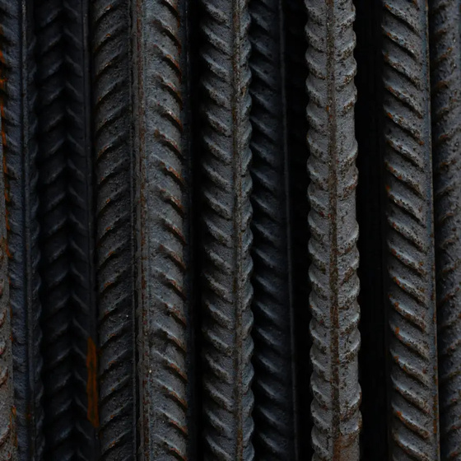


Our Technologies
2022
2023
2024
Plastic
Metal
Aluminium
Carbon
Our platform combines plastic, metal, aluminum, and carbon fiber processing, allowing us to optimize production and maintain consistent quality from development through final product.
This ties in with a personalized industrial planning, and a LEAN production system. This integrated approach enhances quality, efficiency, and sustainability across the entire production lifecycle.

Slide 7
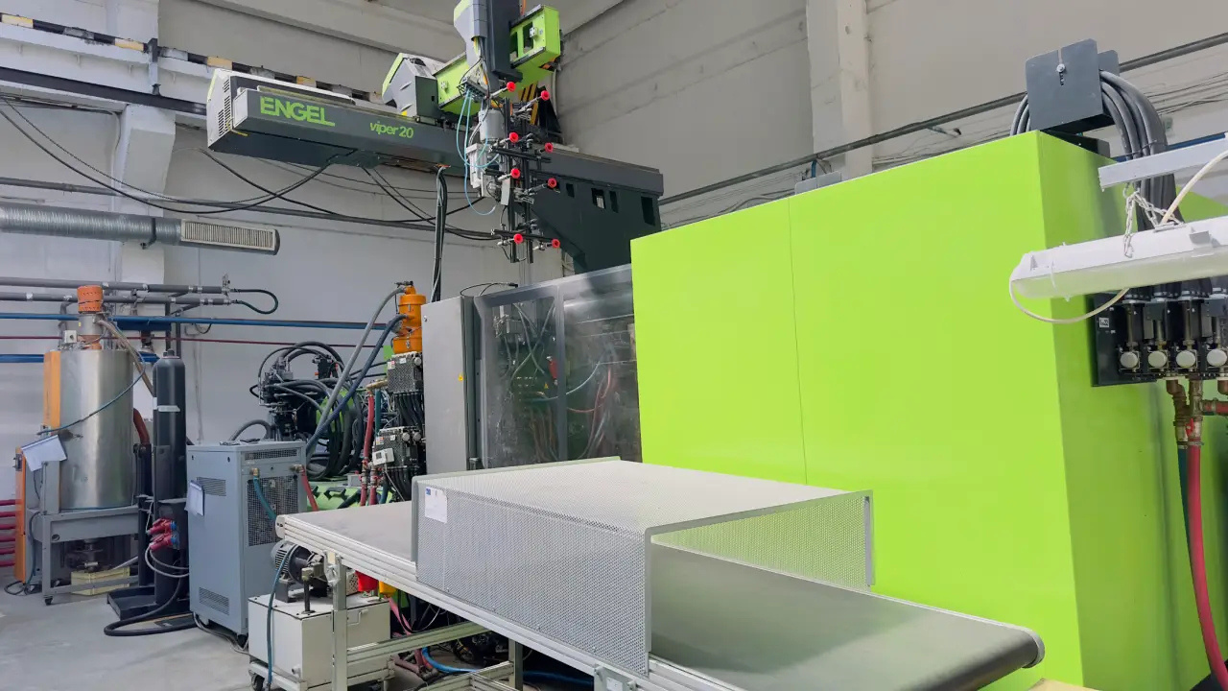
Plastic
Injection molding, thermoforming, expansion, and extrusion are performed in-house using a wide range of equipment, experienced personnel, and adhering to the highest-quality standards.
This capability allows us to customize production according to the specific requirements of component parts, including part geometry, weight, precision, appearance, and cost.
Our in-house capabilities include:
  40 injection molding machines with clamping forces between 40 and 1700 T, from Engel and Krauss Maffei, most equipped with robots
  Thermoforming machine with a work surface of 2000 x 1200 mm
  EPP/EPS injection machine with maximum dimensions of 1485 x 1285 x 180 mm
  Plastic extrusion machines, including coextrusion, with a total capacity of 180 kg/hour
  PUR foam dispensing robot

Slide 8
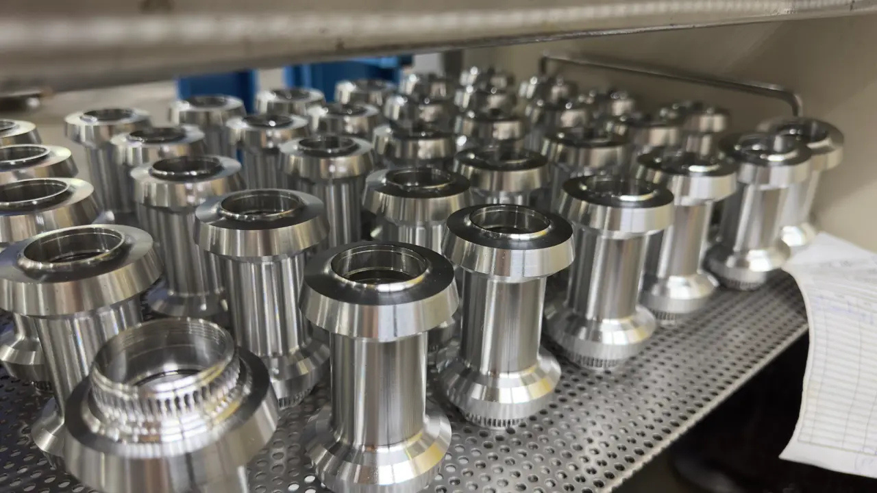
Aluminium
We have our own capacity for processing bicycle hubs for all three essential phases: aluminum bar cutting, turning, and milling.
Our team of specialists uses advanced equipment to guarantee the precision and consistency of each manufactured component.
The anodizing operation, crucial for the durability and aesthetics of our products, is outsourced through a strategic partnership of over 20 years with a renowned company, recognized for its high standards of quality and reliability.
This long-term partnership allows us to benefit from the most advanced anodizing techniques, ensuring that each bicycle hub meets or even exceeds our clients' expectations in terms of performance and aesthetics.

Slide 9
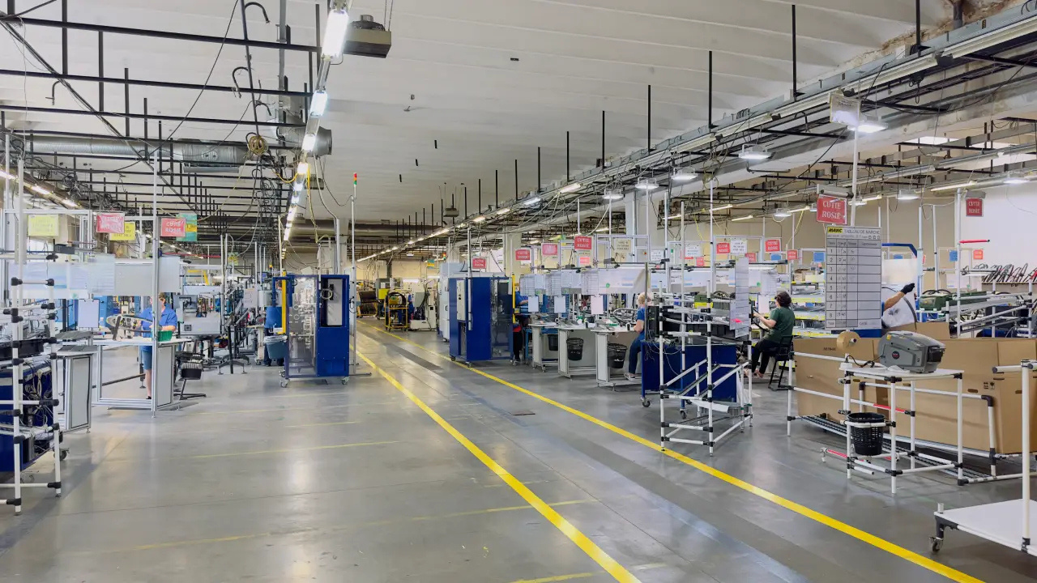
Carbon
We have a partnership of over 20 years for operating an advanced carbon fiber processing capacity, which allows us to fully manage all stages of carbon component manufacturing.
Within this strategic partnership, we benefit from the expertise and cutting-edge technology of an industry leader, ensuring the superior quality of each product. The complete integration of design, lamination, molding, curing, and finishing processes allows us to maintain rigorous quality control and optimize each stage to meet our clients' specific requirements.
Through close collaboration and a shared dedication to excellence, we deliver top products that meet the most demanding industry standards.

Slide 10
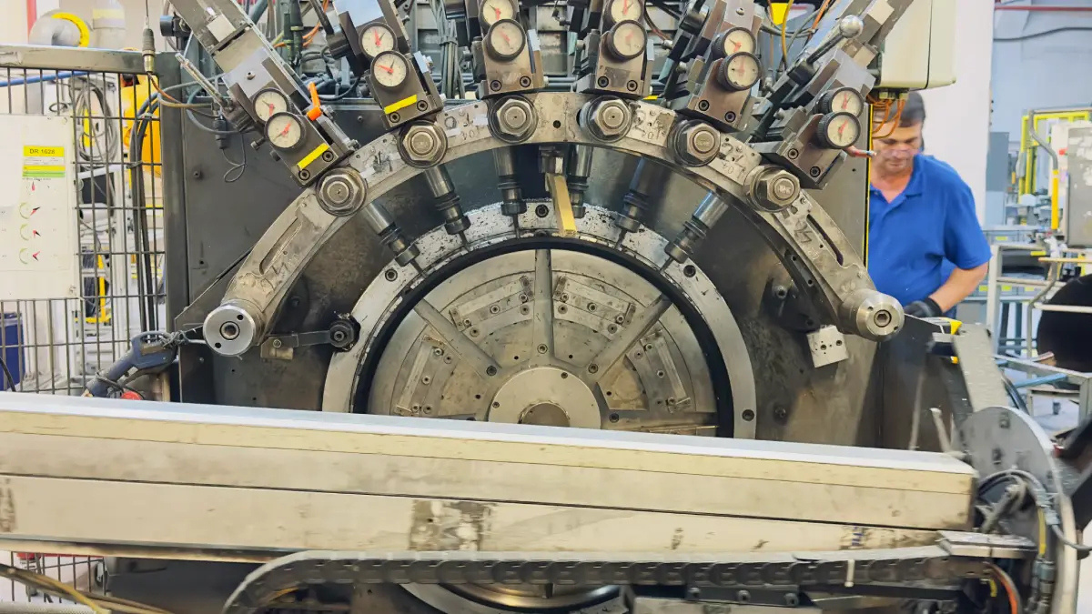
Metal
We ensure metal processing with the help of 79 advanced pieces of equipment, which give us the ability to offer a full range of metal processing services tailored to the varied needs of our clients.
Our in-house capabilities include:
  20 hydraulic presses: Allowing for various metal deformation and forming operations with precision and consistency.
  2 plasma cutting/filing installations: Technology for fast and precise cutting in different types of metal.
  2 laser cutting equipment: Ideal for complex and precise cuts, necessary for fine details and smooth edges.
  3 bending press brakes: Performing precise and uniform bends according to technical specifications.
  20 welding machines: Allowing for high-quality welds for large projects and detailed work.
  1 electrostatic painting installation: Applying durable and uniform paint layers, providing protection and aesthetic finish.

Slide 11
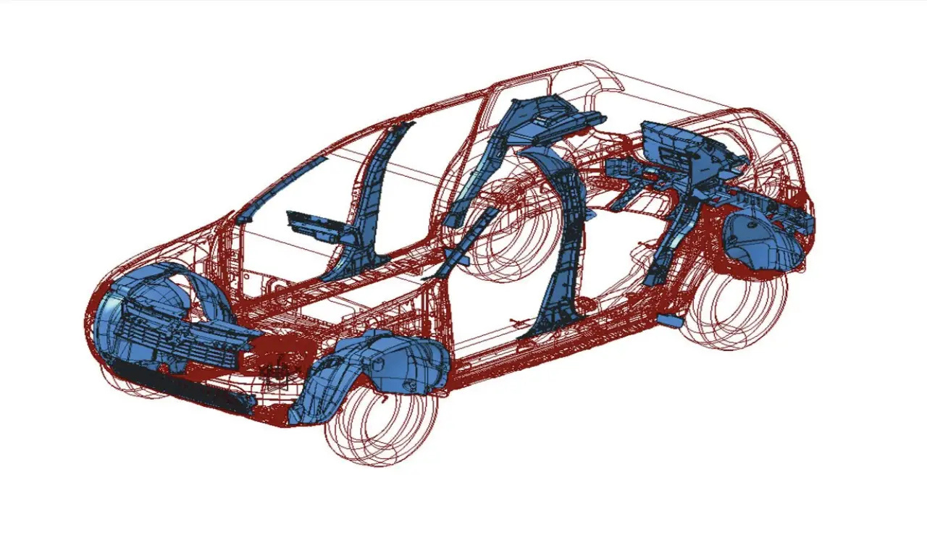
Automotive Components
We are recognized as the first Romanian company to have produced an entire car dashboard.
Today, we manufacture safety and aesthetics related components for various brands, including Dacia, Renault, Mercedes, Porsche, Maserati, Fiat, Citroën, Peugeot, and GM.
Safety components:
  “A” Pillar
  “B” Pillar Upper
  “B” Pillar Lower
  “C” Pillar
  “CD” Pillar
  Rear Shock Absorber
  Front Side Protector
  Mudguard
  Lock
Aesthetics related:
  Trunk Door Trim
  Air Intake Housing
  Upper Front Grille
  Lower Front Grille
  Front Wheel Liner
  Rear Wheel Liner (100% plastic and hybrid)

Slide 12
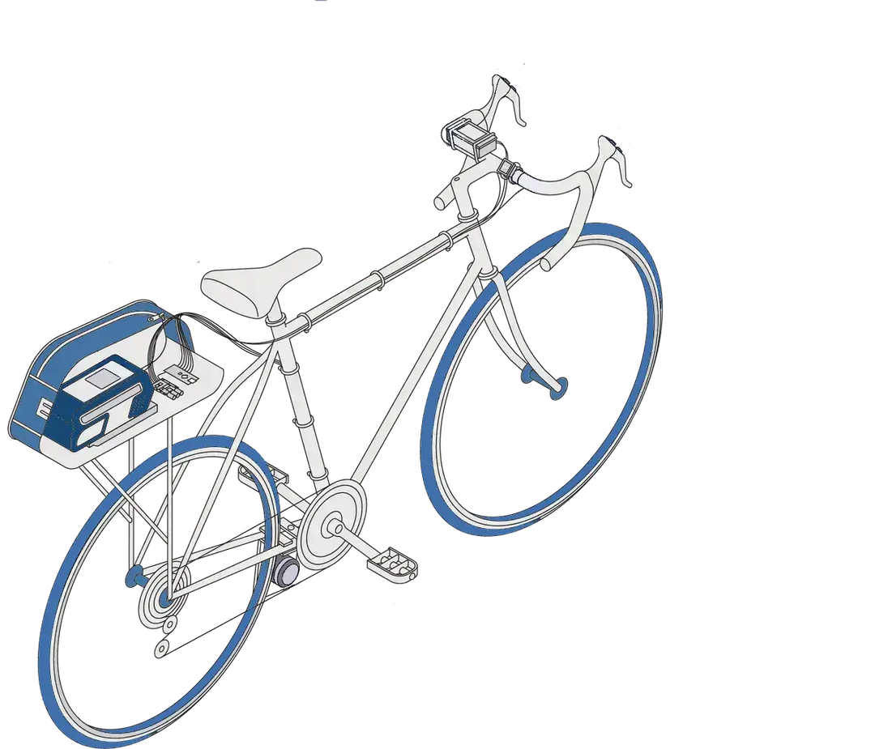
Bicycle Components
Cycling has been recognized by the EU as one of the most sustainable, accessible, healthy, cost-effective, and inclusive forms of transport and recreation, highlighting its significant importance for European society and economy.
Aware of these contributions, we produce the following components for bicycles, electric bicycles, cargo bikes, trailers, etc.
  Hubs
  Aluminum rims
  Carbon rims
  Aluminum wheels
  Carbon wheels
  Plastic motor protection
  Plastic battery protection

Slide 13


Our Commitment to Sustainability
We are dedicated to sustainable practices within
our industrial platform.
Our initiatives include calculating emissions, minimizing
carbon output, offsetting remaining emissions, and publishing
non-financial sustainability reports.
Chimica Group has calculated an annual CO2 footprint of 6090 tons, with 5920 tons offset through our 10-hectare forest, plus an additional 74 tons annually.
Currently, our sustainability strategy focuses on two pillars from EU Regulation 852/2020:
  Pillar I: Circular Economy
  Pillar II: Climate Change Mitigation

Slide 14

















Our Clients
We're proud to have worked with a long list of respected clients who trust us for quality and reliability.

Slide 15





Our Certifications
We maintain a strong commitment to quality, safety, and environmental responsibility, backed by globally recognized certifications. These certifications demonstrate our adherence to international standards across sustainability, health and safety, quality management, and industry-specific requirements.
ISO 14001 Certification for Sustainability and Durability
ISO 45001 Certification for Health and Safety
ISO 9001 Certification for Quality Management
IATF 16949:2016 certification in the Automotive Industry
Lloyd's Register Certification for Technical Industries
ISO 14001 is an international standard for environmental management systems.
An international standard dedicated to occupational health and safety management systems.
ISO 9001 is the most recognized standard for quality management systems.
IATF 16949:2016 is an international standard for quality management systems in the automotive industry.
A certification and consultancy organization that provides inspection services for various technical sectors.

Slide 16




Thank
You!
Visit our website for more info
www.chimica.ro
in
Visit our LinkedIn page
linkedin.com/company/chimica-group/
Email us at
office@chimica.ro
Reach us by phone at
(+40) 736 629 295
(+40) 773 301 960

