Slide 1
Action Finance Initiative
_microfinance in Greece_
www.afi.org.gr

Slide 2
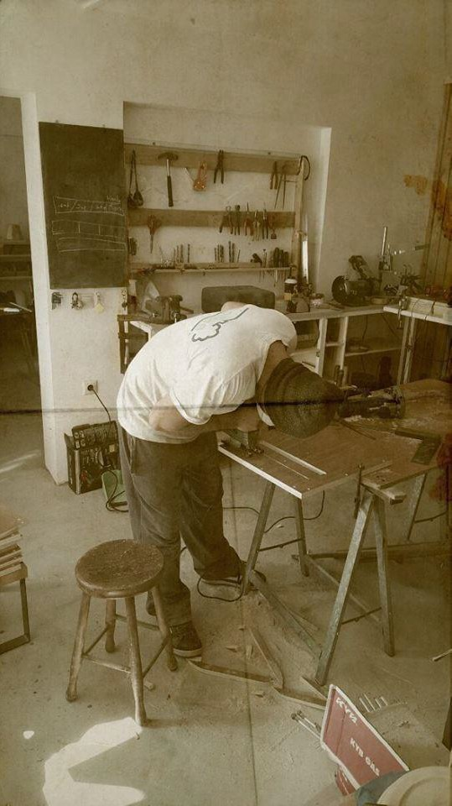
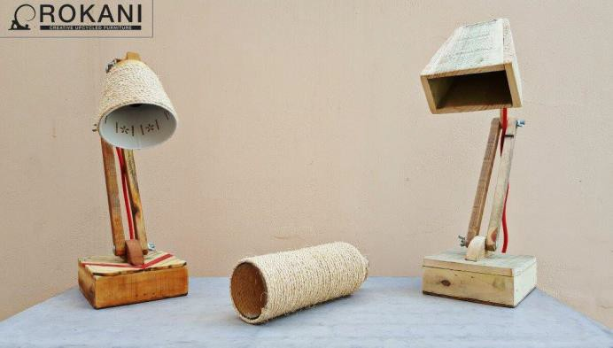


Meet the KOIN.SEP Rokani
AFI - Action Finance Initiative 2

Slide 3
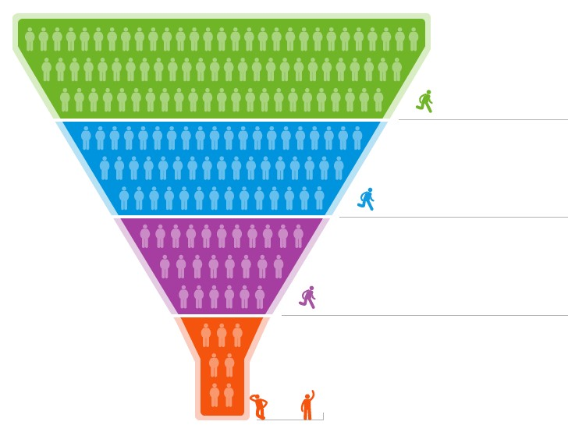
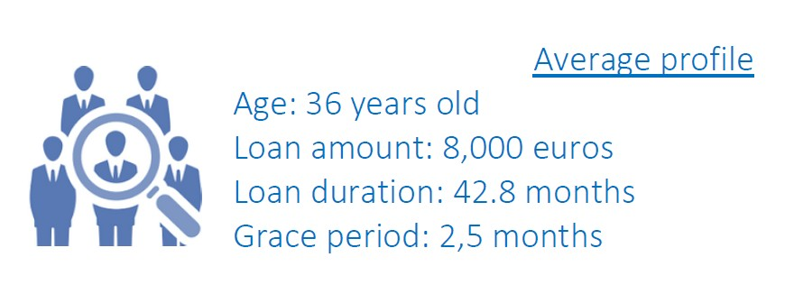
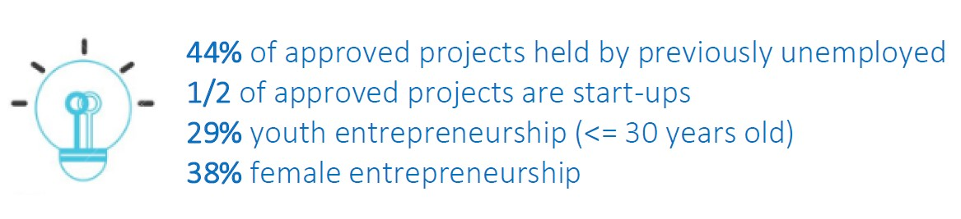
Snapshot of our activities
592 informed
244 trained
156 interviewed
45 approved
AFI - Action Finance Initiative 3

Slide 4
Based on all approved loans
45
COMPANIES
361,650 €
Total credit
97
JOBS CREATED
206,660 €
Working Capital
Of the approved projects:
38% female – 62% male
20 + 77
PREVIOUSLY UNEMPLOYED
(directly & indirectly)
154,990 €
Investments

Slide 5
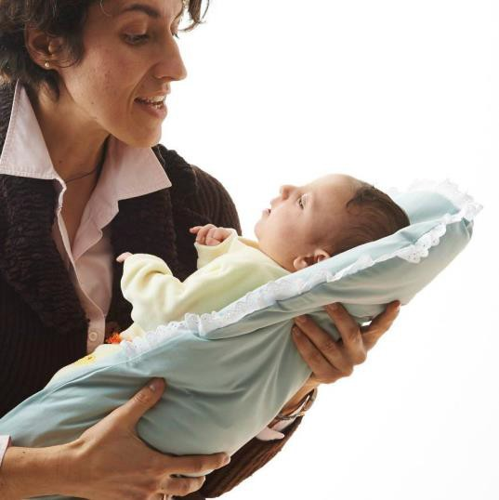
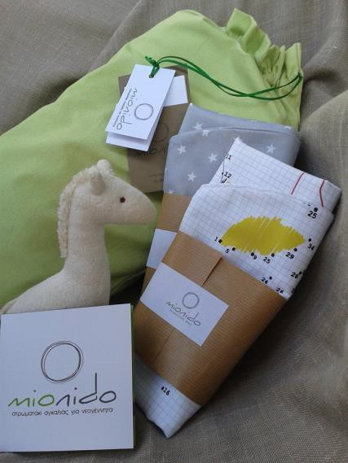

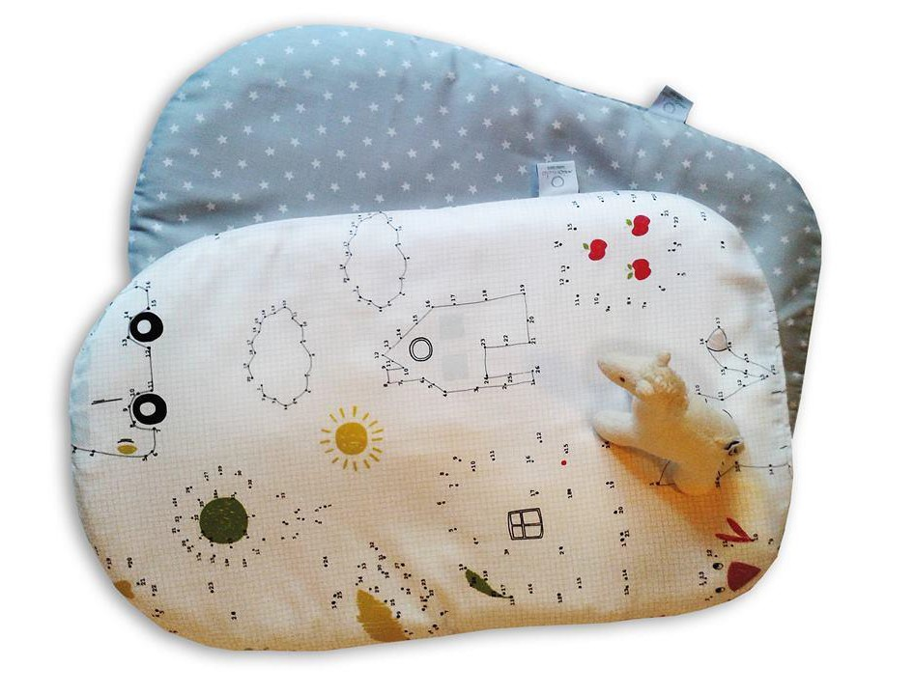

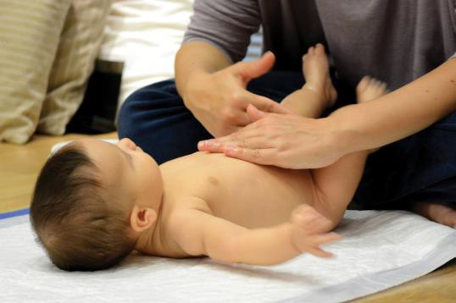
Meet female entrepreneurs
5
AFI - Action Finance Initiative

Slide 6

Business support services provided
Get Started Sessions
Business Model Canvas module Business Planning Basics module Business Planning Advanced module Online Marketing & Social Media UX/UI module
Exports Licensing Mentoring

Slide 7
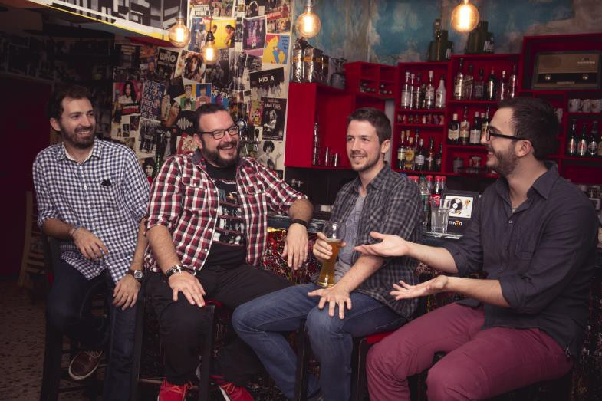

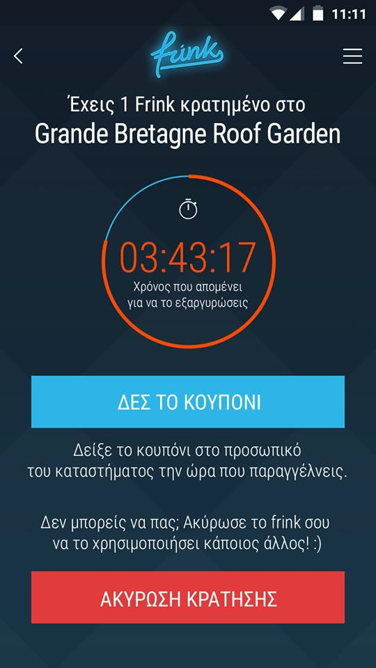

Meet the Frink team
AFI - Action Finance Initiative
7

Slide 8

Risk Management
0 % Bad Debt
Despite the capital controls and the banking freeze during summer !

Slide 9
New partnership with UK charity
AFI was selected as the preferred partner to perform the selection process and disbursement
Bundle grants and microloans for the first time
Partnership is currently finalized
Goal is to launch in June 2016
Target: 100 loans/grants combined
The charity is responsible for fund-raising the grants
portion

Slide 10


Selected by the European Investment Bank
As a recognition for the quality of the launch of the organization and the services provided, AFI has been awarded sponsored technical assistance, training and best practices sharing for one year delivered by the European Microfinance Network, Microfinance Center and Frankfurt Business School.
Total EU Recipients
Greek Recipients
Start-up
Recipients
24
+ 1

Slide 11
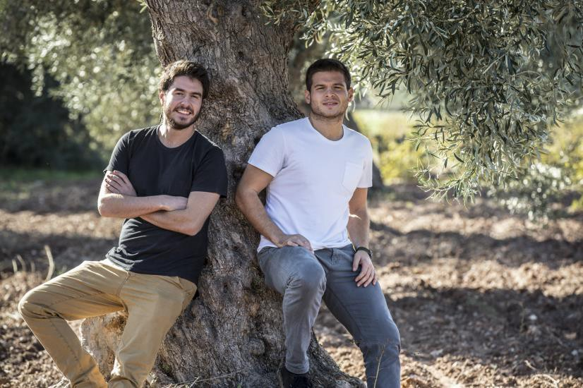

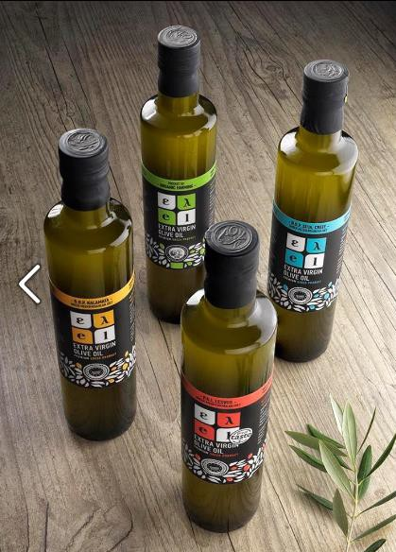
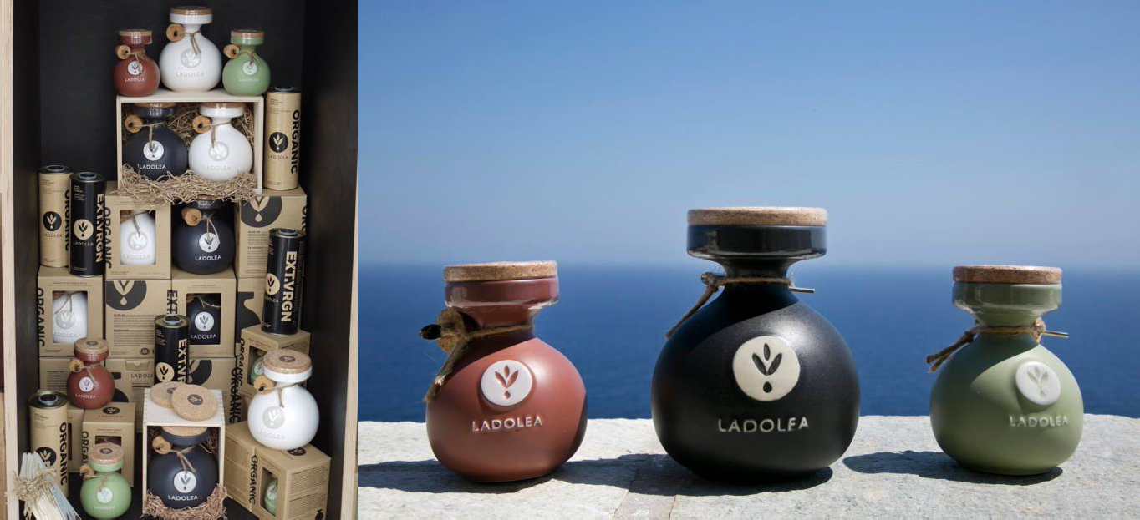
Meet our exporters
11
AFI - Action Finance Initiative

Slide 12



Pilot Year 2 targets
Fixed branches
Inform
Train
Fund
400 150 100

Slide 13
Fixed branch
Amount | New hire(s) | # of branches
250.000 € | - | 1
What | Target
Loans disbursed | 100
Jobs created | 115
New financial products | 2-3
Qualitative profile | 50% of unemployed 50% of women 40% of young (<35) among clients 25% of agri-entrepreneurs
People Informed | 400
People trained (unique) | 150
Default rate | < 10%

