Slide 1
Coface
RUSSIA and CIS: managing credit risks

Slide 2

Agenda
01
02
03
04
Increased credit risks
Current market situation
The most popular reasons of payment defaults
Making a new contact
check your customer

Slide 3
Increased credit risks in CIS region
Deterioration of liquidity position of some buyers
Decrease of demand from population, growth of expenses, disruption of logistic chains
Newly established companies – especially in CIS, TURKEY, ASIA
and insufficient information for risk assessment
Fraudulent buyers
Growing number of fraudulent attempts in turbulent times.
Ban on delivery to Russia of wide range of products – due to sanctions or producer’s decision
Could “parallel import” be a solution?
Bank services
Logistics

Slide 4
Russian market – current situation
GDP decreased by -3,0% in April 2022 y-o-y after positive results in 1Q 2022. Main negative drivers are logistic issues and decrease of internal demand. Overall turnover of retail trade, horeca and services to population decreased by 6,7% y-o-y. On other hand, volume of production in pharmaceutical industry, construction materials, in agro and metal sectors continue to grow.
According to official Rosstat data inflation of prices for food was 20.3% as of 13.05.22.
In 1st quarter 2022 real disposable income of the population decreased by 1.2%. People started to spend savings.
Experts of Central Bank of Russia reported lower consumer activity in April and May 2022, and noted that after short period of peak demand in March, people switched to “saving” behavioral model.
In April 2022 number of issued overdrafts to credit cards reached record amount of 50 million (for 145 million of population).
Source of data: Federal Agency of State Statistics, Central Bank of Russia, Ministry of Economic Development

Slide 5
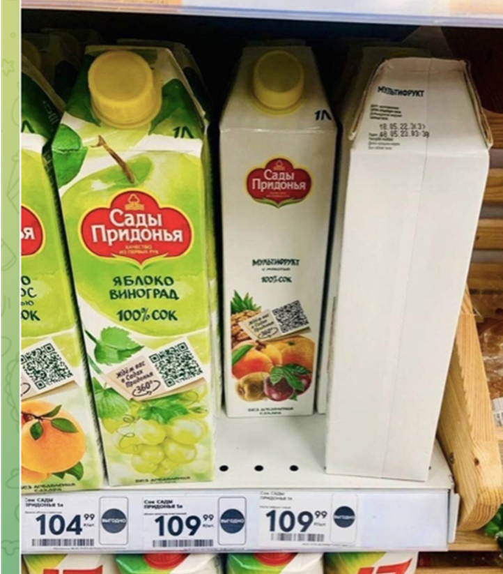
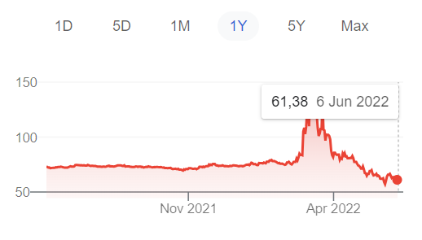
Russian MARKET – Current situation
“Strong” Ruble – mainly result of low import activity:
In current situation ability to substitute the import, at least without growth in costs, in short run perspective is limited. Wide range of products is banned by sanctions, or suppliers are not willing to deliver due to political or pragmatic reasons – issues with logistics and prices distortion. Almost all industries faces lack of certain raw materials or components.
Hot and disputable topic – “parallel import” (import of goods without permission of the producer of official distributor).
These packages of juice were not colored due to deficit of paints.

Slide 6
Kazakhstan MARKET – current situation
Inflation speed up to 14% in May 2022 (y-o-y) after 13.2% in April 2022.
Prices for food grew by 19% in average (some main categories like fruits, green vegetables, poultry meat, potatoes, cheese and others became more expensive by 20-30% and more), for non-food goods prices grew by 12% and for services for population – by 9%.
71% of population asses the situation as “economic crisis” (Nielsen Kazakhstan at Kazakhstan Marketing Conference).
Country experiences logistics issues which are common for the whole region. Rail road system is overloaded due to many railcars coming from China to Russia. Delivery takes additional weeks.
Retailers reported decrease of assortment and product range.
Government takes prudential position and does not want to violate Western sanctions against Russia, banks started to be more cautious while approving new accounts and transactions.
Government is interested in reallocation of intentional business from Russia to Kazakhstan.
Source of Data: Bureau of National Statistics, Nielsen Kazakhstan

Slide 7
The most often reasons of long non-payments
buyer did not receive payment from its customers timely and in full, while own financial sources are not sufficient to pay to the supplier
Buyer faces difficulties with refinancing of bank loans, and decides to postpone payments to suppliers
Hardly predicable events lead to issues with payments - like loss of assets, death of the buyer’s owner, corporate conflict, issues with tax inspection

Slide 8
The most often reasons of long non-payments
Contractual payment terms are far from real situation, verbal agreements about flexible trade credit period between the supplier and the buyer
Issues with logistics and custom services
For machinery and equipment - Delayed phases of project realization

Slide 9
Making a new contract: CHECK your customer
IDENTIFY and VALIDATE
Check legal IDs in documents
Use local online info services
Phone calls
WARNING: legal IDs are not consistent, nobody answers the phone, info about legal claims, reorganization.
FINANCIAL REPORTING
Ask for official financial reporting
If possible – perform high level analysis
WARNING: buyer does not disclose financial data, very small business, big loans, negative net result, negative capital.
NON-TIPICAL ORDERS
WARNING: abnormal big volume, ordered goods are not in line with usual activity, order is too big for the buyer
Ask for details
4. ULTIMATE CUSTOMERS
If goods are ordered for resale – are you comfortable with final customer?
Any doubts about credit quality of the final customer?
Russian law “Parallel import”
5. LOGISTICS
Who will be responsible for delivery and how long does it take to deliver?
What is the current situation on the boarders?
Possible issues with insurance due to sanctions
6. PAYMENTS
New Russian banks are sanctioned or excluded from SWIFT
CIS banks became more restrictive to “Russian” accounts
Check if the payment channel is available

Slide 10
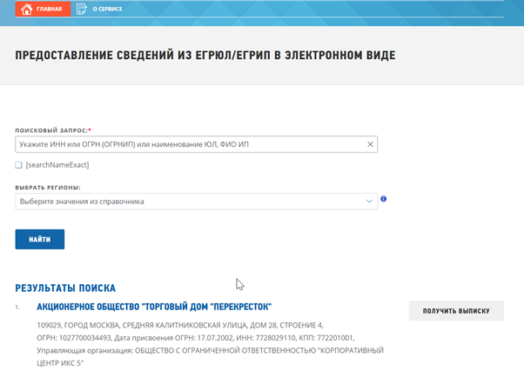
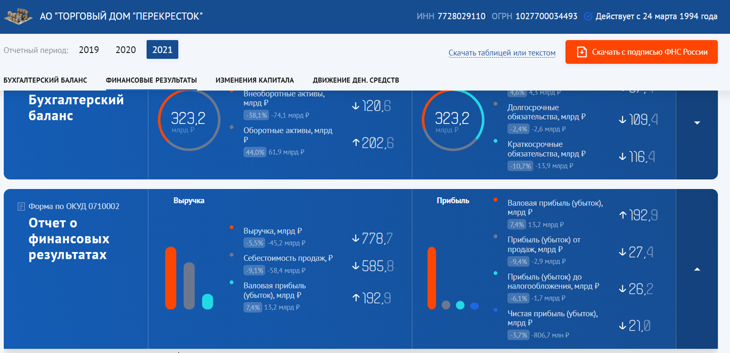
SIMPLE CHECK: RUSSIAN BUYER
MAIN ID of legal entity is ОГРН (OGRN) or unique number in state register
TAX ID – ИНН (INN or VAT NUMBER)
Certificate from state register of legal entities and access to financial reporting – fully legally and for free.
https://bo.nalog.ru/
https://egrul.nalog.ru/
Regular issues:
ID numbers in the proposed contract and in provided financials are different
ID numbers and bank credentials are not of the named buyer
Buyer occurs to be not an active company
Tax ID can be duplicated

Slide 11
coface
Questions & Answers

Slide 12


ContaCt
  Olga Sharkova
  Member of Board Coface PKZ zavarovalnica d.d., Slovenia
  Risk Underwriting, Enhanced Information Center, Claims collection
  + 386 30 673 609
  olga.sharkova@coface.com
  COFACE SERBIA
  Svetogorska 7L
  Belgrade
  orders-rs@coface.com
  +381 60 3910 844
  www.coface.rs
Click here
to add your text

