Slide 1



CORONA CRISIS IN THE NETHERLANDS:
WHAT IS THE IMPACT ON COMPANIES?
ONLINE SURVEY CONDUCTED FROM MARCH 20 TO APRIL 1, 2020

Slide 2



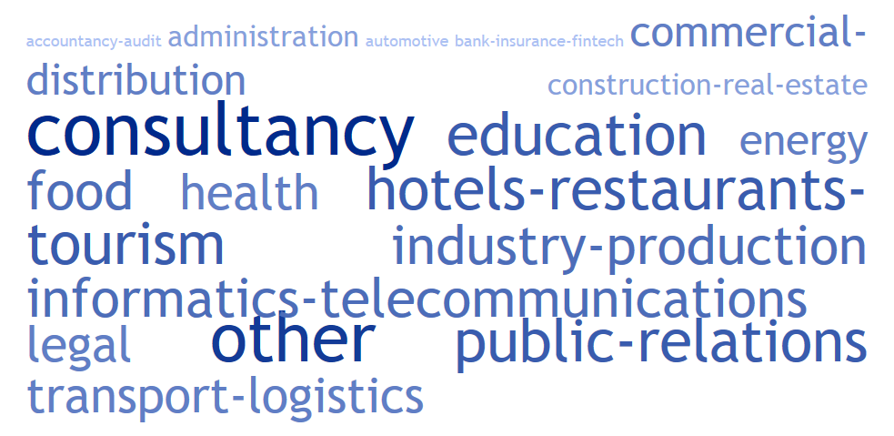
SAMPLE
80 PARTICIPATING BUSINESS LEADERS
FROM 17 SECTORS:
Notes:
Majority of Dutch companies
Broad sectoral representation
The vast majority of participating companies are self-employed and SMEs.

Slide 3
MITIGATION MEASURES
AND CHANGES IN PRACTICES
ADOPTION OF IMMEDIATE PREVENTIVE MEASURES
FUTURE ADOPTION OF PRACTICES AND ORGANIZATION OF WORK
67% OF THE COMPANIES SURVEYED INTEND TO REORGANISE THEIR PRACTICES AND THE ORGANISATION OF THEIR ACTIVITIES IN RESPONSE TO THE CORONAVIRUS CRISIS.
OF THESE, THE FOLLOWING MEASURES ARE THE MOST POPULAR:
Notes:
In the Netherlands: home office is already widespread and it is common for employee to have 1 day/week, so it has been easier to apply it on a large scale.
Several companies also stressed that they would voluntarily strengthen health and hygiene measures in the future.
Diversification of the supply chain does not seem to be a priority at this stage, although the over-representation of service companies should be highlighted.

Slide 4

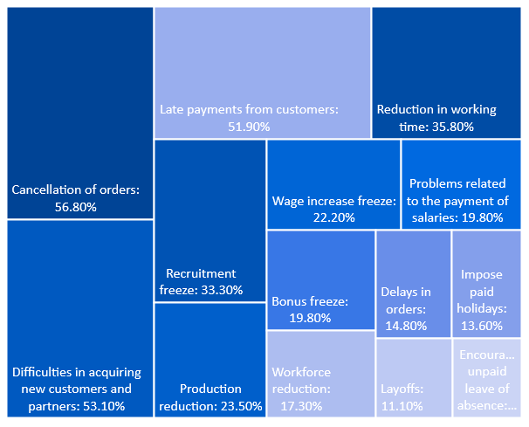
ENCOUNTERED CHALLENGES
MAIN CONSEQUENCES ANTICIPATED BY COMPANIES
DIFFICULTIES IN THE LOGISTICS AND SUPPLY CHAIN
48.8% OF THE COMPANIES SURVEYED DO NOT REPORT ENCOUNTERING ANY PARTICULAR DIFFICULTIES.
AMONG THE DIFFICULTIES CITED, THE RECURRING PROBLEMS ARE:
Notes:
Almost half of the participating firms report that they do not encounter any particular problems in the logistics chain, although again the sample includes a variety of firms, including those not involved in physical supply chains.
It can be assumed that some problems do not emerge due to the absence of certain sectors in the sample: agriculture, fishing, ...
Problem of liquidity risk and customer payment risk is shown on the left.
Impact on employees with measures such as a recruitment freeze, imposing paid-leave, or even staff reductions and redundancies, which remain a little-used option at this stage.

Slide 5
ECONOMIC CONSEQUENCES FOR BUSINESSES
Notes:
Even if at the beginning of the crisis the decline in turnover and the adjustment of profit forecasts was difficult to establish, it is interesting to note that :
More than half of the companies surveyed were already forecasting a drop in turnover; in particular 43% were forecasting a drop of more than 20% and would therefore be eligible for government support schemes (NOW).
More than a quarter of the respondents anticipated a sharp drop in turnover, more than 80%.

Slide 6
USE OF THE BUSINESS SUPPORT MEASURES
*: NOW: without independents (ZZP); microcredits: companies with less than 10 employees; TOZO: only independents
Notes:
Nearly two thirds of the companies plan to use at least one of the support schemes put in place.
In particular, 80% of the ZZPs plan to apply for aid under the TOZO scheme.
However, perceived barriers or inadequacies persist for the self-employed and smaller businesses.
These barriers or inadequacies may explain the lower level of use of the system by small businesses.
***
Despite a degree of satisfaction that could be improved and obstacles to accessing assistance, 3/4 of self-entrepreneurs intend to use the TOZO scheme.
Similarly, more than a third of companies (excluding ZZP) intend to make use of the NOW wage compensation scheme and almost half of them of tax relief arrangements.
On the other hand, the low level of demand for the business financing assistance scheme seems to reflect its weakness and inadequacy rather than a lack of need. The government has just taken new measures to make it more accessible and attractive: a bridging loan package for XXM EUR for start-ups; lower guarantee premiums and a new EUR 12 billion package of supplier credit guarantees, in the face of the withdrawal of credit insurers (Atradius, Coface, Euler Hermès).
- Sectoral aid: pre-enlargement questionnaire to sectors not closed on 18/03. Since then, aid schemes have been extended to many other sectors.

Slide 7

WWW.NL.AMBAFRANCE.ORG
@FranceinNL
WWW.TRESOR.ECONOMIE.GOUV.FR/PAYS/NL
@FRTreasury_NL
WWW.CFCI.NL
@CCIPaysBas

