Slide 2



Montae & Partners – Our services
Employers (HR partner)
Pension funds
Works councils
Consultancy & management
Consultancy & management
Consultancy & training
Pension
Boardsupport
Health & Disability
Governance & Strategy
Global Mobility Program
Risk & Investment
IT Tools: RiskProfiler, Learnster and Heartpace

Slide 3
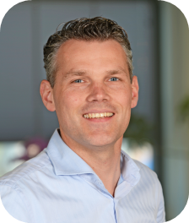
Maarten Reesink
Maarten.reesink@montaepartner.nl
+31 (0)6 15 61 01 85

