Slide 1

The Policies and Vision for Renewable Energy Sources in Greece
Alexandra Sdoukou
Secretary General for Energy and Natural Resources
Greece, the El Dorado of Renewable Energy Sources in Europe
Webinar, Greek-French Chamber, June 2020

Slide 2

Introduction – Greek National Energy and Climate Plan
2. Current market
3. Investment opportunities in the Greek RES market
4. E-Mobility

Slide 3

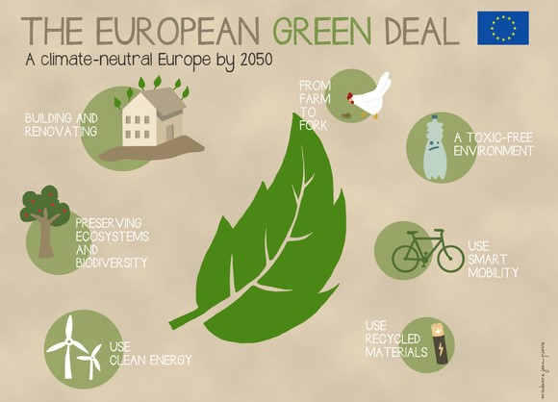
Greek Government announced the National Energy and Climate Plan till 2030
The EU Commission adopts an ambitious plan for a climate-neutral Europe till 2050

Slide 4
National Energy & Climate Plan
“The vision”
Decarbonization of the energy sector – Shut down of all lignite plants by 2028
Integrated model for sustainable development in all economic sectors
Energy sector development combined with environmental protection and mitigating climate change
Selection of energy policies with the best cost-benefit ratio for the energy transition
Waste management and utilization with modern circular economy technologies
Transforming Greece into an energy hub with a strong contribution to EU energy security
Diversification of energy import strategy in parallel with the modernization and development of energy infrastructure and lifting the energy isolation of the islands
Create attractive investment climate to support the energy transition, with an emphasis on innovation and new technologies
Maximum utilization of community resources and mechanisms
Outreach to achieve strong growth and job creation
The vision of the country is
CLEAR & GREEN!

Slide 5
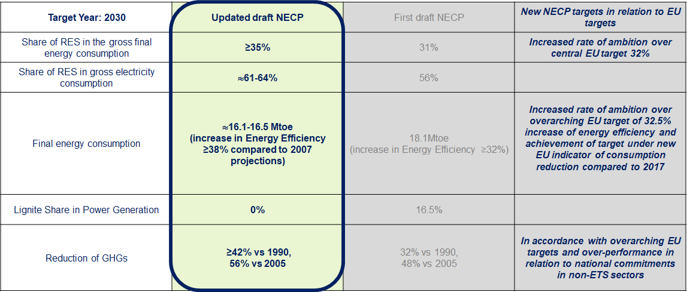
National Energy & Climate Plan
“Ambitious targets”

Slide 6
National Energy & Climate Plan
“Dynamic RES Share Growth”
RES Share in Gross Final Energy Consumption (%)
RES Share in Gross Final Electricity Consumption (%)
2020
2022
2025
2027
2030
2020
2022
2025
2027
2030
Up to 2030
By 2025
RES the main electricity source
New WIND and PV installed power > 8GW
Development of storage systems

Slide 7
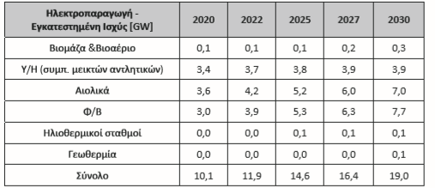
Στόχοι 2020-2030
Μερίδιο ΑΠΕ στην Τελική Κατανάλωση για θέρμανση και ψύξη ≥40% (43%)
Μερίδιο ΑΠΕ στην Τελική Κατανάλωση στον τομέα των μεταφορών 19%
Προώθηση των συστημάτων ΑΠΕ στα κτίρια και τα συστήματα της διεσπαρμένης παραγωγής, μέσω ουσιαστικά της αυτοπαραγωγής ~ 1 GW (ικανή να καλύψει την μέση ηλεκτρική κατανάλωση > 330.000 νοικοκυριών)

Slide 8
National Energy & Climate Plan
“Boost Investments”
Sector | Total Estimated Investments (mil.€) 2020-2030
RES for Electricity Generation | 9.000
Electrical Systems Infrastructure | 5.500
New CHP (Combined Heat & Power) & Energy Storage | 1.300
Development of Distribution Network for Electrical Power - Digitalization | 3.500
Cross Border Natural Gas Pipelines | 2.200
Natural Gas Networks & Storage | 2.000
Research & Innovation | 800
Energy Efficiency | 11.000
Refineries | 1.500
Climate Change | 2.000
Cycling Economy - Recycling | 5.000
TOTAL | 43.800

Slide 9
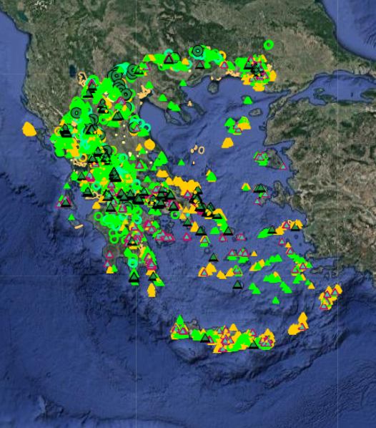
Electricity & RES Market
“Current Market”
Installed power for electricity generation
Stations | Interconnected System (MW) | Non-Interconnected Islands (MW)
Lignite | 3,903.9 | -
Natural Gas | 4,900.3 | -
Oil | - | 1,808.3
Large Hydro | 3,170.7 | 0.3
RES | 6,354,8 | 462.22
Total | 18,329.7 | 2,269.3
RES Share in Gross Final Energy Consumption 2018 (%) ~ 18.0%
RES Share in Gross Final Electricity Consumption 2018 (%) ~ 25.0%
RES in Operation in 2019 ~ 6.8 GW
RES Production in 2019 ~ 11.0 TWh

Slide 10
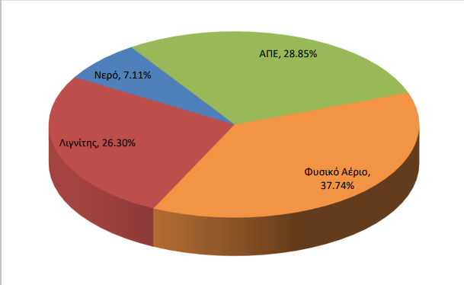
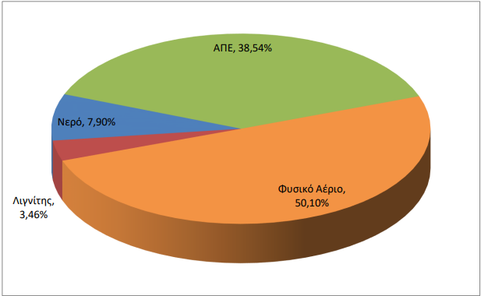
Electricity & RES Market
“Current Market”
May 2019
May 2020
RES 28.85%
RES 38.54%
Hydro 7.11%
Hydro 7.90%
Lignite 26.3%
Natural Gas
Natural Gas
37.74%
50.10%
Lignite 3.46%
RES generation: from 28.9% to 38.5%
Lignite generation: from 26.3% to 3.5%

Slide 11
RES in Greece
“Existing Licensing Procedure”
Registration Certificate
Environmental Terms Approval
Grid Connection Contract
Installation License
Operation License
Power Purchase Agreement
RAE
Environmental Authorities
ADMIE or DEDDIE
DAPEEP
Ministry of Environment & Energy
NOTE: Small RES Projects are excluded from the Registration Certificate and submit its interest directly to DEDDIE for Final Connection Terms

Slide 12
RES in Greece
“Simplification of the Licensing Procedure”
Update the RES licensing framework, in order to simplify the whole process, so as the new RES projects to be fully licensed within 2-3 years.
1st Phase: Replacement of the Production License with the Registration Certificate
2nd Phase: Reform and simplify Environmental framework
3rd Phase: Simplify Connection Terms, Installation & Operation Licenses
OUR TARGET:
Speed up licensing process facilitating the investments in RES sector
From 6-8 years to 2+1 years

Slide 13

RES in Greece
“1st & 2nd Phase of Simplification”
1st Phase: Replacement of the Production License with the Registration Certificate
Development of a new Management Information System for RES
Interoperability of the new MIS with the existed systems
Monitoring of the licensing procedure
Automated procedure of the submitted request
Limitation of the required documents for the submission
Automated check of the potential investor and his request
Determination of specific milestones for the investors
Discharge of extra costs and administrative burdens
2nd Phase: Reform and Simplification of the Environmental framework
Updated Electronic Environmental Registry
Limitation of the required steps until receiving the Environmental Terms Approval
Decreased deadlines for the evaluation of the environmental studies
Outsourcing evaluation of the submitted environmental studies
Registration Certificate within 30 days
Environmental Approval within 150 days

Slide 14

RES in Greece
“3rd Phase of Simplification”
3rd Phase: Simplify Connection Terms, Installation & Operation Licenses
Dealing with licensing distortions
Integration of the European Guidelines 2018/2001
Digitalization of the licensing procedures
Limitation of the required documents
Speed up the electrification process
Expansion of the existed networks and development of new network systems
Examine the requirement of Installation & Operational Licenses

Slide 15
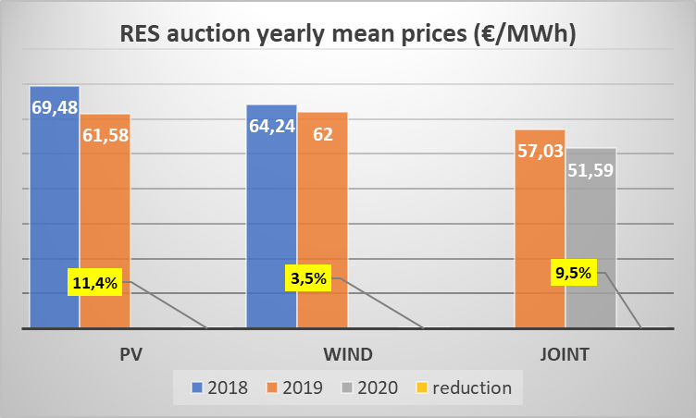
RES in Greece
“Auctions Scheme”
Year | Technology | Date | Power (MW) | Average Price
2018 | PV<1 | July 2018 | 53,52 | 79.02
 | PV>1MW | July 2018 | 53,40 | 63.81
 | PV<1 | Dec 2018 | 61,95 | 66.66
 | WIND | Dec 2018 | 160,94 | 69.53
2019 | Joint (PV-WIND) | April 18 | 455,00 | 57.03
 | PV | July 2019 | 142,88 | 62.78
 | WIND | July 2019 | 159,65 | 58.58
 | PV | Dec 2019 | 84,00 | 61.16
 | WIND | Dec 2019 | 244,00 | 58.27
2020 | Joint (PV-WIND) | April 2020 | 502,94 | 51,59
 | PV | July 2020 | 480,00
 | WIND | July 2020 | 480,00
 | PV | Dec 2020 | Rest of year
 | WIND | Dec 2020 | Rest of year
The next specific technology auction is scheduled for: 27/07/2020

Slide 16
RES in Greece
“Upcoming Framework”
Short Term Schedule
  Regulation of the Registration Certificate
  Ministerial Decision for the small wind turbines (<60kW)
  Ministerial Decision for the installation of RES in high productivity land
  Ministerial Decision for the environmental reclassification of RES Projects
  Pricing Framework for hybrid projects in non-interconnected islands
  Special framework to define the Reference Tariff for large projects (>250MW), through individual notification process is foreseen
  Assessment for the future RES auction scheme (2021 – 2025)
  Updated framework for Guarantees of Origin
Long Term Schedule
  New framework, for offshore wind parks
  Framework for the development of storage systems
  Framework for hydrogen and biomethane projects
  Framework for Repowering & Life Time Extension of RES Projects

Slide 17

RES in Greece - kick-starting e-mobility
ΝECP has set clear targets for the adoption of electric vehicles in Greece in the next 10 years
  1 in every 3 new vehicles must be electric by 2030
In order to achieve these targets...
We created the necessary regulatory framework through the introduction of the first e-mobility legislation in Greece
We signed a “Green Deal” with 20 key stakeholders from public and private sector committing to specific actions to support e-mobility
We are launching a subsidy scheme to support the purchase of electric vehicles
We are working on a National E-Mobility Plan that will define specific policies and measures towards a green transport sector in Greece

Slide 18
RES in Greece - kick-starting e-mobility
Key provisions of e-mobility legislation
Offering generous tax based incentives to businesses purchasing electric vehicles
Attracting investments by offering incentives for creating production lines or other activities related to e-mobility (e.g. battery/charge points productions, e-vehicles assembly etc)
Creating the regulatory framework for the electric vehicles charging services market
Key highlights of the subsidy scheme “Go electric”
Offering an eco-bonus to individuals and business who want to buy or lease an electric car, bicycle, motorbike, van or taxi
Using a budget of €100Μ to subsidise more than 7.000 passenger cars, 3.000 e-bikes/e-motorcycles, 1.000 taxis and 1.000 vans, in the next 18 months

Slide 19
The Policies and Vision for Renewable Energy Sources in Greece
Alexandra Sdoukou
Secretary General for Energy and Natural Resources
Greece, the El Dorado of Renewable Energy Sources in Europe
Webinar, Greek-French Chamber, June 2020

