Slide 1
Stratégie et priorités de financement de l'UE dans le domaine de la santé
The EU4Health programme: Une opportunité pour transformer la santé publique en Europe
Georgios Margetidis
Health and Digital Executive Agency (HaDEA)

Slide 2


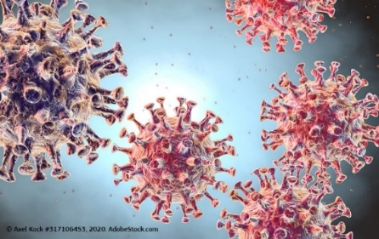

HaDEA Dept. A: Health & Food
EU4HEALTH
Improve and foster health in the Union
Protect people in the Union from serious cross-border threats to health
Make medicines available and affordable
Strengthen health systems, their resilience and resource efficiency
Single Market Programme Food safety
Ensure a high level of health for humans, animals and plants, and the safety of food and feed
Prevent, detect and eradicate animal diseases & plant pests
Support the welfare of animals
Fight against antimicrobial resistance
Develop sustainable food production and consumption
Ensure reliable official controls
HE Cluster 1 - Health
D1: Staying healthy in a rapidly changing society
D2: Living and working in a health-promoting environment
D.3: Tackling diseases & reducing disease burden
D4: Ensuring access to innovative, sustainable & high-quality Healthcare
D.5: Unlocking the full potential of new tools, technologies and digital solutions for a healthy society
D.6: Maintaining an innovative, sustainable & globally competitive health industry

Slide 3

Access to affordable medicines
European Health Data Space
AMR & “One health” action plan
Europe’s beating cancer plan
Vaccination

Slide 4
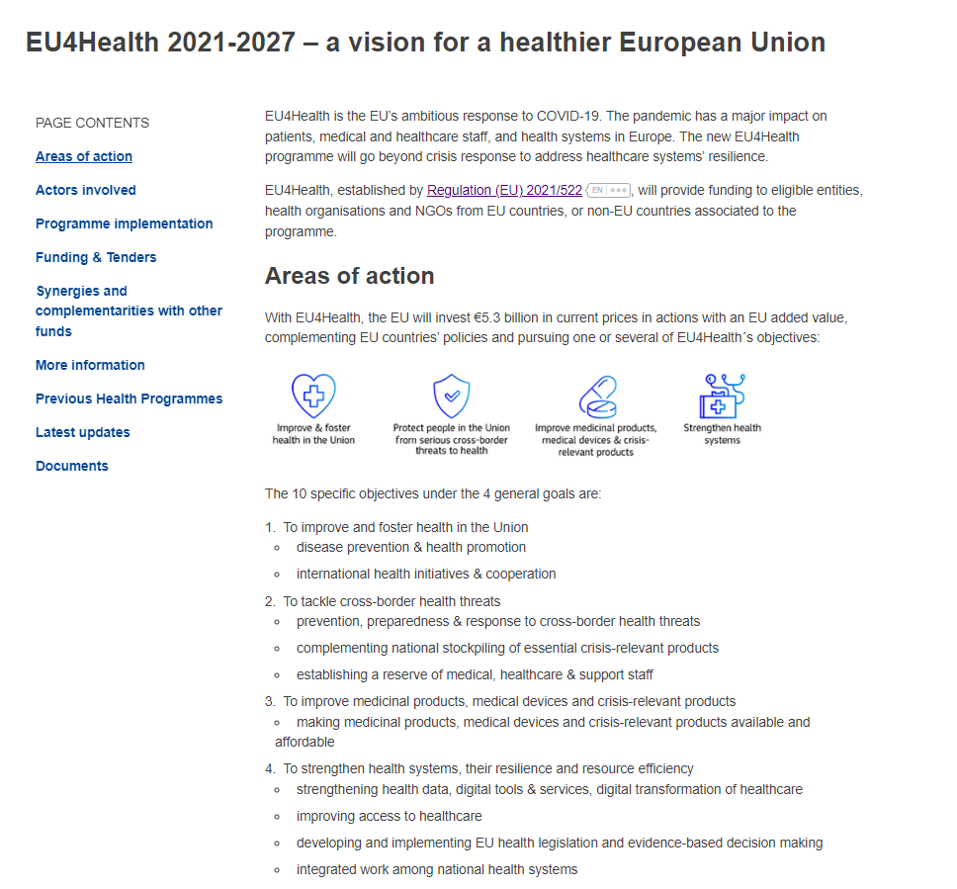

Slide 5
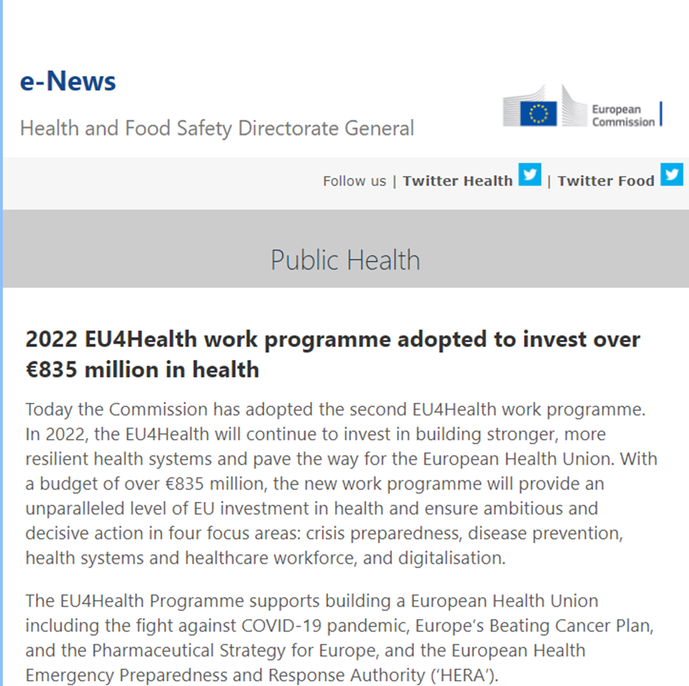
The EU4Health programme: a material change in EU funding for health but … subject to turbulence

Slide 6
Key message 1: Public Health remains a member state level responsibility
The EU itself does not run national health systems; it doesn’t decide on pricing or reimbursement of medicines; it doesn’t run vaccination programmes
The EU complements and supports national efforts/ policies in those areas where the member states see added value from EU level collaboration

Slide 7
Key message 2:
Even though we are in an area of subsidiarity of EU action, there is a lot happening in public health at the EU level - especially post COVID-19

Slide 8
Key message 3: financial support for health is important
Circa. EUR 15 billion of spending available to support health (sector/ stakeholders)
  Cohesion policy (ESF and ERDF)
  Research (Horizon Europe)
  Digitalisation and innovation (Digital Europe, Connecting Europe Facility & InvestEU)
  Financial sustainability (Structural reform)
  Crisis response (Emergency Support Instrument)
  European Recovery and Resilience facility (20% digital objectives)

Slide 9
Key message 4: “strategy, strategy, strategy”
It is not easy
The trap: focusing on each amount/ programme as a stand-alone opportunity
  Sectorial specificities should be considered but are not be the only criterion
The solution: strategic planning across sectors
EU support for an integrated approach

Slide 10
Ask the right questions before embarking in a transformational strategy: e.g. digitalization
Why hasn’t the digital transformation of healthcare already taken place
eHealth: e or health?
The role of healthcare professionals?
Insufficient funding?
Compatibility of data/ dbases/ semantic interoperability?
Build a positive dynamic for change
  COVID-19 was a digital paradigm change
  Use this (and other positive developments) as a “window of opportunity”

Slide 11
Thank you!
Your questions?
Georgios MARGETIDIS
Head of Sector,
Sector A.2.1. EU4Health programme
Health and Digital Executive Agency (HaDEA)
European Commission
+32 229 60899
+352 661 416351 (GSM)
georgios.margetidis@ec.europa.eu
georgios.margetidis@gmail.com
https://hadea.ec.europa.eu/index_en

