Slide 1




Slide 2

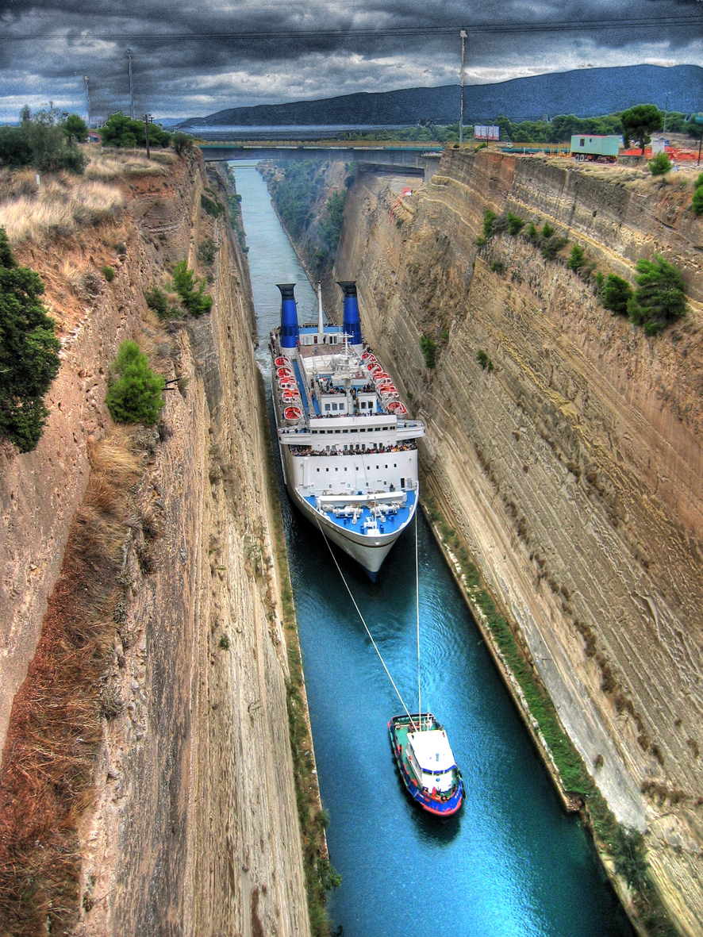
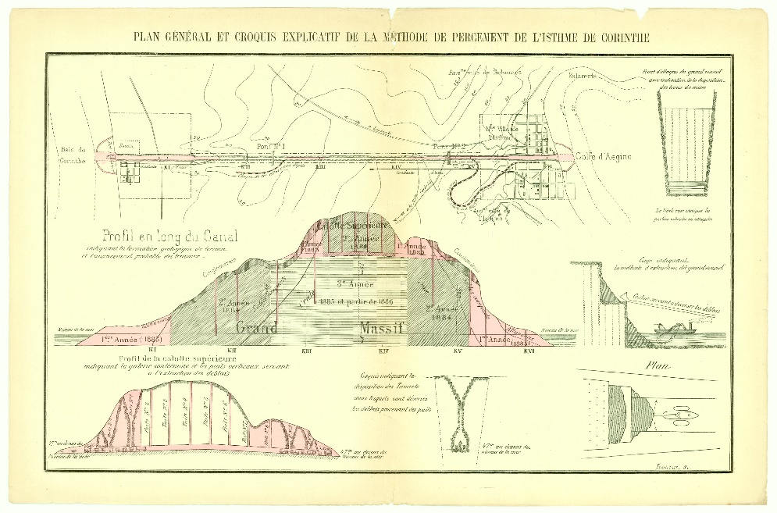
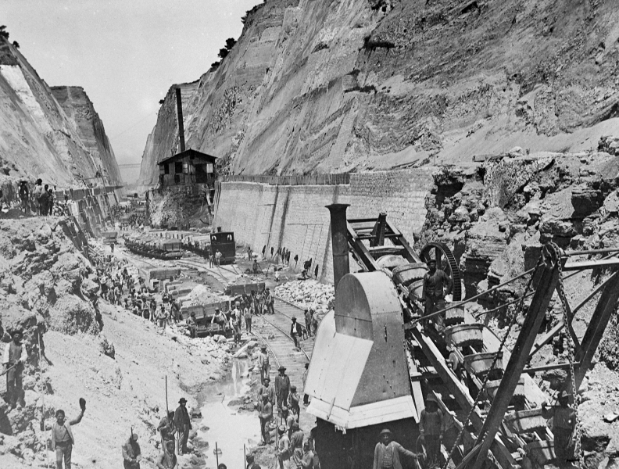
From the Corinth Canal Construction…

Slide 3
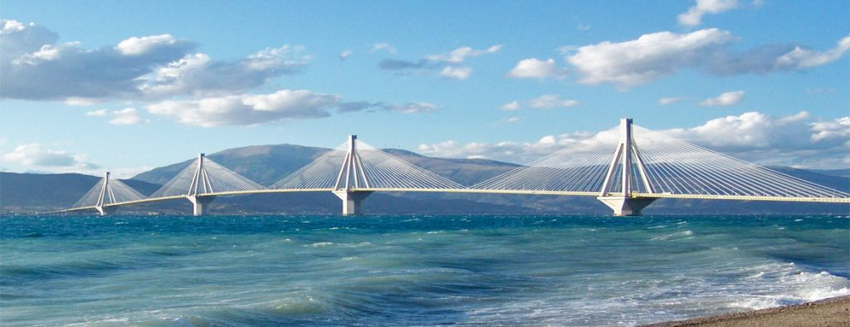
…to the Rio–Antirrio Bridge

Slide 4












National Transport Infrastructure plan
Rail and road infrastructure plan
Logistics infrastructure plan
Air and port infrastructure plan
Metropolitan Area Infrastructure Plan of Athens and Thessaloniki (Metro)

Slide 5
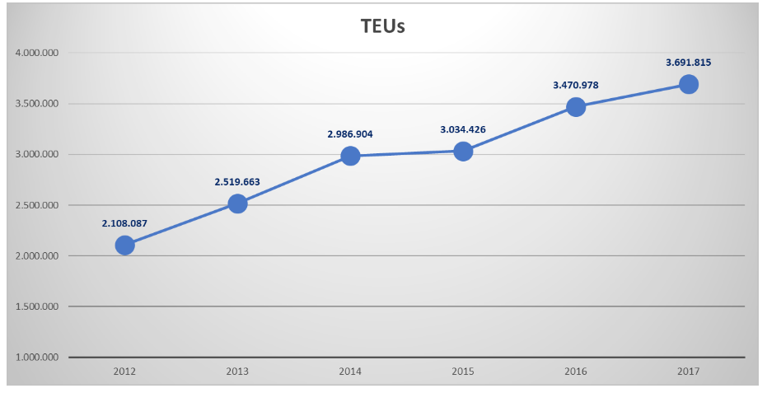
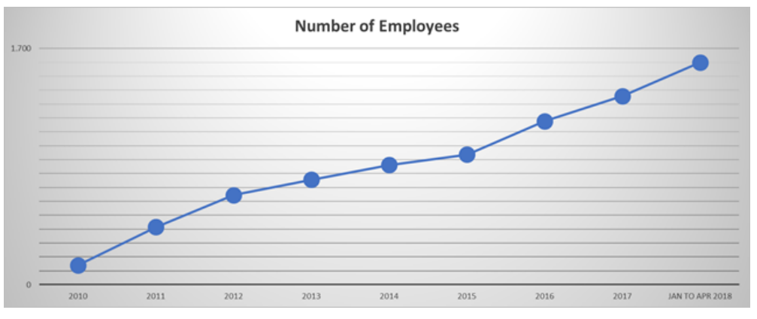
COSCO in the Port of Piraeus
Container traffic at Piraeus port reached 4.9m TEU in 2018, 18.4% higher than the previous year, and over 700% higher than when the Chinese company was first awarded the operation of Pier II

Slide 6
















Slide 7





✓
✓
✓
✓
✓
✓
✓
✓
✓
✓
✓

Slide 8
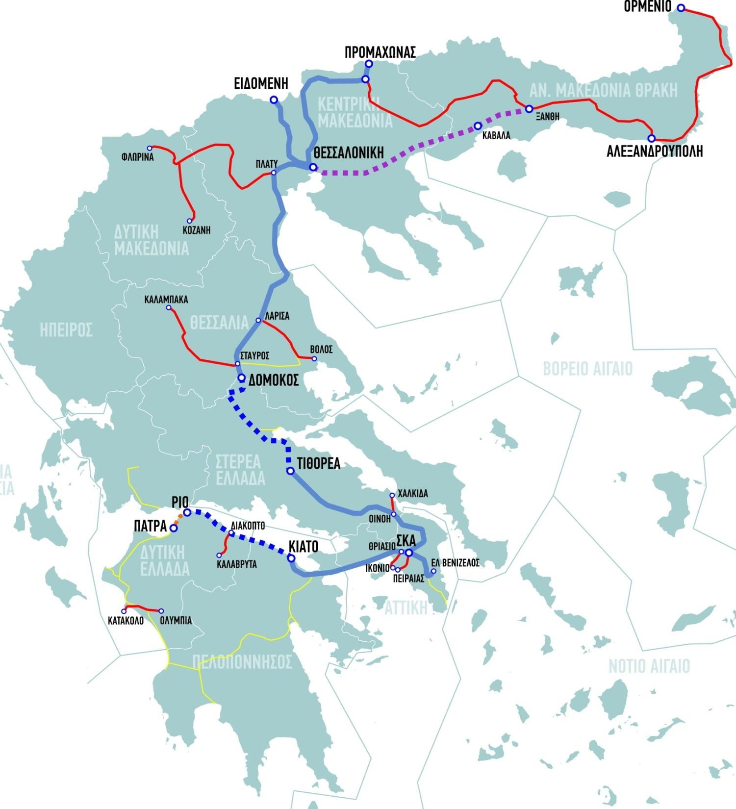









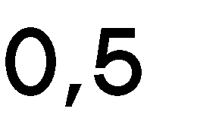


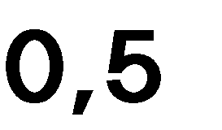







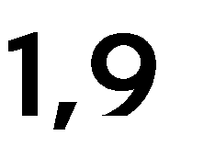







4

Slide 9

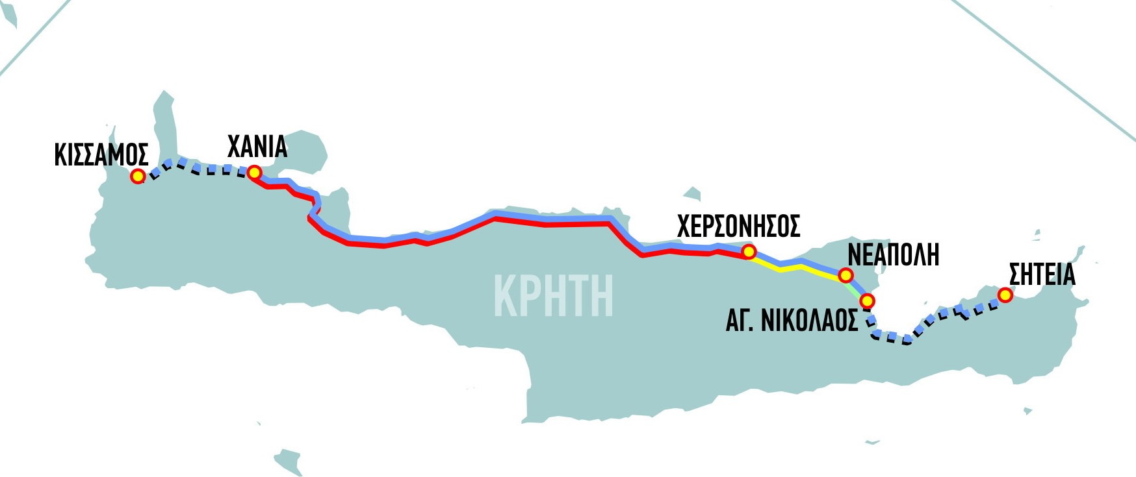

























Slide 10
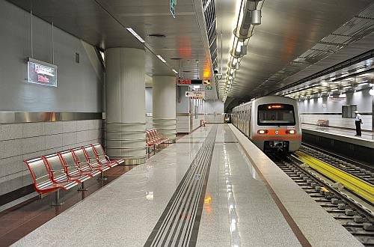
New Athens Metro Line 4
Budget | € 1,7 bn.
Contracting [estimation] | end of 2020
Completion [estimation] | 2029

Slide 11
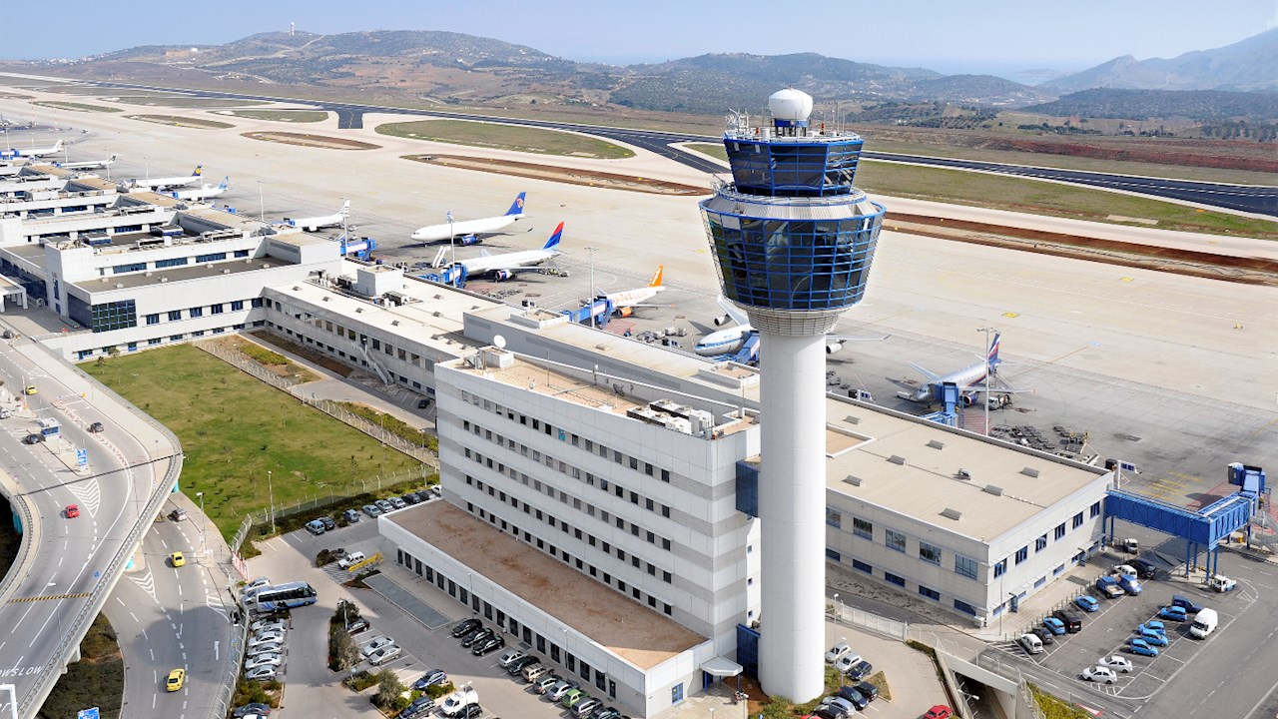
Athens International Airport

