Slide 1

Digital Health in Cancer Care
National Cancer Plan for Public Health – Helleniic-French Strategic Alliance
Kathi Apostolidlis – President – ECPC – European Cancer Patient Coalition
President – Hellenic Cancer Federation - ELLOK

Slide 2
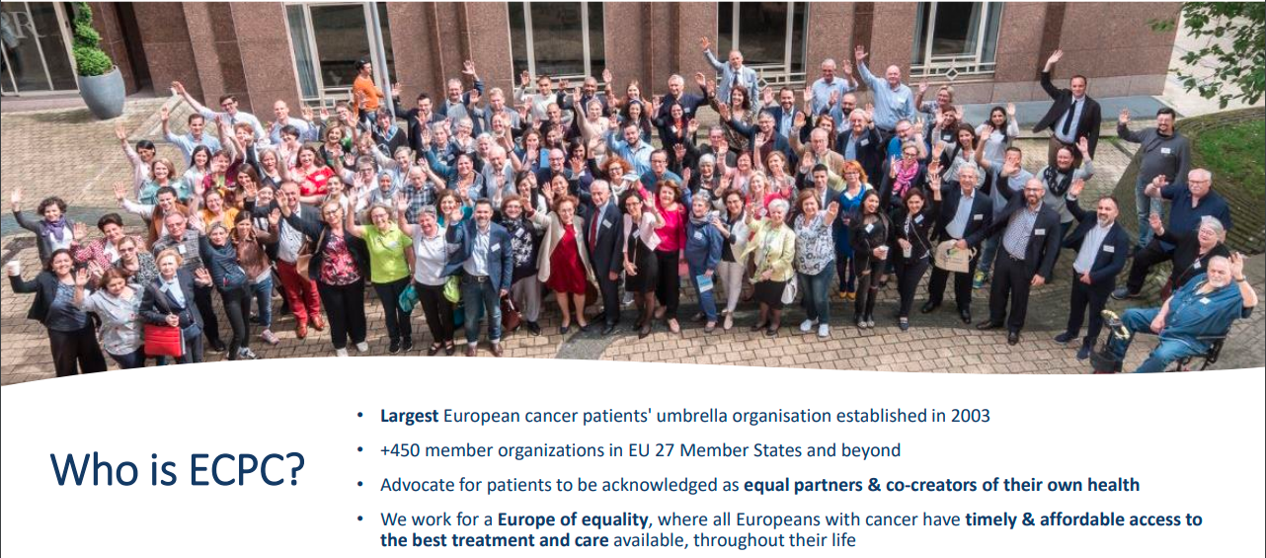
Notes:
Η Ευρωπαϊκή Συμμαχία κατά του καρκίνου είναι η μεγαλύτερη Ευρωπαίκή οργάνωση ασθενών με καρκίνο. Ιδρυθηκε το 2003 και έχει περισσότερα από ΄450 μέλη στις 27 χώρες της ΕΕ και εκτός.
Στην ECPC συνηγορούμε για την αναγνώριση των ασθενών ως ισότιμων εταίρων και συν-δημιουργών της υγείας τους.
Εργαζόμαστε για μια Ευρωπη ισότητας, όπου ολοι οι Ευρωπαίοι με καρκίνο θα έχουν έγκαιρη και οικονομικά προσιτή πρόσβαση σε άριστη ογκολογική περιθαλψη και φροντίδα, καθ όλη τη διάρκεια της ζωής τους.

Slide 3
Digital Transformation in Cancer
Two emblematic actions: the EU Cancer Plan and the Cancer Mission
Flagship initiatives on research, innovation and digitalisation
Knowledge Centre on Cancer to facilitate the coordination of scientific and technical cancer-related initiatives at EU level – 2021.
Launch a European Cancer Imaging Initiative to support the development of new computer-aided tools to improve personalised medicine and innovative solutions – 2022.
EU Health Data Space
Other actions
Electronic health records for prevention and treatment across borders through the European Health Data Space – 2021-2025.
European Cancer Information System – 2021-2022
European Health Data Space

Slide 4
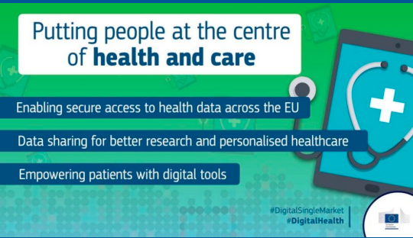
The Promise of Digital Transformation
of Health and Care
Empower citizens and build a healthier society
Digital Transformation offering the tools for
Improved, evidenced, faster, more accessible cancer care but
Cancer Care depends on personal contact of the patients with his physician

Slide 5
Driving adoption of digital health solutions
Keeping the patient at the centre
Understanding the role of regulatory frameworks and policies
Involving patients
Adapt to local conditions
Facilitate multistakeholder engagement
Fostering training and capacity building of human resources
Addressing data governance

Slide 6
What patients & health stakeholders expect from mhealth apps
1. Privacy
2. Transparency
3. Safety
4. Reliability
5. Validity
6. Interoperability
7. Technical stability
8. Effectiveness
9. Efficacy
10. Efficiency
11. Accessibility
12. Usability/desirability
13. Scalability

Slide 7




Thank you!
@ECPCfb
@cancereu
@european-cancer-patient-coalition
Your email
European Cancer Patient Coalition
Avenue des Arts, 6
1210 Brussels, Belgium
www.ecpc.org I info@ecpc.org I + 32 (0) 2 721 41 14

