Slide 1

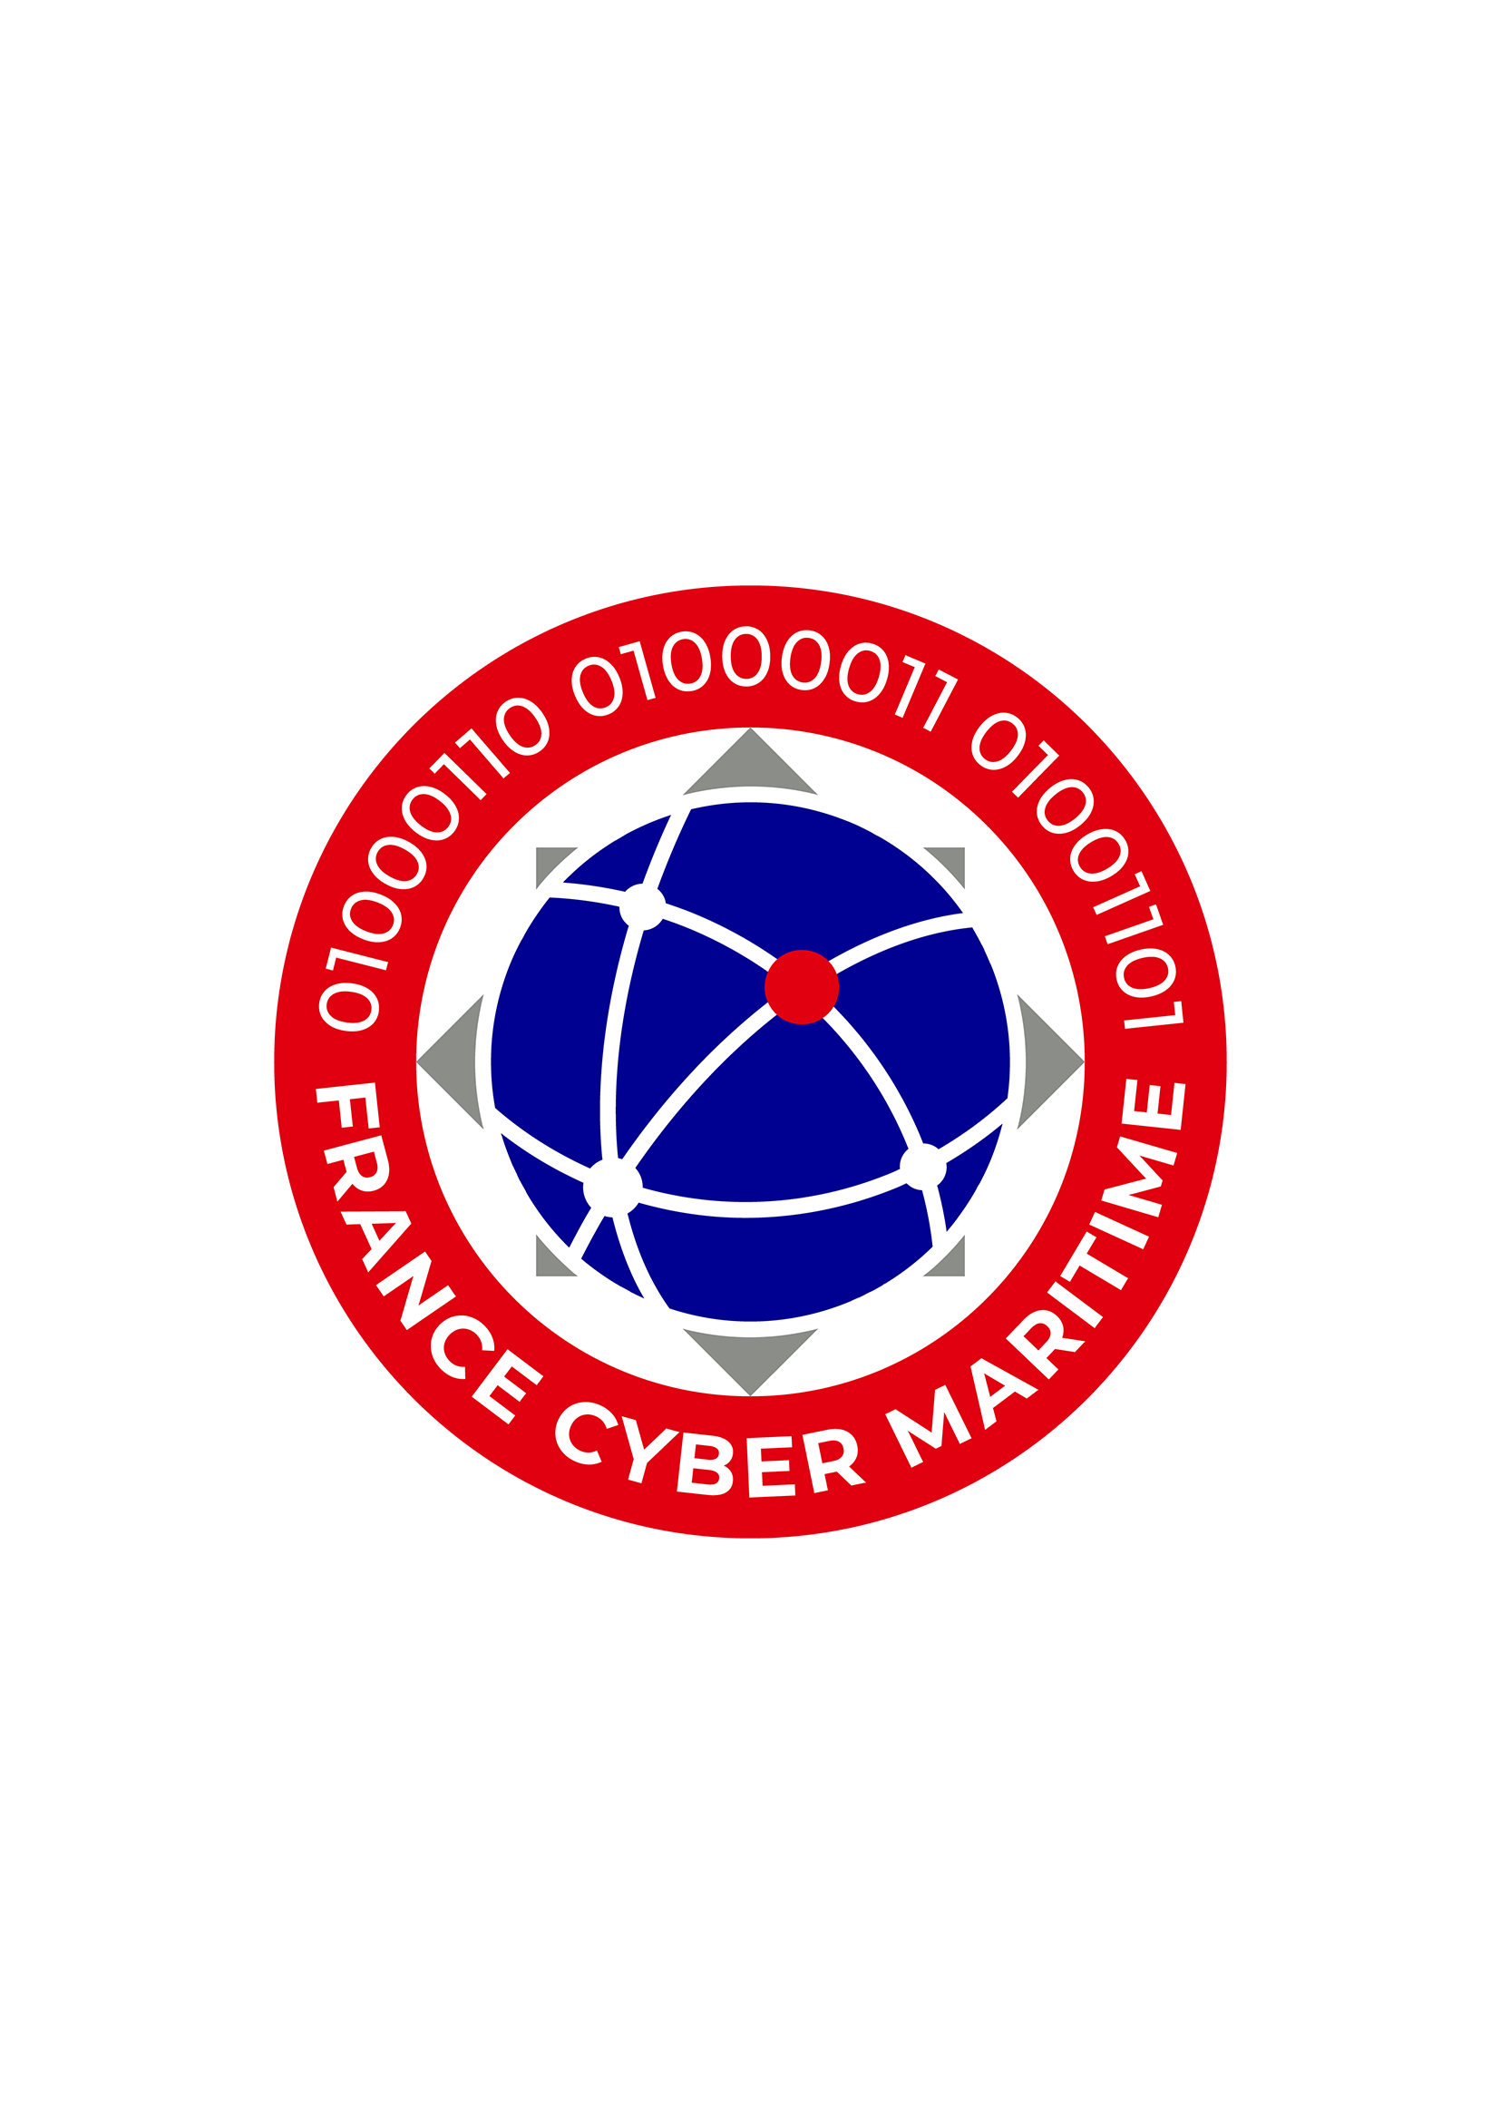
FRANCE CYBER MARITIME
Maritime Forum
Athens
21st of November 2023
Safeguarding the Maritime Digital Community
© France Cyber Maritime 2022 - Utilisation et reproduction interdites sans autorisation de France Cyber Maritime.
© France Cyber Maritime 2022 - Utilisation et reproduction interdites sans autorisation de France Cyber Maritime.

Slide 2

FRANCE CYBER MARITIME’S MISSION :
« Contribute to the strengthening of cybersecurity
of the French maritime and port sector»
Action 1
Action 2
Increase the resilience of maritime and port operations to cyber threats
Develop a network of expertise in
maritime cybersecurity
Operate the M-CERT (Maritime Computer Emergency Response Team) which provides information and assistance to all maritime and port operators
Foster the creation of high value-added services adapted to the needs of the industry
© France Cyber Maritime 2022 - Utilisation et reproduction interdites sans autorisation de France Cyber Maritime.

Slide 3
OUR COMMUNITY
© France Cyber Maritime 2022 - Utilisation et reproduction interdites sans autorisation de France Cyber Maritime.

Slide 4
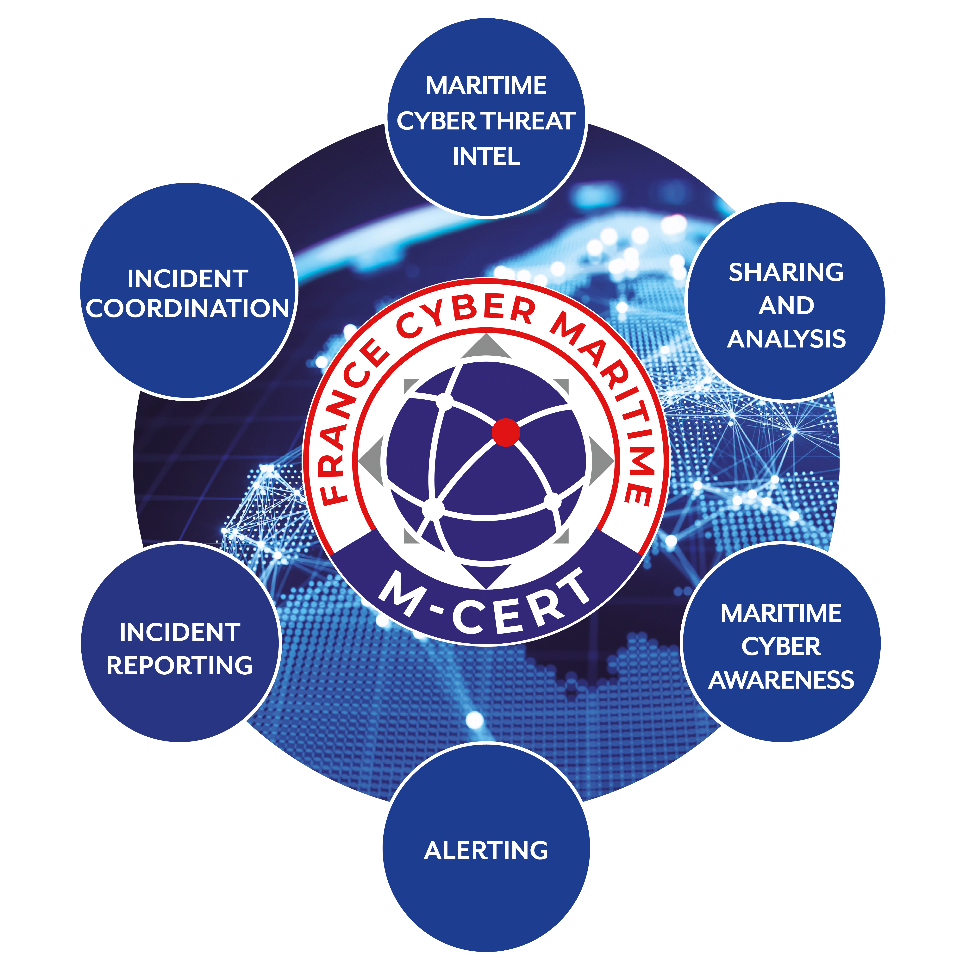
M-CERT: analysing, sharing and PROVIDING Assistance
The M-CERT (Maritime Computer Emergency Response Team) is a national centre in charge of monitoring and analysing cyber threats as well as sharing information and providing assistance to the maritime and port sector.
© France Cyber Maritime 2022 - All rights reserved - Any reproduction forbidden without written authorization.

Slide 5
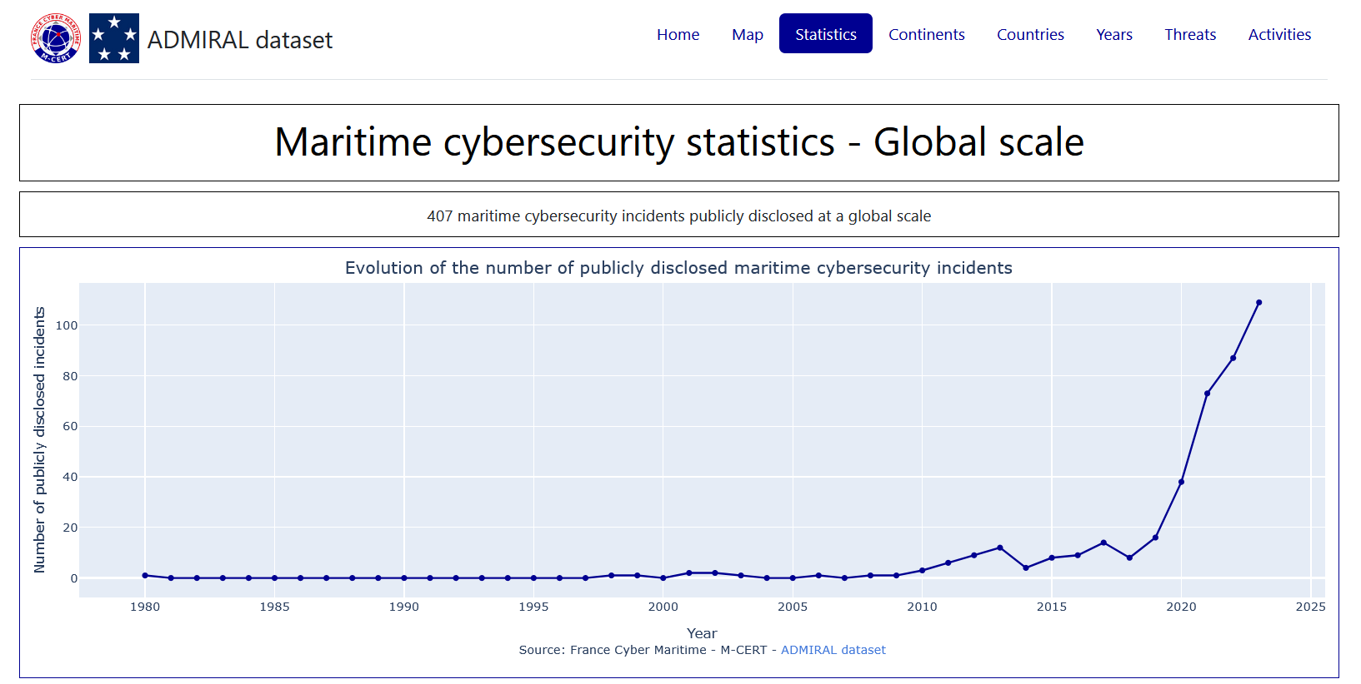
© France Cyber Maritime 2022 - Utilisation et reproduction interdites sans autorisation de France Cyber Maritime.

Slide 6
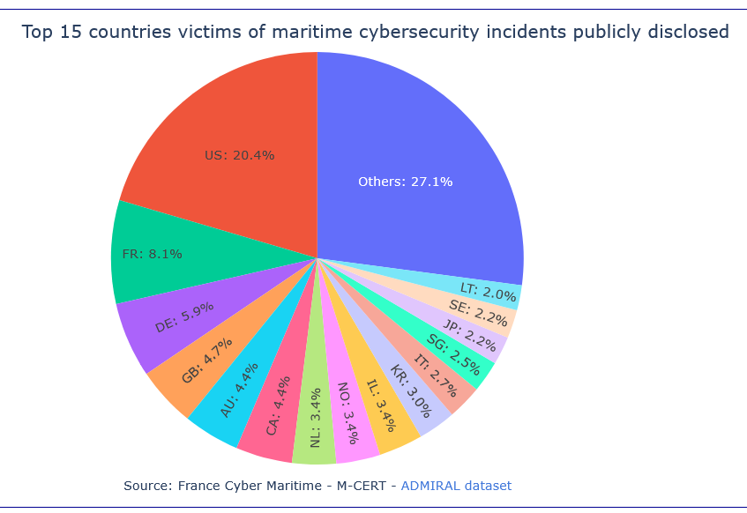
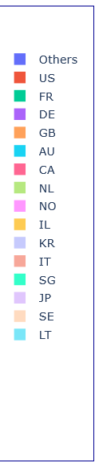
© France Cyber Maritime 2022 - Utilisation et reproduction interdites sans autorisation de France Cyber Maritime.

Slide 7
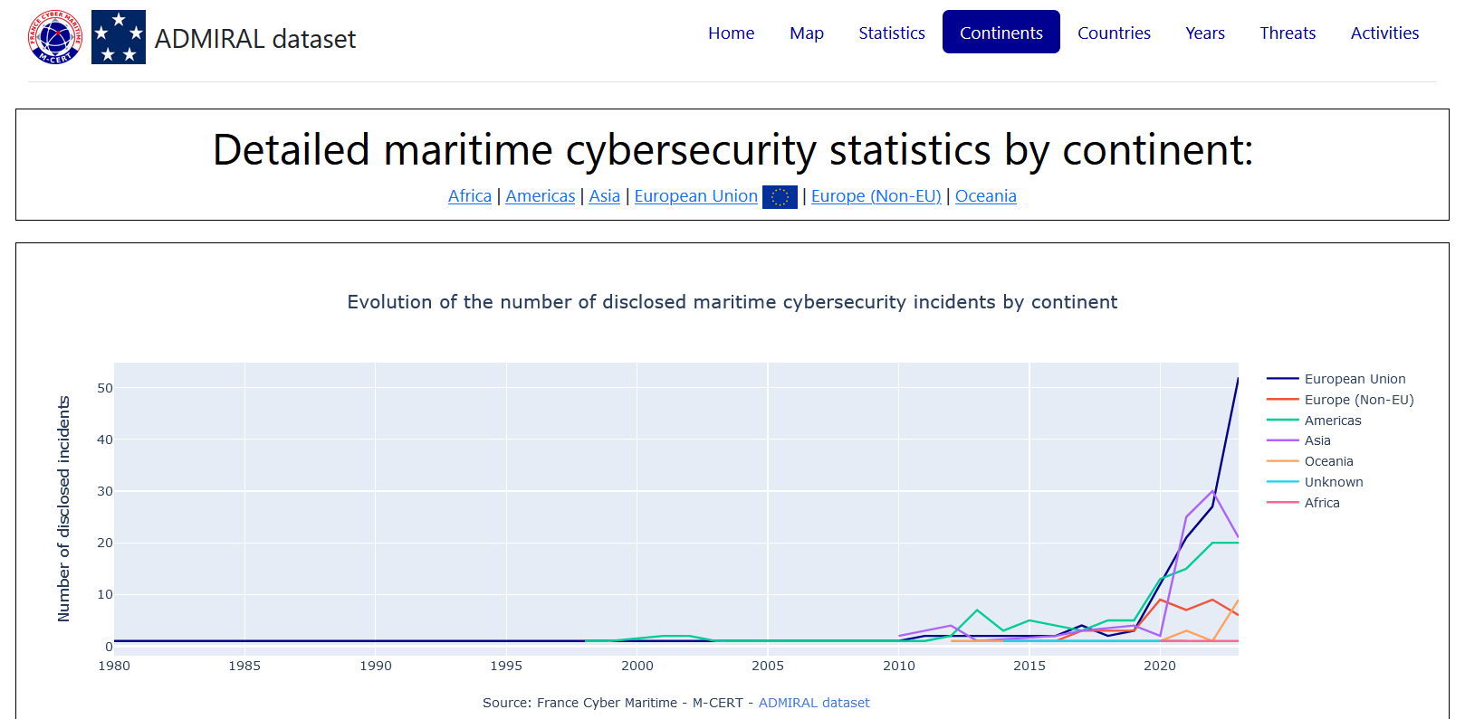
© France Cyber Maritime 2022 - Utilisation et reproduction interdites sans autorisation de France Cyber Maritime.

Slide 8
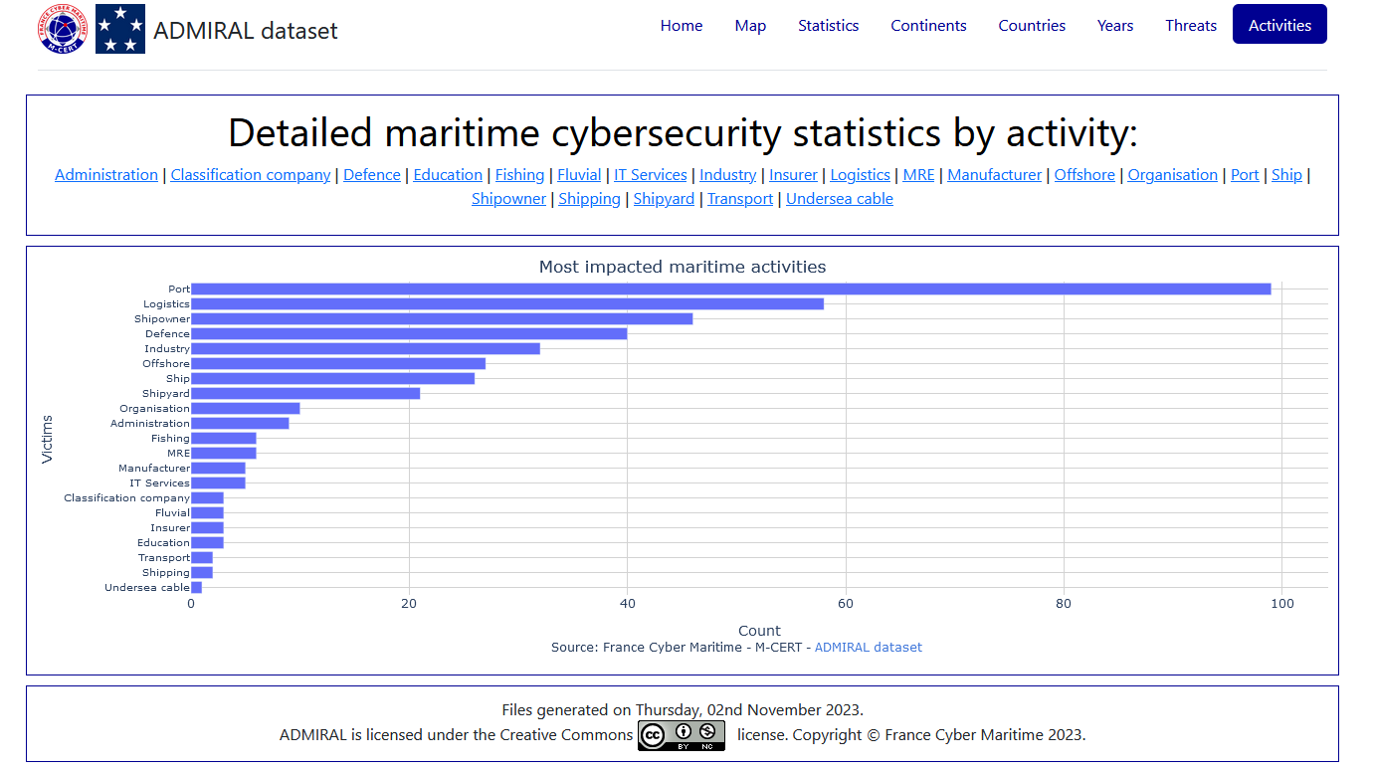
© France Cyber Maritime 2022 - Utilisation et reproduction interdites sans autorisation de France Cyber Maritime.

Slide 9
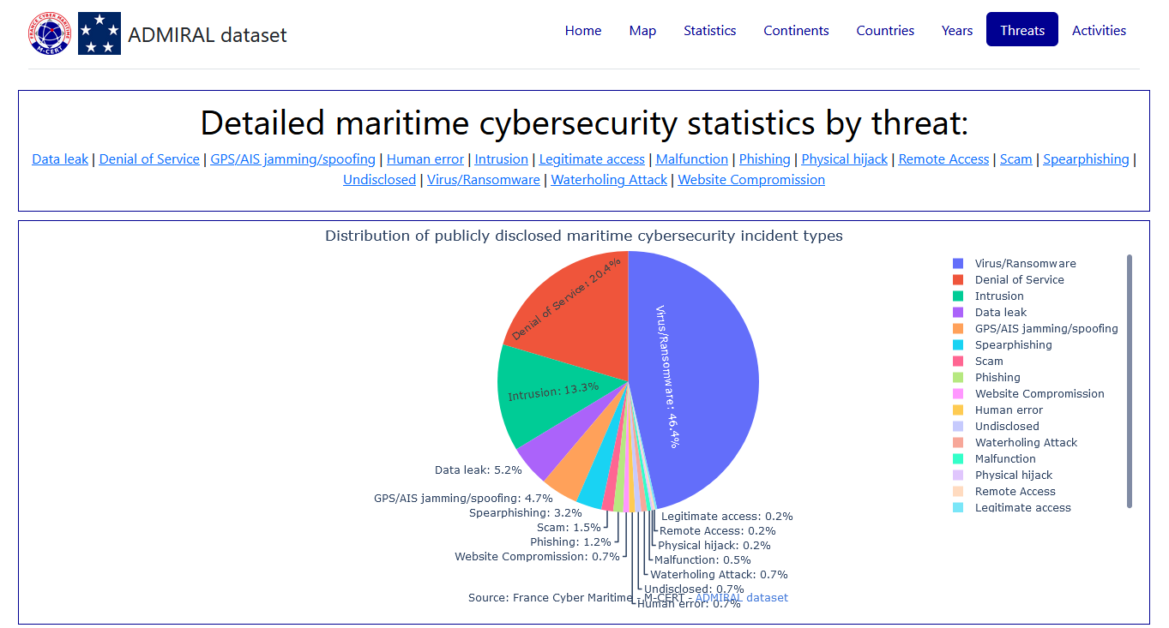
© France Cyber Maritime 2022 - Utilisation et reproduction interdites sans autorisation de France Cyber Maritime.

Slide 10
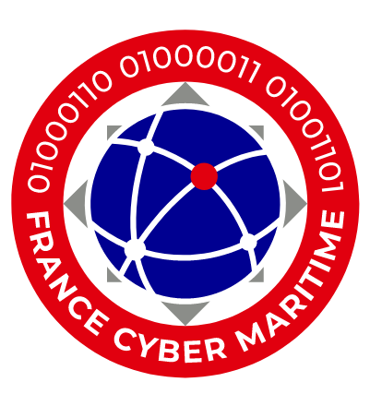
CONTACTS
Xavier Rebour
Managing director
xavier.rebour@france-cyber-maritime.eu
www.france-cyber-maritime.eu
M-CERT
contact@m-cert.fr
© France Cyber Maritime 2022 - Utilisation et reproduction interdites sans autorisation de France Cyber Maritime.

