Slide 1

Let Greece
inspire you!
e-Business Booster Forum Europe, January 26th, 2021
Mr. Georgios Filiopoulos, CEO

Slide 2
Agenda
Economic perspective
Greece: A unique investment proposition
Energy-RES: Locating in an emerging energy hub
ICT: An innovative market benefitting from ample talent
Investment Incentives, options and opportunities
EG services

Slide 3
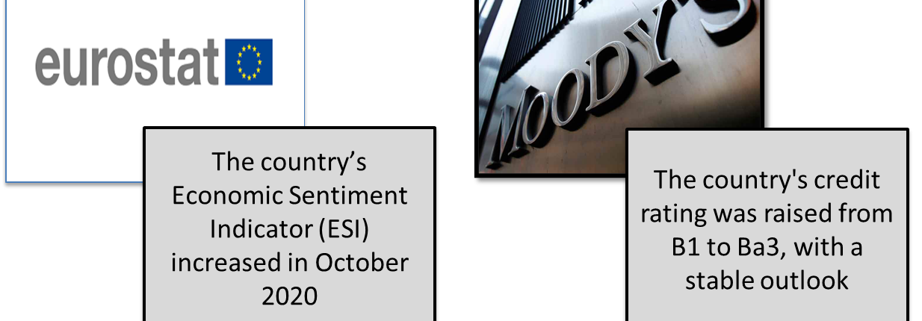
Improved economic climate

Slide 4






Greece in the spotlight
Greece becomes a top investment choice for flagship investments

Slide 5


A Unique Investment Proposition

Slide 6

A unique investment proposition
Location
Human Capital
Growth opportunities in key business sectors

Slide 7


Building a pro-investment business environment
Corporate Tax
Dividends Tax
Gradual reduction of social security contributions by
reduced by 4%
reduced from 10% to 5%
5%

Slide 8
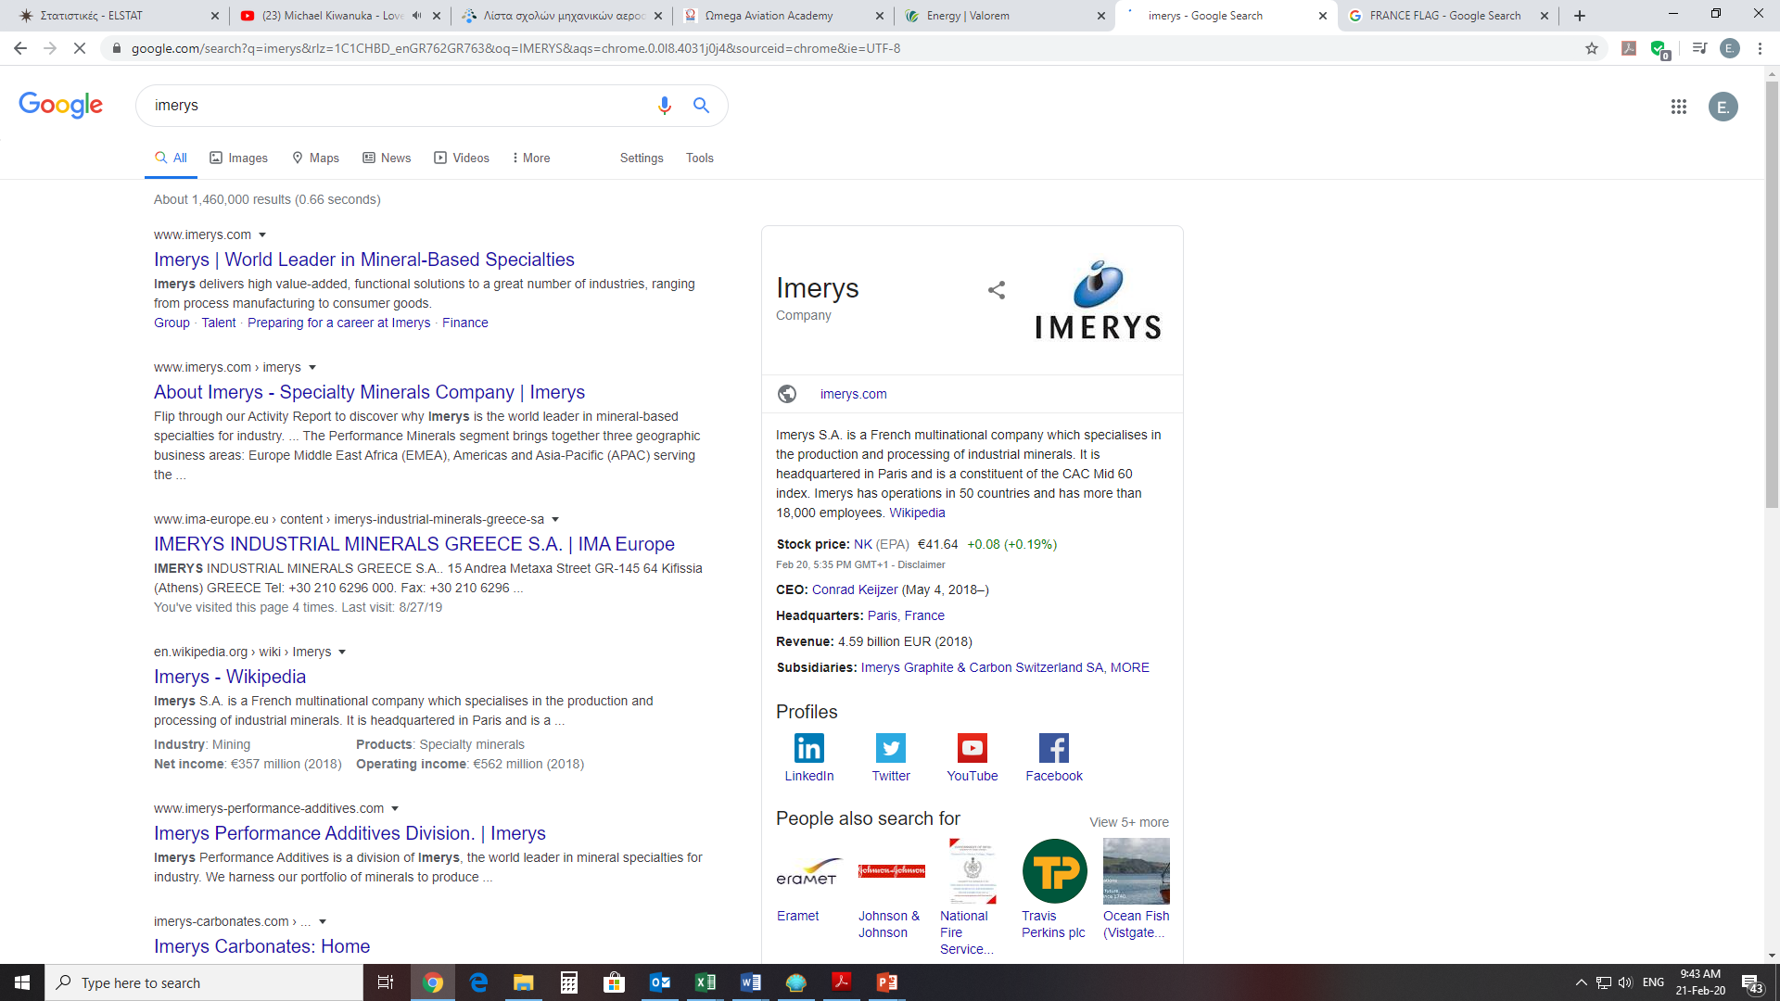






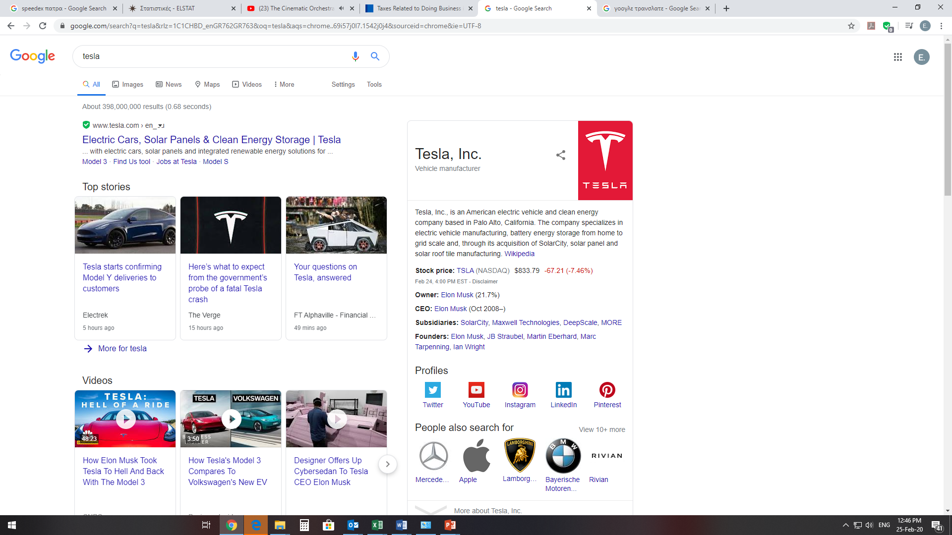











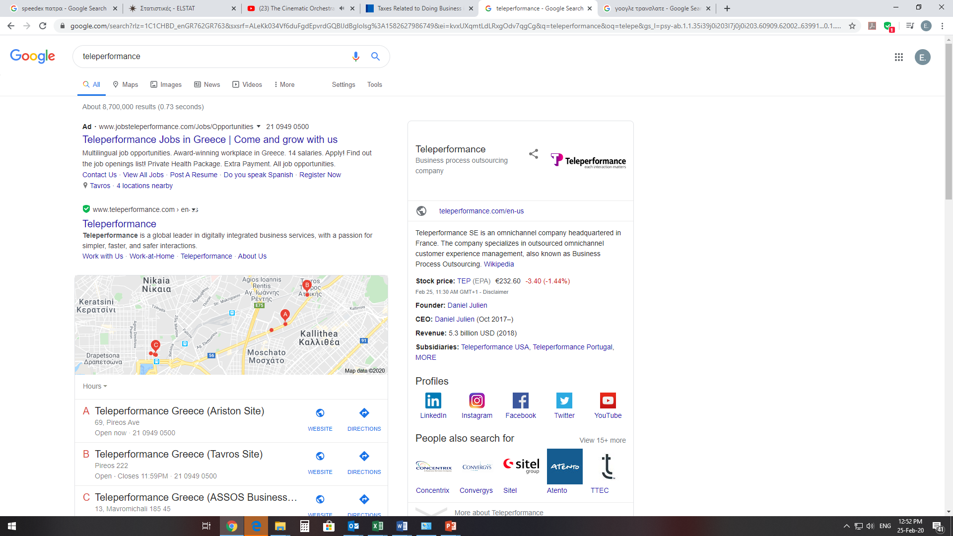




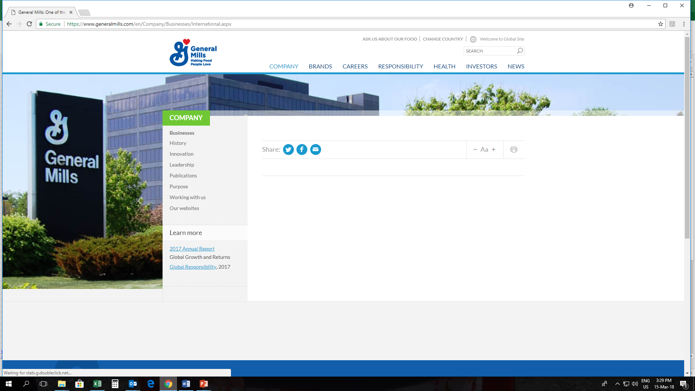

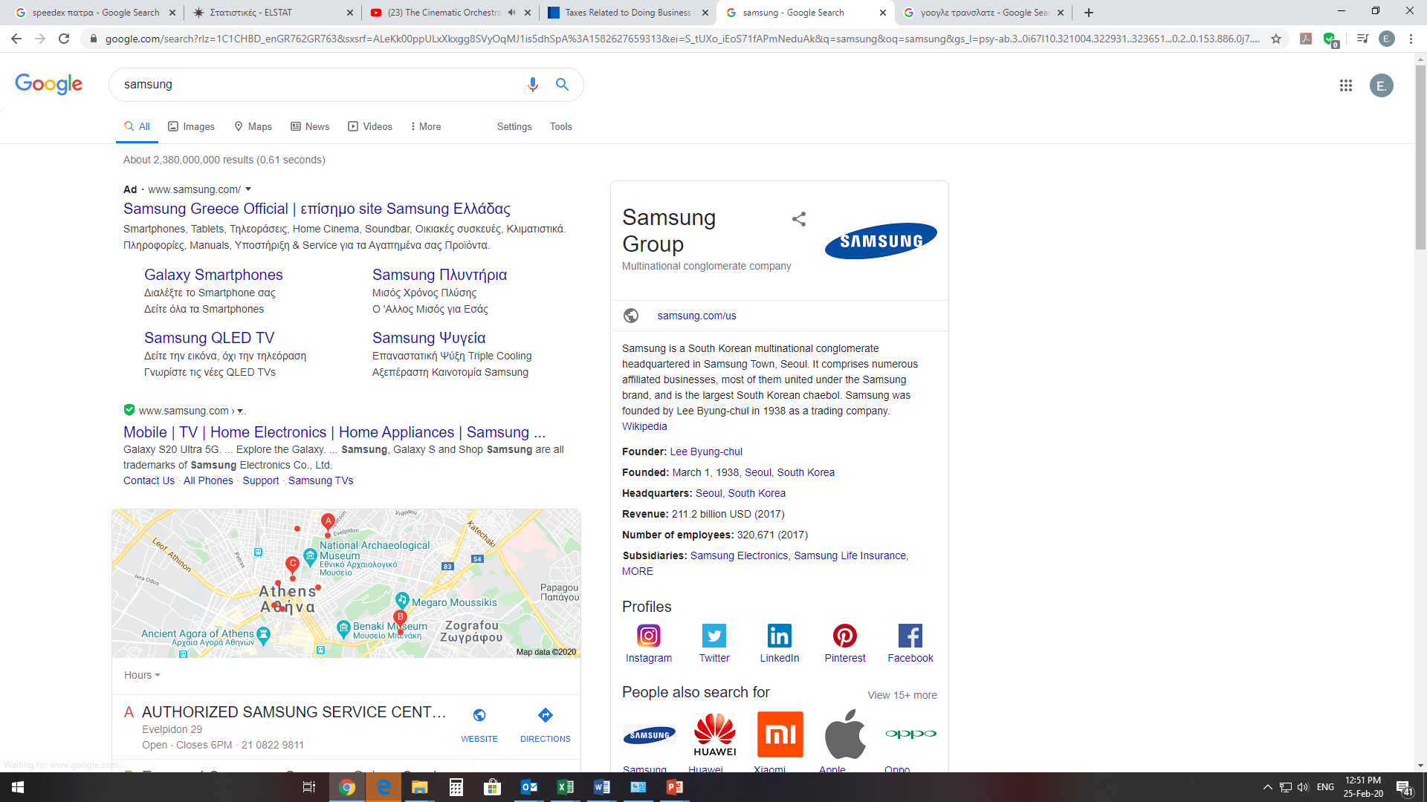
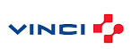


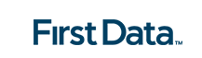



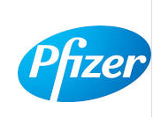



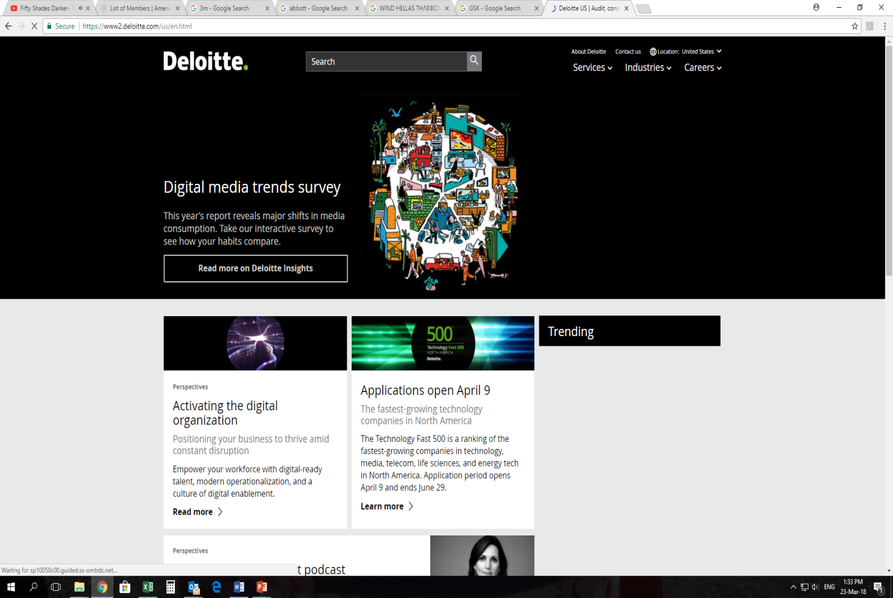





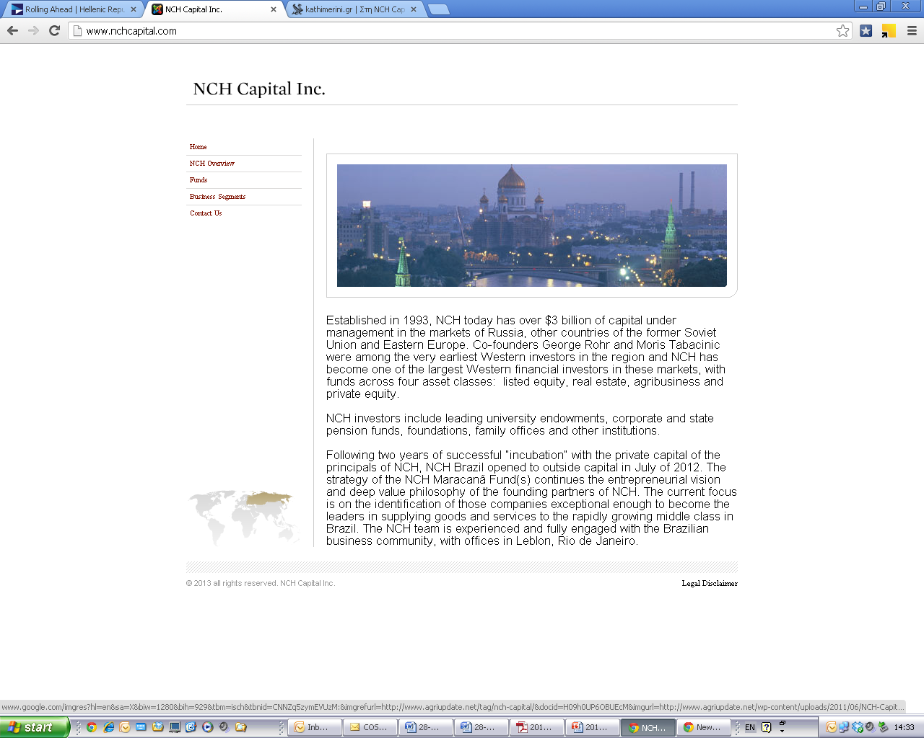

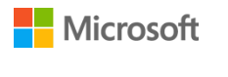





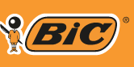





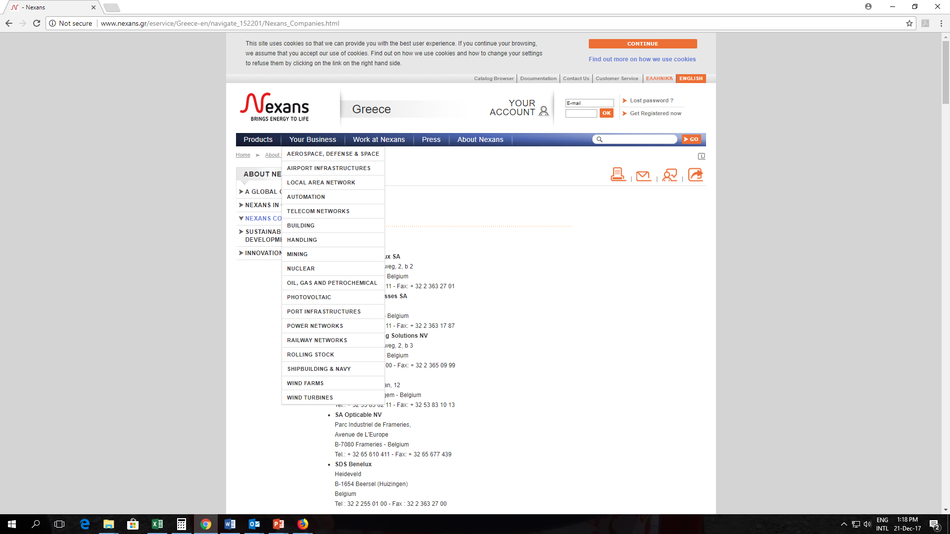

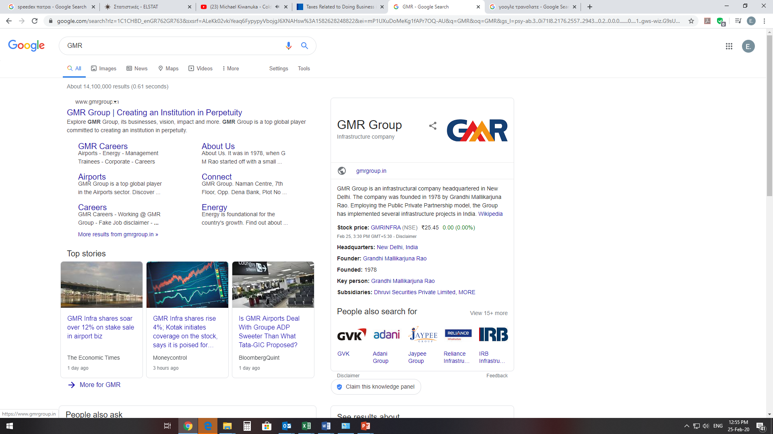


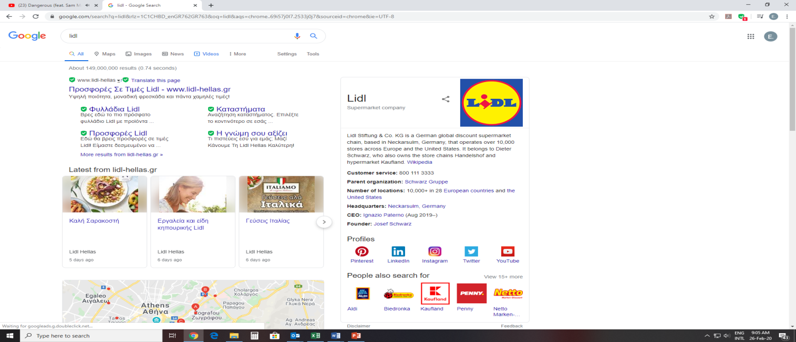



Selected FDI Deals
In Greece

Slide 9

Investment opportunities
ENERGY &
RENEWABLES
Untapped RES availability
Strategic location

Slide 10
4+4 reasons to invest in the Greek energy sector
1
Electricity & gas interconnections plus PCI projects transform Greece into a regional energy hub
3
The national target of 14+GW of RES installed capacity by 2030
2
Energy Decarbonization is a solid government commitment set to boost new RES investments
4
Successful operation of a well structured scheme for RES production reimbursement

Slide 11
4+4 reasons to invest in the Greek energy sector
5
An improved, efficient legal framework for RES investments
7
an expanding portfolio of private investment opportunities
6
An ambitious privatization program of state-owned energy assets
8
The presence of major market players from all energy subsectors, including RES

Slide 12

Investment opportunities
ICT
From start-ups to research centres of global ICT giants, the ICT scene benefits from highly-skilled personnel at competitive costs

Slide 13
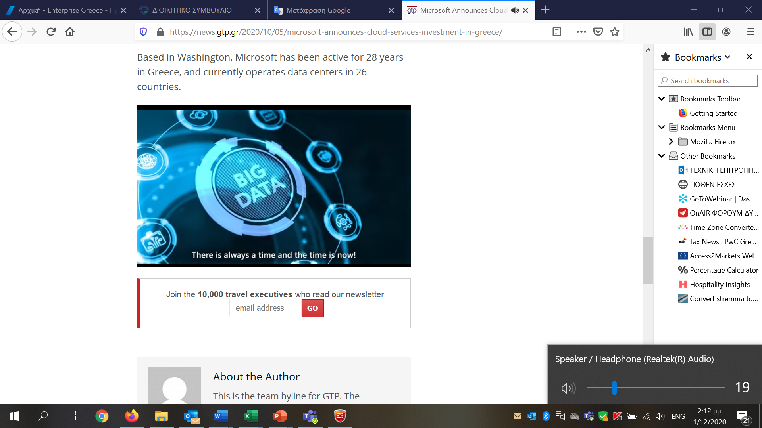

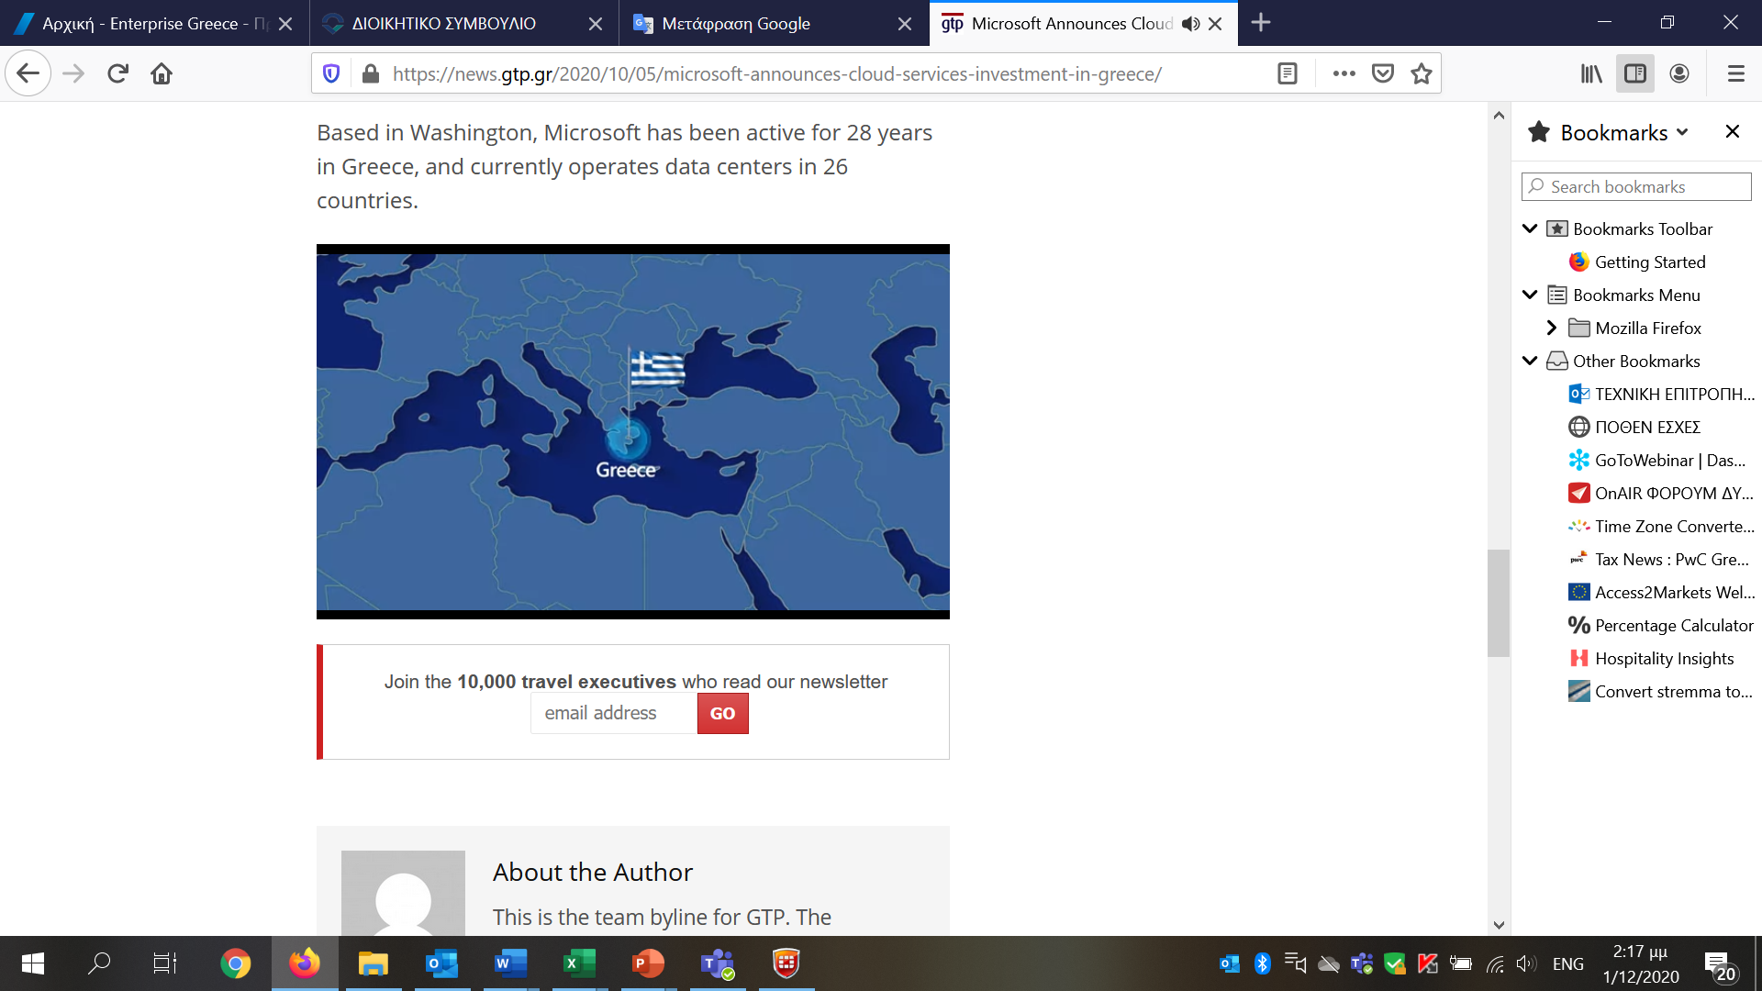
Microsoft plans $1 billion data center venture in Greece
US tech giant Microsoft Corp announced that it would be investing in the creation of a new data hub in Greece, expected to stimulate entrepreneurship and enhance the country’s attractiveness as an investment destination.

Slide 14


Slide 15

Generous Incentives available through various schemes and for various investment budget levels
Development Law
Incentives for SMEs- Partnership Agreement (PA) 2014-2020
Incentives for Strategic Investments - Fast Track Law
Incentives for the creation of new jobs
Incentives for R&D Projects
Incentives for Intra Group Service Centers
Incentives for Technology driven SMEs

Slide 16
Development Law Aid Schemes
Aid:
1) Tax exemptions
2) Cash grants
3) Leasing subsidies
4) Wage costs subsidy
5) Stable corporate tax rate for 12 years
6) Financing of business risk through loans or equity
7) Fast track licensing
Level of Aid depends on
the size of the company
and the specific region in which the project will be implemented.
State Aid percentages :
state aid for regional development ranges from 10% to 55% of total expenditures
state aid for specific types of expenditure (start-up costs, consulting costs, innovation costs, etc.) can reach up to 80%

Slide 17

Fast Track/ Strategic Investment (Law 4608/2019):
criteria & incentives
CATEGORY | CRITERIA Total Budget/Annual Work Units | INCENTIVES
STRATEGIC 1 | ≥100m€ | Spatial planning, Tax Exemptions and/or Fast Licensing
 | ≥40m€ + ≥75 AWU
STRATEGIC 2 | ≥30m€ + ≥50 AWU | Fast Licensing and/or Tax incentives, Subsidising Expenses
 | Investments located into industrial & BusinessParks ≥25m€ + ≥50 AWU
EMBLEMATIC | Investments implemented by Emblematic Entities + sustainable Investments No limits | Spatial planning, Tax Incentives, Fast Licensing, Subsidising Expenses
 | Investments in the Sectors of Industry and/or Tourism ≥200m€ + ≥200 AWU
FAST-LICENSING INVESTMENTS | ≥20m€ + ≥30 AWU | Tax Exemptions and/or Fast Licensing
PCI and PPP | PCI and PPP Investments No limits | Tax Exemptions and/or Fast Licensing

Slide 18
Tax Incentives for R&D
On the basis of the Greek Tax Code 4172/2013, as amended
Tax Incentive for R&D Activity – Super deduction
R&D expenses are deducted at the time of their realization from legal entities’ gross income, incremented by 100%.
Patent Box Regime
Business profits from the sales of products with an internationally recognized patent, are exempt from income tax for three fiscal years starting from the year in which they were first realized.

Slide 19
Enterprise Greece offers a set of integrated investment promotion and facilitation services
Portfolio of Projects (public and private)
Matchmaking services
Site location
Available financial tools and incentives
Labor regulations, taxation, cost related topics
Customized investment proposals
Enterprise Greece is the national trade and investment agency,
operating under the supervision of the
Ministry of Foreign Affairs

Slide 20



YOUR PARTNER IN GROWTH
info@eg.gov.gr
www.enterprisegreece.gov.gr

