Slide 1

Aris Xenofos | Executive Chairman
Wednesday 29th January 2020

Slide 2
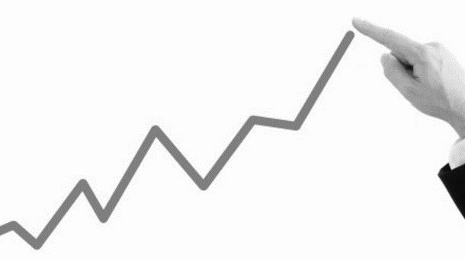
Greece is lifting off
Steady positive GDP growth
Unemployment rates subside
Greek money market and capital market outperforming European peers
Banking sector remedies the NPL issue
Strong political commitment

Slide 3
Our strategy
Value
Mature our assets and bring on the surface hidden value
Society
Place society and people at the forefront of our policy
Growth
Secure a positive multiplier effect by developing an asset and putting in place a challenging mandatory investment plan

Slide 4
Our principles
Extroversion
Address international markets
Transparency
Design an open and transparent tender process
Governance
Apply best corporate governance principals and multi-level approval process
Support
Quality and consistency in services we provide prior and post transaction

Slide 5

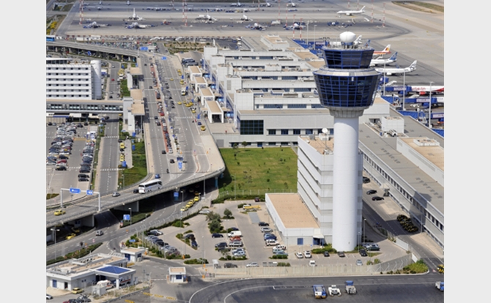
Corporate
Athens International Airport (AIA)
Traffic 2019: 25.57mn passengers (+6.0% vs 2018)
Completed €35mn investment to reach capacity of 26mn passengers
Currently expanding the main terminal to increase annual capacity from 26mn to 33mn passengers
Significant reduction of its carbon footprint by 50% and environmental certification requirements for all major third parties operating in the airport
Socioeconomic impact (2017): 4.4% of GDP (€7.9bn) / 4.8% contribution to employment

Slide 6
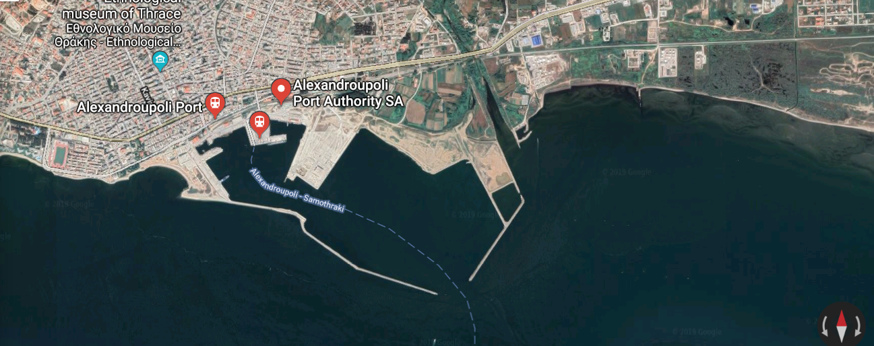
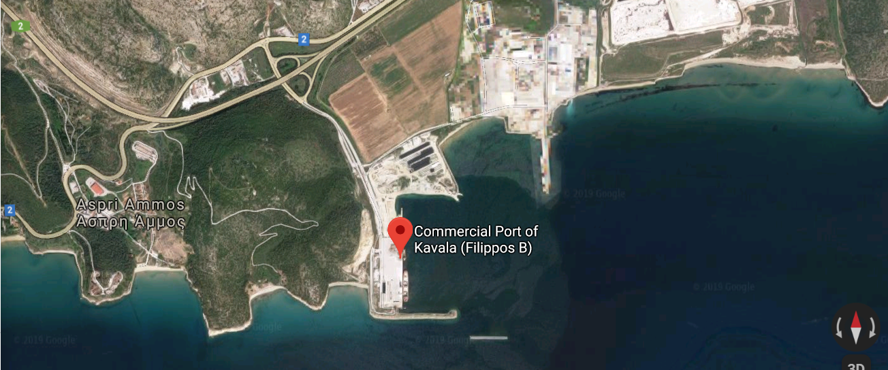
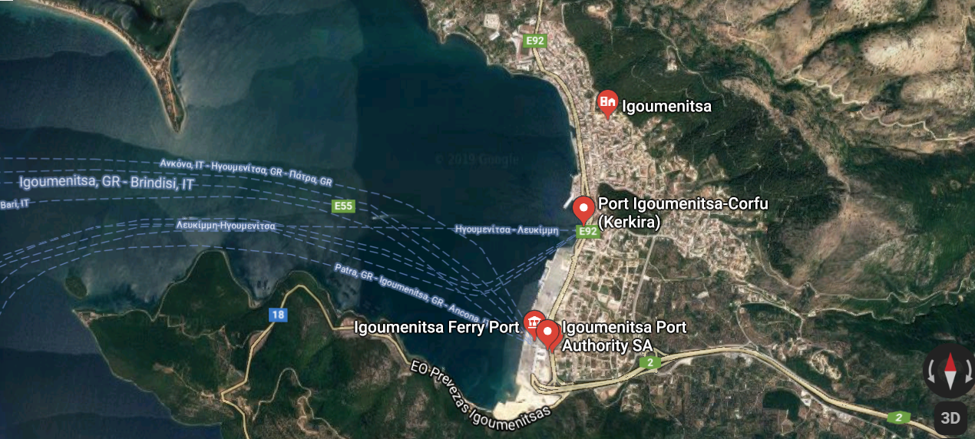
Infrastructure
10 Regional Ports
Kavala
Alexandroupolis
Corfu
Volos
Igoumenitsa
Patras
Elefsina
Rafina
Lavrio
Alexandroupolis Port
Heraklion
Serves cargo (general cargo, dry bulk) & passengers
TAP gas pipeline passing by; construction of an offshore gas import facility, to be connected to the TAP pipeline, is expected
Kavala Port
Igoumenitsa Port
Main commodity is marble, as general cargo and dry bulk
Kavala, Alexandroupolis, Varna and Burgas ports have completed studies of “SEA2SEA Program” for upgrading the rail infrastructure between them
International and domestic ferry and Ro-Ro traffic
Development of a logistics centre at 15km distance next to EGNATIA planned

Slide 7
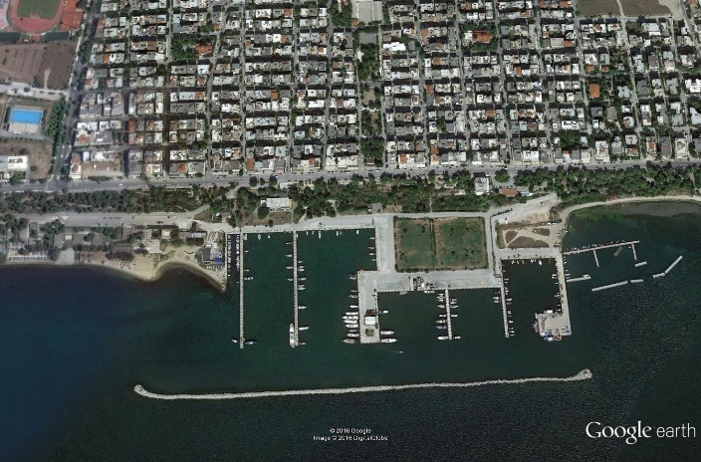
Infrastructure
Marinas
Thessaloniki
Skiathos
Skyros
Cephalonia
Itea
Chios
Zante
Nea Epidavros
Glyfada
Katakolo
Poros
Mykonos
Kos
Thessaloniki Marina
Pylos
Hydra
Rhodes
Land Area: 77,825m²
Berths: 388 up 20m length (today 242)
Uses allowed: Hotels / Commercial / Residential / Other
Rethymno
Ag. Nikolaos
Itea Marina
Argostoli Marina
Municipality of Delphi
Land Area: 24,700m²
Berths: 146
Cephalonia island
Land Area: 46.000m²
Berths: 190

Slide 8
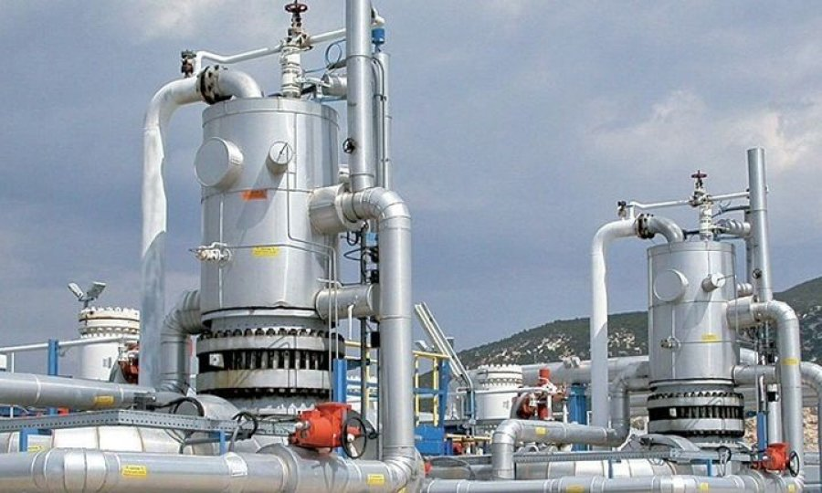
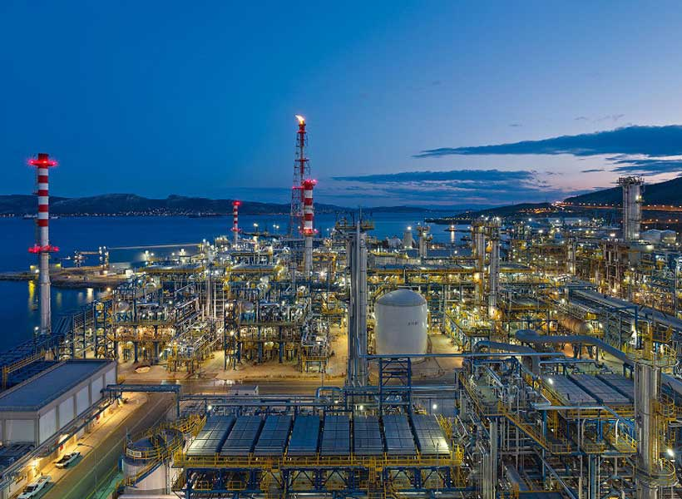
Corporate - Energy
DEPA (Public Gas Corporation)
HELPE (Hellenic Petroleum)
DEPA Infrastructure SA (100% sale)
  Distribution networks
  Servicing over 400K connections
DEPA Commercial SA
  Wholesale & retail gas supply
  Over 160K retail contracts for gas & electricity supply
  20% equity participation in Gastrade SA
Operates 3 refineries in Greece, which cover approx. 2/3 of the country’s total refining capacity
Holds stakes in Elpedison – a joint venture in power generation
Holds 35% in DEPA
Engaged in projects related to exploration and production of hydrocarbons

Slide 9
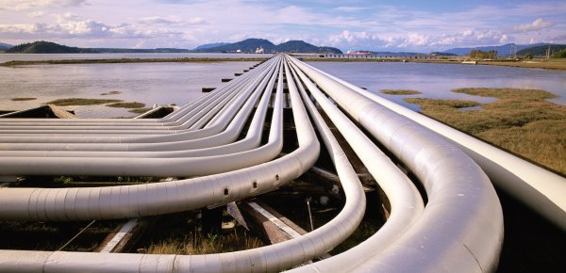
Infrastructure - Energy
South Kavala Offshore Natural Gas Storage (UGS)
Development and exploitation of the country’s first Underground Gas Storage (“UGS”) facility in the depleted offshore natural gas field of South Kavala, 30km south from the city of Kavala in Northern Greece
Existing infrastructure of pipelines, wells and platforms necessary for gas transmission and injection are located within 30-40km of the coast; South Kavala UGS can store up to 360mn Nm³ of working gas
Expected to realize significant benefits for the Greek & European gas market:
  Security of gas supply / System balancing gas / Gas sourcing diversification
Included in the list of projects of common interest (“PCI”) by the European Commission

Slide 10
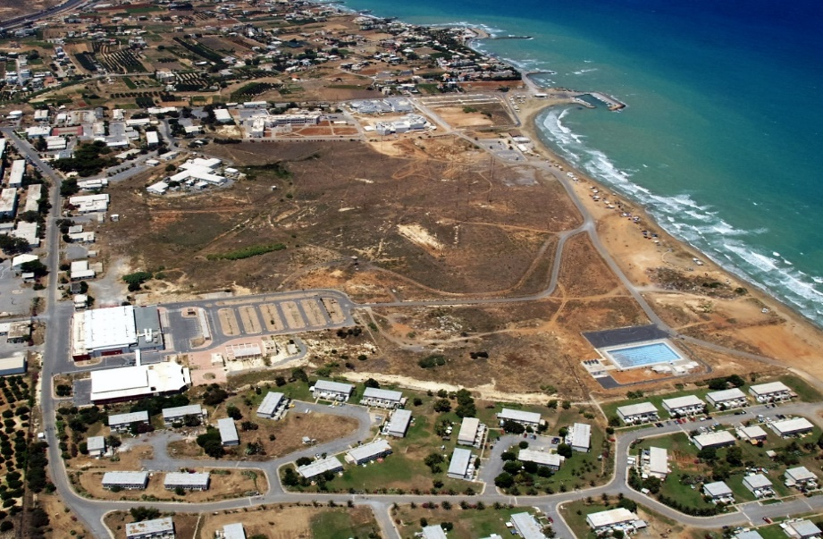
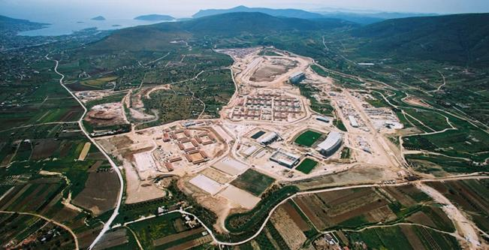
Real Estate
Former American Base in Gournes
Heraklion – Crete
Markopoulo - Athens
Olympic Equestrian Centre
Land plot area: 717,854.00 m²
Development concept: Theme Park| Retail and Tourism| Recreation | Casino
Land plot area: 1,026,779.62m²
Development concept: Theme Park| Sports| Leisure

Slide 11
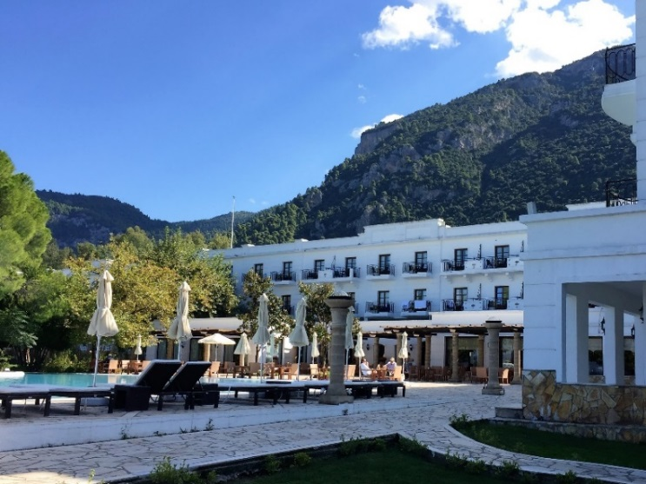
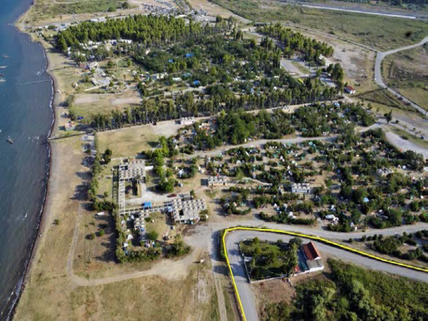
Real Estate
Thermal Springs
Galini Hotel & Spa Kamena Vourla
Fthiotida
Koniavitis Camping Kamena Vourla
Fthiotida
Land plot area: 474,827m²
Development concept: Health & Spa Resort | Wellness
Land plot area: 783,321m²
Development concept: Health & Spa Resort | Golf & Recreation | Marina

Slide 12



Thank you!
akallianou@hraf.gr
akitanidi@hraf.gr
+30 210 327 44 00
+30 210 327 44 25
www.hradf.com

