Slide 1

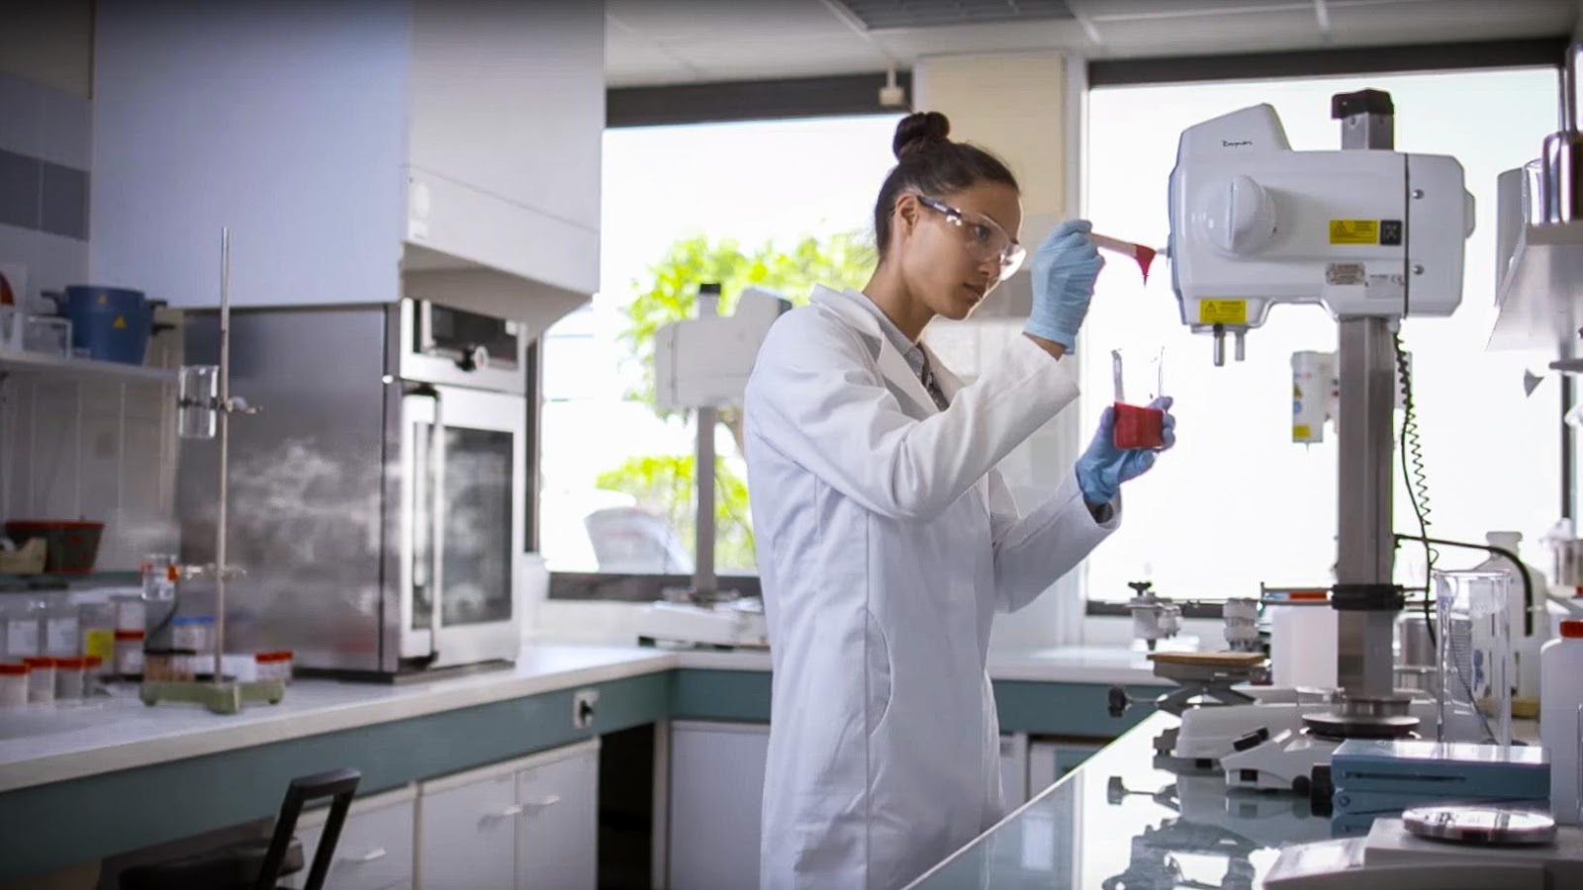

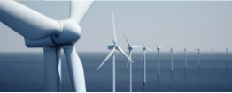
Imerys
The world leader in mineral-based specialties
Sustainable Purchasing
30 November 2023

Slide 2
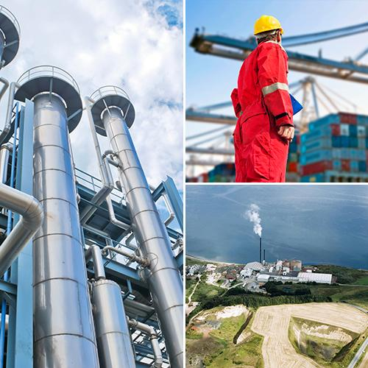
An introduction to Imerys
A world leader in mineral-based specialties, offering
high value-added solutions to many different industries,
ranging from process manufacturing to consumer goods.
We succeed through:
Best-in-class operations, delivering commercial excellence
and market-driven innovation
A strong business model and value proposition
Unrivalled technological and industrial processes,
solutions and leading positions in most
of our markets
Understanding our customers’ applications
Meeting ambitious targets for being
a responsible business
A world leader in mineral-based specialties, offering
high value-added solutions to many different industries,
ranging from process manufacturing to consumer goods.
We succeed through:
Best-in-class operations, delivering commercial excellence
and market-driven innovation
A strong business model and value proposition
Unrivalled technological and industrial processes,
solutions and leading positions in most
of our markets
Understanding our customers’ applications
Meeting ambitious targets for being
a responsible business
Notes:
Talking Points
- Today, Imerys is a global leader of specialty minerals solutions with a resilient and profitable business.
- We draw on our understanding of applications, technological knowledge and expertise in materials science to deliver solutions by beneficiating its mineral resources, synthetic minerals and formulations.
- Imerys contributes essential properties to customers’ products and their performance, including heat resistance, hardness, conductivity, opacity, durability, purity, lightness, filtration, adsorption and water repellency.
- Imerys meets ambitious targets to develop responsibly, focusing on people, the environment, business conduct and corporate governance.

Slide 3
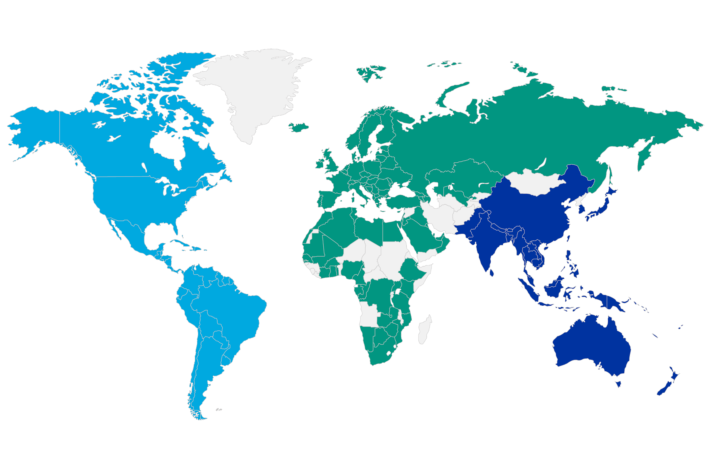
We operate in more than 40 countries…
Americas
32% of 2022 revenue
EMEA
47% of 2022 revenue
APAC
21% of 2022 revenue
…with a commercial presence in 133 countries

Slide 4
Our key figures* – At a glance
Nearly 30,000
customers
Sales
In 133 countries
14,000
employees
€4.3bn
revenue
€720m
EBITDA
#1
32%
47%
21%
in 75%
of our businesses
Americas
32% of revenue
EMEA
47% of revenue
APAC
21% of revenue
(*2022 figures)

Slide 5
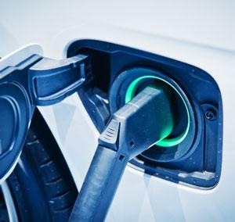
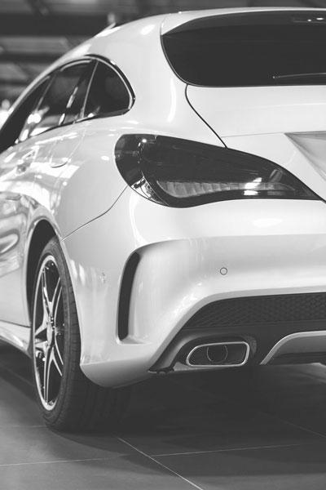
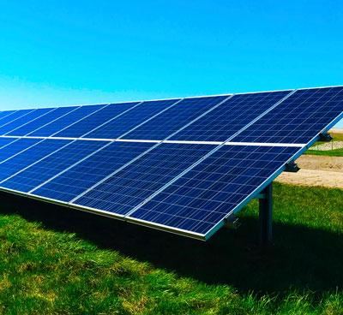
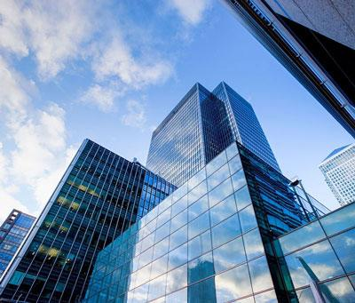

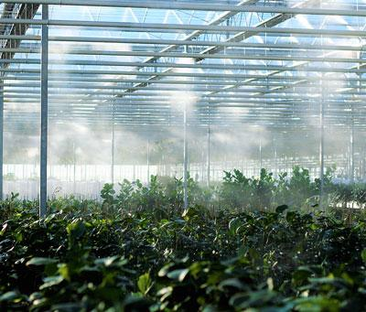
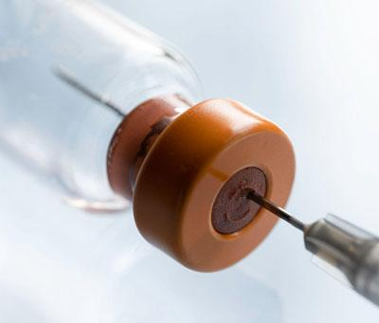
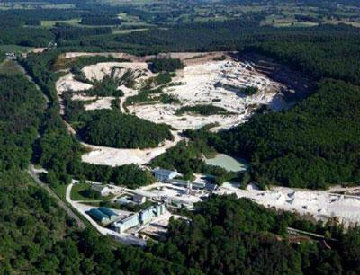
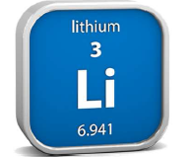
Ready to invest in fast growing markets with higher profitability
Green Mobility
& Sustainable Energy
Sustainable Construction
Natural solutions
for consumer goods
Development
into Lithium
Mobile energy
Green energy
High performance
and durable building
Feeding the world
Lightweighting
Reduced CO₂ emission materials
Good health
and well being
+€250m annual
revenues by 2025 /
+€600m by 2030 vs. 2021
+€150m annual revenues
by 2025 vs. 2021
above market growth
+€100m annual revenues
by 2025 vs. 2021
above market growth
34,000 tons of lithium hydroxide per year
from 2028
Ambitious CAPEX program:
Graphite & Carbon black
for energy transition & EVs
High performance minerals
for plastic lightweighting
in automotive
Aluminates for mineral foam insulation
Metakaolin as green supplementary cementitious material
Minerals substituting microplastics & chemicals
Capacity increase in high purity filtration for pharmaceuticals
Launch of Emili project
Other sites under investigation
Potential upside post 2025

Slide 6

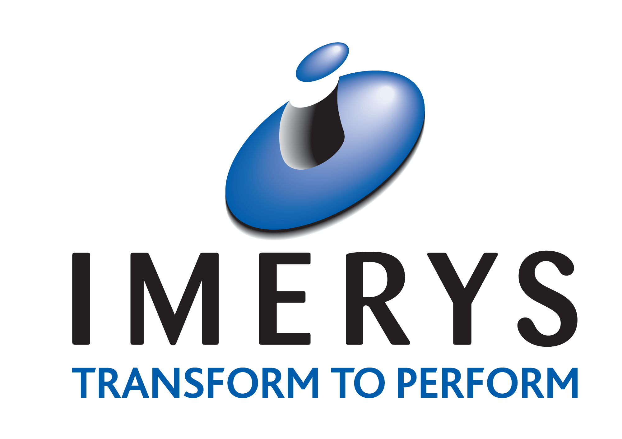




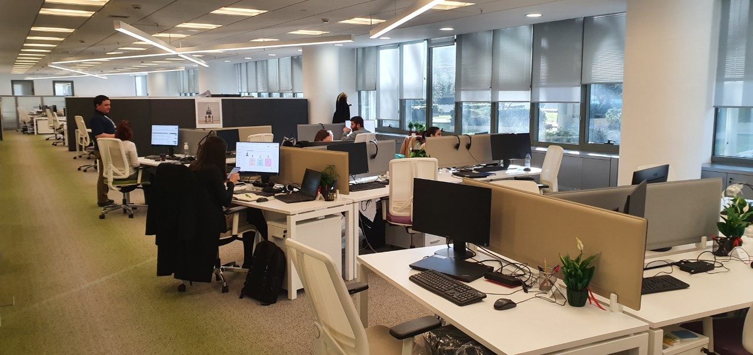
Imerys has a long established history in Greece
Building of the largest perlite factory in Europe
Greek Bauxite Operations reacquired
Foundation of Bauxites Parnasse Mining Co and S&B Ores Mining Co
Renaming to
S&B Industrial Minerals SA
1952
1994
2015
2019
1934
1975
2003
2017
Listing of S&B
in the Greek Stock Market
IMERYS Shared Service Center Establishment
Beginning of bentonite production
IMERYS acquires S&B and establishes Greek operations

Slide 7
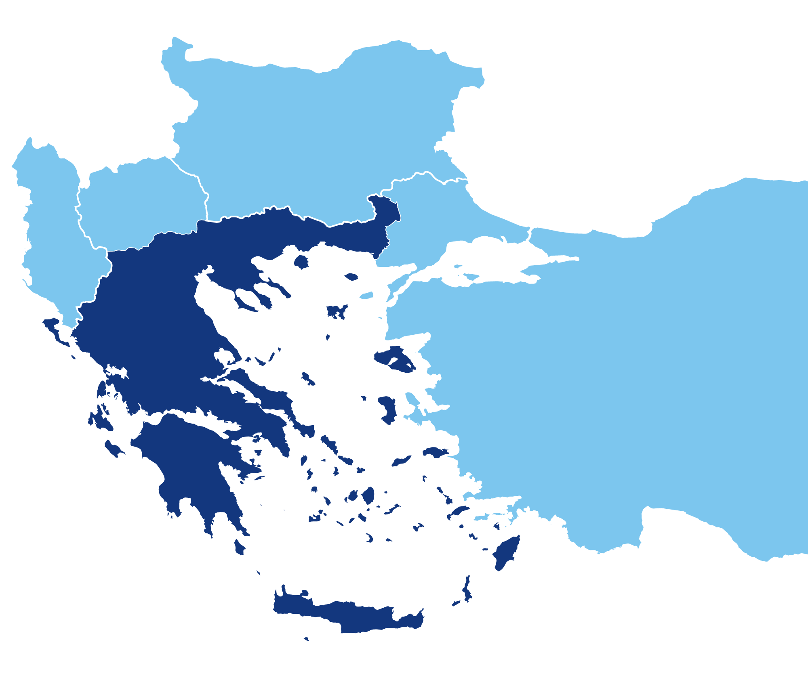
Where we operate in Greece
18
Kavala
250
86
212
Fokida
Kifissia
209
Milos
*Direct employees
Notes:
Imerys Bauxites - Fokis Employees : 250 / Contractors:116 Fokis FTEs around 370
Imerys Greece - Athens & Milos Employees :
Athens 86 employees + 16 contractors = 102
Athens: 86 (84+2) / Contractors: 16
Milos 209 / Contractors 240 / Milos FTEs around 450
Imerys SSC - Athens: Employees 212
Kavala: 18 FTEs
Totals 775 direct employees / 240 +116+16 = 1.147

Slide 8
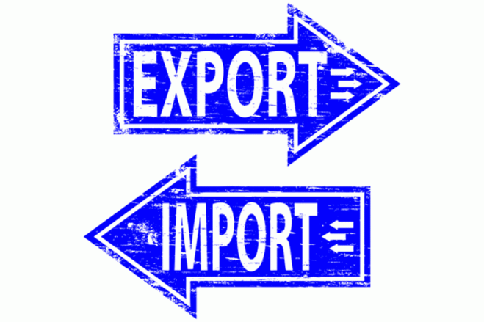


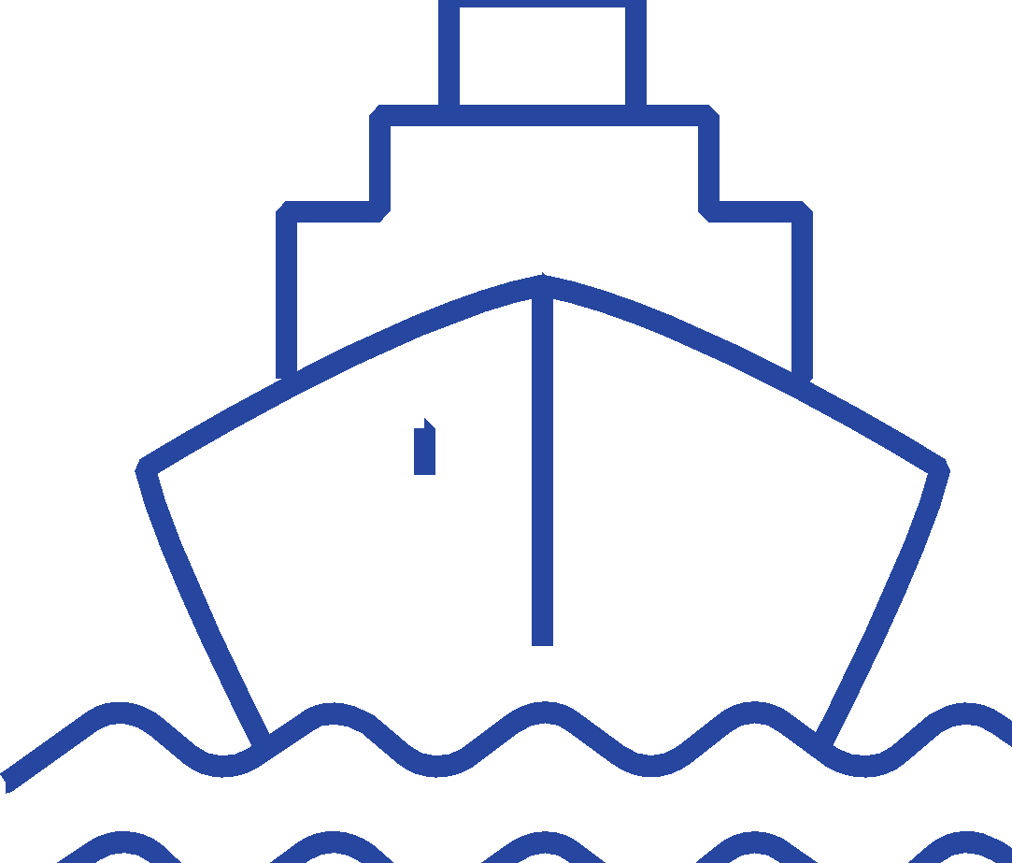

Imerys in Greece
Turnover
€188,4 million
Exports
78,8 % - 148,5 million
€24,2 million
Annual Investments
+1150 FTEs
Employees & Contractors
21 Quarries
& Mines
6 Operating / Processing Sites
5 Loading Facilities
1 Shared Services Center
(*2022 figures)
Notes:
BEN & PER
2 perlite mines
6 bentonite mines
3 processing sites and 3 loading bridges
BAU
2 processing sites
3 loading bridges

Slide 9
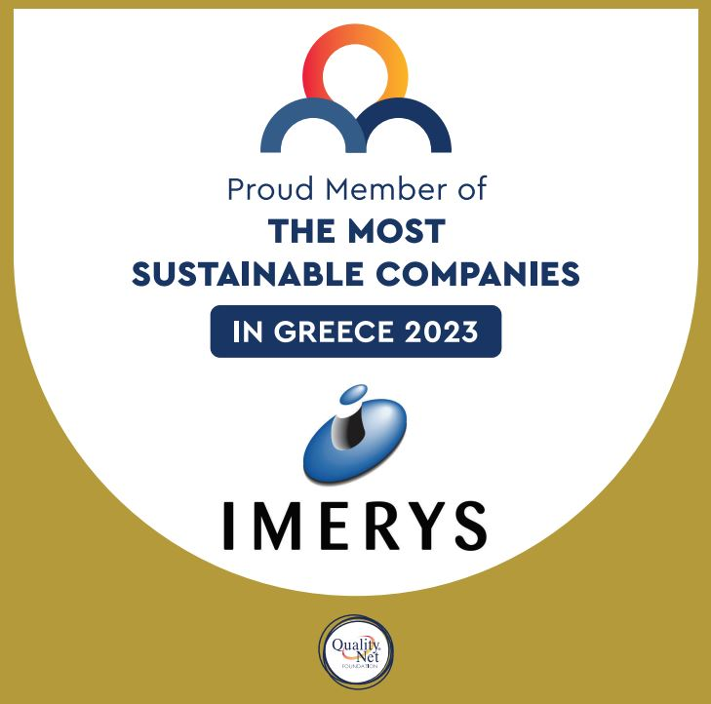
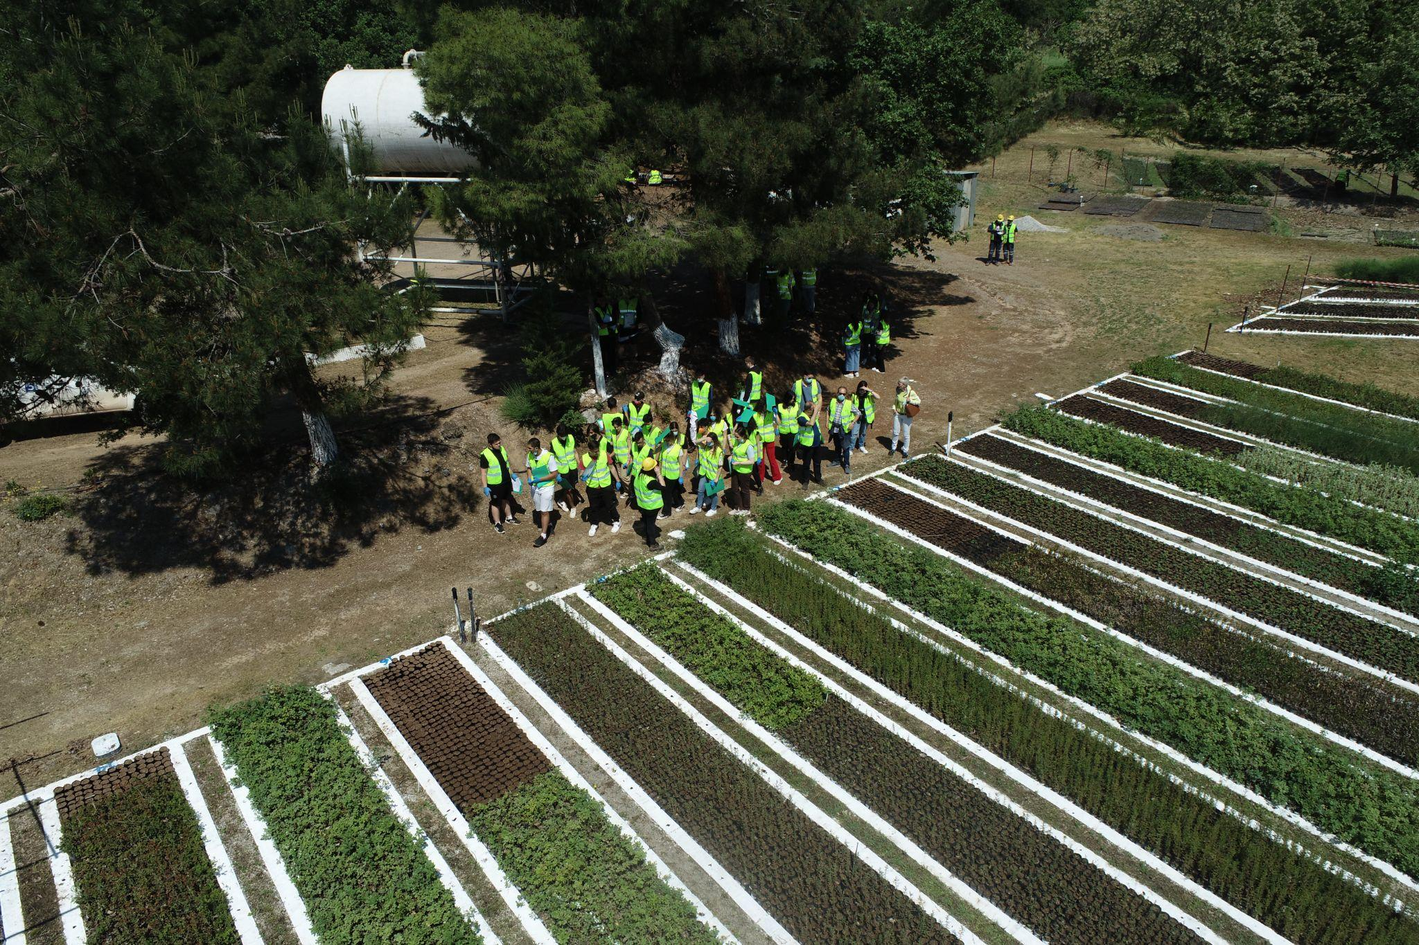
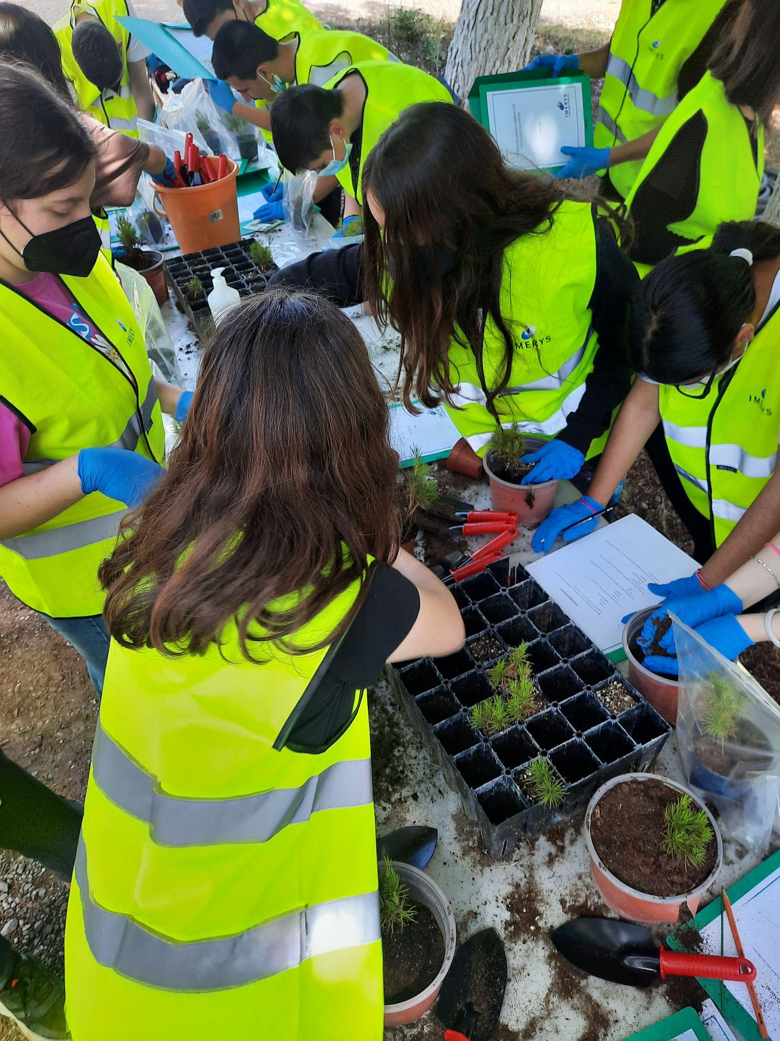

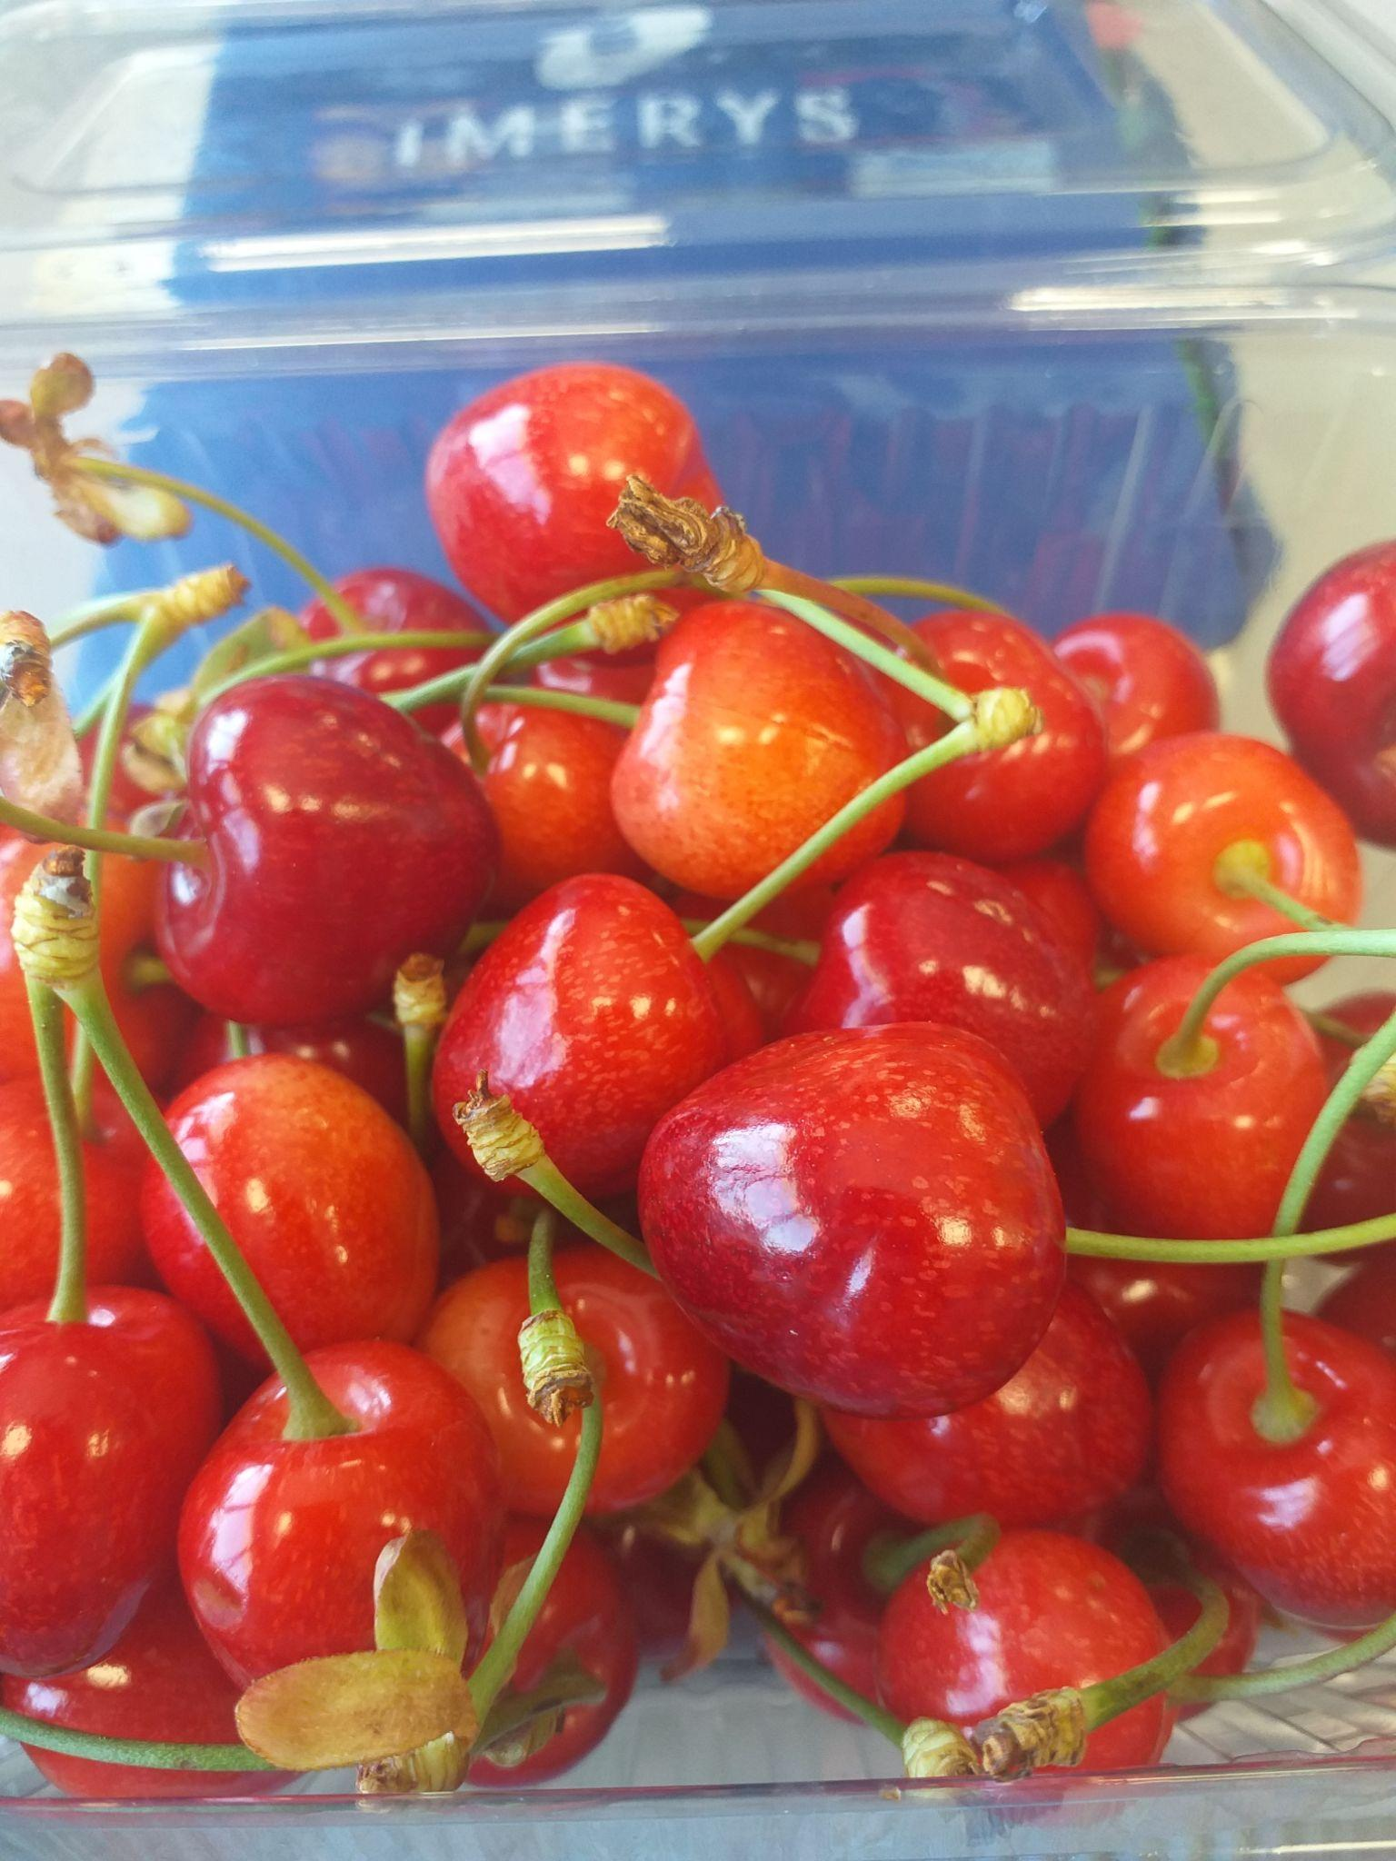
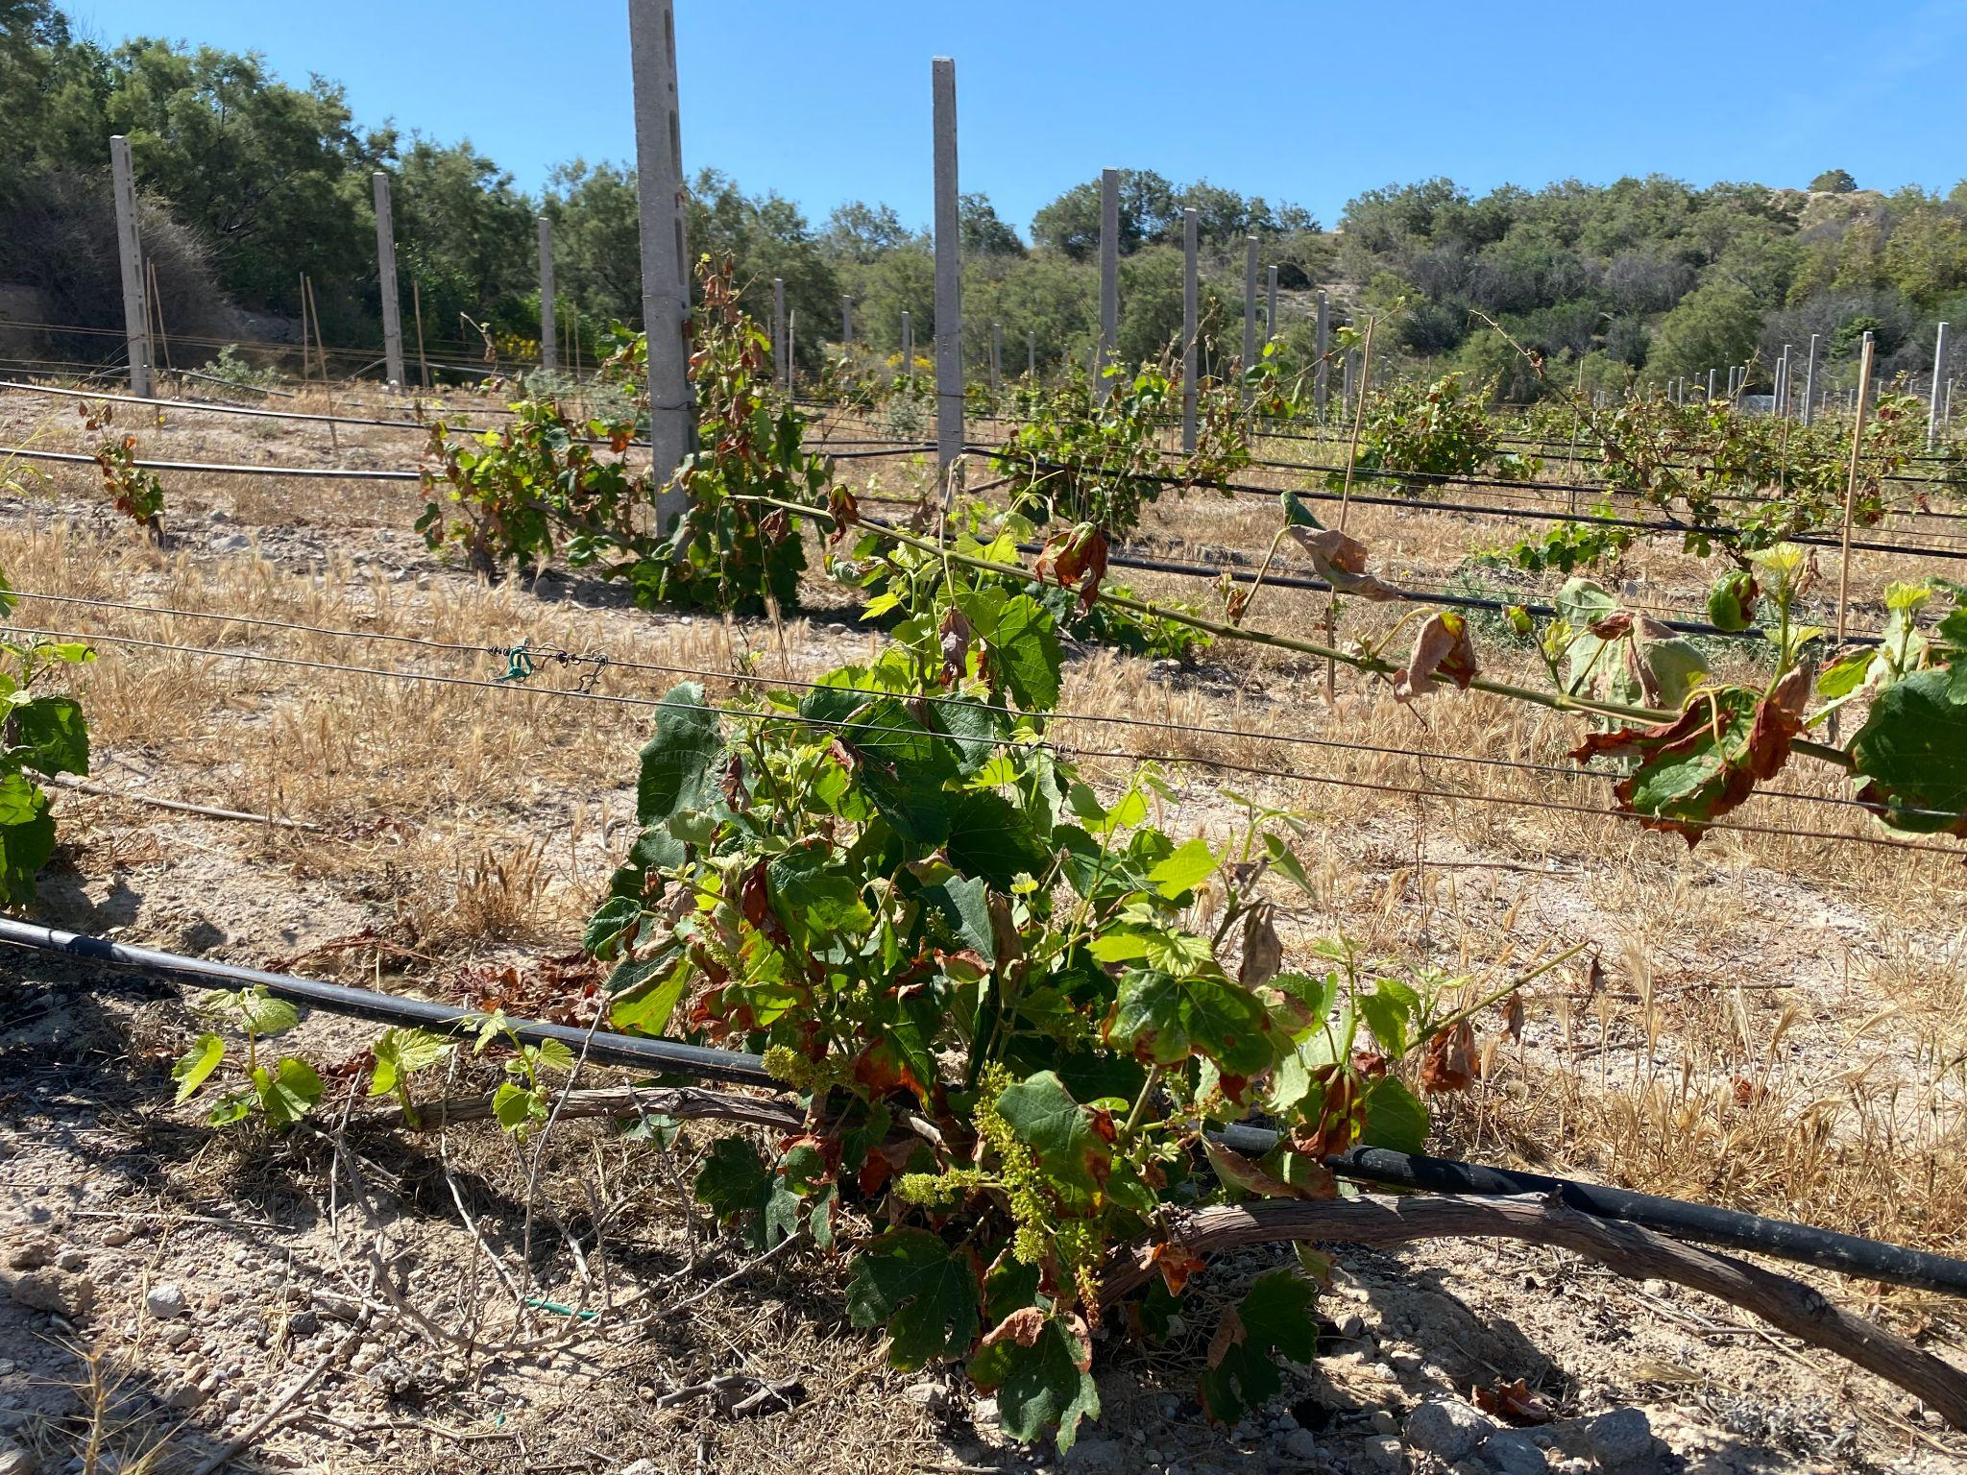
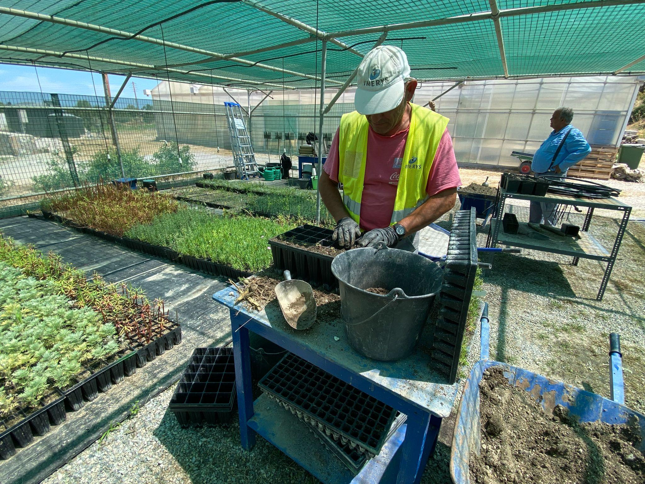
Social license to Operate

Slide 10
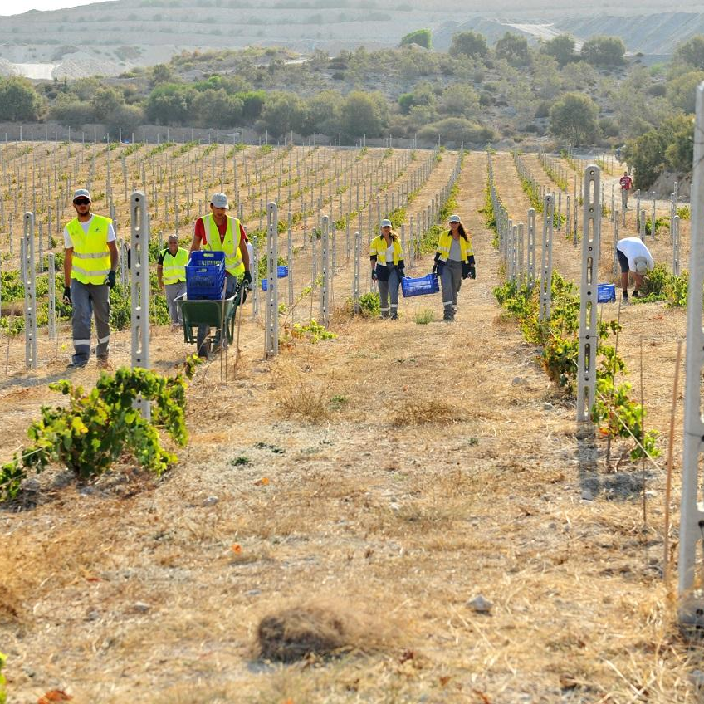

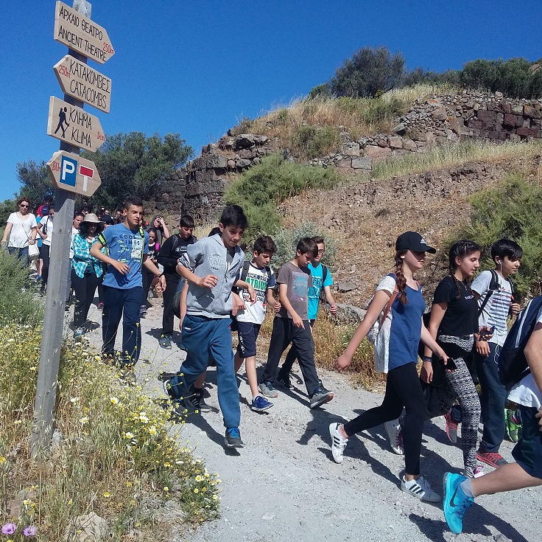


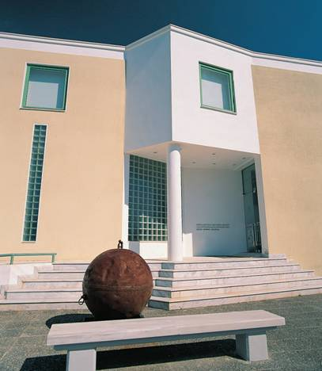
Milos: A balanced development paradigm
Operating model in Milos relies on the long-term co-existence of
mineral & tourism businesses
Innovative post mining land use: Vineyard development
Biodiversity:
Local species
re-introduction
Support
to tourism: Guided treks
Milos Mining Museum
Notes:
Talking Points:
- SustainAgility is focused on empowering our people, caring for our planet, and building our sustainable future.
- SustainAgility builds on our existing systems and initiatives and will help us to go beyond compliance towards a program fully aligned with the United Nations' Global Compact and Sustainable Development Goals (SDGs).
- We have a clear ambition – to put sustainable development at the heart of our overall strategy and mobilize employees at every level to achieve our CSR targets. One way we do this is through our annual SD Challenge.

Slide 11
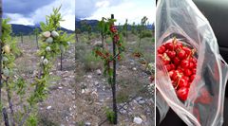
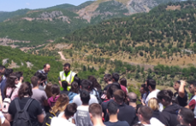
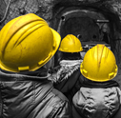
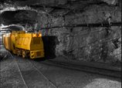
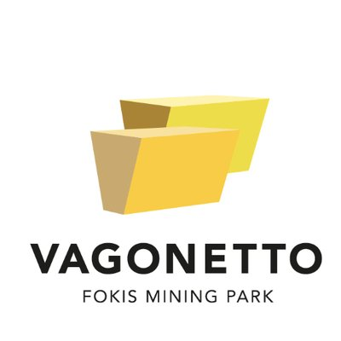
Bauxite: An innovative approach in Social Contribution
Biodiversity:
Fruit Tree Garden in an old depleted mine
Connecting with Academia:
Students from all over the world visiting our mines and learn for the mining activity and rehabilitation techniques
1.000 fruit trees planted in a rehabilitation area of 800 sq.m using modern and continuous improving methods
Attract Tourism
Creating shared value with tourism: Vagonetto Mining Park
A unique thematic park, where visitors can follow the lives of miners and
visit a real underground gallery

Slide 12
Why sustainability matters?

Slide 13


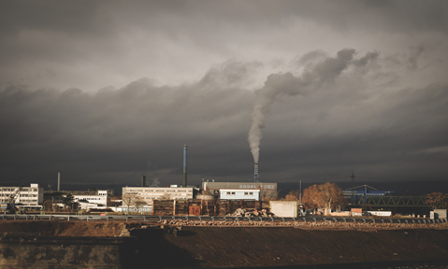
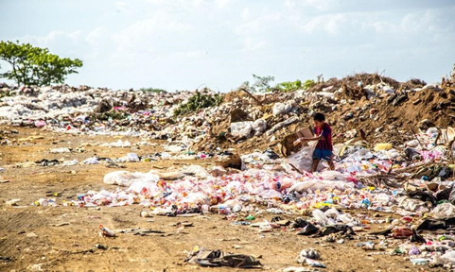
Population
has reached
8.0 billion
Child labor
still exists
CO2 emissions
are still rising
Waste
is piling up

Slide 14
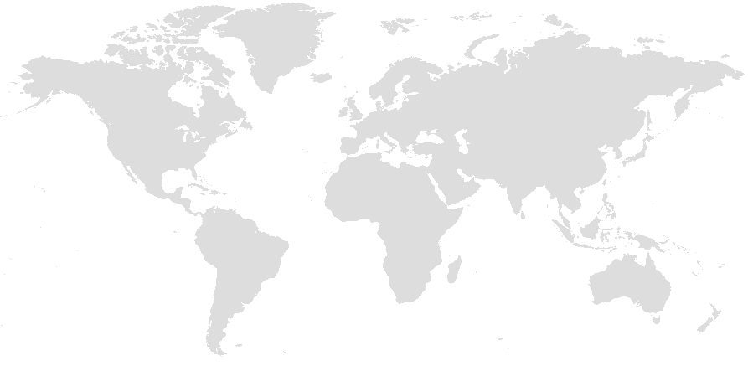
Worldwide Regulations Related to Supply Chain Due Diligence
European Union:
GDPR (2018)
Conflict Minerals Regulation (2021)
Non-Financial Reporting Directive (2018)
Timber Regulation (2013)
Mandatory corporate human rights and environmental due diligence
Canada:
Transparency In Supply Chains Act
Netherlands:
Child labour law (2020)
Norway:
Transparency Act (2021)
USA:
Dodd Frank Act - Section 1502 (conflict minerals)
Foreign Corrupt Practices Act (1977)
Federal Acquisition Regulation (1947)
Trade Enforcement Act (2015)
Uyghur Forced Labor Prevention Act
UK:
Modern Slavery Act (2015)
UK Bribery Act
Germany:
Human Rights due diligence law “Supply Chain Act” (2021)
Japan:
The Act on Promoting Green Procurement (2001)
The Clean Wood Act
France:
Duty of care (2017)
Sapin II (2017)
California:
Transparency in Supply Chains Act (2010)
California Consumer Privacy Act (2018)
China:
Chinese Guidelines for Mineral Supply Chains (2015)
Restricted Use of Hazardous Substances (2019)
Belgium
Duty of care
Austria
Supply Chain Legislation
Switzerland:
Responsible Business Initiative (counter proposal)
Australia:
Australia Modern Slavery Act (2018)
New South Wales Modern Slavery Act
Adopted regulations
Expected regulations

Slide 15
Our Sustainability Commitments

Slide 16


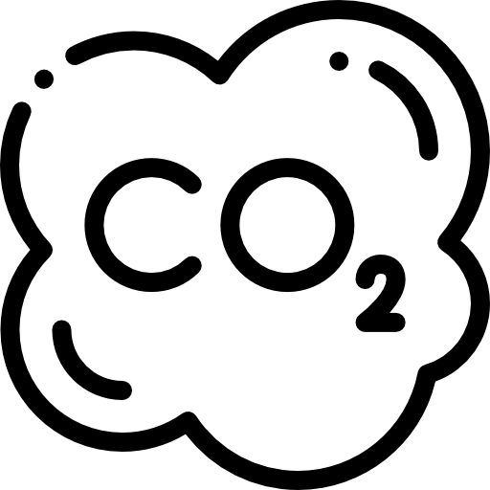



We act as a responsible company …
We are embedding responsible
and
sustainable thinking
in everything that we do.
OUR MAIN ACHIEVEMENTS END OF 2022
69
Gold EcoVadis rating
In 2022¹
55%
of our product portfolio in revenue is assessed according to sustainability criteria²
-31%
GreenHouse Gas emission relative to revenue (tCO2eq/M€)
compared to 2018 baseline
75%
of our new product developments are scored as SustainAgility Solutions²
53%
Group suppliers (by spend) are covered by an EcoVadis rating scheme
93%
of our mines and quarries have defined a biodiversity action plan
¹ Mining industry average of 43
² Visit our website imerys.com to learn more
Notes:
Talking Points
-> EcoVadis is the global most recognized rating platform to assess corporate social responsibility and sustainable procurement.
¹ The Group portfolio is assessed using the SustainAgility Solutions Assessment methodology, which is based on the World Business Council for Sustainable Development’s Portfolio Sustainability Assessment framework
² Based on the SustainAgility Solutions Assessment framework a “SustainAgility Solution” is a product in an application that has scored within the two highest categories of the four possible categories.
-> Greenhouse Gas includes CO2. Scopes 1 (the emissions generated directly by Imerys activities) and 2 (the emissions generated by the energy we use for our activities). Our Climate Change strategy is aligned on the SBTi (the global reference for defining, promoting and certifying the best practices in emissions reductions and net-zero targets in line with climate science). We have been rated B for our Climate Change performance by the CDP, a tier global environmental impact non-profit organization, providing a platform for all companies and cities to report information on their climate impacts.

Slide 17
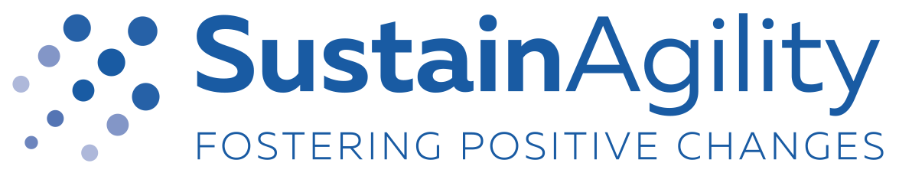

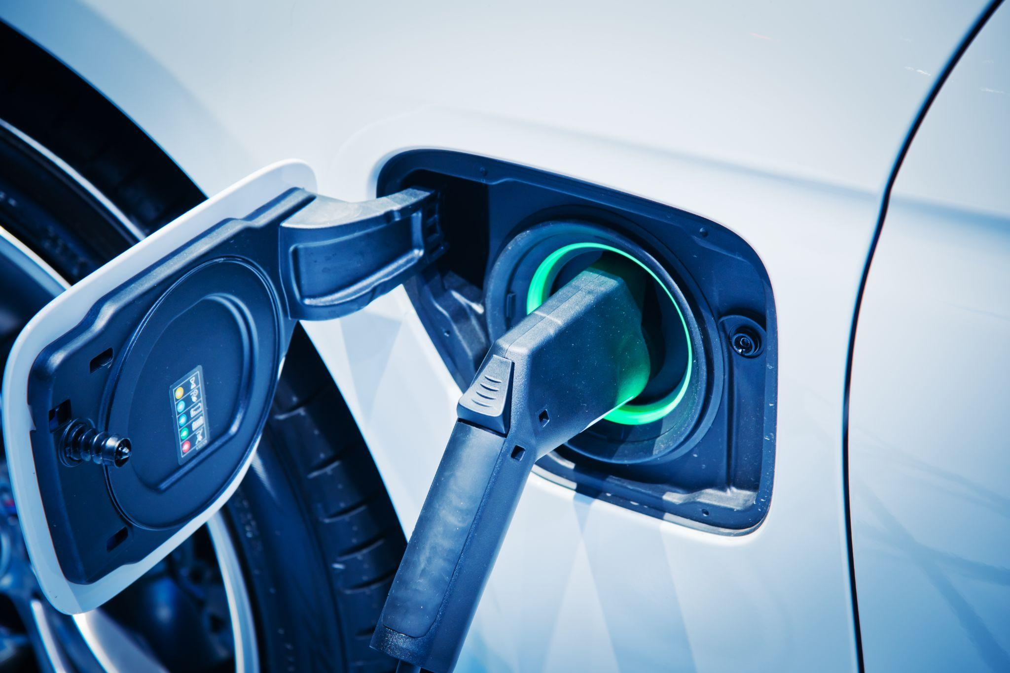

… following a robust sustainability program
Growing with
our Customers
Making sure employees stay healthy and safe, safeguarding human rights and labor practices, nurturing talent, promoting diversity, equity and inclusion and engaging with local communities.
Behaving ethically, operating fairly, ensuring responsible purchasing, and advancing sustainable products and processes.
Protecting the environment, promoting natural resources efficiency, respecting biodiversity and acting on climate change.
Empowering
our People
Caring for
our Planet
In 2018, Imerys launched its sustainability program named SustainAgility, with in 3 main axes.
SustainAgility aims to further embed sustainability within Imerys’ long-term strategy and the whole value chain.
Notes:
Talking Points:
-> Since January 2023, Equity is now included in the index
-> We will assess the sustainability of 75% of our supplier by spent
-> the 4 new objectives are:
Reduce environmental impacts by assessing the maturity level of sites against environmental management requirements
Improve water management by ensuring major sites⁽⁶⁾ comply with new water reporting requirements
Improve mineral resources efficiency by ensuring priority sites (by mineral waste volume) comply with new mineral wastes reporting requirements
Reduce impact on biodiversity by filling our Act4nature commitments and conducting biodiversity audits on the priority sites

Slide 18
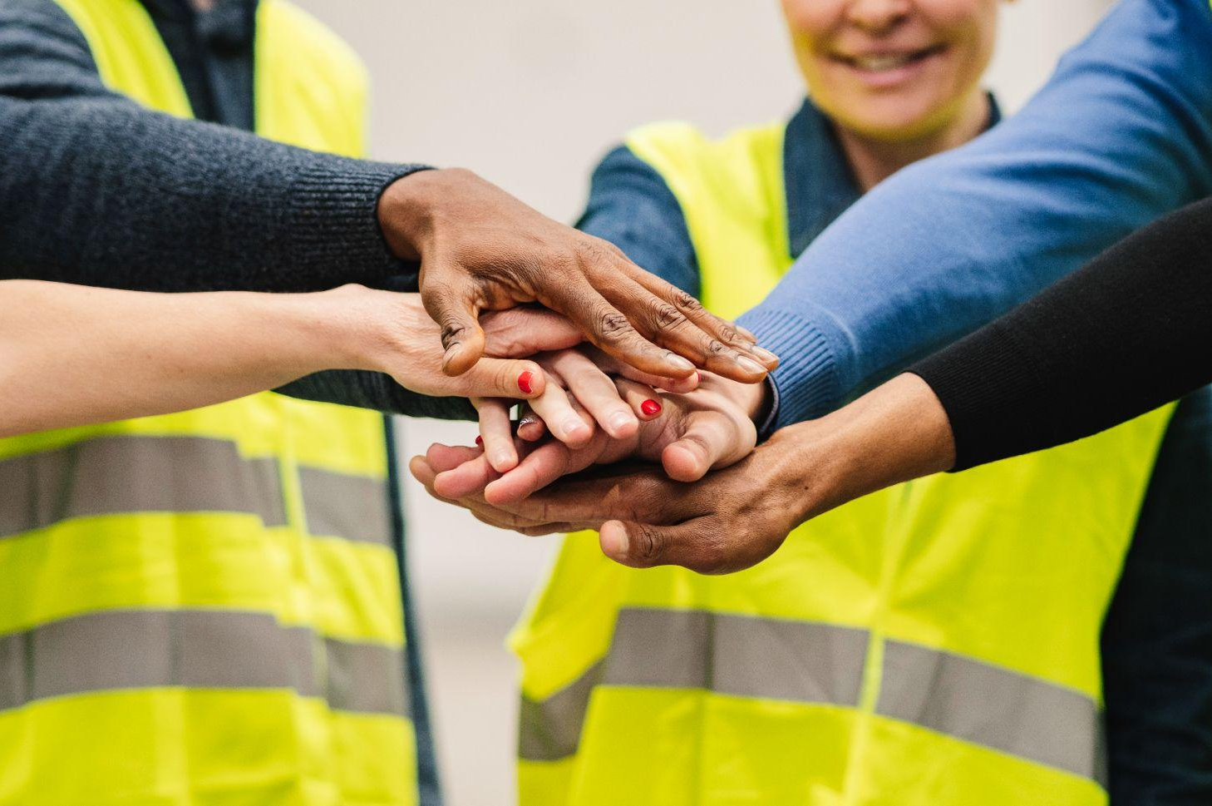
…. And raising our sustainable ambitions for 2025
Empowering our People
by reinforcing the maturity of our core values
Growing with our Customers
by ensuring ethical business and accelerating the development of sustainable solutions
Caring for our Planet
by strengthening our commitments to preserve the environment
We are introducing a new
Diversity, Equity and Inclusion (DE&I) index¹ with the objective to achieve it at 100% by 2025.
We will assess 75% of our product portfolio (by revenue) against sustainability criteria by 2025.
We will rate the sustainability practices of 75% of our suppliers.
We will reduce the Group’s GHG emissions by 42%² by 2030, aligning on the 1.5°C trajectory.
Engage our suppliers to have climate change reduction targets
² From 2021 base year
¹ For more information, go to Imerys.com
Notes:
Talking Points:
-> Since January 2023, Equity is now included in the index
-> We will assess the sustainability of 75% of our supplier by spent
-> the 4 new objectives are:
Reduce environmental impacts by assessing the maturity level of sites against environmental management requirements
Improve water management by ensuring major sites⁽⁶⁾ comply with new water reporting requirements
Improve mineral resources efficiency by ensuring priority sites (by mineral waste volume) comply with new mineral wastes reporting requirements
Reduce impact on biodiversity by filling our Act4nature commitments and conducting biodiversity audits on the priority sites

Slide 19
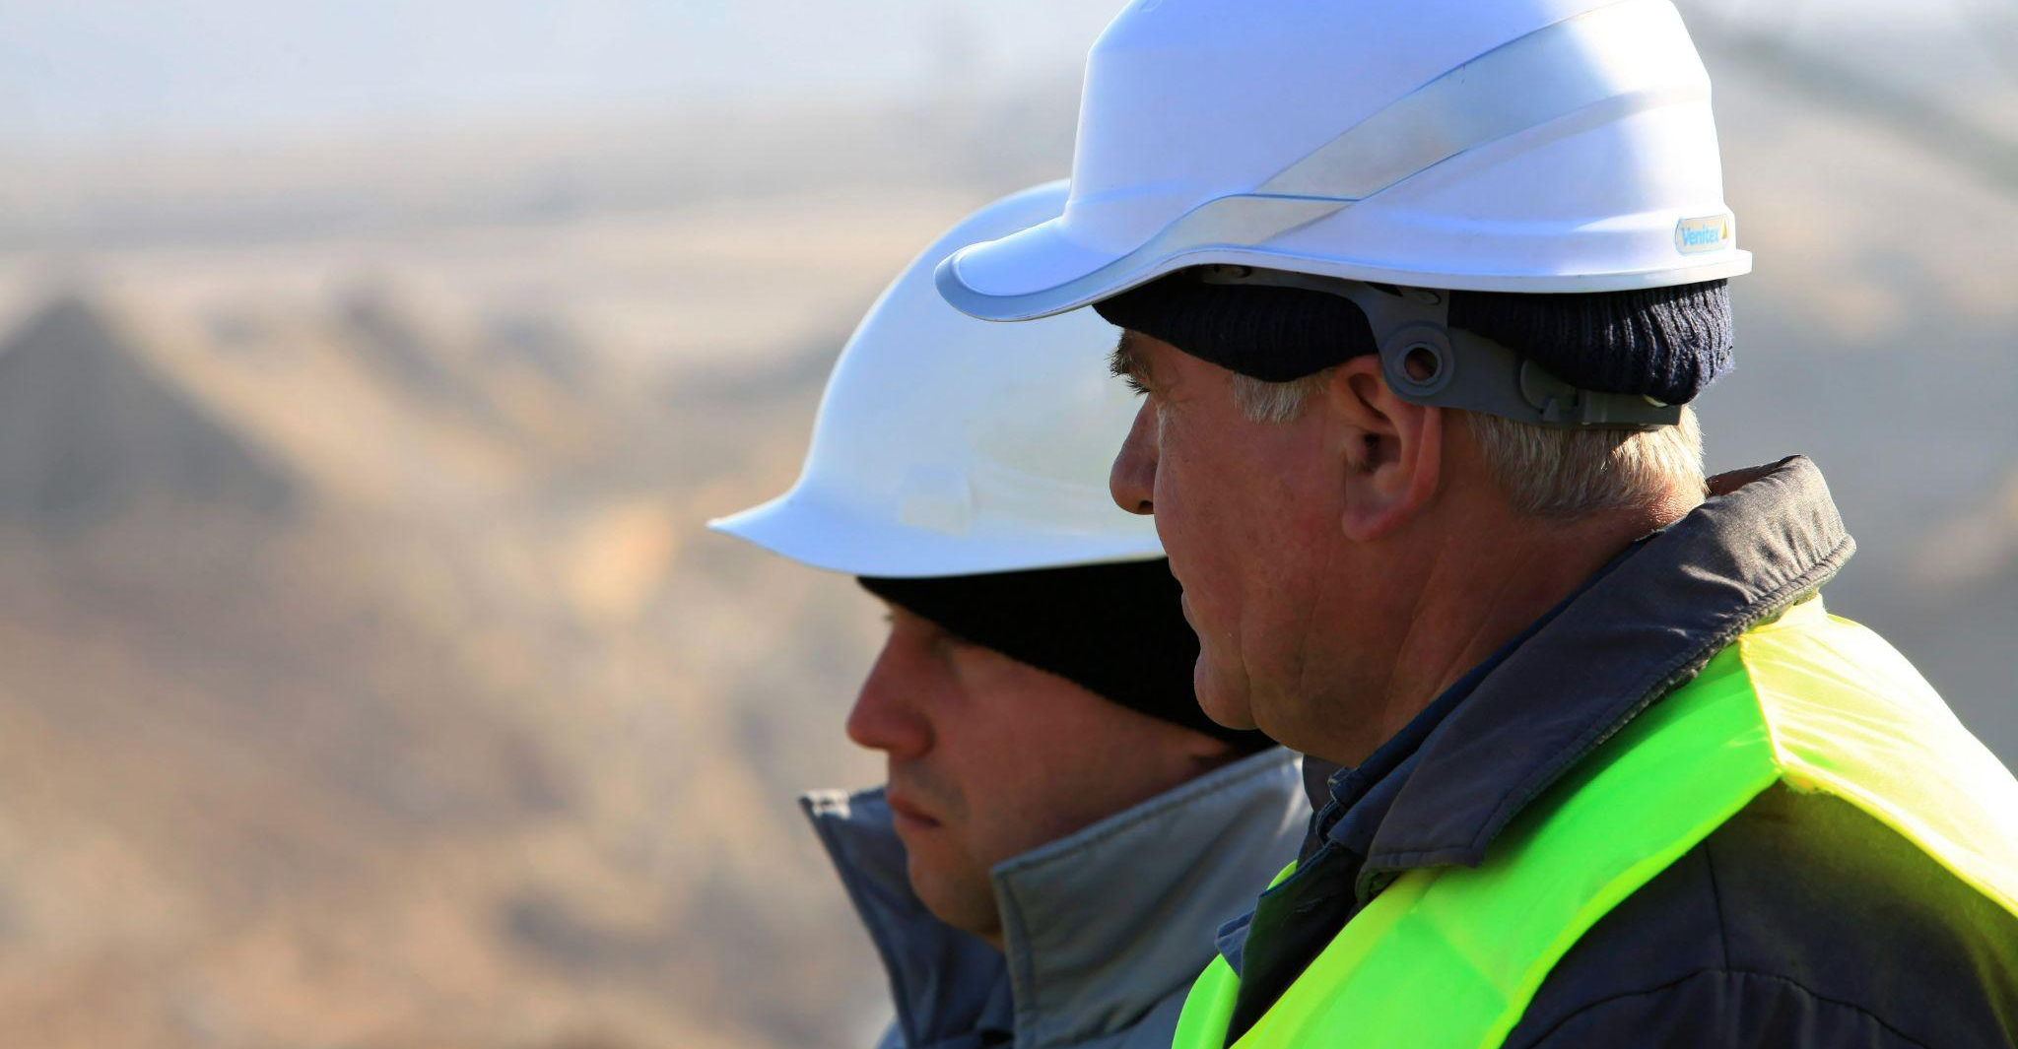
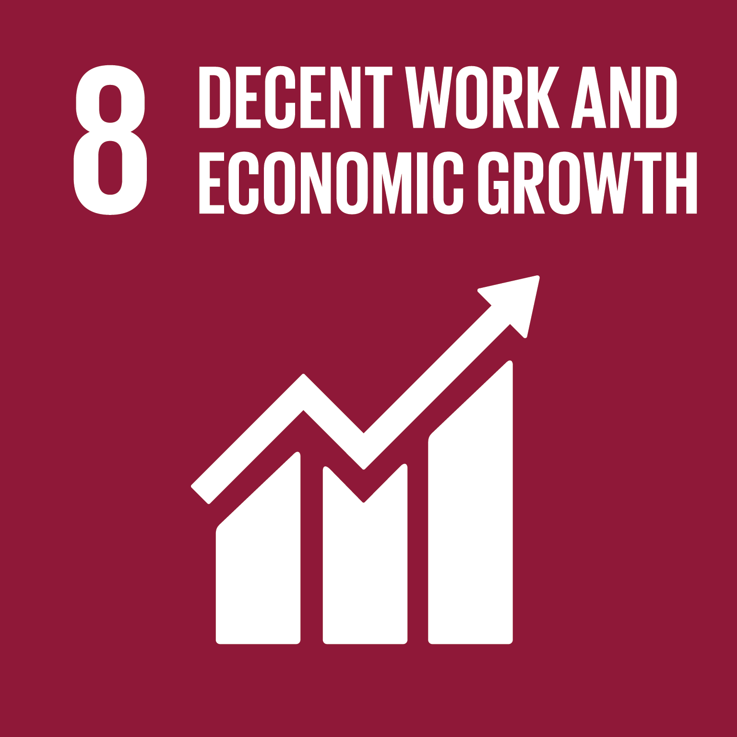
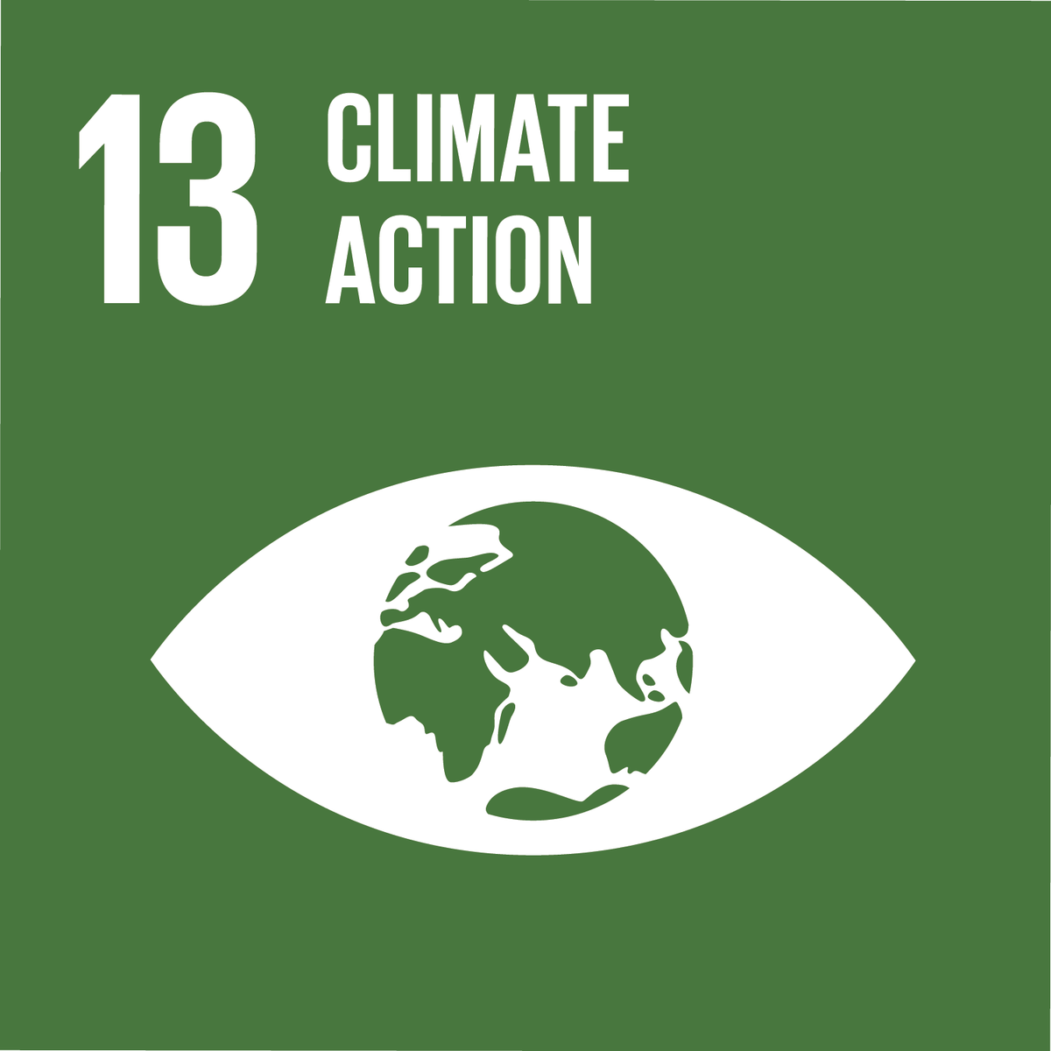

Responsible Purchasing
We want to be a force of change to help tackling the largest issues the world is facing.
We believe in working hand in hand with our partners along the value chain to make this happen.

Slide 20
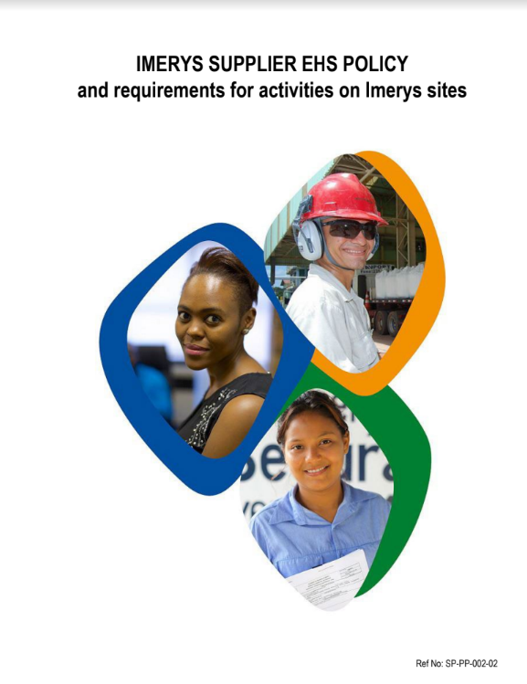
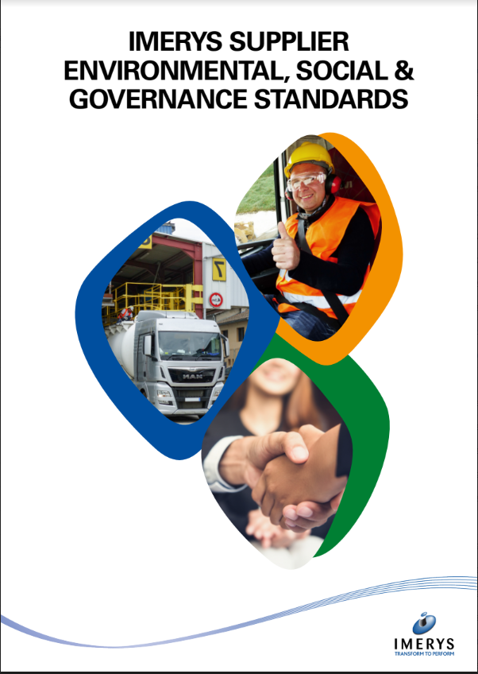
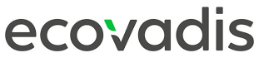
Partnering with Imerys starts with sharing common values and standards
Working with Imerys implies that our suppliers:
Comply and sign our Health & Safety policy and our Supplier ESG Standards
Join EcoVadis assessment program
Help us to understand your CO2 reduction journey

Slide 21

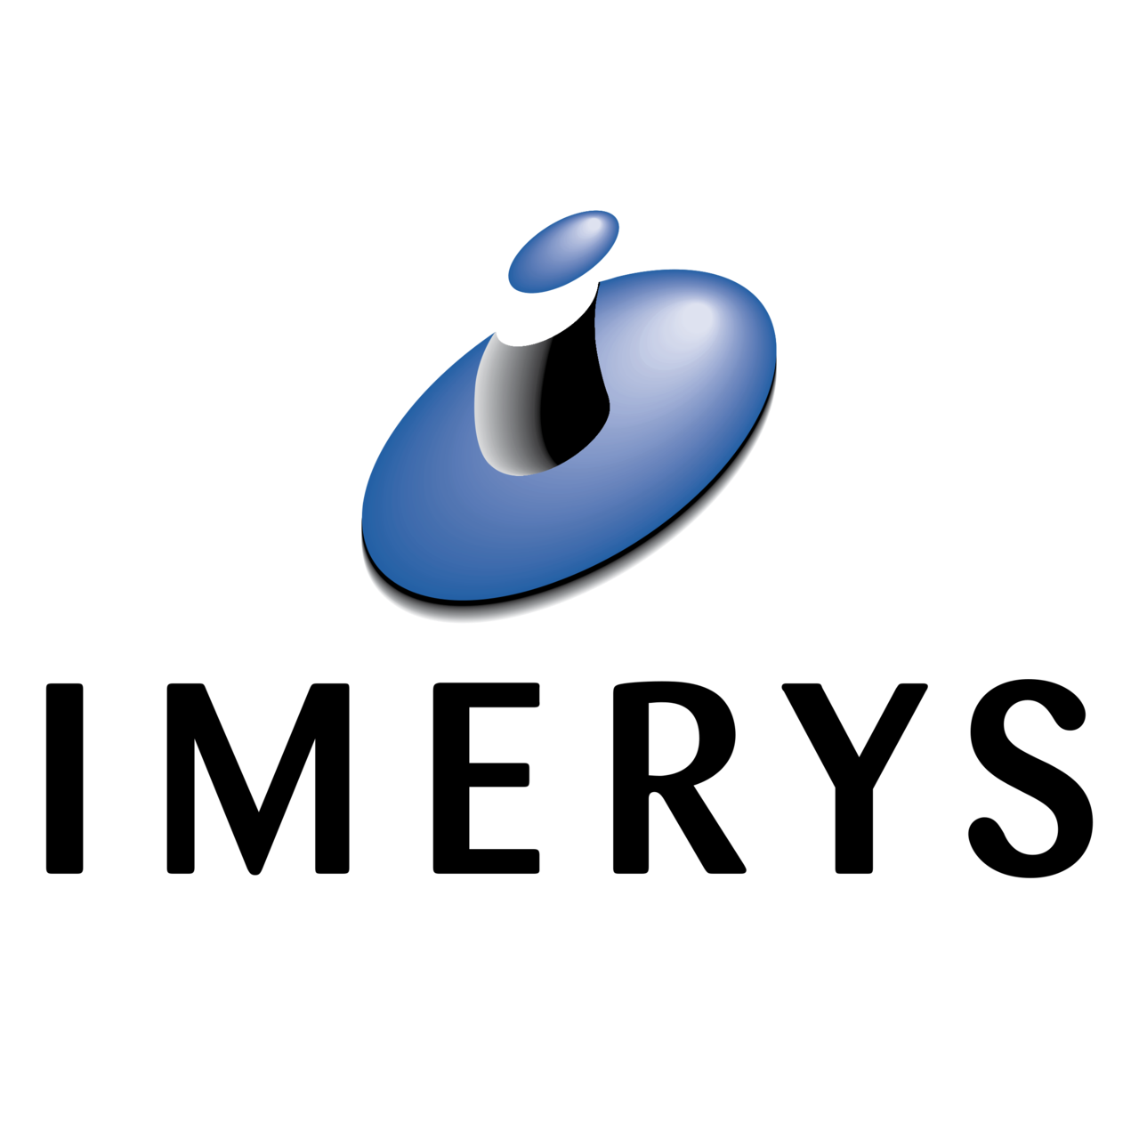
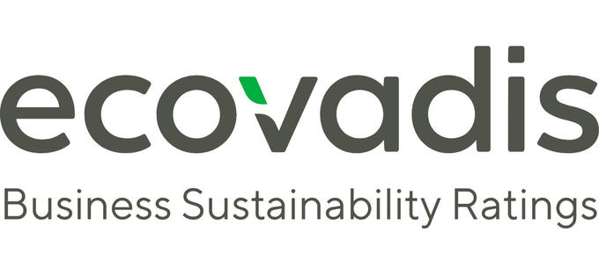
A more responsible supply chain
Imerys is committed to acting as a responsible corporate citizen worldwide, with the aim to fully align with international standards. One of our main Group targets is to mitigate the risks in the supply chain.
Imerys and EcoVadis are partnering to assess the sustainability of Imerys global value chain.

Slide 22






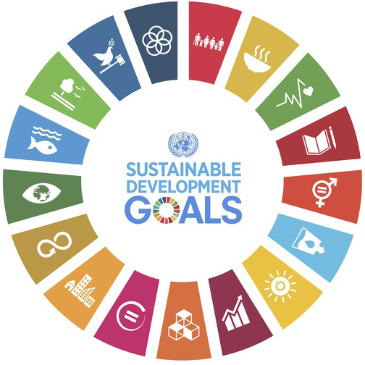


Focused on sustainability priorities and is aligned to global standards
21 Sustainability Criteria Covered in Four Theme Areas
Environment
Labor & Human Rights
Ethics
Sustainable Procurement
Energy Consumption & GHGs
Water
Biodiversity
Air Pollution
Materials, Chemicals, & Waste
Product Use
Product End-of-Life
Customer Health & Safety
Environmental Services & Advocacy
Employee Health & Safety
Working Conditions
Social Dialogue
Career Management
& Training
Child Labor, Forced Labor & Human Trafficking
Diversity, Equity & Inclusion
External Stakeholder Human Rights
Corruption
Anticompetitive Practices
Responsible Information
Management
Supplier Environmental Practices
Supplier Social Practices
Notes:
The EcoVadis methodology is at the heart of our Ratings and Scorecards.
Customized by size, location, and industry/materiality
Updated according to evolving regulations, best practices, and innovations
External Updates & Validation through 360 Watch (100k + Sources)
Supplier questionnaires customized by size, location, and industry/materiality
Data validated by 200+ Sustainability analysts
15 Years of Experience
Data is evidence-based and verified
Mapped to global standards
Updated according to evolving regulations, best practices, and innovations

Slide 23




Supplier assessment is a simple process…
REGISTER ONLINE
Create a company profile*
A profile used to customize questionnaire to your industry, size, and location
QUESTIONNAIRE
Answer assessment and upload documents**
A secure & multilingual questionnaire with a support team ready to help
EXPERT ANALYSIS
EcoVadis distills answers into an easy-to-read Scorecard
An independent document audit & analysis from sustainability experts
RESULTS
Online access to scorecard results & Corrective Action Plan
Share results and start improving performance
5-10 days
6 weeks
6-8 weeks
Valid for 1 year

Slide 24
Climate Change & CO2 Commitment

Slide 25
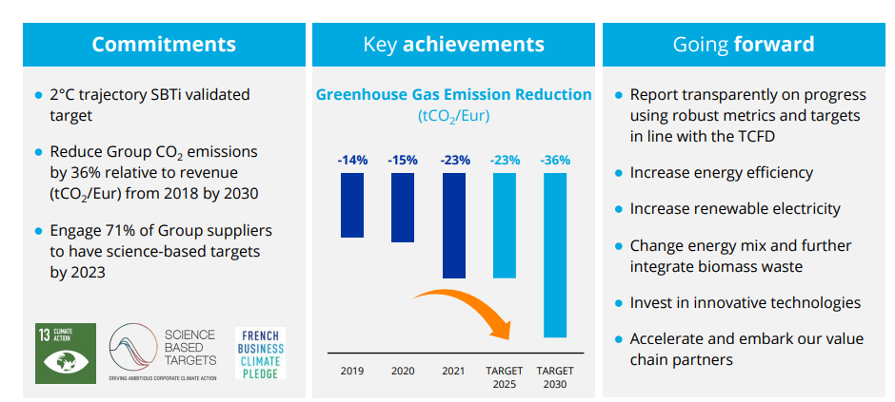
We already reduced by more than 30% our CO2 emissions in our operations
Figures at end of October 2022

Slide 26
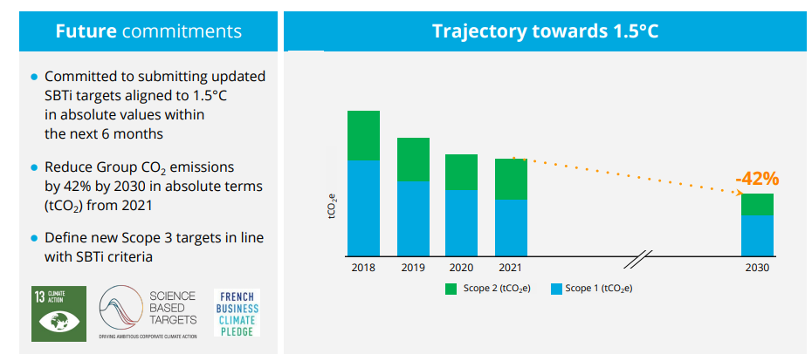
A new 2030 climate change target aligned with the 1.5°C trajectory

Slide 27

The CO2 emissions you generate counts in ours
2/3rd of the CO2 emissions that we report annually are indirect emissions. They are called Scope 3 emissions. They occur in our upstream and downstream value chain, meaning most of them are directly generated by our suppliers.
Understanding your commitment to reduce your carbon footprint is key to us.
What we would like to know:
Have you made a Commitment to reduce your CO2 emissions?
What Actions have you initiated to reduce your CO2 emissions?
Do you Report publicly to prove your commitment and demonstrate the result of your actions?

Slide 28



To learn more
Visit www.imerys.com
Or connect with us:
@imerys
www.linkedin.com/company/imerys/
www.facebook.com/imerysgroup/

