Slide 1



GOOD REPUTATION AS AN
ATTRACTIVENESS FACTOR
FOR YOUNG GENERATION
SHIPPING
PRESENTATION

Slide 2
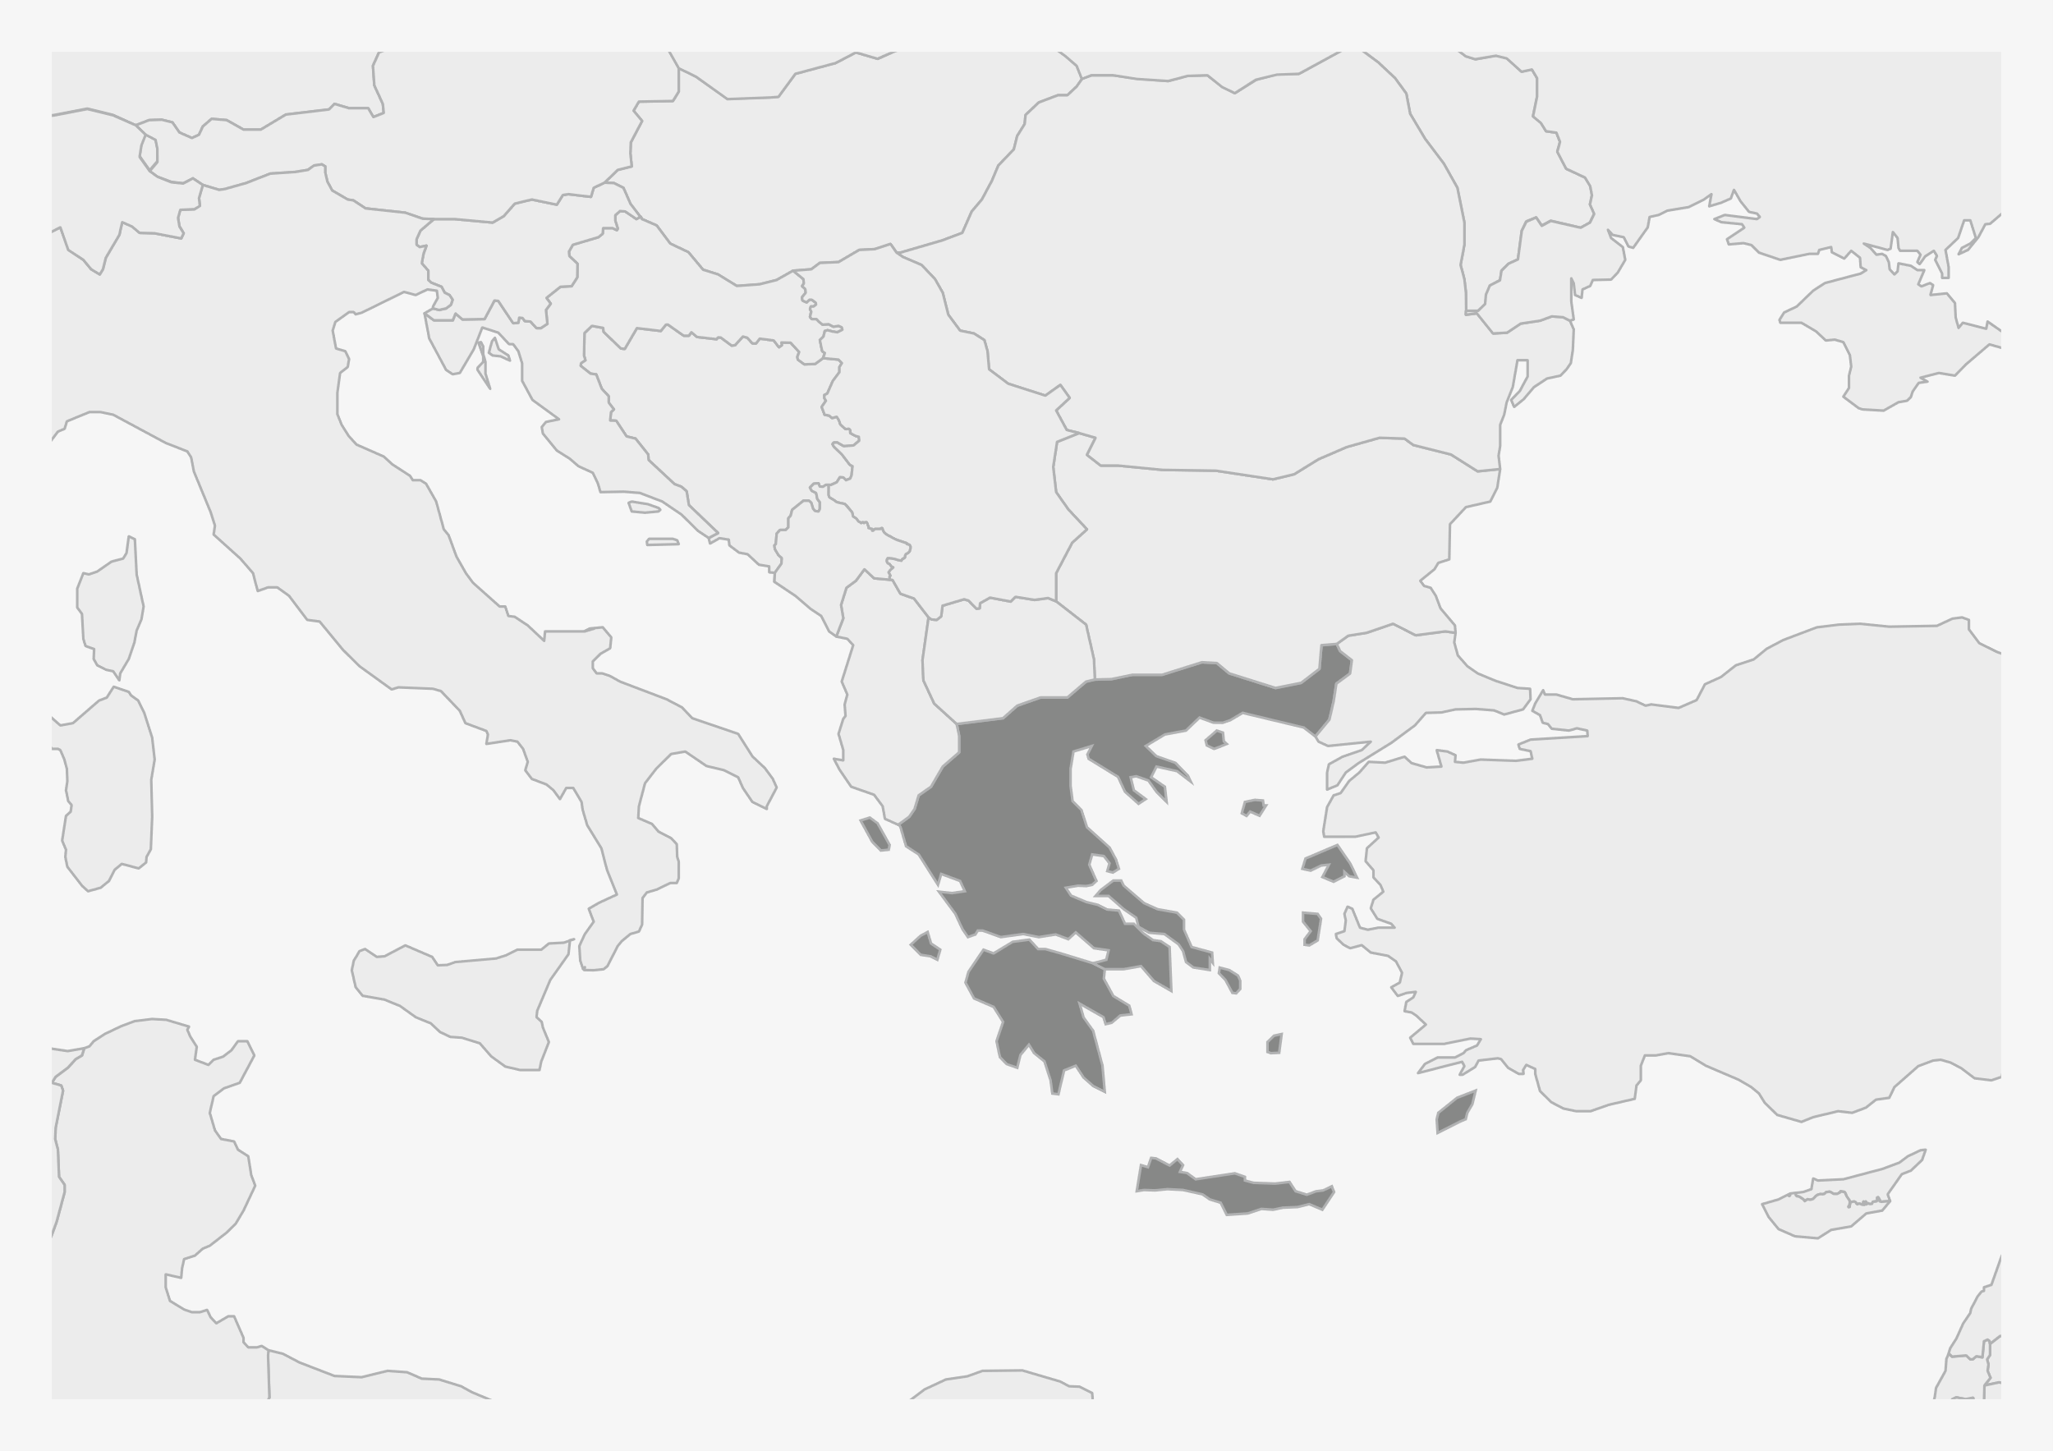


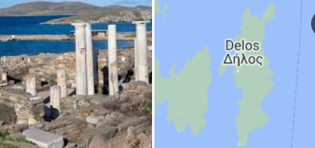



GREEK SHIPPING:
HISTORY OF 3.000 YEARS
SAILING THROUGH TIME – GREEKS’ HISTORICAL PREVALENCE
one of the smallest islands in the Aegean, (6.85 km2)
Delphi was the center of the world
became soon the maximum emporium totius orbis terrarium
Antikythera mechanism
NAVIGATION SYSTEM
Due to exceptionally favourable geographical location and the destruction in 146 BC of Corinth - hub of the transit trade between East and West, North and South.

Slide 3
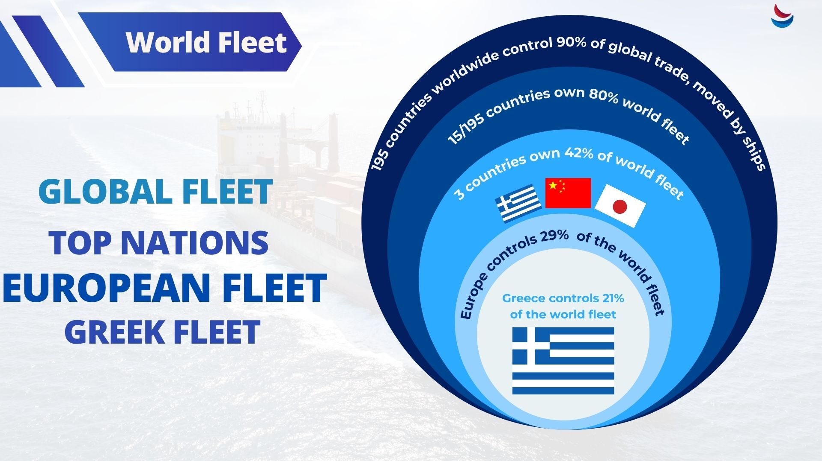

Slide 4
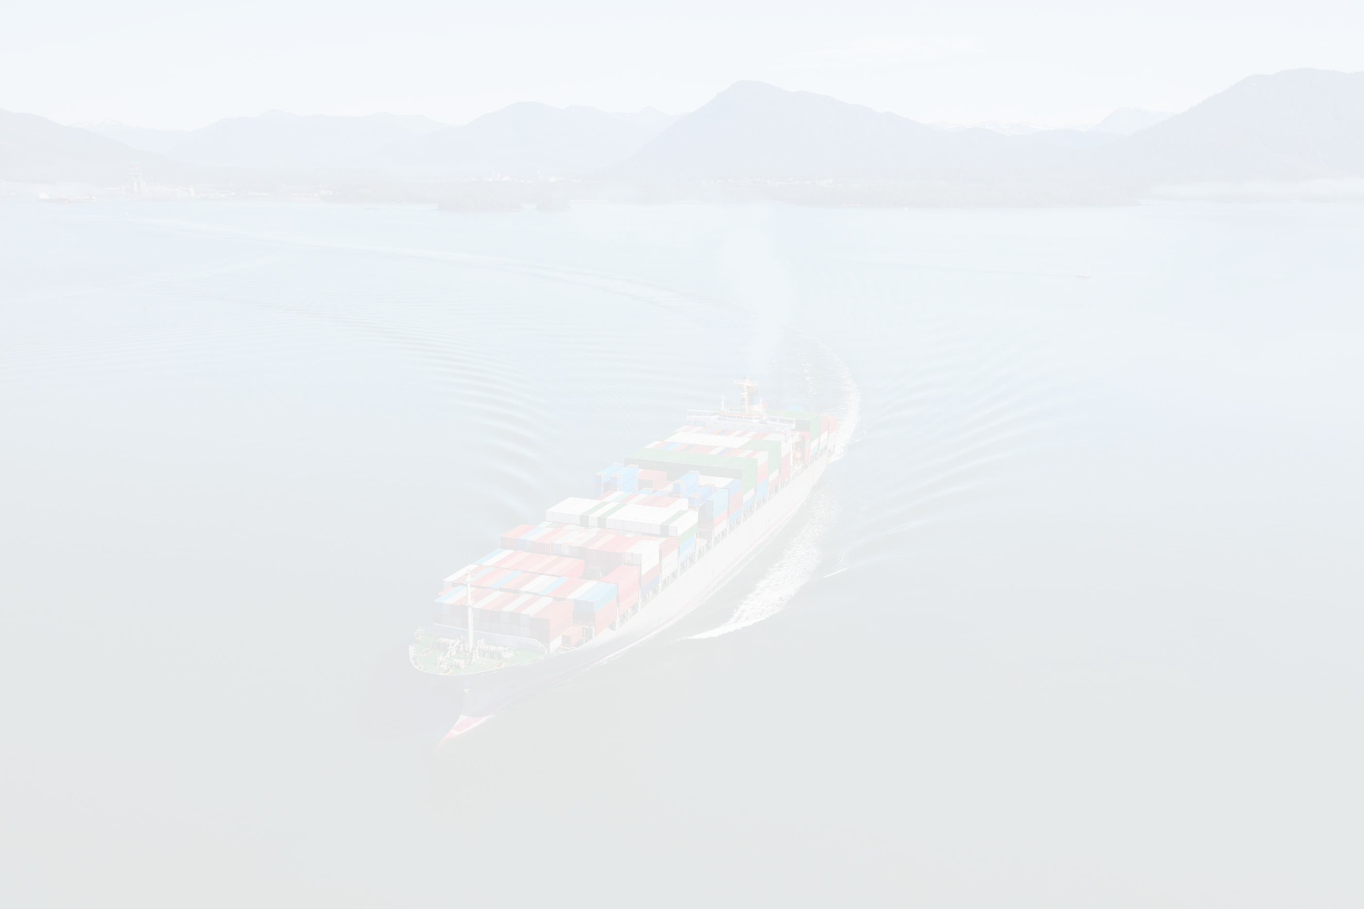
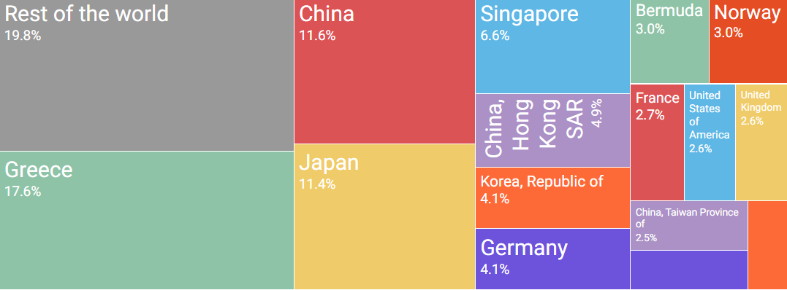
WORLD - EUROPE -GREECE
Share of world fleet in % owned by top 15 countries in 2021

Slide 5

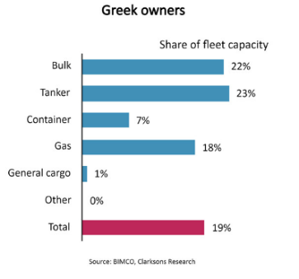
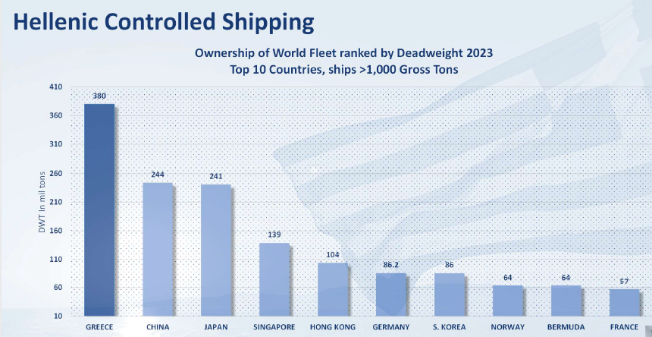





GREEK SHIPPING IS A CORNERSTONE OF GLOBAL SEABORNE TRADE
Greece, a country that makes up only 0.15% of the world's population
GREEK FLEET / GLOBAL FLEET
GREECE IS THE ONLY NON ASIAN COUNTRY IN THE TOP 5
21%
59%
45.8%
OF THE WORLD
FLEET IN DWT
OF THE EUROPEAN
FLEET IN DWT
INCREASE IN
TOTAL CAPACITY
FROM 2014
5,514 VESSELS OF
441 MIL DWT

Slide 6


Slide 7




Challenges Facing Greece & Europe
DEMOGRAPHIC
BRAIN DRAIN
SEA THE CHANGE
GREECE: No. 2 older country in Europe
500,000
young people
from 2002-2020
CRISIS
LOW BIRTH RATE
BE PART OF IT
MIGRATION
GLOBAL POPULATION
LACK OF SEAFARERS
NAVIGATE
THE CHANGE
Global population will reach
10 BN by end of 21st century.
Europe's population will decrease from 22% in 1950 to 7.3% by 2050.
Greece's population to decrease by 1.3 million (12%) by 2050.
1990: 150,000 seafarers
2023: 20,000 seafarers
The need to train
800,000 out of 2M
seamen in new
technologies by 2030.

Slide 8




MAIN ISSUES
REGULATIONS
New Regulations should encourage innovation while safeguarding the environment and maintaining high ethical standards.
Decarbonization:
how the new generation will be instrumental in implementing it.
we decide today for those who will implement tomorrow
SMART SHIPPING
We collect data, analyze them, and make decisions based on them.
We use technology to our advantage for change.
Need for better education and understanding of technology and its potential.
Emphasis on Artificial Intelligence (AI) and its numerous implications in shipping.
HUMAN ELEMENT
Companies and ships are becoming “smarter” . Need a different mindset, leadership and soft skills (+ out of the box thinking). Seafarers have to better understand what the office is requesting and we have to make sure that seafarers are capable and ready to manage the ship.
We can achieve to embrace safety culture by common values and by creating leaders with management skills. Although the technical skills are important, the soft skills will be crucial in the future.

Slide 9
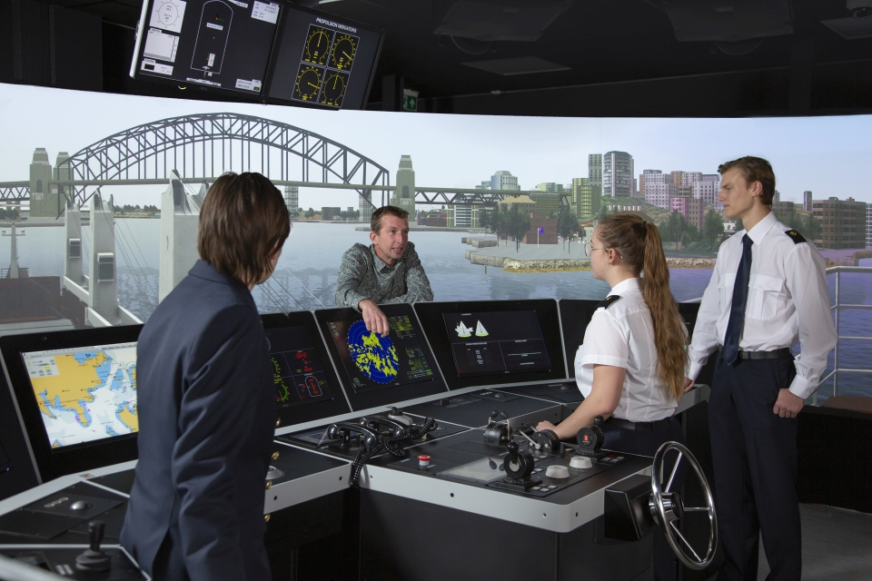
2024
YEAR OF MARITIME EDUCATION
MINISTRY OF MARITIME AFFAIRS & INSULAR POLICY

Slide 10


THE SIGNIFICANCE OF SEAFARERS AND THE NECESSITY TO INCREASE THEIR ENGAGEMENT
THE RELATIONSHIP WITH THE SEA AND FOSTERING A SENSE OF "SEAFARERENESS" (ΝΑΥΤΟΣΎΝΗ)
Prioritizing Seafarers
NAUTICAL EDUCATION AND ITS ROLE IN THE GREEN TRANSITION
Nautical Education
EXPLORING DILEMMAS AND EXPERIMENTS IN
THE INDUSTRY, ESPECIALLY CONCERNING CLIMATE CRISIS,
NEW FUELS, AI, GEOPOLITICAL
CHALLENGES, MIGRATION
Human element is irreplaceable: responsibility to foster an environment that not only attracts but also retains skilled seafarers
RAISE AWARENESS FROM SCHOOL

Slide 11
ATTRACTIVE FACTORS FOR
YOUNG PEOPLE IN SHIPPING
SEVERAL FACTORS CAN ATTRACT YOUNG PEOPLE TO PURSUE CAREERS IN THE SHIPPING INDUSTRY.
HERE ARE SOME ASPECTS THAT MAY BE PARTICULARLY APPEALING TO YOUNGER INDIVIDUALS:
DIVERSE CAREER
PATHS
GLOBAL
OPPORTUNITIES
TECHNOLOGICAL
ADVANCEMENTS
COMPETITIVE
SALARIES
ADVENTURE AND
CHALLENGES
ENVIRONMENTAL
SUSTAINABILITY
GLOBAL TRADE IMPACT = REPUTATION:
YOUNG PROFESSIONALS INTERESTED IN THE GLOBAL ECONOMY FIND THE SHIPPING INDUSTRY FASCINATING, AS IT PLAYS A CRUCIAL ROLE IN FACILITATING INTERNATIONAL TRADE. UNDERSTANDING THE IMPACT OF SHIPPING ON THE MOVEMENT OF GOODS AND ITS CONTRIBUTION TO THE GLOBAL ECONOMY CAN BE INTELLECTUALLY STIMULATING.

Slide 12
FACTOR: GOOD REPUTATION
A GOOD REPUTATION IS A CRUCIAL FACTOR IN ATTRACTING THE YOUNGER GENERATION TO A PARTICULAR INDUSTRY OR COMPANY. HERE'S HOW A POSITIVE REPUTATION CAN BE APPEALING TO YOUNG PROFESSIONALS:
ETHICAL AND
RESPONSIBLE PRACTICES
INNOVATION AND TECHNOLOGY
ATTRACTIVE
WORKPLACE CULTURE
RECOGNITION AND AWARDS
POSITIVE EMPLOYEE EXPERIENCES
CAREER DEVELOPMENT
OPPORTUNITIES
OVERALL, A GOOD REPUTATION IS A POWERFUL FACTOR IN ATTRACTING THE YOUNGER GENERATION. IT NOT ONLY HELPS IN RECRUITING TOP TALENT BUT ALSO CONTRIBUTES TO EMPLOYEE RETENTION AND CREATES A POSITIVE BRAND IMAGE THAT RESONATES WITH THE VALUES AND ASPIRATIONS OF THE YOUNGER WORKFORCE

Slide 13

The Road to Success:

Slide 14


Role of Media
Here are a few ways in which media can shape perceptions about shipping:
The role of tv & social media
in shaping public perception
Mentioning the negative portrayal of shipping in movies and countering it with positive initiatives.
the impact of documentaries
in promoting the positive aspects of shipping
Emphasizing the need for cooperation between the private and public sectors

Slide 15
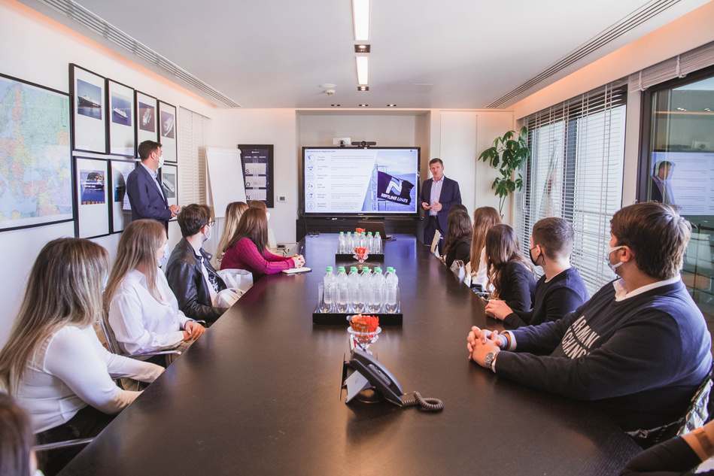
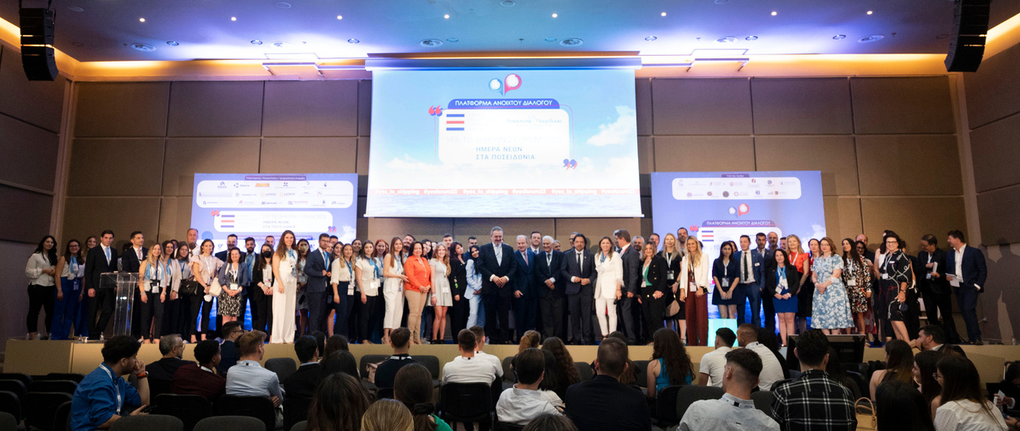
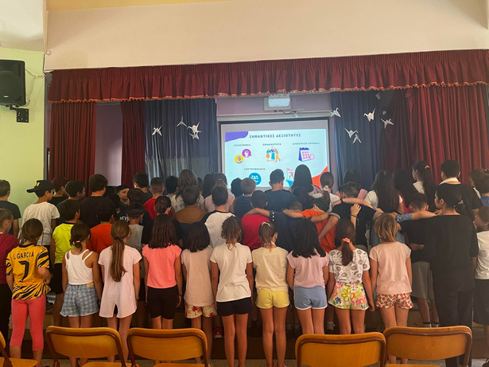











INITIATIVES
YES FORUM
PILLARS
OPEN DAYS
YES TO SHIPPING FORUM
YES TOUR TO SCHOOLS
*
7TH JUNE 2024
YES TOUR
TO SCHOOLS
PRESENTATIONS
STUDENTS
70
40
15
4.000
PUBLIC SCHOOLS
CITIES
*
With the official approval of the Ministry of Education and Religious Affairs

Slide 16
STEREOTYPES
THAT BECAME ADVANTAGES
WE RESPONDED TO REMOTE WORK..BECAUSE THIS WAS OUR DAILY DAY
AVAILABLE 24/7/365
"CLOSED”
BUSINESS CIRCLE
WE MANAGE 20% OF WORLD TRADE... BUT OUR DECISIONS CONCERN MANY
OUTDATED
WE ONLY USE PROVEN SYSTEMS

Slide 17
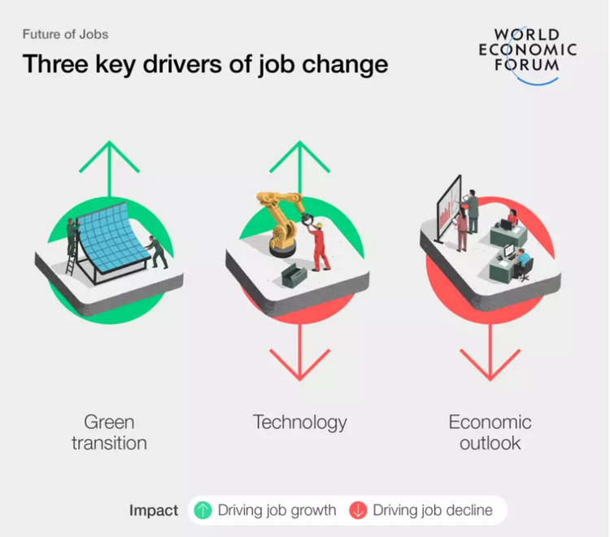
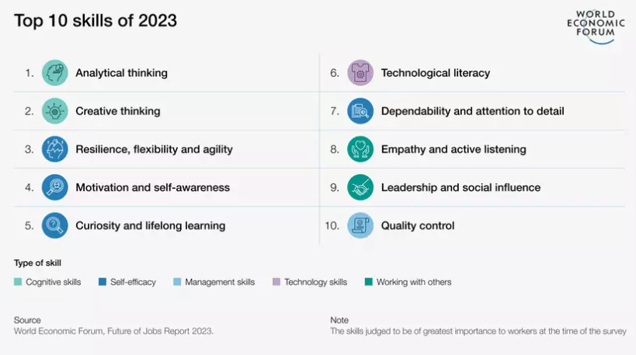
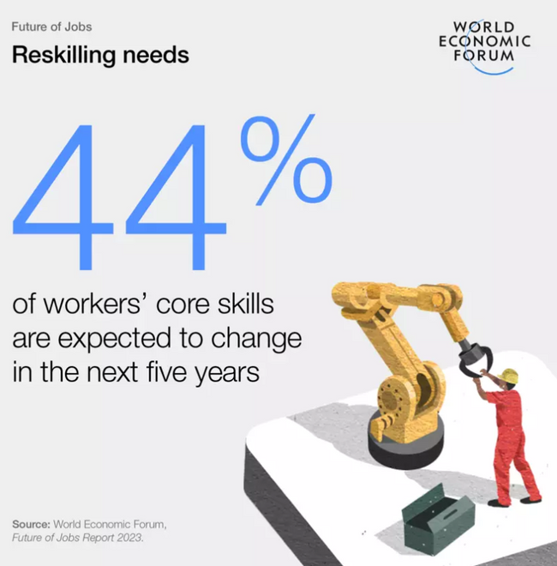
NUMBERS MATTER

Slide 18
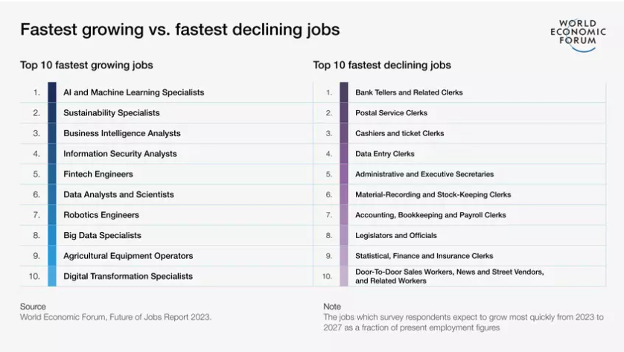
NUMBERS MATTER

Slide 19



SHIPPING
ATTRACTIVENESS
REPUTATION
INVESTING IN EDUCATION
CONCLUSION
VALUE OUR SEAFARERS
RESILIENSE
SAFETY
YOUNG GENERATION

Slide 20



NAVIGATOR SHIPPING CONSULTANTS
www.navigatorltd.gr

