Slide 1

CCIFJ COMMITTEES EVENTS
Supporting knowledge sharing
Sponsoring

Slide 2

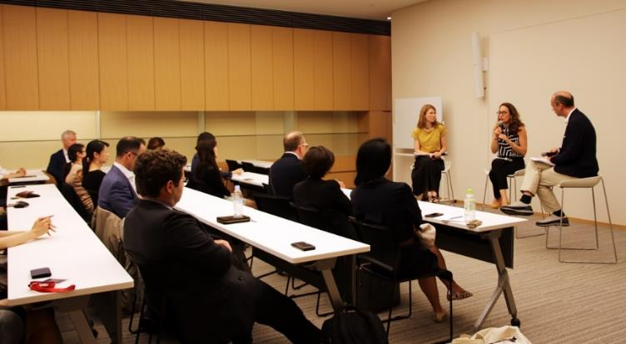



CCIFJ Committees
Galas & events
Brands Forum
Business development
Club Sport
Design Thinking
Entrepreneur
Hospitality
Human Resources
Information & New Technologies
Marketing & Distribution
Rules & Regulations
Sustainability
Women in Business
Young professionnals

Slide 3
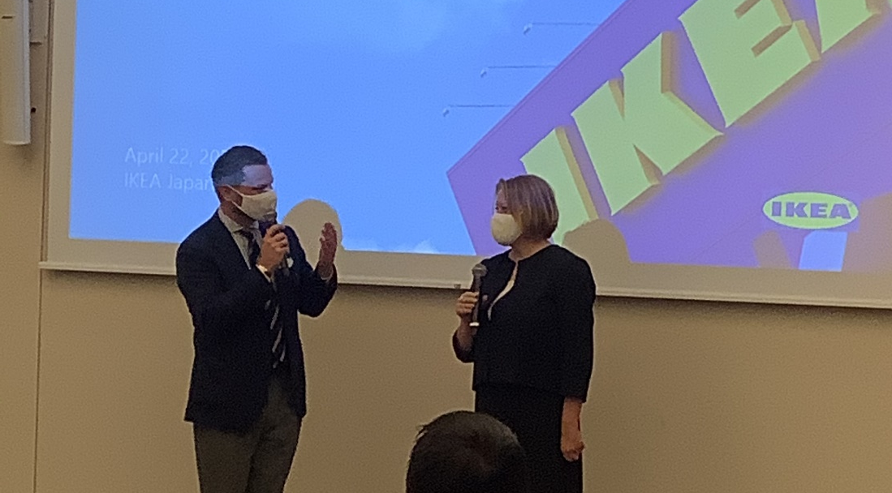
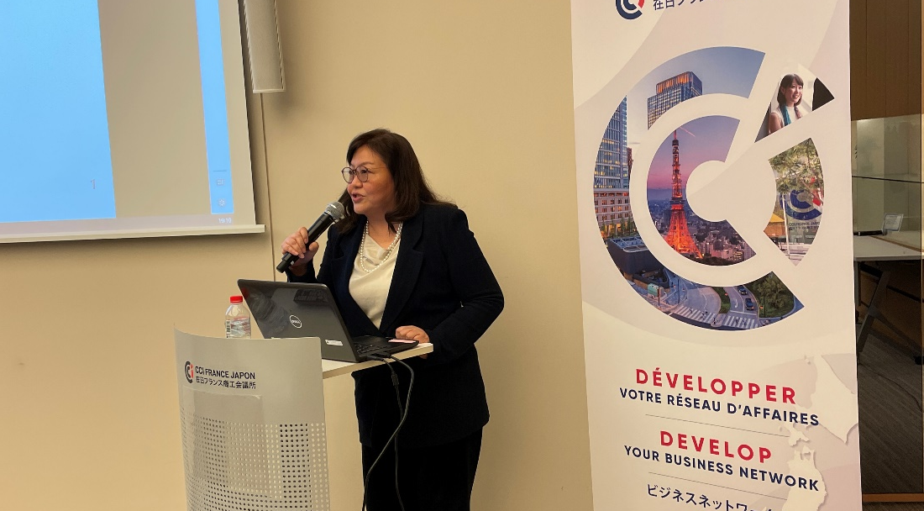
Business Development committee
Past events includes:
Our challenges to build the first truly global financial super app in Japan» by Yoko Makiguchi, CEO Revolut Technologies Japan
Developing a business in Japan, testimony from Helene von Reis, CEO of Ikea Japan.
How restaurants will change after COVID 19, pb Yukihiro Wada, Director, Country Head of Sales at Uber Eats Japan
Battles successes and scars – exploring the entrepreneurial process in Japan by Terrie Lloyd, founder and CEO of Japan Travel KK

Slide 4
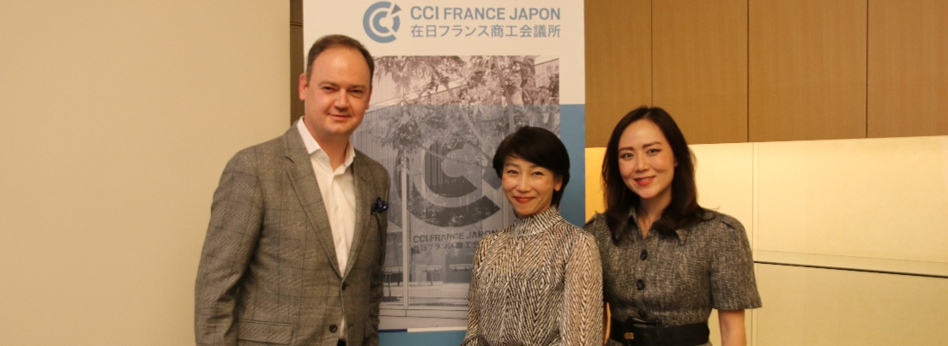
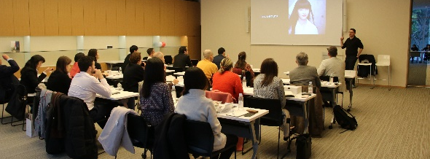
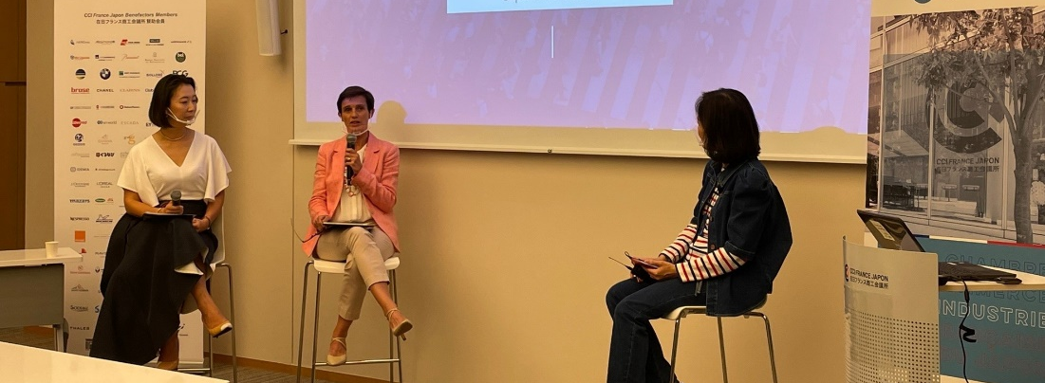
Sponsoring includes
3 free entrances by conference
Logo at the beginning of the presentation and with the invitations
Visibility on all communication support linked to the event as well as on the CCIFJ annual report
Sponsorship fees: 500’000 JPY / year

Slide 5


Visibility on CCIFJ website
Around 300’000 visitors/year - Displayed on the page of each event of the committee
Example:
Title of event
Banner
The event kindly sponsored by 〇〇〇〇〇〇
Logo

Slide 6


Visibility on the announcement
Sent to around 4’000 CCIFJ members
Example:
Title of event
Banner
The event kindly sponsored by 〇〇〇〇〇〇
Logo

Slide 7



Visibility on CCIFJ Social network
Facebook: ~14’000 subscribers
LinkedIn: ~5’000 subscribers

