Slide 1


General Secretariat for
Private Investments and PPPs

Slide 2

Contents
PPP (Public and Private Partnerships)
Investment incentives law L.4399/2016
Intra – group services establishment in Greece
Strategic investments procedures

Slide 3
PUBLIC & PRIVATE
PARTNERSHIPS

Slide 4


PPP Contracts
Major achievements
Institutional framework - Functional
Legal certainty: more than 60 favorable decisions of the Hellenic Council of State, contracts approval by the Court of Audit.
Institutional framework –Innovative
First time at EU level that PPP funding was a combination of EIB funds
and funds of JESSICA
“The first activation of a secondary market in a PPP project in Greece.”
According to Law
No. 4635/2019, all PPPs
will be
categorized as
“strategic projects”.
As a result, they will benefit from a fast-track and
centralized licensing process
and will be easier to implement.
“Greece was classified 3rd worldwide among 135 countries in the field of “Procurement of PPPs” according to the World Bank 2018
Procuring Infrastructure Public-Private Partnerships report.”
In a recent study for the REGI Committee of the European Parliament,
Greece is recognized to be leading in the blending of EU grants and
private capital financing of PPP schemes

Slide 5
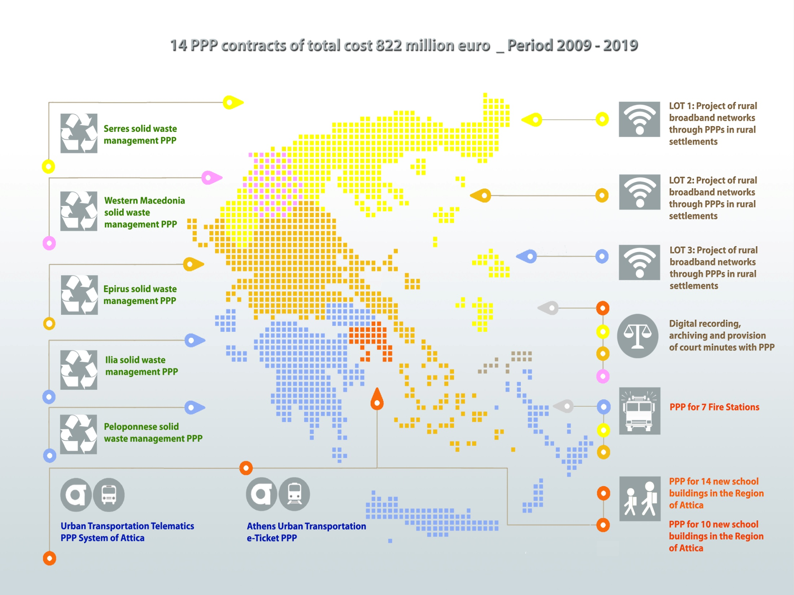
Signed PPP Contracts
14 PPP Contracts of total cost € 822 mil.– Period 2009-2019

Slide 6



PPP Contracts
International Awards
24 Schools PPP Project
“Education Deal of the Year 2014”
by the magazine World Finance
W. Macedonia Waste Management PPP Project
“Waste Deal of the Year 2014”
by the magazine World Finance &
“Waste Partnership” Award
by Waste & Recycling Awards 2017
Serres Waste Management PPP project shortlisted as one of the 6 best international project in the category
“Best Utilities Project in 2019” in Europe, Africa, Middle East for the
“Partnerships Awards”
Epirus Waste Management PPP project was awarded as the best infrastructure project for the year 2018 at the 3rd Infrastructure and Transport Conference.
Broadband Network Development in White Rural Areas PPP Project
“European Broadband Award 2017” in the Category “Territorial cohesion in rural and remote areas”
by the European Commission
“Digital Opportunity Award 2018”
at the WITSA Worldwide Conference

Slide 7
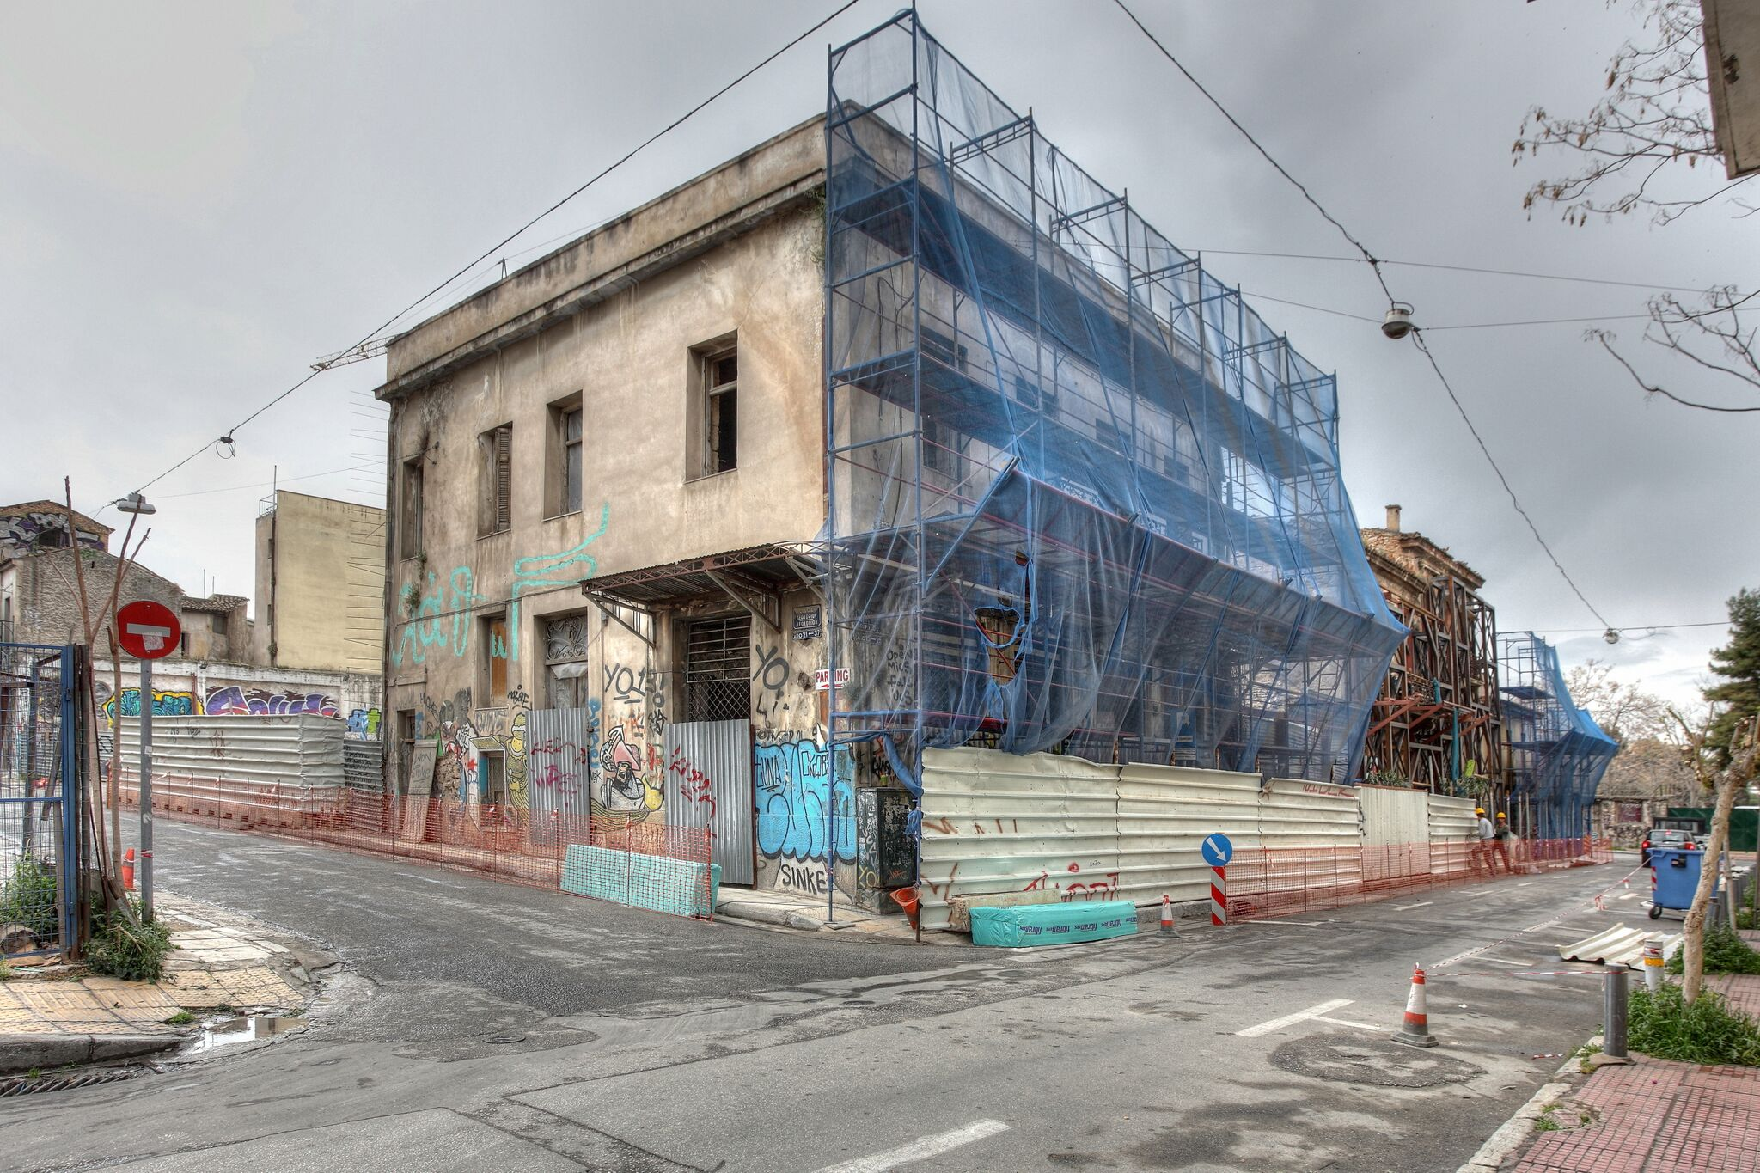
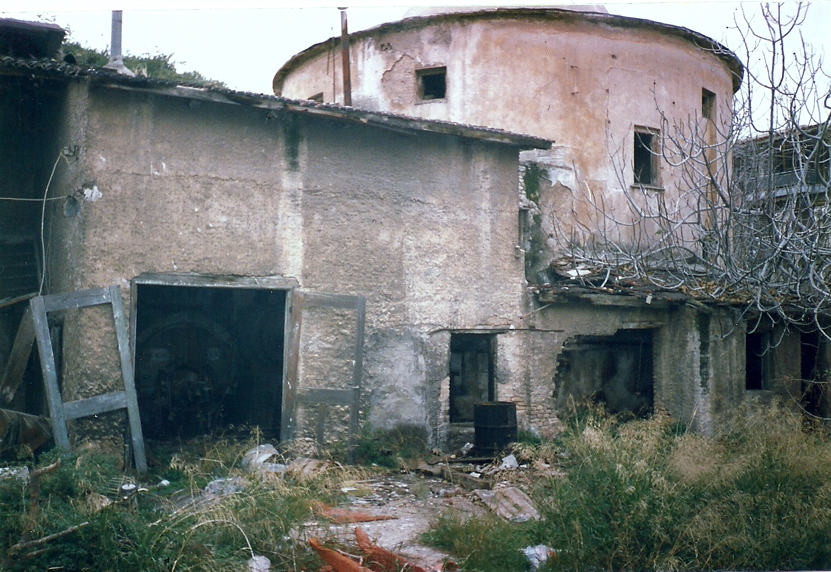
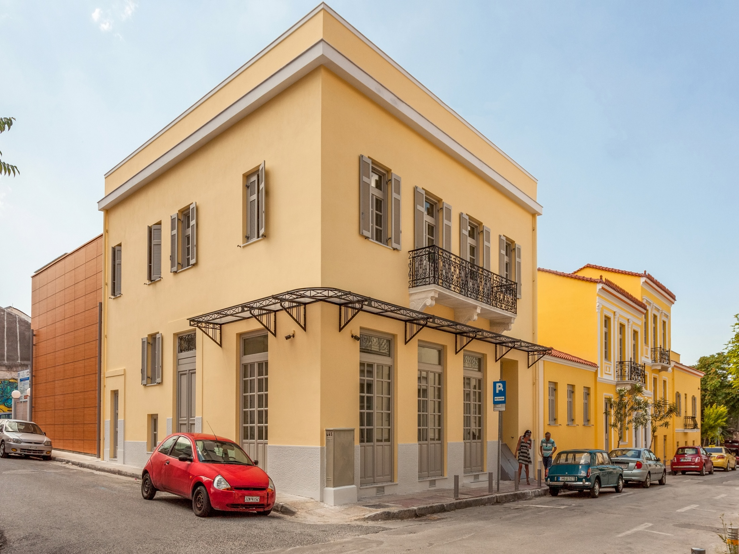
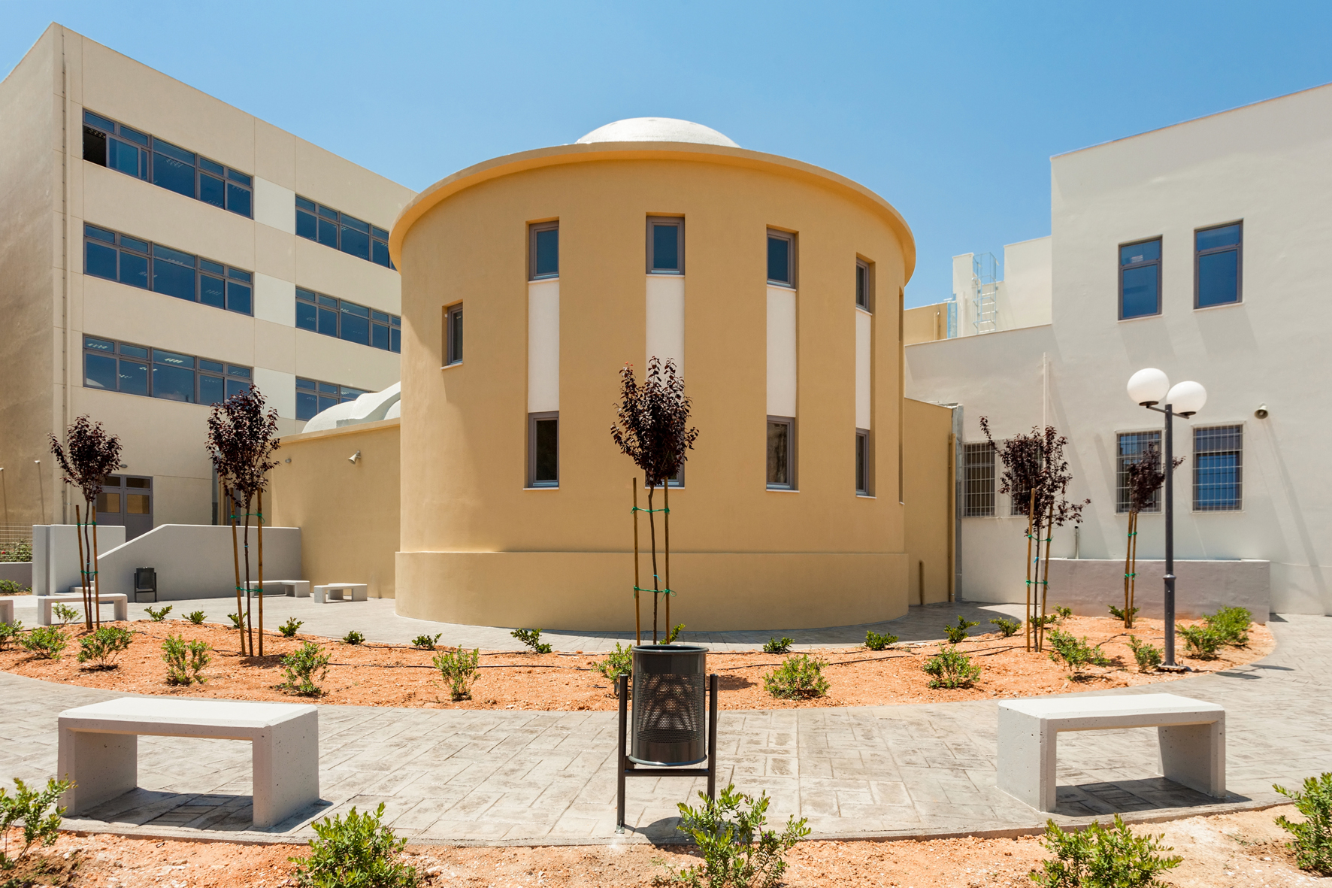
Pictures of PPP projects
Before
Before
Restoration of existing building converting to school in Thiseio, Athens
Restoration of existing building converting to Special artistic school in Keratsini, Athens
Now
Now

Slide 8
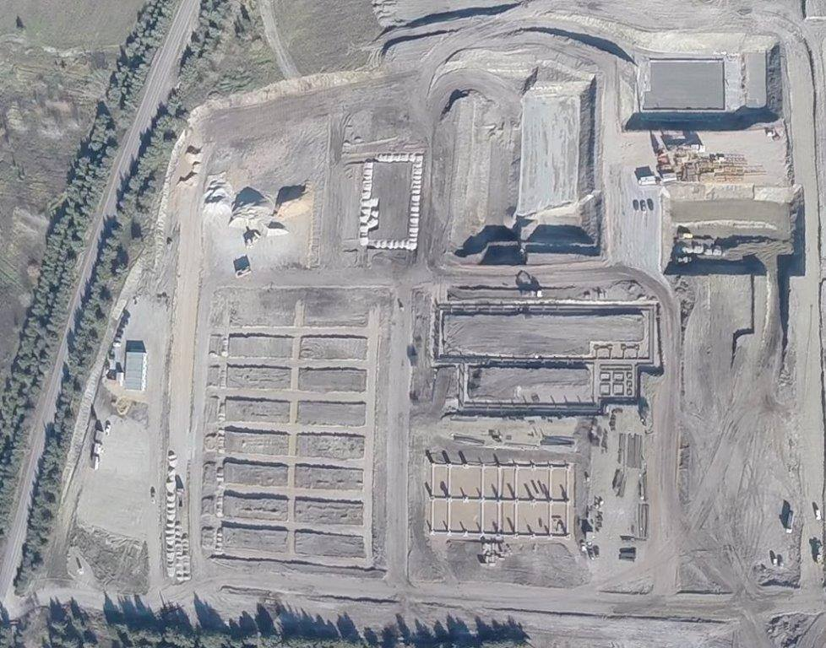
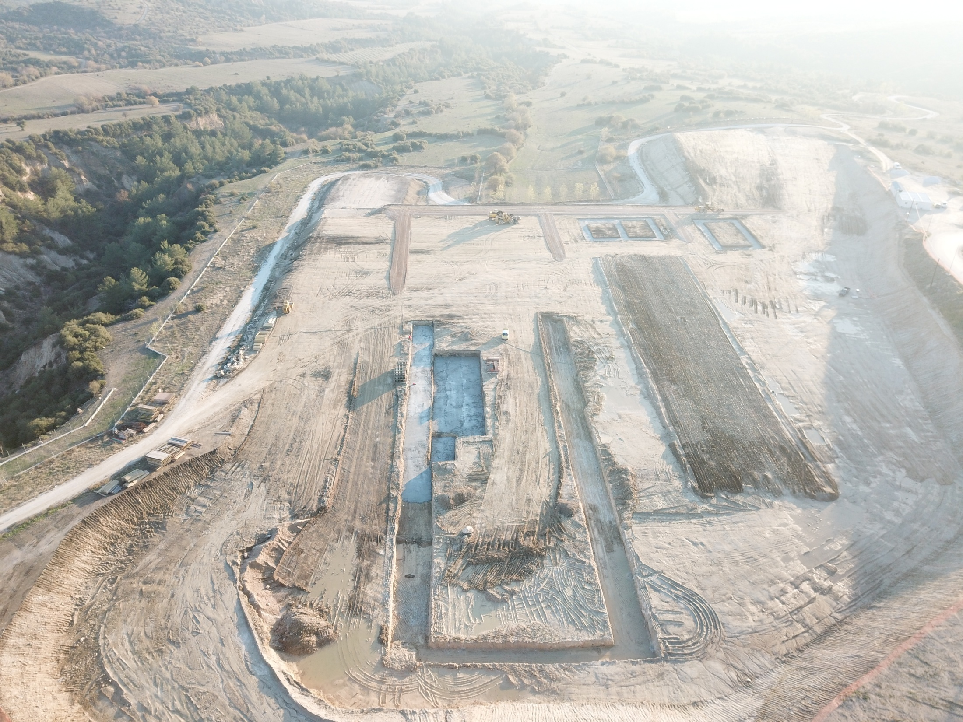
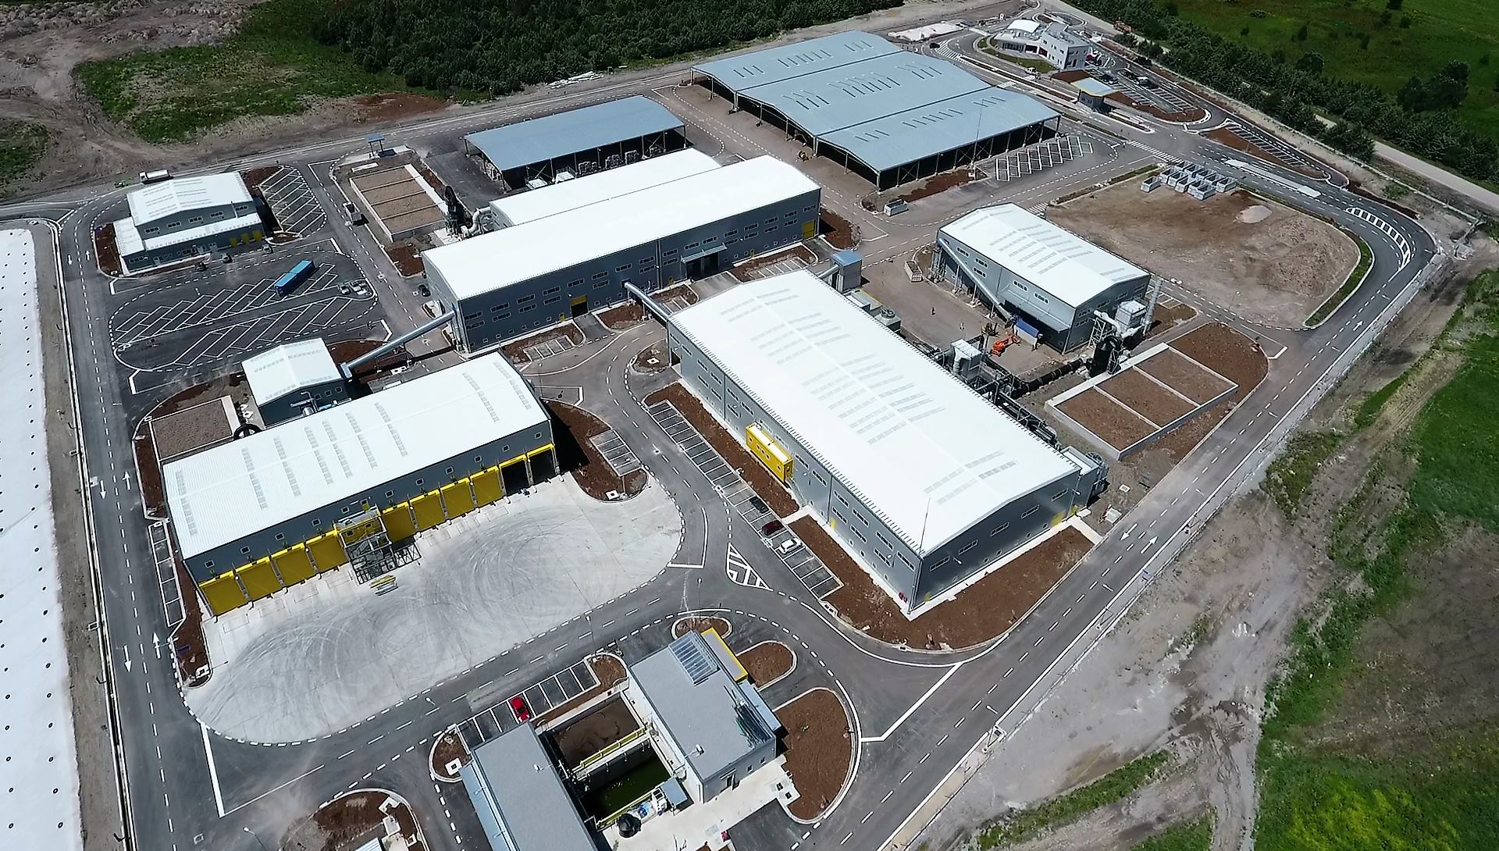
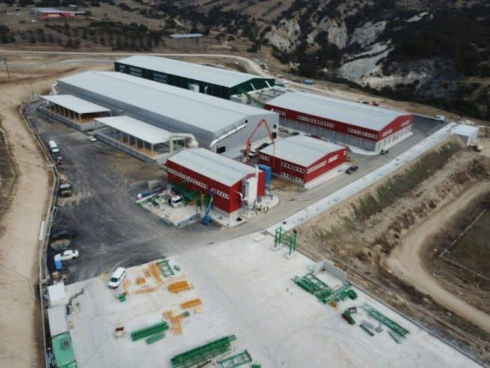
Pictures of PPP projects
  Western Macedonia waste management PPP – December 2015
  Serres waste management PPP - November 2017
  Western Macedonia waste management PPP – February 2017
  Serres waste management PPP - February 2019

Slide 9
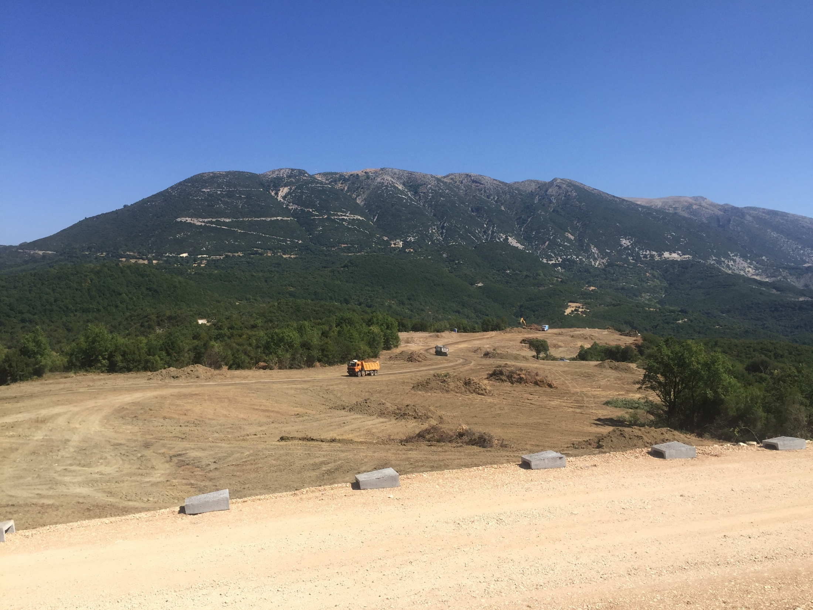

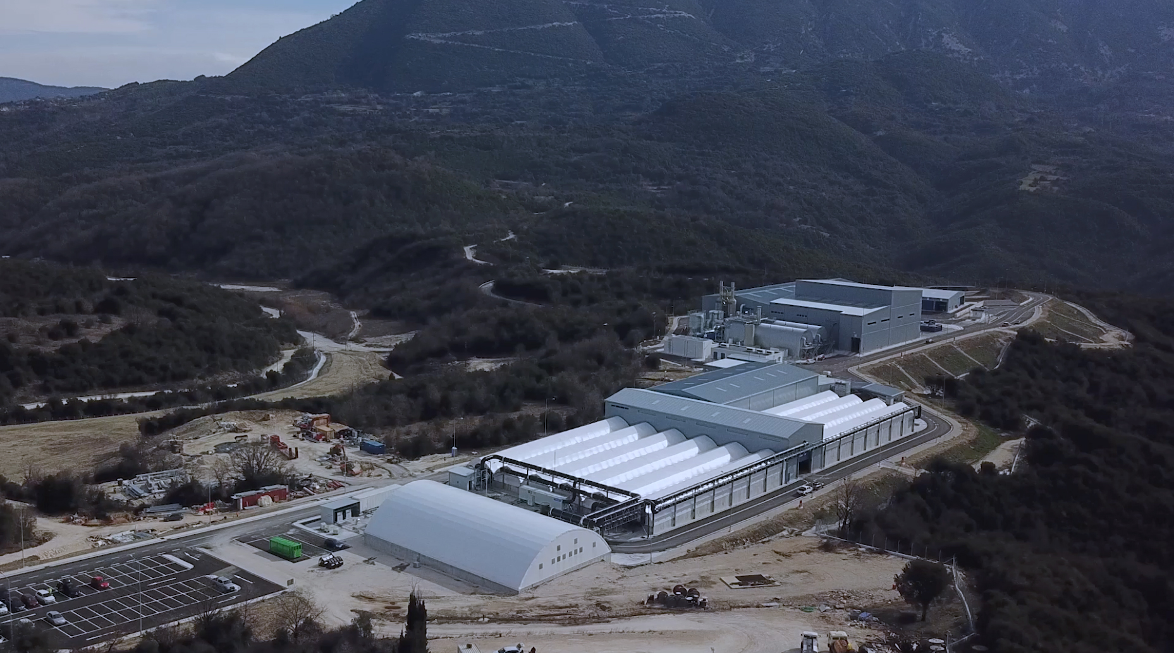
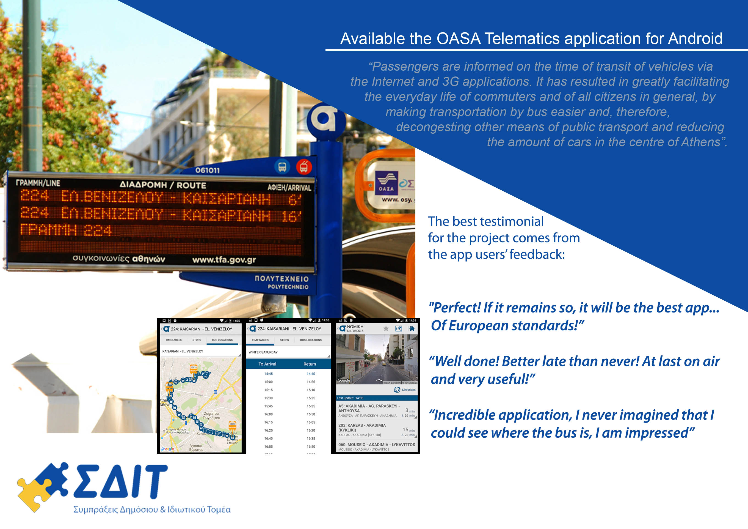
Pictures of PPP projects
  Epirus waste management PPP – September 2017
  Electronic ticket system for Athens Urban Transport
  Epirus waste management PPP – February 2019
  OASA Telematics system and application for Athens Urban Transport

Slide 10
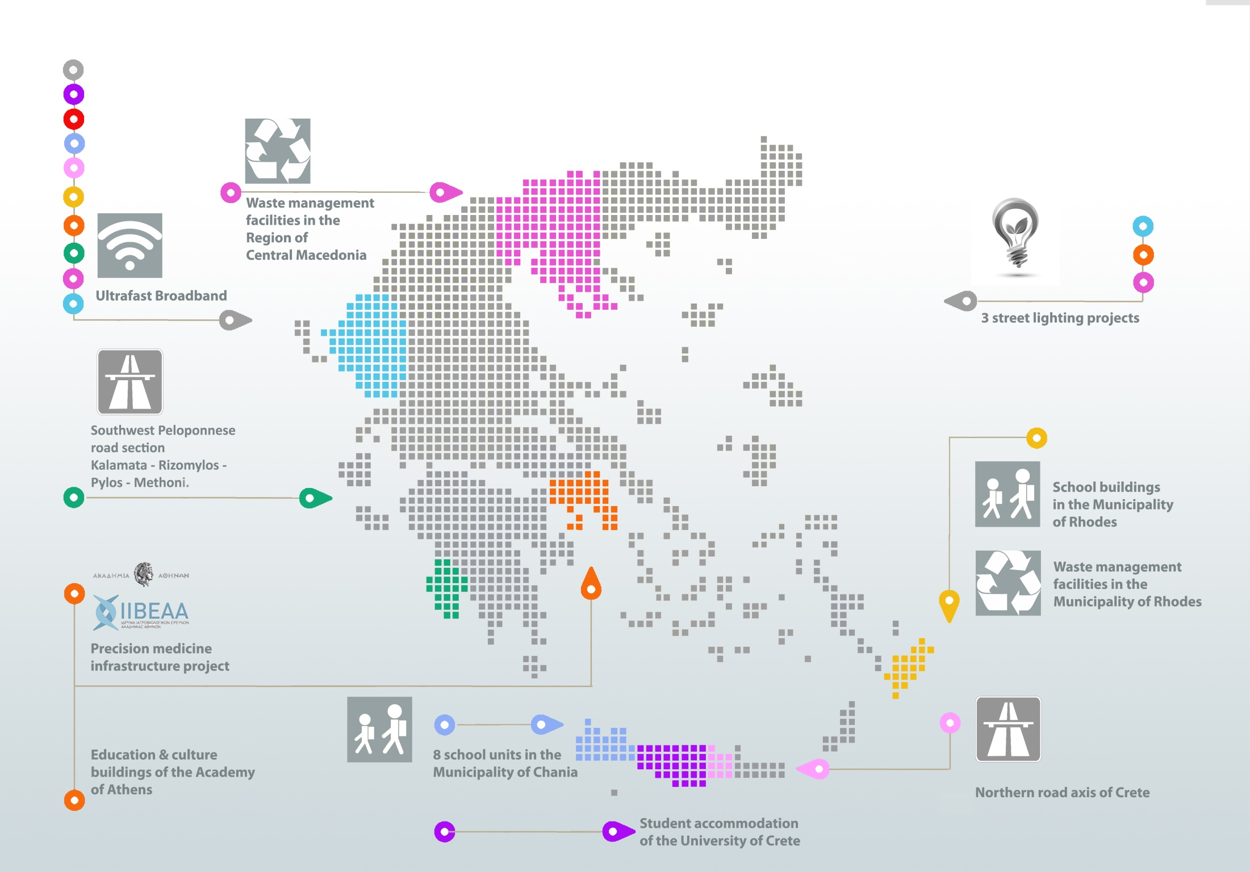
Active PPP Pipeline
13 PPP Projects of total value € 1.7 billion

Slide 11
INVESTMENTS
INCENTIVES LAW
L.4399/2016

Slide 12

INVESTMENTS INCENTIVES LAW L.4399/2016
STATE AID SCHEMES
01.
02.
03.
MACHINERY
& EQUIPMENT
GENERAL
ENTREPRENEURSHIP
ENTREPRENEURSHIP
VERY SMALL & SMALL COMPANIES
Type of aid :
Tax exemption
Leasing subsidy
Wage subsidy
For Special categories 70% subsidy on the projected amount
of aid
Type of aid :
Type of aid :
Tax exemption
Subsidy
Leasing subsidy
Subsidy of 70% of the projected amount of aid
For Special categories 100% Subsidy on the projected amount of aid
Employment cost subsidy
Tax exemption
Deadlines :
28th February 2020
Evaluation :
Direct evaluation
Deadlines :
14th February 2020
Deadlines :
Evaluation :
14th February 2020
Comparative Evaluation
Evaluation :
Comparative Evaluation

Slide 13

INVESTMENTS INCENTIVES LAW
Law amendment
For the purpose of accelerating and simplifying the process of certification of investment completion and commencement of the productive operation, Law Νο. 4635/2019 introduces an alternate certification procedure by certified auditors – accountants or accounting firms as well as engineers of the relevant specialties. This procedure at the same time ensures transparency and the public interest given that it implements a system of sample checks, penalties and avoiding conflicts of interest between the auditors and the investors.

Slide 14
INTRA-GROUP SERVICES
ESTABLISHMENT
IN GREECE

Slide 15

INTRAGROUP SERVICES ESTABLISHMENT
IN GREECE
Legal entities need to have a special license by the Ministry of Development and Investments, issued within 50 calendar days from the submission of the application to the Directorate of Foreign Capital. The special license (Ministerial Decision) sets the mark up to the total cost of services provided, not including income tax (cost – plus method).
SERVICES
Under Law No. 3427/2005 (Ch. F), intra-group service centers can be established in Greece solely to provide exclusively to their affiliates abroad and in Greece the following services:
Consulting services
Centralization of accounting services
Quality control of production, products, procedures and service
Preparation of studies, designs and contracts
Advertising and marketing services
Data processing
Receipt and supply of information
Research and development services
Software development, computer programming and information system support
Storage and management of files and information
Supplier, customer and supply chain management excluding performance of transportation with own means,
Management and training of human resources
Contact center and computer-based telephone information
The legal entities, after they establish presence in Greece have the following obligations:
Employment of at least 4 employees within 12 months from the issuance of the Ministerial Decision and hereafter; and
EUR 100,000 annual operating expenses
in Greece to be covered via bank remittances

Slide 16
INTRA-GROUP SERVICES ESTABLISHMENT IN GREECE
TYPES OF INCENTIVES
1
2
3
4
Job Creation- Wage Subsidy
Training Programs - Subsidy
CAPEX Subsidy - Wage Subsidy
R&D - Grants

Slide 17
STRATEGIC INVESTMENTS
PROCEDURES

Slide 18

Strategic Investments - Categories
All sectors
All sectors
within Organized Manufacturing and Business Operators
Strategic Investments 1
Strategic Investments 2
Strategic Investments 2
Emblematic Investments
in industry/ tourism
Fast Track Strategic Investments
Automatically included Strategic Investments
1
2
3
4
5
6
> EUR
100 000 000
OR
> EUR
40 000 000
& at least
75 new Annual Work Units (AWU)
> EUR
30 000 000
& at least
50 new AWU
> EUR
25 000 000
& at least
50 new AWU
> EUR
200 000 000
& at least
200 new AWU
> EUR
20 000 000
& at least
30 new AWU
Public and Private Partnerships (PPP)
Projects of Common Interest (PCI)
Fast track licensing
Tax incentives
Expenditure grants
Spatial development
incentives
Fast track licensing
Tax incentives
Expenditure grants
Spatial development incentives
Tax rate stabilization
Fast track licensing
Tax rate stabilization
Fast track licensing

Slide 19
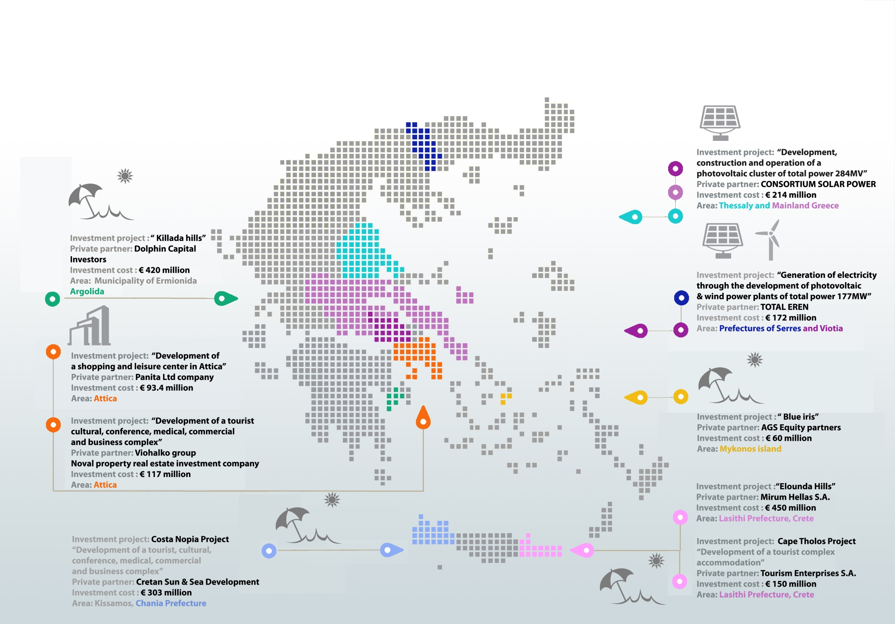
Recent Strategic projects
9 Strategic projects recently approved licensed of total value € 2 billion

Slide 20


