Slide 1
All you need to know about e-commerce: Tax
4 October 2021
Andy Spencer

Slide 2
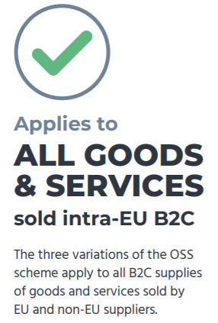
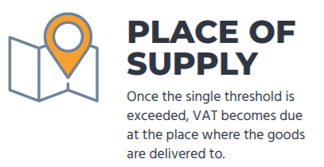
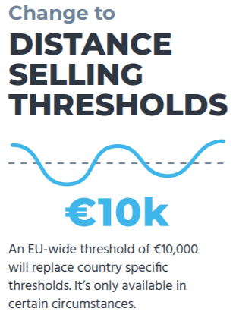
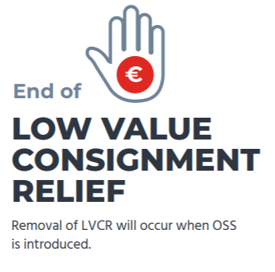
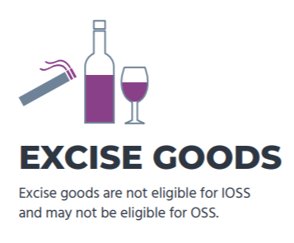
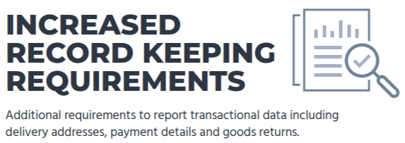
Key changes of the EU e-Commerce VAT Package
Notes:
Here is a summary of some of the key changes. In particular I’d like to draw attention to the change in the distance selling threshold and the end of LVCR – the next two slides will summarise the consequence of these and these are the core use cases that we’ll focus on.
With the distance selling threshold, this is where an EU wide threshold of €10k replaces country specific thresholds. The consequence of this is overnight on 1st July, many EU e-commerce companies had an obligation to charge VAT relating to the member state where the customer was based, rather than the MS in which they’re established. In principle this would have significant and costly compliance consequences and the need to register in every MS where they have sales (assuming the €10k threshold outside of their home country is breached).
With the end of LVCR, this also happened on 1st July. Prior to this, goods could be sent to consumers into the EU (from non-EU countries) without any customs or VAT implications, as long as the value of the shipment was below €22. Whilst many businesses complied, many did not – a change was needed to close the VAT gap and level the playing field between EU and non-EU businesses.
Before we move on to a more detailed look at these changes I’d like to draw your attention to marketplace liability. This webinar doesn’t focus on marketplaces but the key thing to understand here is that where goods below €150 are sold by a non-EU seller, this is facilitated by a marketplace, – the marketplace becomes the deemed supplier. This means the marketplace is responsible for the payment and reporting of VAT. It’s much more straightforward for the EU to work with aggregators such as marketplaces to collect VAT and monitor compliance and also reduces the compliance burden for very small non-EU e-commerce sellers who only use marketplaces as their route to market.
The final point to mention on this slide is record keeping requirements. In addition to VAT reporting, this legislation is associated with increased record keeping requirements that may be called upon by tax authorities at any time.

Slide 3
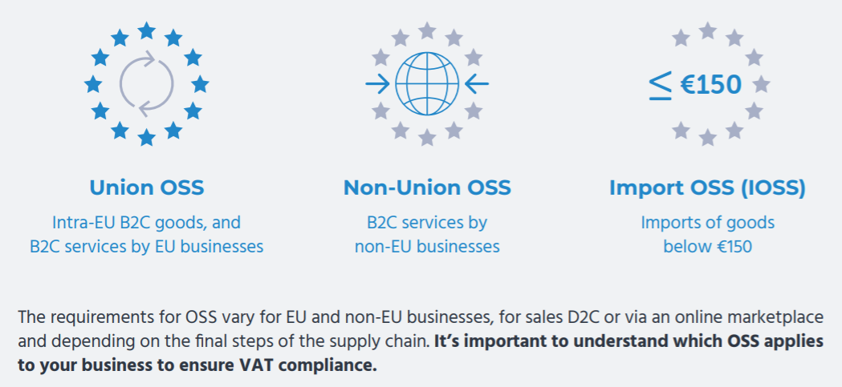
Three variations of One-Stop Shop (OSS) schemes
Notes:
So for the two use cases we’ve talked about shows the additional compliance obligations that sellers may face. To reduce the compliance burden, simplified reporting schemes have been introduced.
Union OSS is used for intra-EU B2C sales of goods and/or services. In the example where the pan-EU threshold of €10k applies, this means that sellers can apply to use the OSS scheme and rather than submitting VAT declarations in all MS where they have sales, they will need to complete one OSS return which contains details of all of their EU sales. These are submitted on a quarterly basis, generally via their home tax authority although this may change depending on the business model. There is still the need to charge VAT at the rate relevant in the other MS, but reporting – and payment – is just via one. This tax authority then share the relevant data and payments with other MS
Non-Union OSS is for the sale of services e.g. digital downloads from non-EU companies. This replaces the MOSS (mini-one stop shop) which was the precursor and test case for these changes.
The import OSS, as we’ve mentioned, relates to imports of goods into the EU and applies where shipments are below €150. As with the union and non-union OSS, this is a consolidated return but is submitted monthly. Crucially, the IOSS comes with the concept of the intermediary, which we’ll cover now.

Slide 4
Union-OSS: Use Case
French business selling clothing to private individuals across all EU MS
Annual sales of €1.5m
Prior to 1st July, threshold crossed in 5 Member States and VAT registrations obtained
All goods shipped from France
Opportunity to use union-OSS
VAT charged at applicable local rate for each MS
Alternative
Register in all MS
Single return submitted to French Tax Authority
Return contains data for each MS
Single VAT payment made to French Tax Authority

Slide 5
IOSS: Use Case
French business selling clothing to private individuals across all EU MS
Sales made via Amazon and also direct from own website
All goods shipped from US
Average parcel value €20 (no goods over €150)
Prior to 1st July, benefited from LVCR. Customer paid VAT on import where over €22
Amazon becomes deemed supplier for sales via their platform
VAT should be factored into price to customer and paid to Amazon
Opportunity to use IOSS for sales from own website
VAT charged at applicable local rate for each MS
Single return submitted to French Tax Authority
Return contains data for each MS
Single VAT payment made to French Tax Authority

Slide 6
Meeting Compliance Obligations
Intermediary
Which scheme?
IOSS Registrations and Set Up to OSS
Submission of Returns
Record Keeping
VAT Audits
Notes:
If you decide these schemes are right for you – and many businesses already have – you need to think about how you will comply with the associated requirements
How will you appoint an intermediary?
Which scheme or schemes are right?
How will you get yourself set up?
How will you submit returns and pay the VAT
How can you ensure record keeping data is in the right format
How will you respond to tax authority audits?

