Slide 1
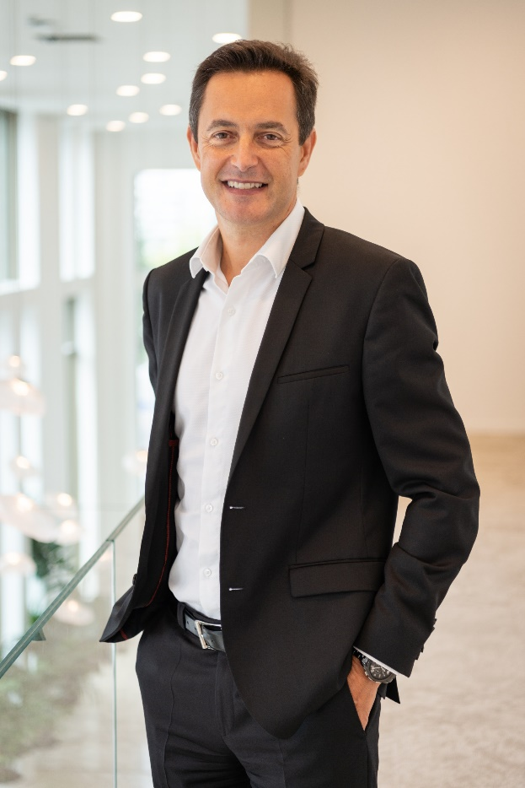

Jean-François GARIN
Deputy Chief Executive Officer of Groupama Group
CEO of Groupama Gan Vie and Life Division
A LEADER IN INSURANCE IN FRANCE
PRESENT IN 10 COUNTRIES GLOBALLY
€ 15,5 billion
Group turnover
31 000
Employees
12 million
Customers
including
€ 2,4 billion
International turnover
271%
Solvency margin
Groupama in France :
1st Agricultural insurer
3rd House insurer
4th Car insurer
3rd Individual health
5th Global health

Slide 2
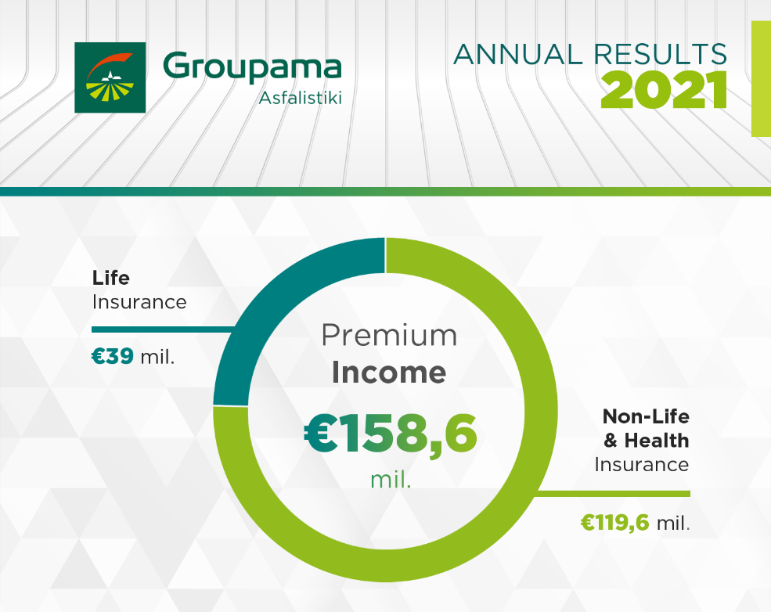
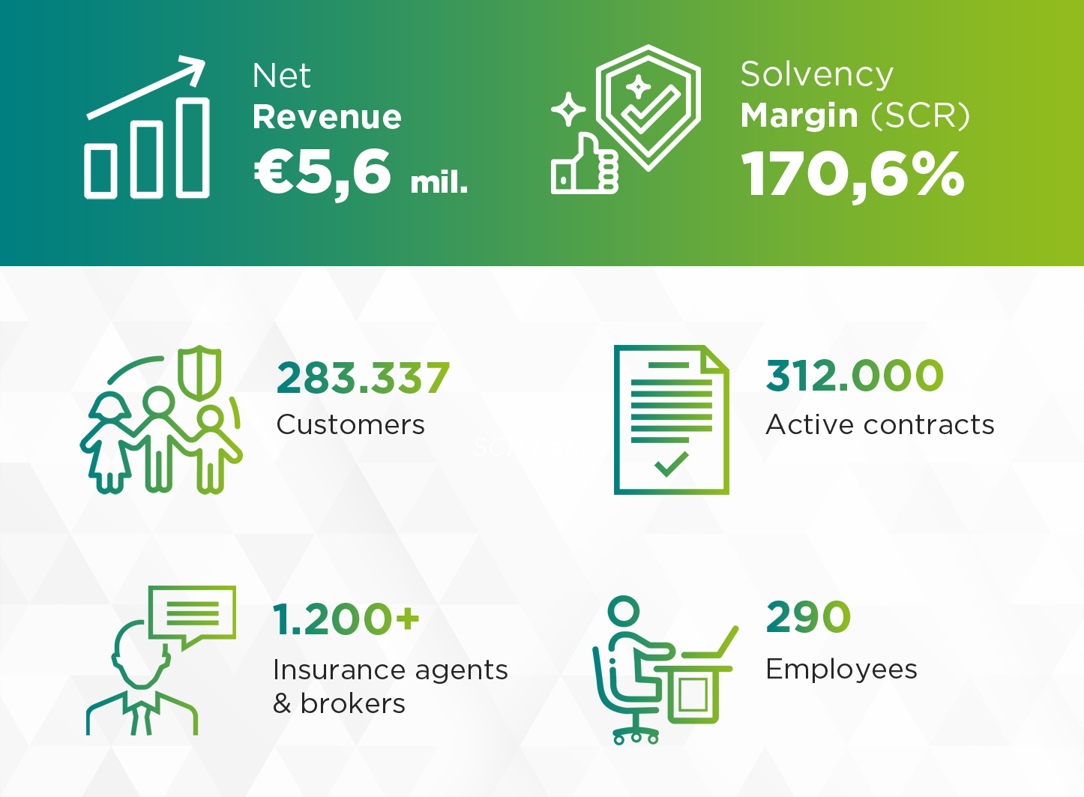
Groupama in Greece – key figures

Slide 3
The french health system
The French healthcare system is based on a social insurance model that guarantees universal coverage
* The « General social contribution » (CSG is levied by the French Treasury on all earnings, including investment incomes

Slide 4
The french COMPLEMENTARY healthCARE system
How are people insured?
Additional Complementary Health
optional
Complementary health paid by all employers (ANI 14/06/2013)
Private individual subscription
Complementary health solidarity (CMU)
mandatory
optional
Employee
Non-salary employees, craftsmen, retirees…
Other

Slide 5
The advantages of the french healthCARE system
The 2-stages system allows flexibility and agility of the system :
  To have a minimum base for all and paid by the community
    a deficit could be created under certain circumstances or crisis (population ageing, pandemic, unemployment…)
  Adjustment according to the financial capabilities
  Flexibility between the State and health insurers, mainly during crisis
    distribution to all actors
  Transfer to private sector with price adjustment

Slide 6
What can the health insurer offer ?
For individuals
For companies
Care network = > quality of service & price
Ability to find health appointments
Telemedicine => to partly respond to medical deserts/dearth of doctors
Help the Head of Human Resources to improve the employee’s quality of work life
Data on absenteeism
Programs dedicated to companies:
  Services in all sectors;
  Services for especial activity;
  Services for a specific busines
Prevention
The health public/private partnership makes it possible to provide better monitoring of pathways, better effectiveness of treatment and the strengthening of prevention

Slide 7
Thank you

