Slide 1
ESG – Shaping a New Corporate Culture Cathy Christidou Managing Director BPM S.A., Chairwoman SESMA

Slide 2
BPM in a nutshell…
Boutique Consulting Firm providing value adding solutions for over 30 years…
Integrity, commitment, excellence, results and respect for people are our core values and have always been the cornerstones of our business conduct.
We address our clients' needs related to business strategy, people & change, business transformation, sustainability and funding.
Through our cooperation with selected business partners, we enhance our services portfolio and offer integrated solutions to our clients.
We are a team of seasoned professionals bringing together solid scientific background, substantial business, managerial and consulting experience, personal involvement and flexibility.
Our extensive experience and impeccable reputation has led numerous businesses and organizations from various business sectors to trust us with important projects for their future development.

Slide 3
BPM in a nutshell…
Our value proposition to our clients is based on:
the international state of the art methodologies and know how;
wealth of experience through the successful completion of numerous challenging projects;
personal involvement of a highly qualified team;
and our commitment to business ethics.
BPM is a member of the Hellenic Association of Management Consulting Firms (SESMA) and of the Hellenic Network for Corporate Social Responsibility (CSR Hellas), of the Chambre de Commerce et d' Industrie France Grèce (CCI France Grèce) and of the Hellenic Entrepreneurs Association (EENE).

Slide 4
Key capabilities overview
Strategy & Corporate Development
People & Change
Business Transformation
Sustainability
Funding

Slide 5
Understand & Comply with the ESG Requirements

Slide 6
ESG as a Critical Success Factor for Value Creation & Resilience
Significance for Management
Significance for Stakeholders
ESG
Factors driving the popularity of ESG strategies:
Customer expectations
Investors & Banks
Employees
Supply chain
Rating agencies, insurance companies and more

Slide 7
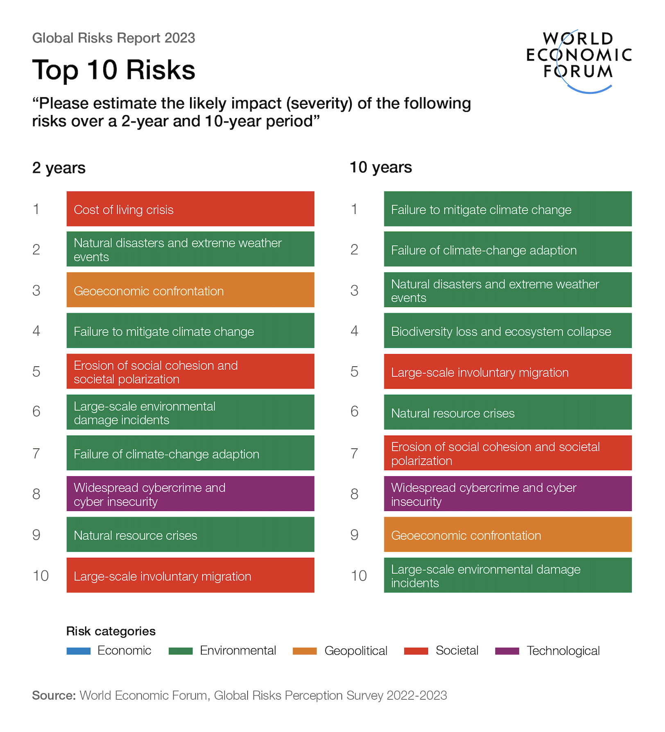
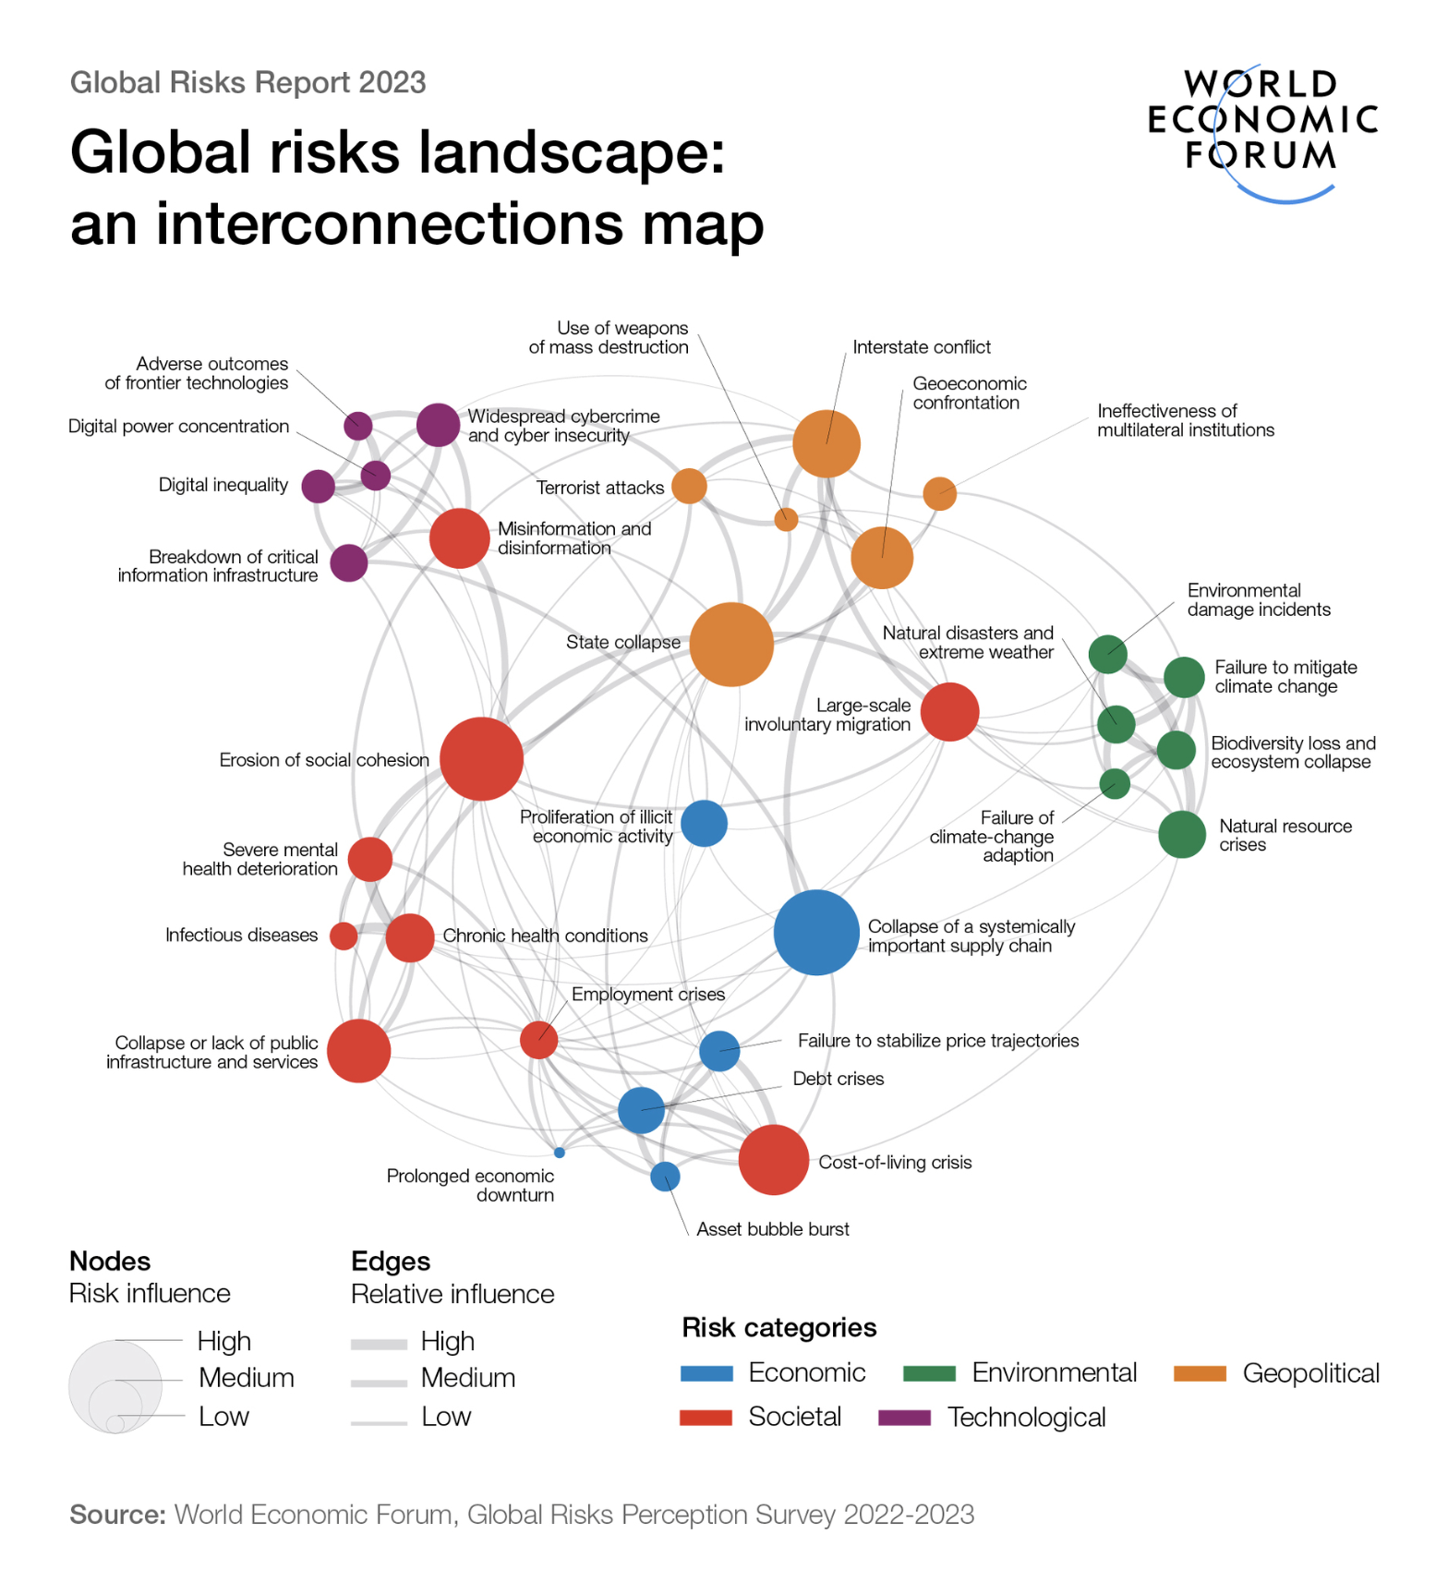
ESG as a Strategy for Resilience towards Global Risks

Slide 8
ESG Reporting Frameworks, Methodologies & Guidelines
GRI
SASB
UN Global Compact
International integrated Reporting Council (IIRC)
Task Force on Climate-related
Carbon Disclosure Project (CDP)
Greek Sustainability Code
AA 1000 Accountability Principles
UN Principles for Responsible Investment
ATHEX ESG Reporting Guide
Various ESG reporting platforms that incorporate basic principles

Slide 9
CSRD Key Areas
Key areas prioritized by CSRD are:
CSRD extends the scope to all large companies and all companies listed on regulated markets (except listed micro-companies)
Double Materiality
More detailed reporting requirements
Simplified approaches and guidance will be provided for SMEs
Limited third-party assurance on the reported information will become mandatory

Slide 10
BPM supporting Companies Shape ESG Culture
Forming ESG Strategy
Identify
impacts
Define & assess material topics
Identify & evaluate stakeholders
Select appropriate measures
Prepare reporting
Developing ESG Initiatives
Identify initiatives / actions
Develop action plan
Support Implementation
Shaping ESG Culture

Slide 11
Creating Sustainable Value Together

