Slide 1
Looking towards 2023: Key macroeconomic, business & geopolitical trends
Cailin Birch
Global economist
October 2022
Notes:
FINAL

Slide 2
Looking towards 2023: key macroeconomic, business & geopolitical trends
Agenda for today’s presentation
Global economic context
Trade and supply chains
A look at the future
Global growth—recession ahead?
Inflation—when will it peak?
What are the main disruptions?
When will things return to normal?
Reshoring—a bridge too far?
Top ten global risks
Q&A

Slide 3
Global economic context
A scene setter

Slide 4
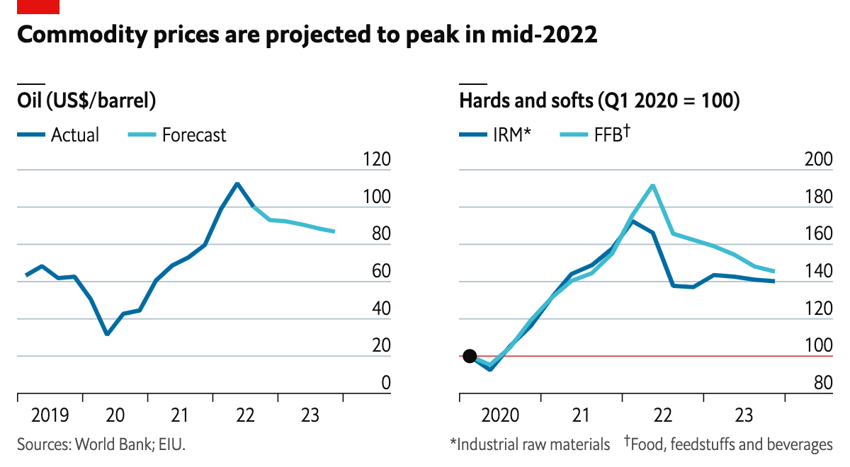
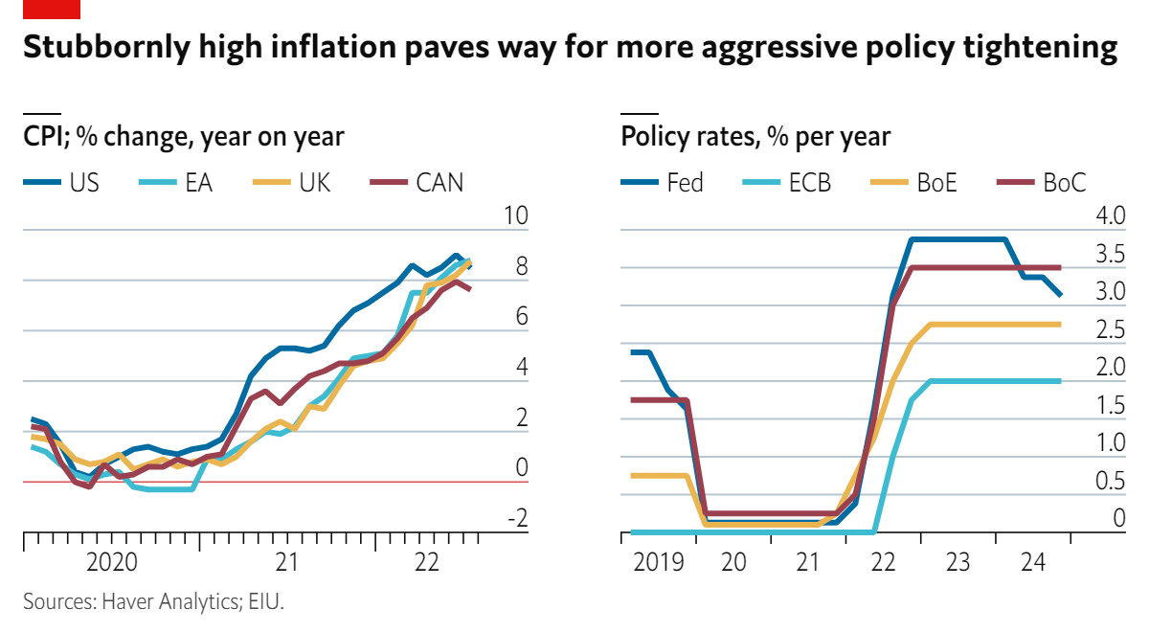
What are the global implications of the war in Ukraine?
Commodity prices:
Prices soared in H1 2022 owing to concerns around supplies and destruction of infrastructure to ship commodities (ports, etc).
Sanctions also restrict access to financial channels to trade commodities with Russia (+ overcompliance).
Oil and gas prices will remain high as long as conflict rages, and so will prices for base metals and grains.
Inflation:
Spike in commodities prices will fuel global inflation to 9.5% this year, weighing on economic recovery.
Supply chains issues (with disruptions to air, sea and ground transport links through Russia) are also fuelling inflation.
Central banks will hike rates aggressively to try to contain inflation, but this will take time to bear fruit.

Slide 5
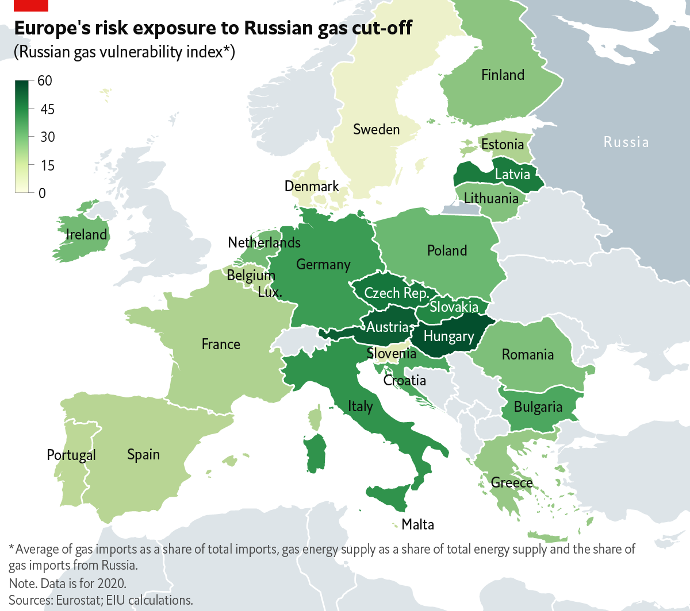
Are we heading towards a global recession?
Global growth:
Most of the hit will be felt in Ukraine and Russia (world’s 11th largest economy)–huge recessions in sight.
EU economies (especially Germany & eastern Europe) will also be affected, with crunch time in late 2022 and next year:
2022: 1.3pp hit to euro zone growth (2.7%)
2023: 3.1pp hit to euro zone growth (-0.4%).
Downgrades to our forecasts for most G20 countries. Commodities producers are the notable exception.
A global recession is unlikely in 2022:
Many economies are still in rebound mode following the covid-19 crisis–this will artificially fuel growth rates.
Also solid growth from Asian economies (despite China’s slowdown) and MEA–growth engines for global economy.
However, some major economies (US, Germany, Italy, France, UK) will post technical recessions in late 2022/early 2023.

Slide 6
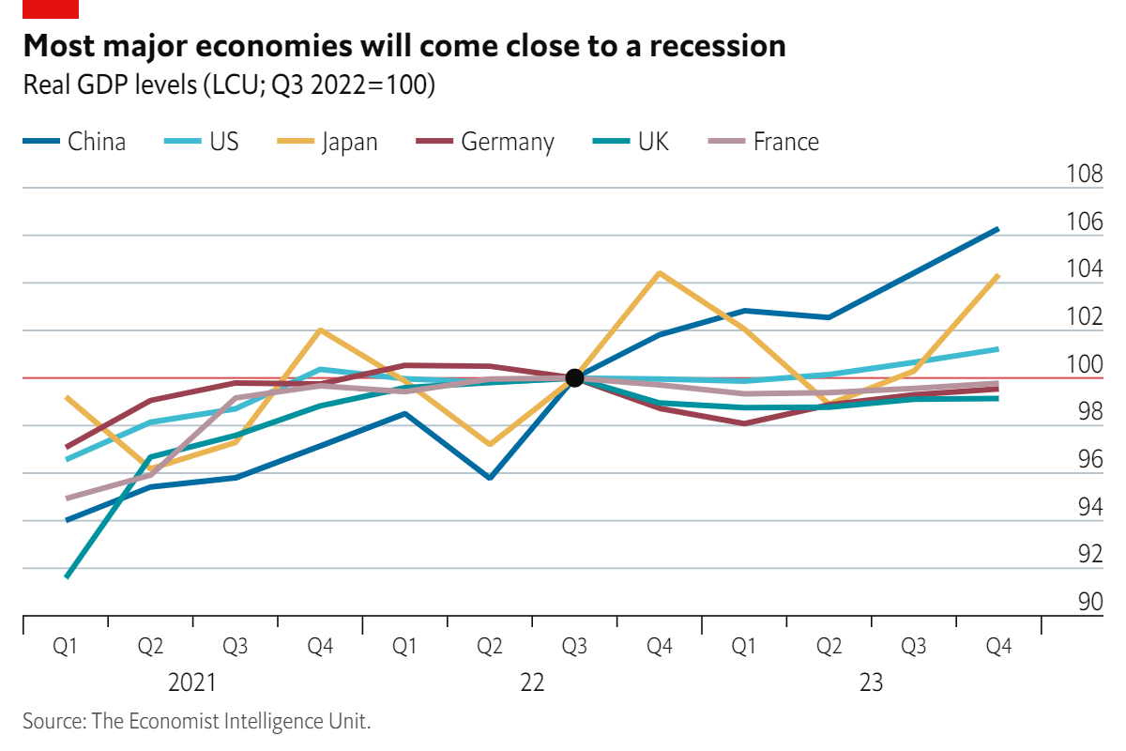
Are we heading towards a global recession?
Risks are concentrated in 2023:
We believe that growth will stand at 1.7% in 2023–reflecting slowing growth in US & China, and recession in Europe.
Global monetary tightening will weigh on growth, but impact will take time to appear (from second half of 2023).
Risks are high: escalation of Ukraine war, covid-19 variants, spikes in energy prices, sovereign debt pile-ups…
Benign environment of pre-2018 is now gone:
Geopolitics are imposing higher costs and playing a bigger role in global economy (eg. US-China, war in Ukraine, Taiwan…).
Era of ultra-low interest rates is also gone, with implications for funding for companies and financial markets.
Tough decisions (lockdowns, trade openness, interest rates) highlight importance of good governance.

Slide 7
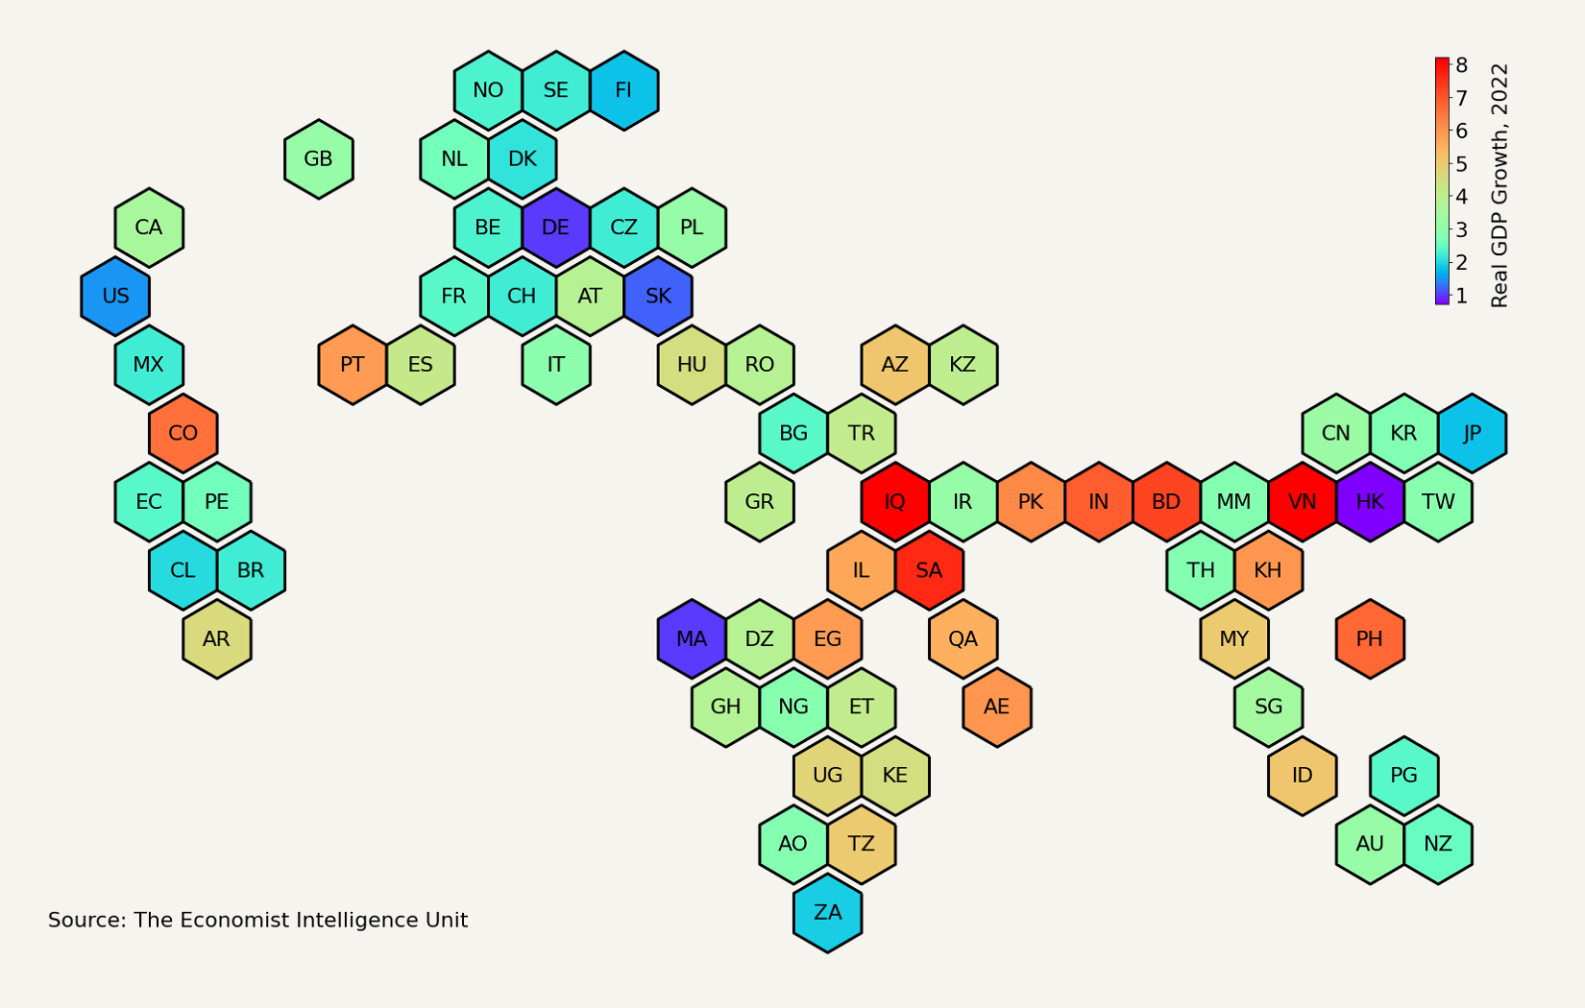
Global growth of 2.6% in 2022 - down from 3.9% before war started
High inflation and Fed tightening are biting in US (1.5% growth)
Recessions in Russia (-6.2%), Ukraine (-36%)
Zero-covid, power shortages, droughts, property sector woes severely weighing on growth in China (3.3%)
UA
Eastern Europe is most affected in euro zone
MEA commodity exporters will benefit from higher prices
China-induced drag on growth in Asia
LatAm will suffer from high inflation, but rising commodities prices beneficial to some states

Slide 8
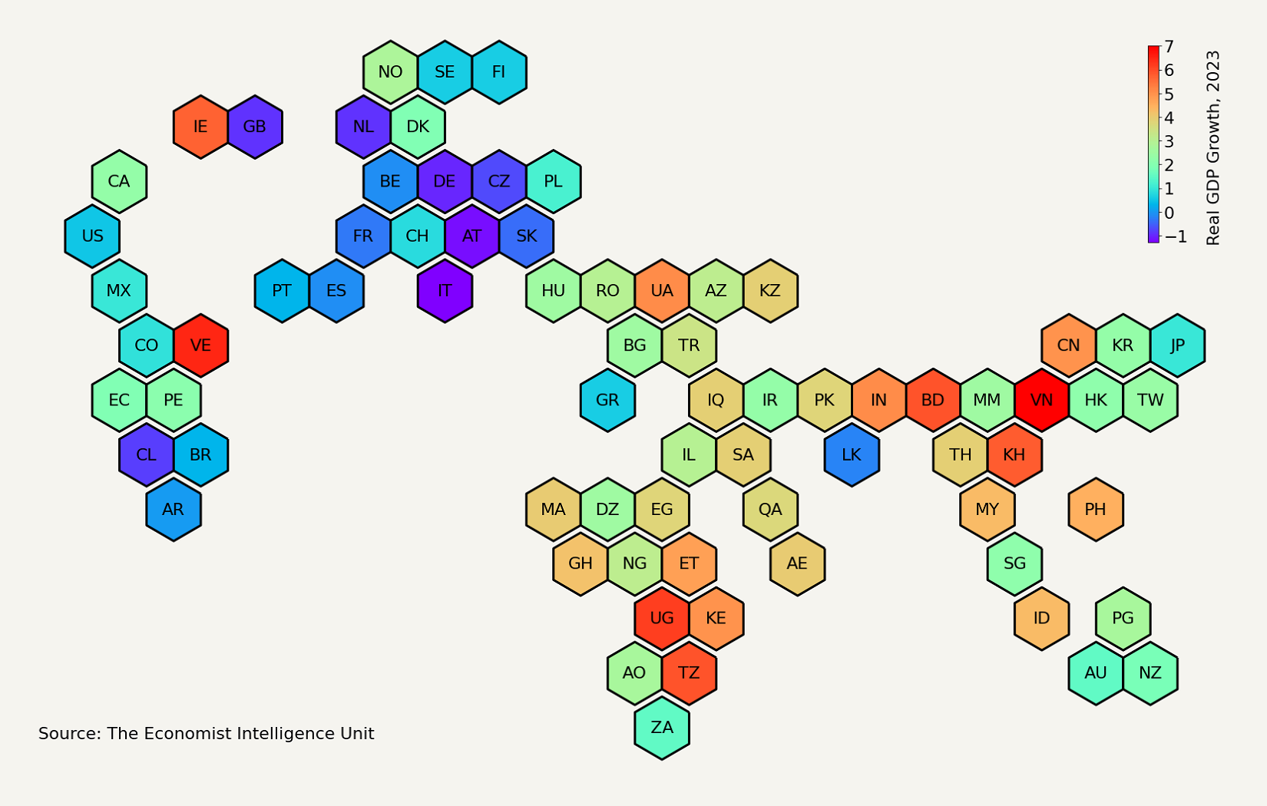
Things will get (much) worse in 2023, with global growth of only 1.7%
Technical recession in US (0.5% growth)
China will post modest rebound after 2022 slump (5% growth)
RU
Recession ahead in euro zone (-0.4%)
Slowdown in growth in US, euro zone and China will be a drag on growth elsewhere in the world

Slide 9
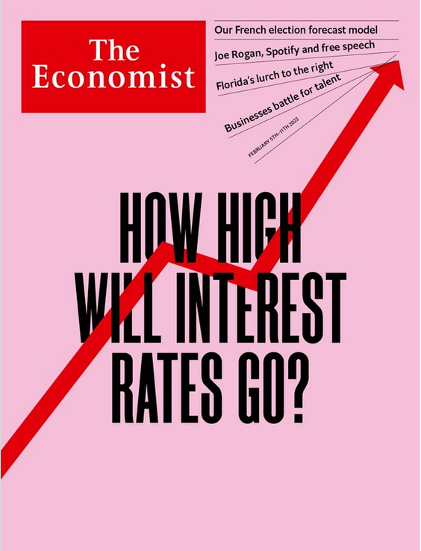
High global inflation:
Where and when will it peak?
What’s happening?
Inflation is rising–fast:
Global inflation at 9.5% this year–highest since 1996.
US inflation still high–8.3% in August 2022.
Mostly a rich countries story (so far):
Will change as Fed starts tightening monetary policy.
Expect ripple effects in emerging countries.
Why is that happening?
Accommodating monetary policy during covid-19.
Re-opening of economies after lockdowns.
Soaring commodities prices:
War in Ukraine has made things far worse.
Food prices–+36% in 2021 and +22% in 2022.
Industrial materials–+40% in 2021 and +6% in 2022.
When will inflation peak?
Inflation to recede to 6.4% in 2023 (still high) and 4% in 2024.
Not out of woods yet! Prices will remain high in level-terms.

Slide 10
Trade and supply chains A closer look

Slide 11
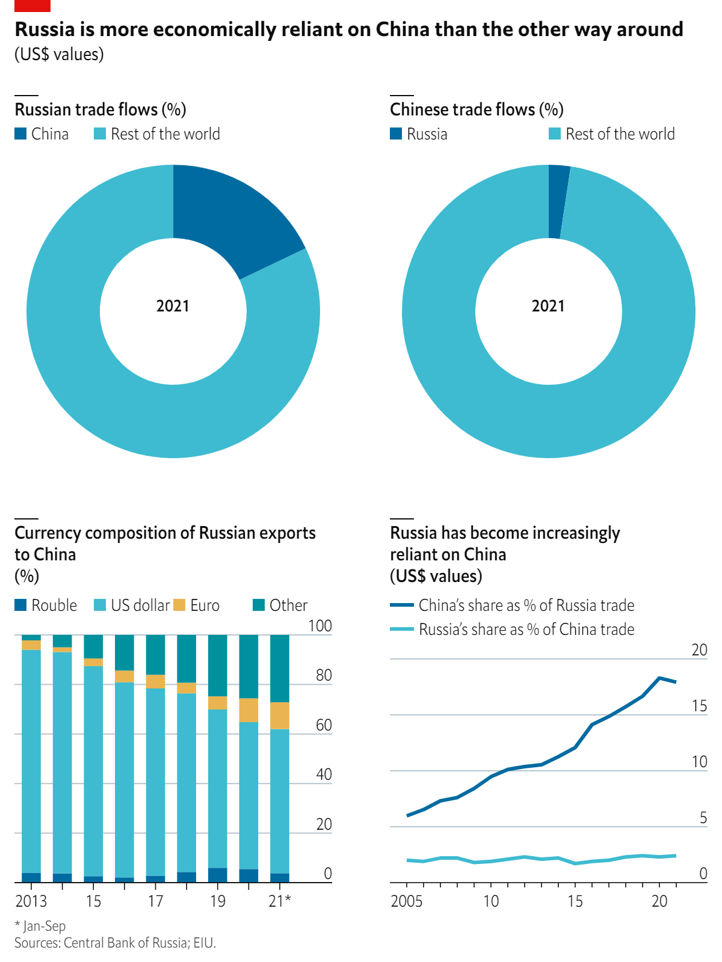
Sanctions will prompt a reshuffling of supply chains
Russia will have to rely on China for trade:
Russia will be cut off from Western countries for a long time.
Expect reconfiguration of supply chains for commodities.
Russia used to be a major supplier of energy, fertilisers, gold, grains, base metals…
Relationship will be unbalanced: China will have leverage.
Co-operation in energy field is most likely:
Energy is the only thing Russia (really) has to offer.
Will help China lessen its dependence (eg. on Australia).
Process will be long, China will avoid becoming dependent.
So far Russian market remains unattractive for Chinese firms:
Fear of US secondary sanctions.
Poor economic outlook in Russia.
Keep an eye on sanctions evasion, too:
Russia will increasingly use CIPS (China’s payments system).
Not new: alternative financial channels’ long-standing goal.
Also keep an eye on digital currencies developments.
Will foster rise of fragmented financial landscape.

Slide 12
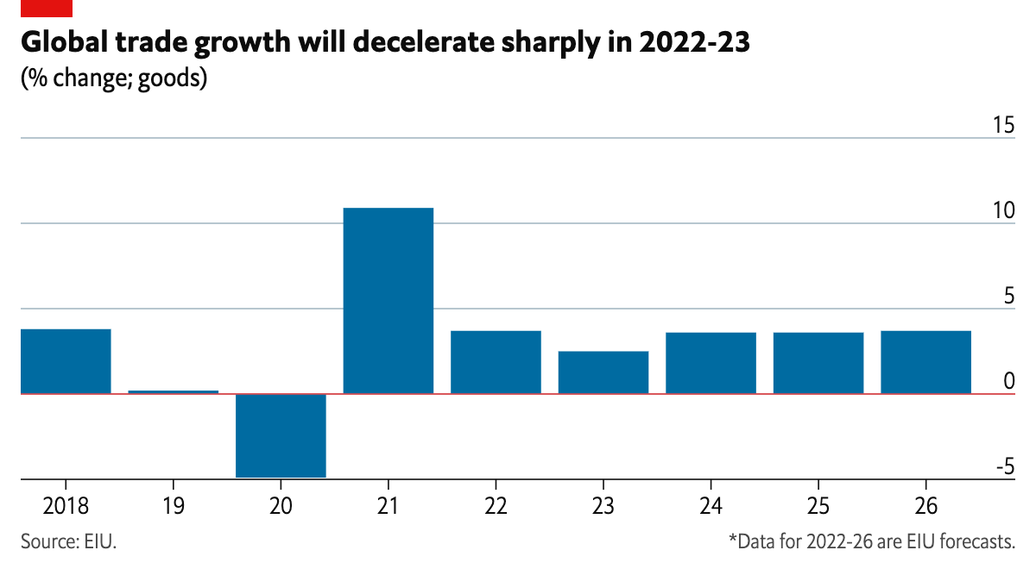
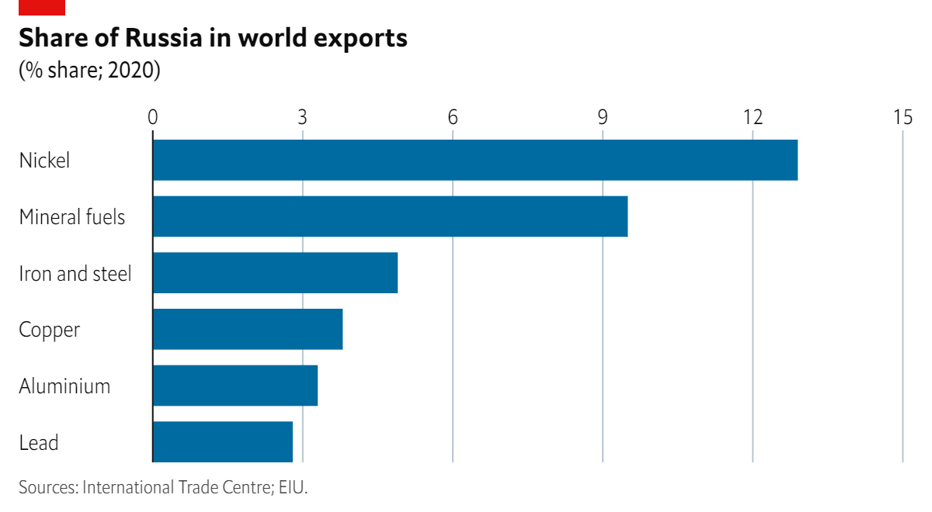
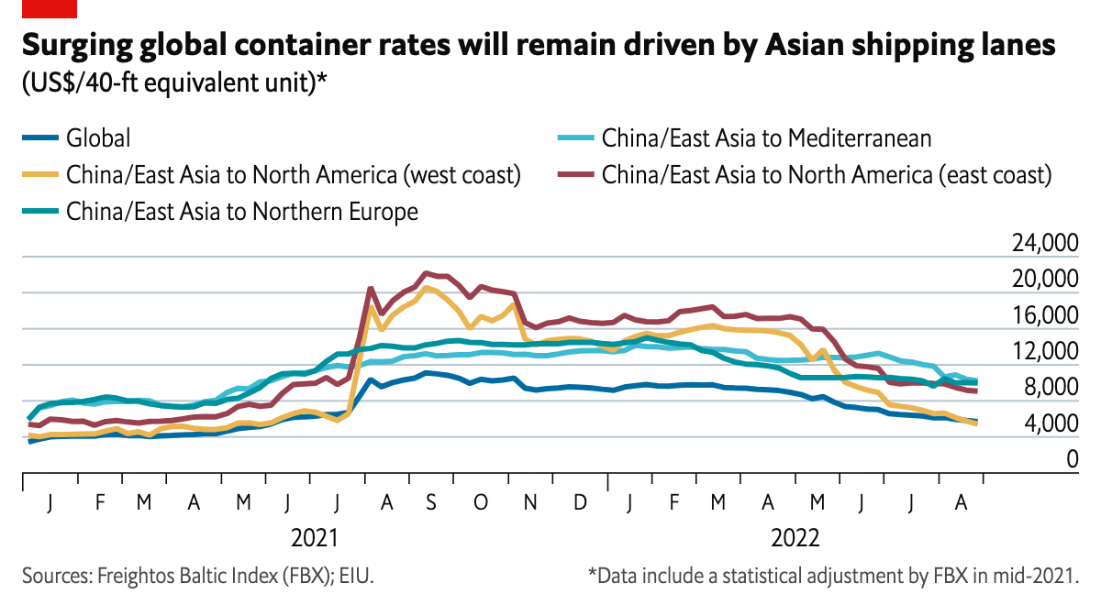
When will things return to normal?
Key takeaways:
Ongoing supply chain disruption and global economic slowdown will provoke sharp deceleration in trade growth in 2022-23.
Global sea freight rates will continue to ease from 2021 peak.
However, strained transport infrastructure (eg, US & Europe) and higher-price contracts will keep rates elevated.
Semiconductor crunch will push into 2023, but will ease more steadily that year, reflecting shifts in household consumption and rising concern over inflation + interest rates.

Slide 13
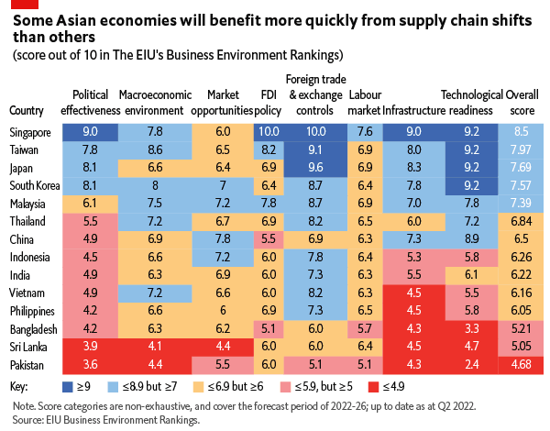
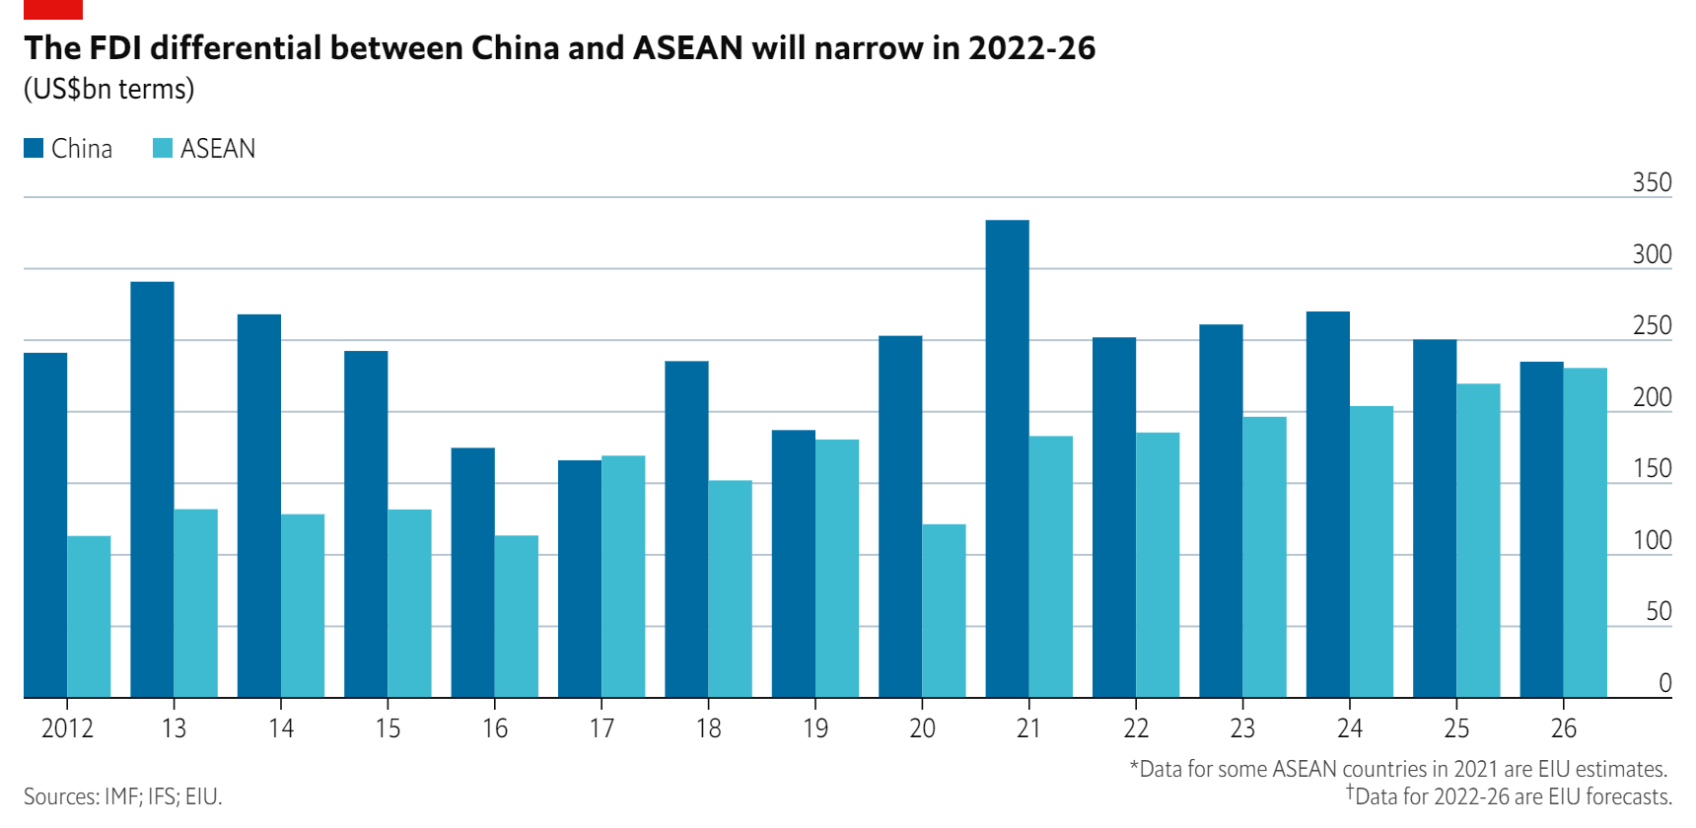
Reshoring—a bridge too far?
Some reshoring is happening, especially in rich Western countries where ambition is met with targeted industrial policies and subsidies.
But these are exceptions and will not be the norm.
We do not expect a mass return of production to rich Western countries or a mass exodus from China.
Why not? Moving supply chains is tricky, costly and risky.
China remains a very important market → vast consumer market, important production networks, strong logistics.
Supply chains are likely to become diversified, but to remain global. Asia will remain production hub, with SEA benefiting.

Slide 14
A look at the future
Some key considerations

Slide 15
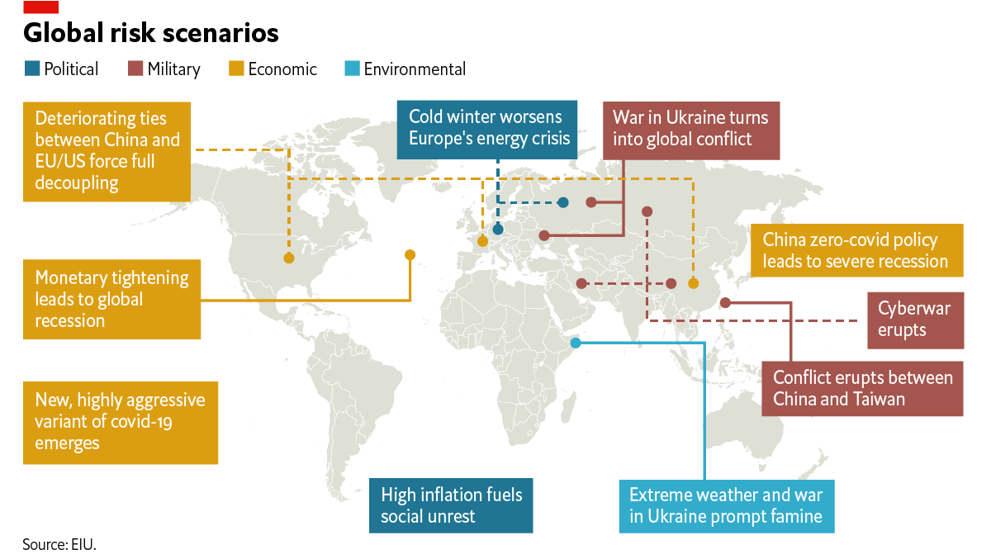
What are the top ten risks for the global economy?

Slide 16
Thank you! Questions and comments welcome

