Slide 1




Hellenic Development Bank
ESG Innovation Challenge
September 2022

Slide 2


In quest of increasing SME Bankability
Alternative scoring
Traditional
credit scoring

Slide 3
HDB’s exposure to the ecosystem
Digital transformation
HDB PoCs
Create business supplier relationships to respond to HDB Strategic quest
Product development alternative scoring, front/back office
Data analytics MIS, BI tools
Digital platforms :
Further educate
Ecosystem
Startups
Universities
Consulting firms
VCs + supportive Organizations
Notes:
Highlight -> not yellow
Visual?

Slide 4

Innovation Competition announcement within TIF 2021context

Slide 5



ESG Innovation Challenge
HDB collaborating with Elevate Greece (Official Innovative Startup Registry) announced the innovation competition tackling 2 themes:
Innovation & ESG
for the development of applications and digital platforms for SMEs automatic evaluation
The Challenges
The Aim
Expand SME bankability
The creation of alternative credit & investment appraisal
The evaluation of the innovative entrepreneuship
Platform creation for
ESG & innovation scoring
The applicants
The reward
27 proposals from 19 companies
Final Stages:
15/11/2021: 7 ESG Challenge Finalists
16/11/2021: 5 Innovation Challenge Finalists
Selection of 2 representing each thematic
Deliverable: June 2022
PoC (Proof of Concept) Financing of 20.000€ for each thematic

Slide 6

ESG
scoring

Slide 7



ESG scoring
Winner to acquire the ESG PoC deliverable : “ResNovae”
Creation of a pilot module for the automated SME evaluation based on ESG criteria following KPIs, serving the prerequisites of each settled criterion of the recently launched “Innovation Loan by HDB” as of any future financing tool requesting ESG evaluation .
HDB needed to offer an evaluation tool to the Banks to appraise business KPIs to be used for rewarding capital rebates on innovation loans
Deliverable Β: application of the evaluation based on preselected ESG criteria as depicted in Deliverable A on 10 companies & HDB audit.
Deliverable C: Creation and presentation of a full evaluation model through a holistic ESG evaluation approach and not only for the sake of the HDB “Innovation Loan needs”- audit & validation
Deliverable Α: evaluation study of HDB proposed criteria

Slide 8





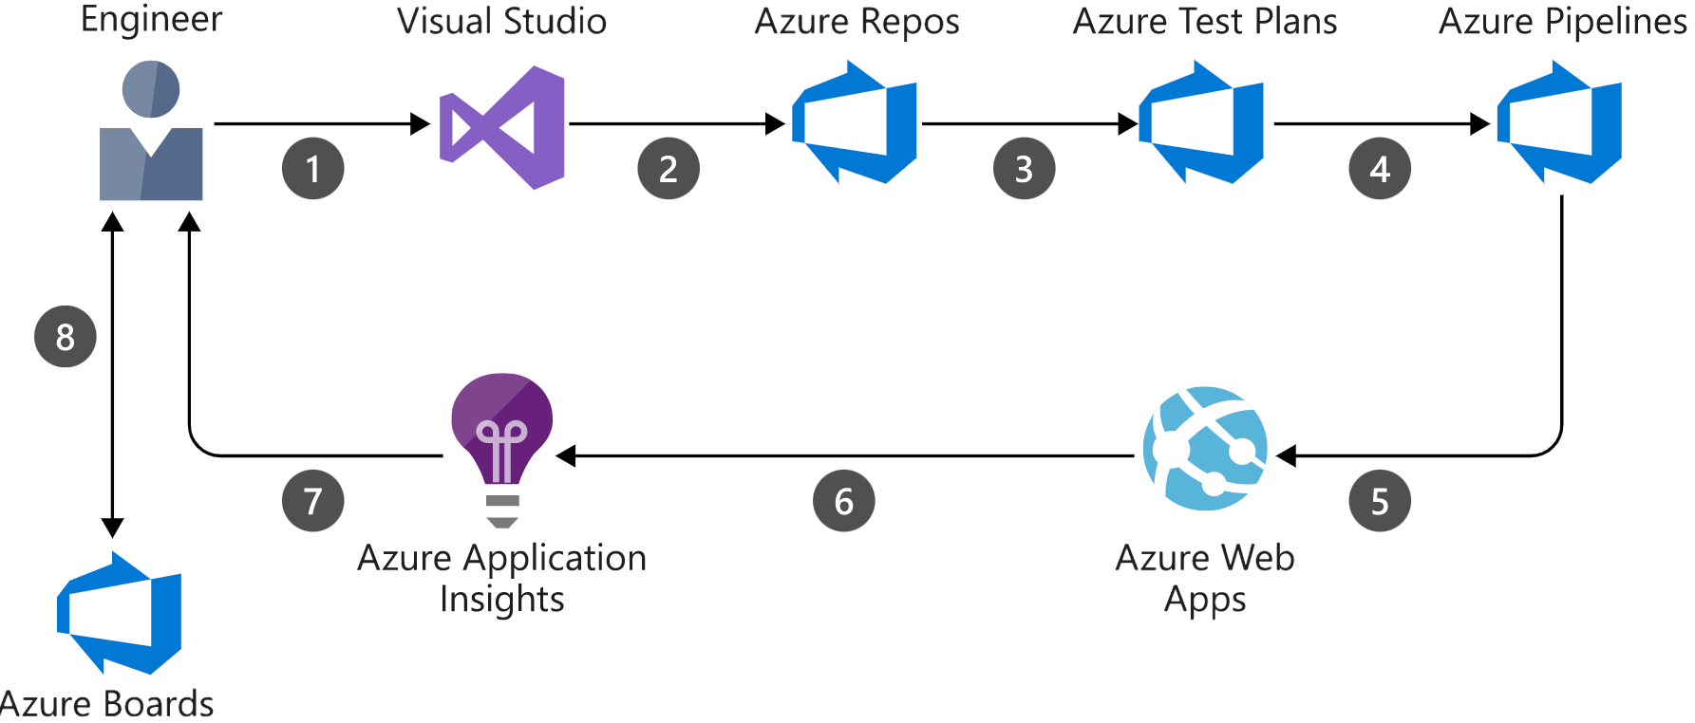
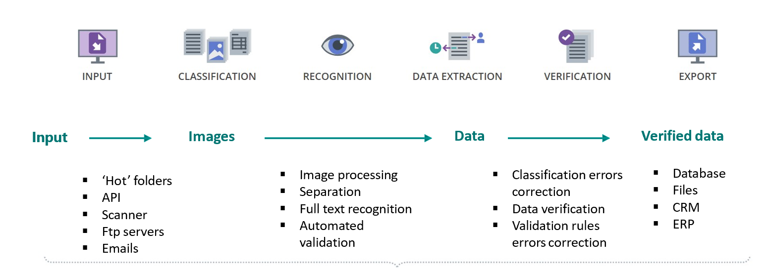



ESG scoring
ESGenius! SaaS Platform using Intelligence Document Processing (IDP)
ESGenius! processes semi-structured documents (like pdf, jpeg, tiff etc.) and extracts data using AI (200 supported languages from Automation Anywhere and ABBYY)

Slide 9
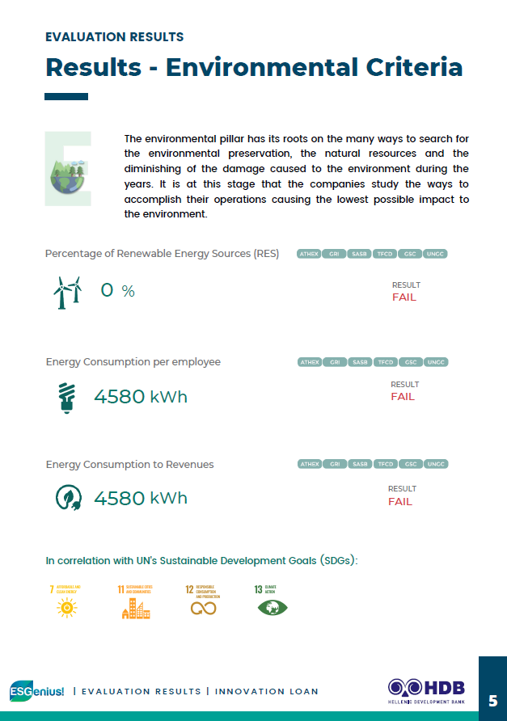
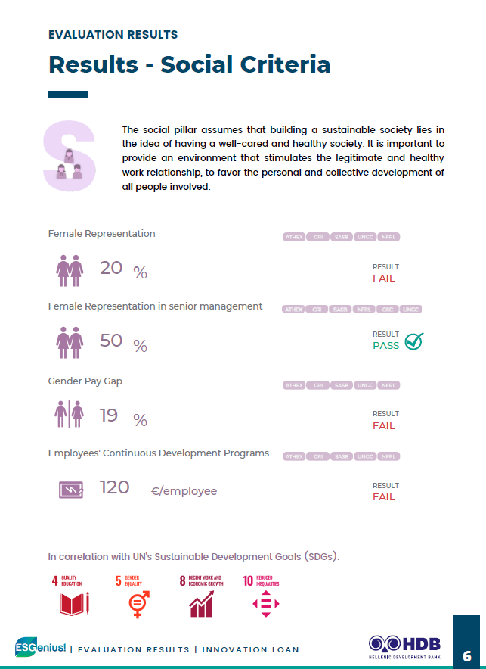
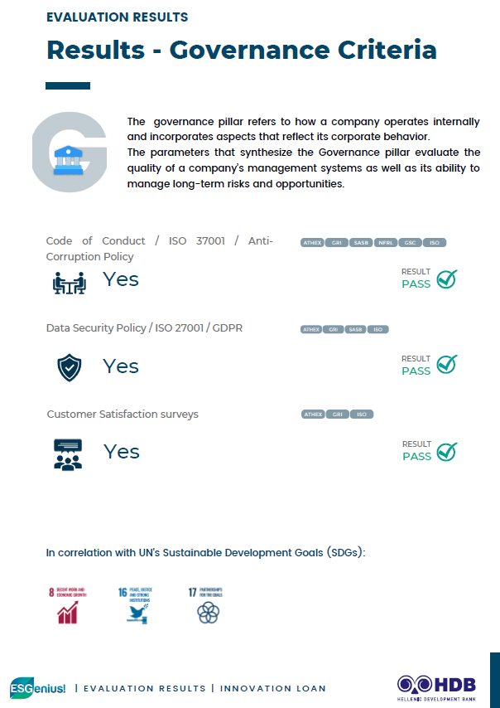
ESG scoring
Automated evaluation based on ESG criteria

Slide 10
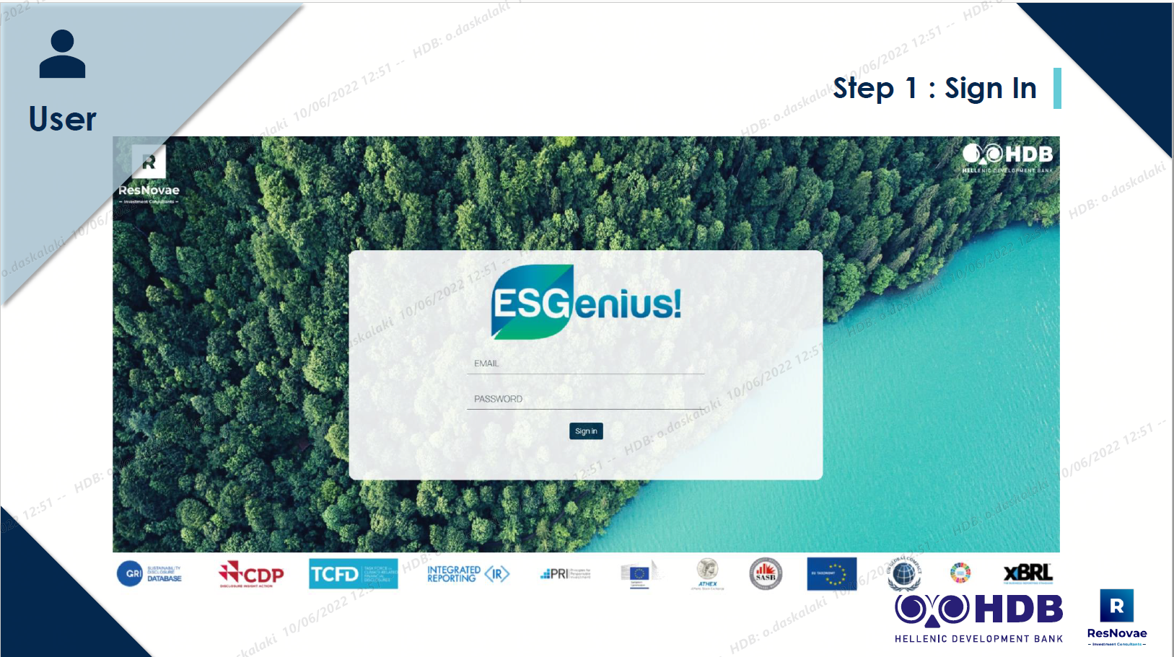
ESG scoring

Slide 11
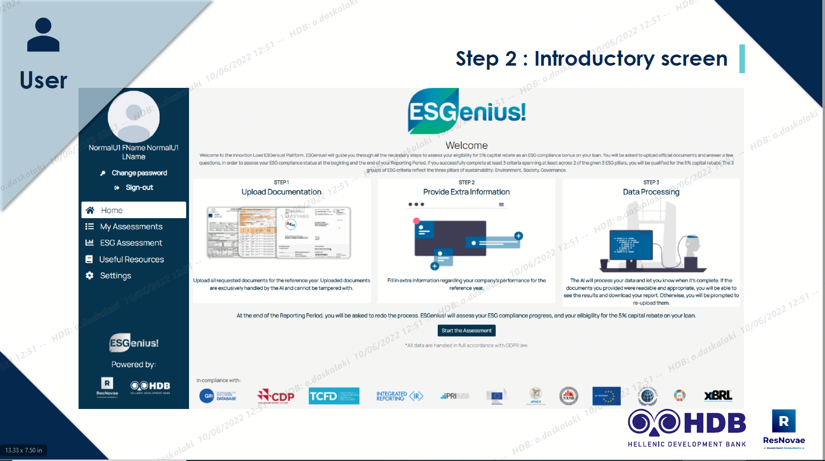
ESG scoring

Slide 12
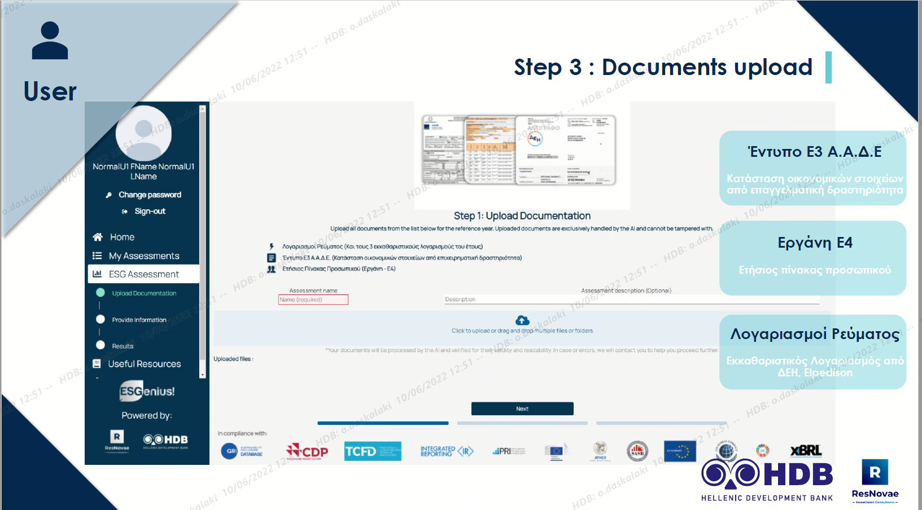
ESG scoring

Slide 13
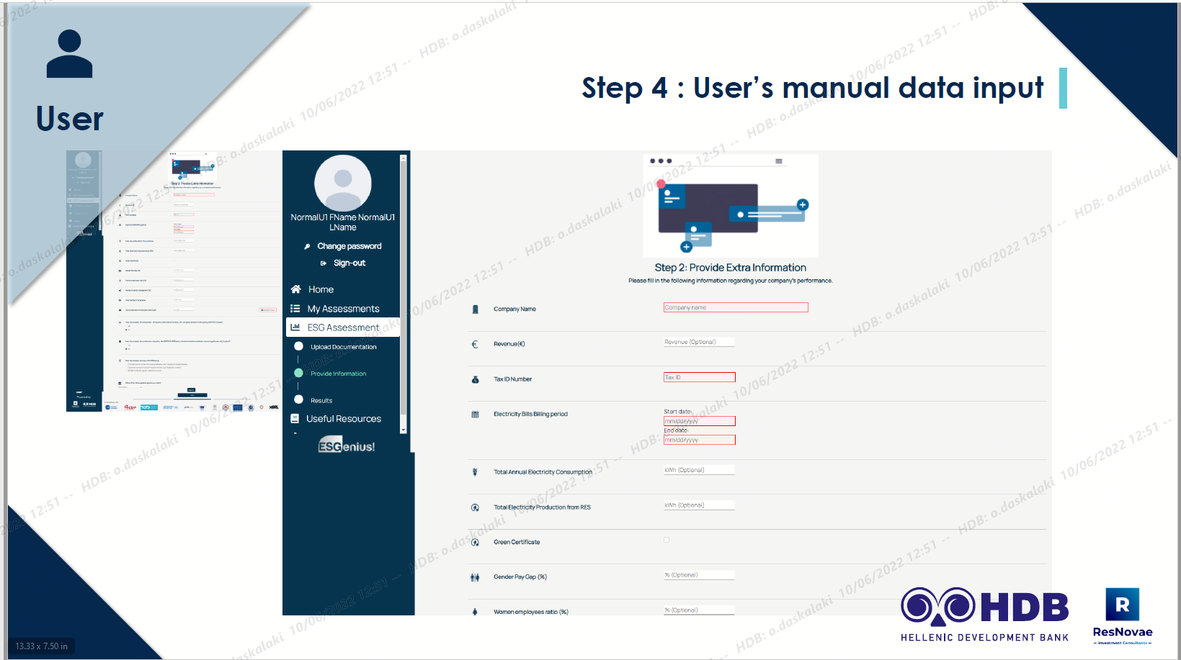
ESG scoring

Slide 14
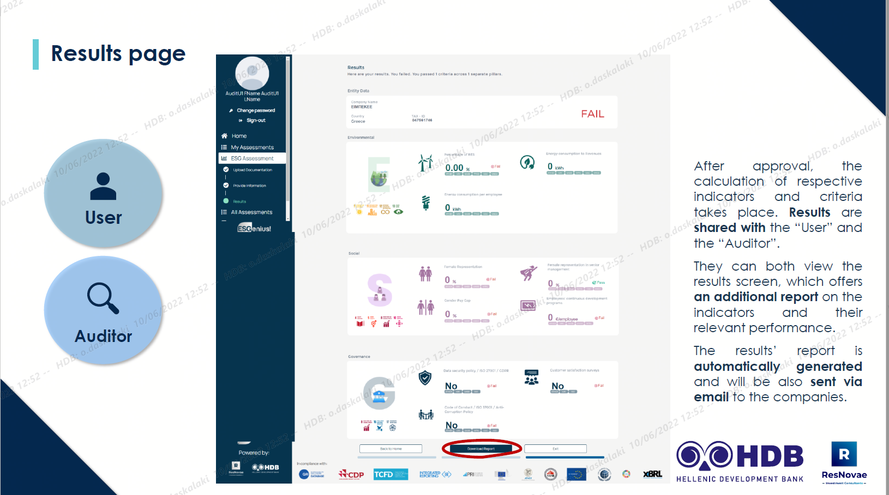
ESG scoring

Slide 15
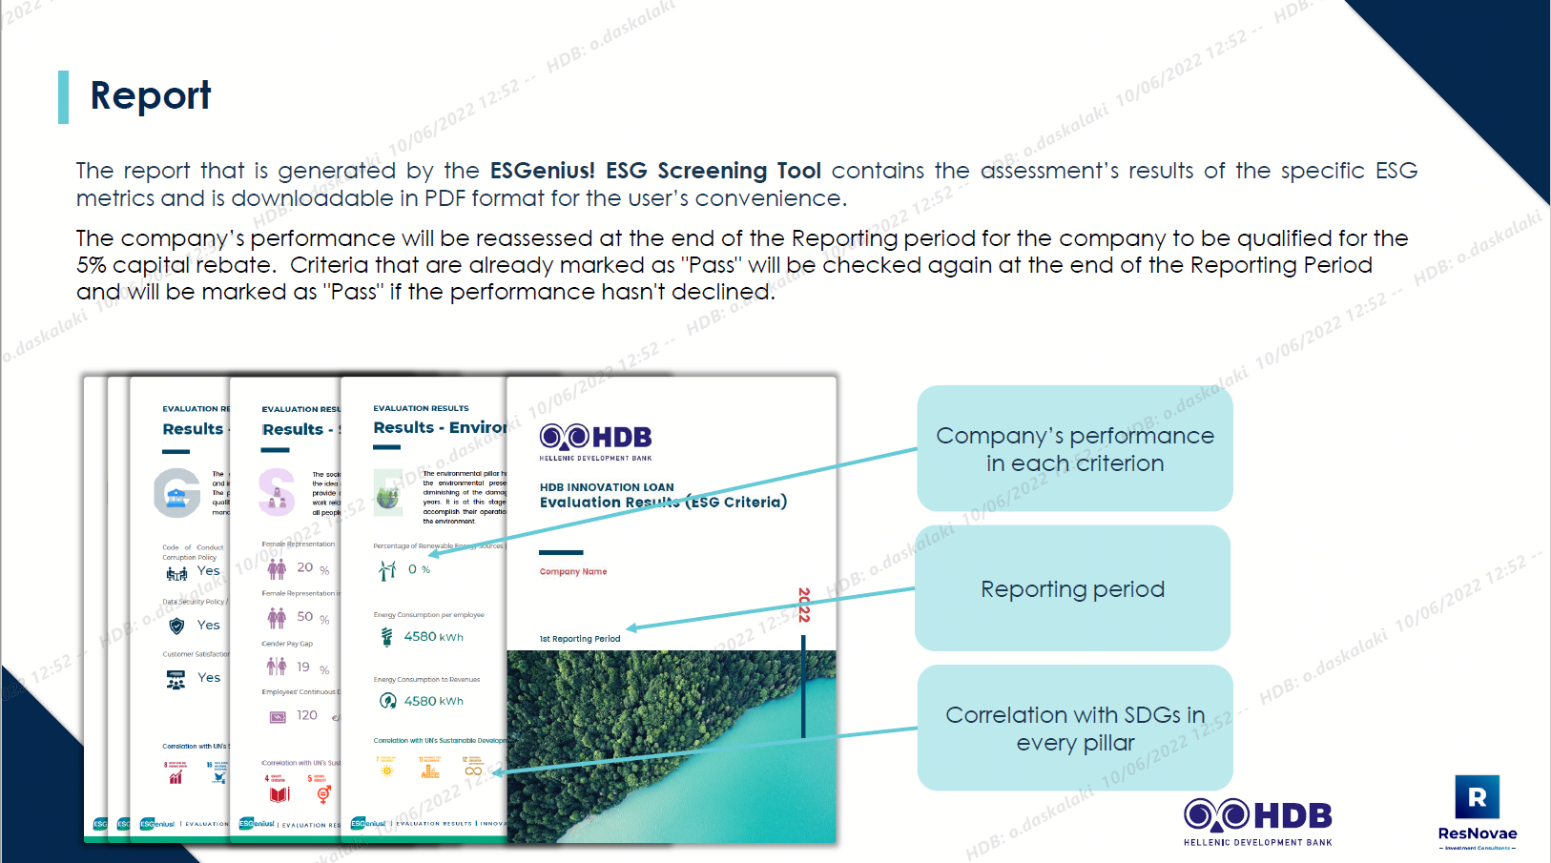
ESG scoring

Slide 16
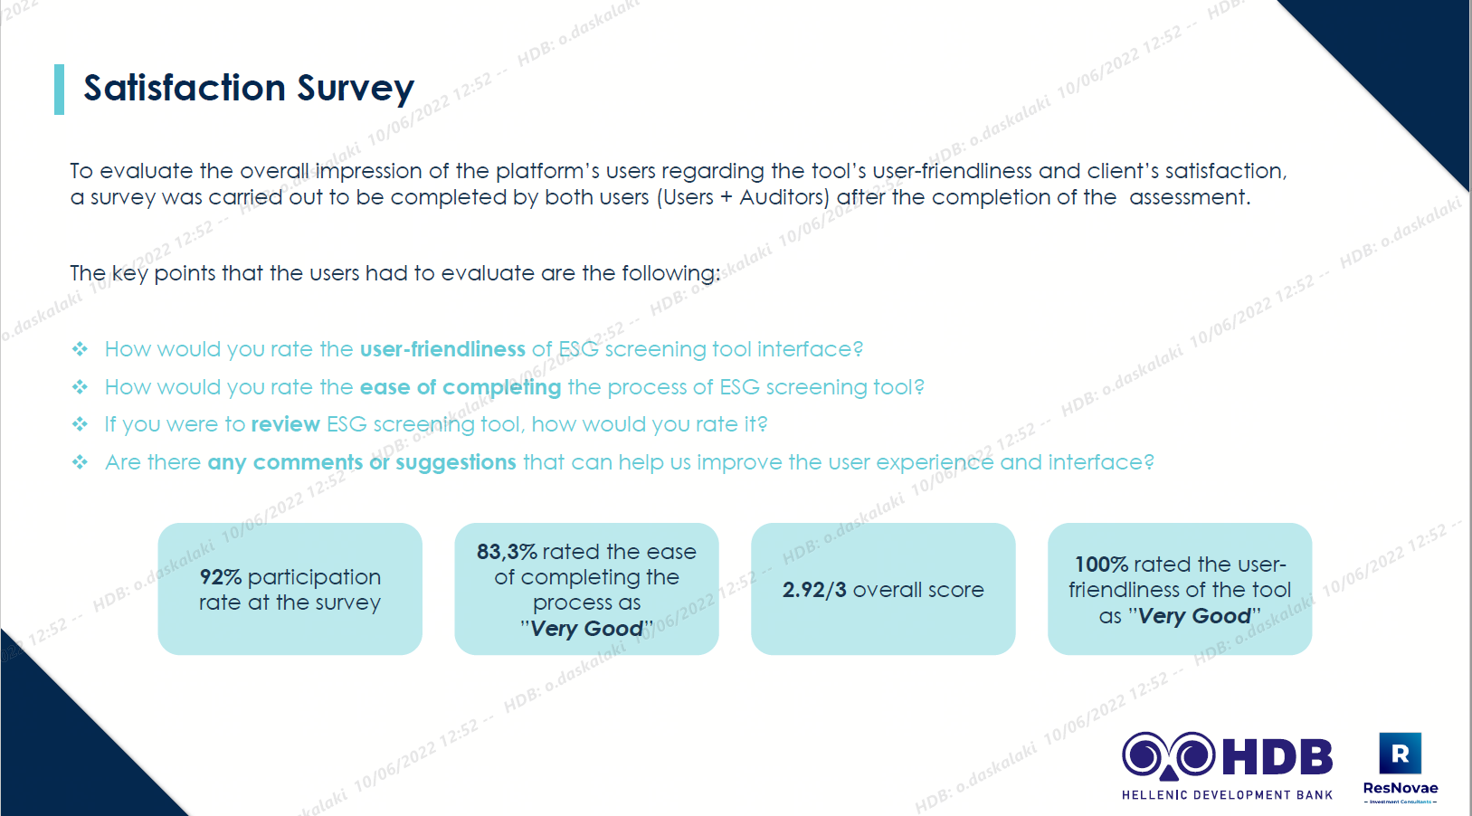
ESG scoring

Slide 17

Innovation
scoring

Slide 18

Innovation scoring
Winner to acquire the Innovation PoC deliverable :“Renvis”
‘SOFIA’: a decision-making support system for Innovation evaluation
Deliverable Α: Academic literature evaluation – interviews with banks /enterprises – Conclusions extracted and applied to algorithms
Deliverable Β: Scoring Models development & evaluation
Deliverable C: demonstration to users -
Scalability/Flexibility check – audit & validation

Slide 19
Innovation scoring
Why?
Improve access to Funding
Increase ‘Bankability’
Introduce Alternative Process Credit & Investment Evaluation
Define Business Innovation Evaluation Factors
Innovation Scoring Process
New evaluation method for Financial sector
Lack of complete Innovation Scoring tool
Use by Banks, Funds, Evaluation Platforms, Business Registries, Program Management Org.
Supplementary to traditional banking credit and investment evaluation criteria

Slide 20
Innovation scoring
How : Innovation Scoring Models
The algorithm created is based on a matrix calculation evaluating :
a)Process innovation
b)Disruptive Innovation
Process Innovation
Innovation that implements improved production or delivery methods for products or services
Eligibility (to which extent exists)
Evaluation(when applied the extent of the success/failure)
Disruptive Innovation
Innovation that disrupts the market, by displacing competition and offering advanced products or services to a wide audience
Eligibility (to which extent exists)
Evaluation(when applied the extent of the success/failure)
Factors
Factors
Factors
Factors
Financial
Organizational
Strategy
Impact
Financial
Organizational
Strategy
Impact
Financial
Organizational
Strategy
Impact
Financial
Organizational
Strategy
Impact

Slide 21
Innovation scoring
How : Innovation Scoring Factors
Innovation Scoring Factors
Financial
Organizational Capability
Strategy
Impact
Taxonomy
Pool of 139 factors

Slide 22
Innovation scoring
Innovation scoring models – factors/weights - example

Slide 23
Innovation scoring
Innovation scoring model – must be
Scalable
Methodology to Models
Multi-factors
Taxonomy & Weights
Flexible
Cloud
Amazon Web Services
API
ERPs/DBs Connection
Cooperative
Businesses
Scorecoards
Users
Roles/Rights
And…
EL/EN
Comparative evaluation
E-Learning
Auto Calculations

Slide 24
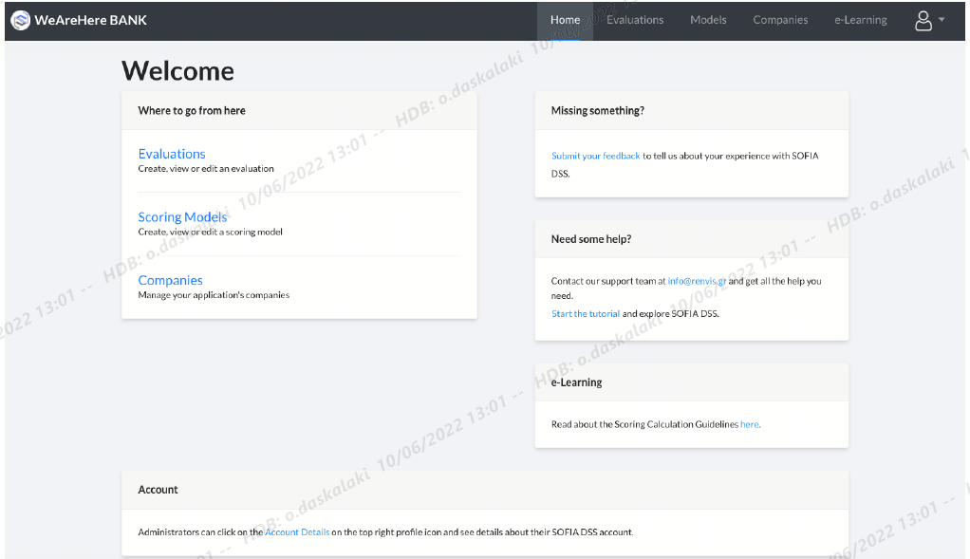
Innovation scoring
Innovation scoring models – user friendly

Slide 25
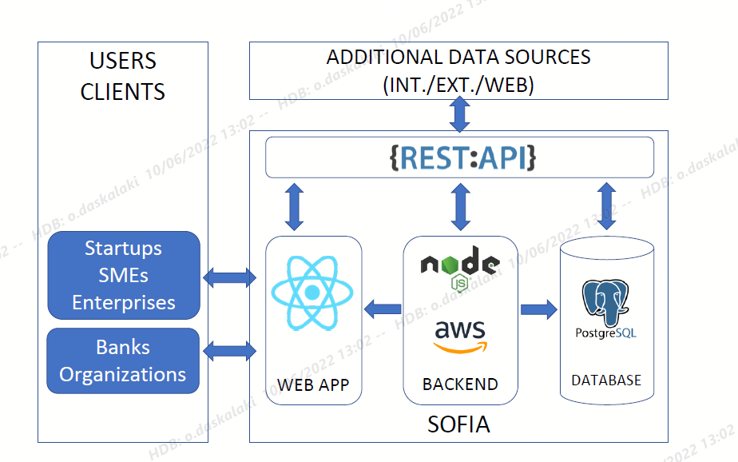
Innovation scoring
Technology Readiness Level 7

Slide 26
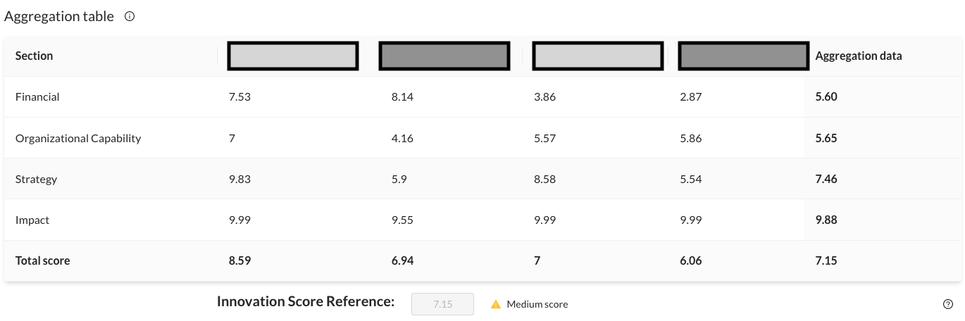
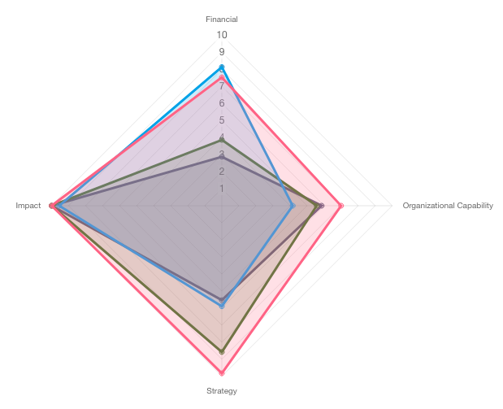
Innovation scoring
SOFIA DSS Innovation Scoring – results example

Slide 27
Final Attributes of the Innovation Scoring tool
Innovation scoring
Modern & Innovative Business Innovation Scoring Tool
Data from external sources/databases
Data Integrity & secure user access
Unified environment Scorecards & Innovation Scoring Models
Alternative/supplementary evaluation process
User satisfaction rate 86,8%
Version v.04 (EUH4D experiment “SOFIA 4.0”, June 2022 – Feb. 2023).
EOSC DIH Business pilots (Oct. 2022 – Feb. 2023)
Hellenic Bank Association
Way forward:

Slide 28
Thank you !

