Slide 1
FR-NO / 2 things in common ?

Slide 2
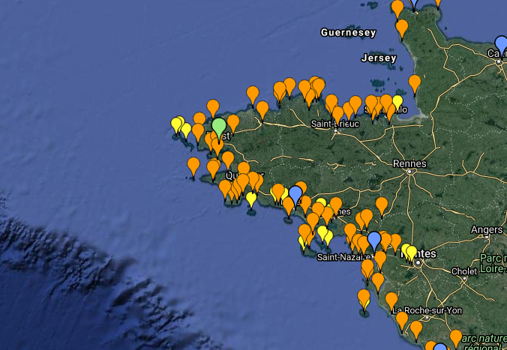
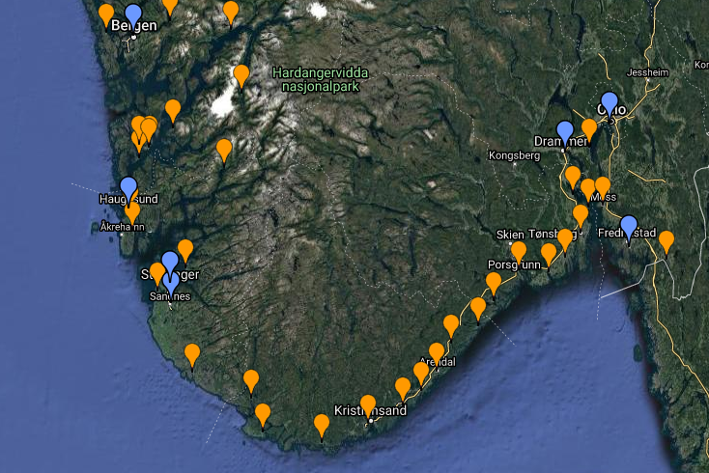

#1 – High number of ports
Western France
Southern Norway

Slide 3
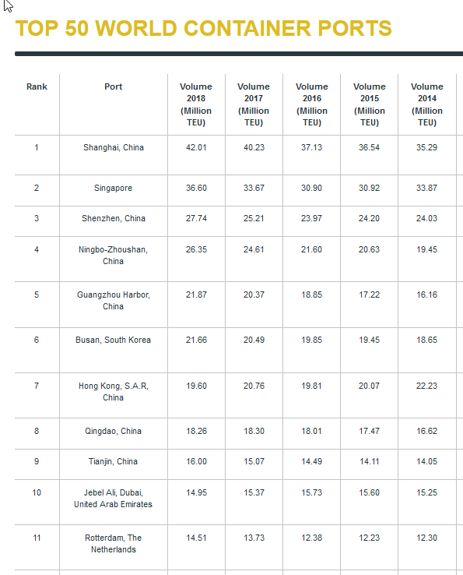
#2 – Absence in the TOP 50

Slide 4
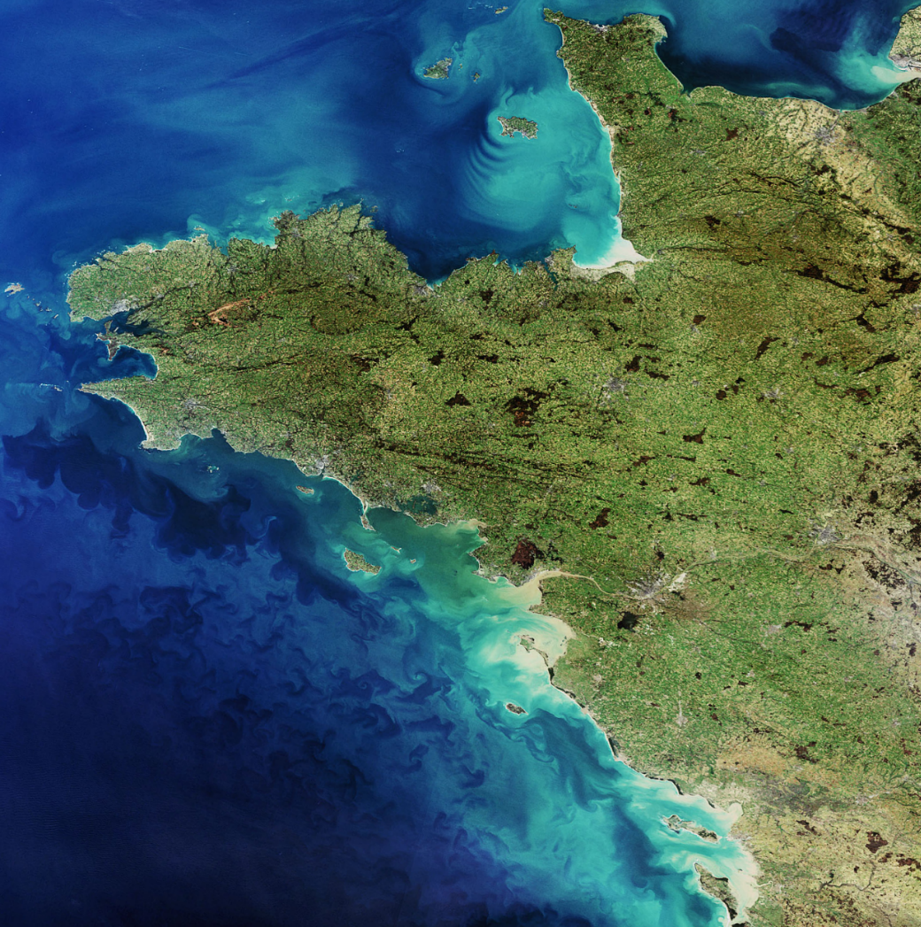

Background
France has the 2nd largest EEZ
Ports are essential to sustain our economy
  350 millions T of goods
  30 millions of passengers
  300000 jobs
On the western part of France
Over 2500 km of coastline (Brittany & Pays de la Loire)
More than 20 commercial ports (fisheries, goods, passengers, shipbuilding…) + 100 marinas

Slide 5
Recent national (french) port strategy
Context
  Over the last 2 decades, mainly evolution of governance
  Now, there is a real ambition to use the ports as:
    Hubs for economy (blue economy)
    (better) Link value chains
    A support for ecological transition
    A driver for innovation and digitalisation

Slide 6

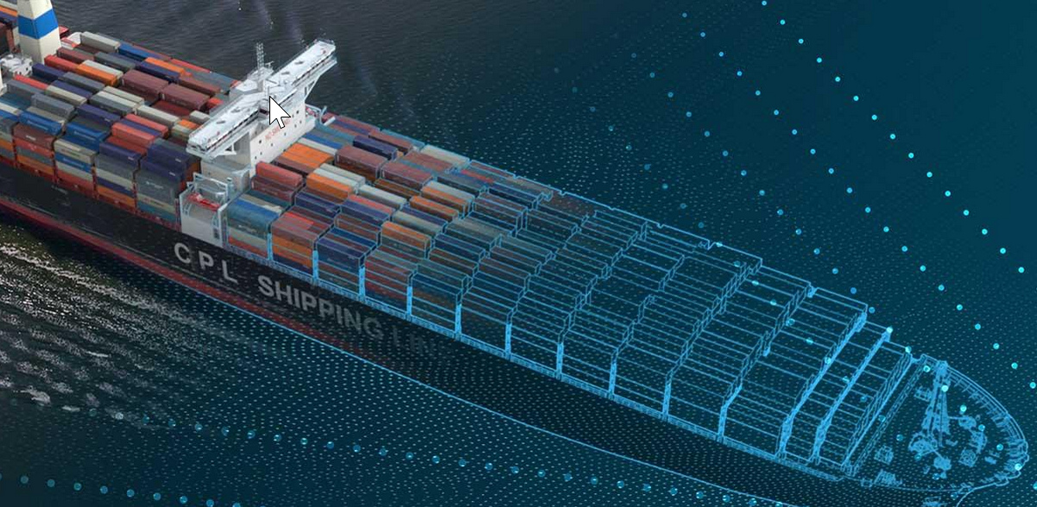
Evolution
Innovation is required!
  Towards Greener and Smarter Ports
    Examples of trends:
HYDROGEN
DIGITALISATION

Slide 7
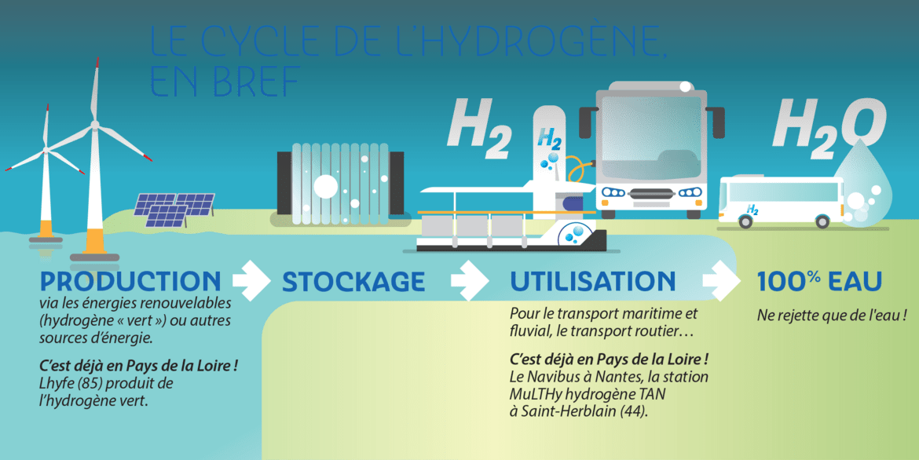
Regional initiatives and Project Examples
H2 regional roadmaps!
  Brittany
    Ports as location for trigerring H2 use (3 port’s ecosystems) 1TH2/day
    Link with Marine renewables for production (250 MW of floating offshore wind)
    10 ships equiped with H2 propulsion (0,5 to 6MW)
  Pays de la Loire
    Over 100 M€ of investment
    First ‘maritime’ electrolyser about to be tested
    Passenger ship for local transport

Slide 8
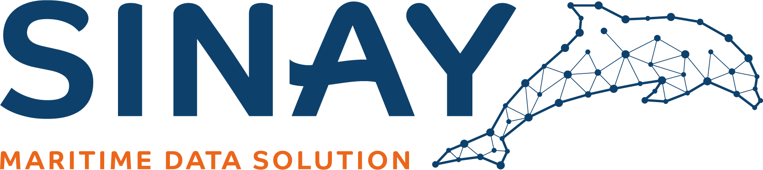
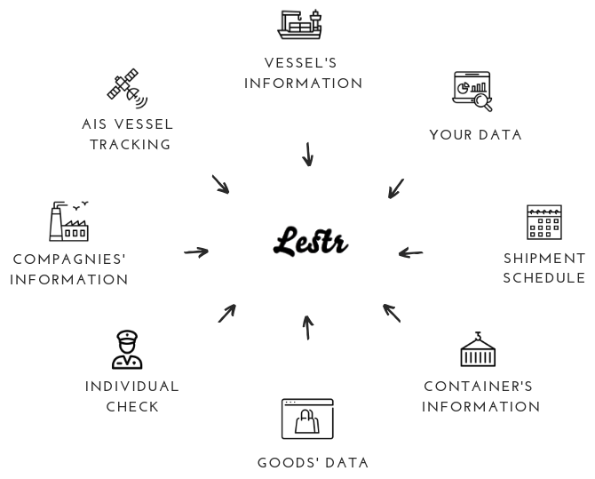

Regional initiatives and Project Examples
Digitalisation
  Development of new services based on AI and big data
  SINAY HUB SOFTWARE
    Setup enviro-monitoring program
    Various modules (Water quality, Air quality, ETA, Fish price...)
    Aggregate all data to support decision making
    Comply with regulations
    https://sinay.ai/en/sinay-hub/
  International trade security
  Lestr
    Aggregate maritime data within int. trades
    check international transactions
    Detect and prevent financial crimes
    https://www.lestr.app

Slide 9







Collaborations
Interclustering
  Foundations for ‘member’ collaborations

Slide 10
Contacts
Phil Monbet
Deputy Director
Philippe.monbet@polemer-ba.com
Tel: +33631221005
https://www.linkedin.com/in/phil-monbet-60b63212/
Eve Raymond
International Development Manager
raymond@polemermediterranee.com
Tel: +33619931104
https://www.linkedin.com/in/eve-raymond-20709446

