Slide 1
Introduction
to Capgemini
June 2024

Slide 2
Who we are
OUR STORY
Capgemini is a global business and technology transformation partner, helping organizations to accelerate their dual transition to a digital and sustainable world, while creating tangible impact for enterprises and society.
It is a responsible and diverse group of 340,000 team members in more than 50 countries. With its strong over 55-year heritage, Capgemini is trusted by its clients to unlock the value of technology to address the entire breadth of their business needs.
It delivers end-to-end services and solutions leveraging strengths from strategy and design to engineering, all fueled by its market leading capabilities in AI, cloud and data, combined with its deep industry expertise and partner ecosystem.
2023 Revenue at €22.5 BN with an operating margin of 13.3%

Slide 3
We draw on deep industry knowledge
Energy & utilities
Digital and technology are reshaping businesses within and across industries
Financial services
Manufacturing &
Life Sciences
Public sector
Services
Telecommunications, media & technology
Consumer
Goods
& Retail

Slide 4
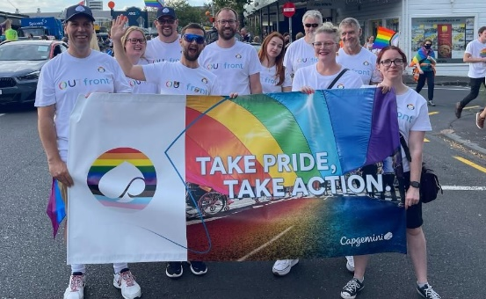
We’re focused on building more sustainable and inclusive futures for all…
59%
Carbon emissions reduction operationally per employee (v. 3.1 tCO2e v.2019)
2.4 million
Environmental sustainability
By driving a sustainable mindset into every aspect of our operations and the work we do with clients, and working collaboratively with partners, suppliers, academics and policy markers, we’re ensuring a sustainable future for our planet.
Digital inclusion
By combining our strength in technology and innovation with the skills and passions of our people, we’re bridging the digital divide and developing innovative solutions to address the biggest challenges of our lifetime.
Diversity and inclusion
By creating a vibrant and inclusive workplace that represents society in all its richness, we boost creativity and innovation, and contribute to the success of the Group.
beneficiaries of digital literacy programs in 2023
+15.1%
Increase in representation of people with disability in 2023
38.8%
Through our Social Response Unit we take an agile approach to responding to the world’s most pressing problems as they evolve
Women in our teams
Public © Capgemini 2024. All rights reserved |
4

Slide 5
About Capgemini
Capgemini is a global business and technology transformation partner, helping organizations to accelerate their dual transition to a digital and sustainable world, while creating tangible impact for enterprises and society. It is a responsible and diverse group of 340,000 team members in more than 50 countries. With its strong over 55-year heritage, Capgemini is trusted by its clients to unlock the value of technology to address the entire breadth of their business needs. It delivers end-to-end services and solutions leveraging strengths from strategy and design to engineering, all fueled by its market leading capabilities in AI, cloud and data, combined with its deep industry expertise and partner ecosystem. The Group reported 2023 global revenues of €22.5 billion.
Get the future you want | www.capgemini.com

