Slide 1
BPIFRANCE :
FINANCIAL AND INSURANCE SOLUTIONS
TURKEY
JUNE 2021

Slide 2
Summary
1.
The group Bpifrance and our activities in Turkey
2.
Financial solutions for buying French goods
3.
Insurance solutions for buying French goods
2

Slide 3
01.
The group
Bpifrance
Focus on Turkey
3

Slide 4
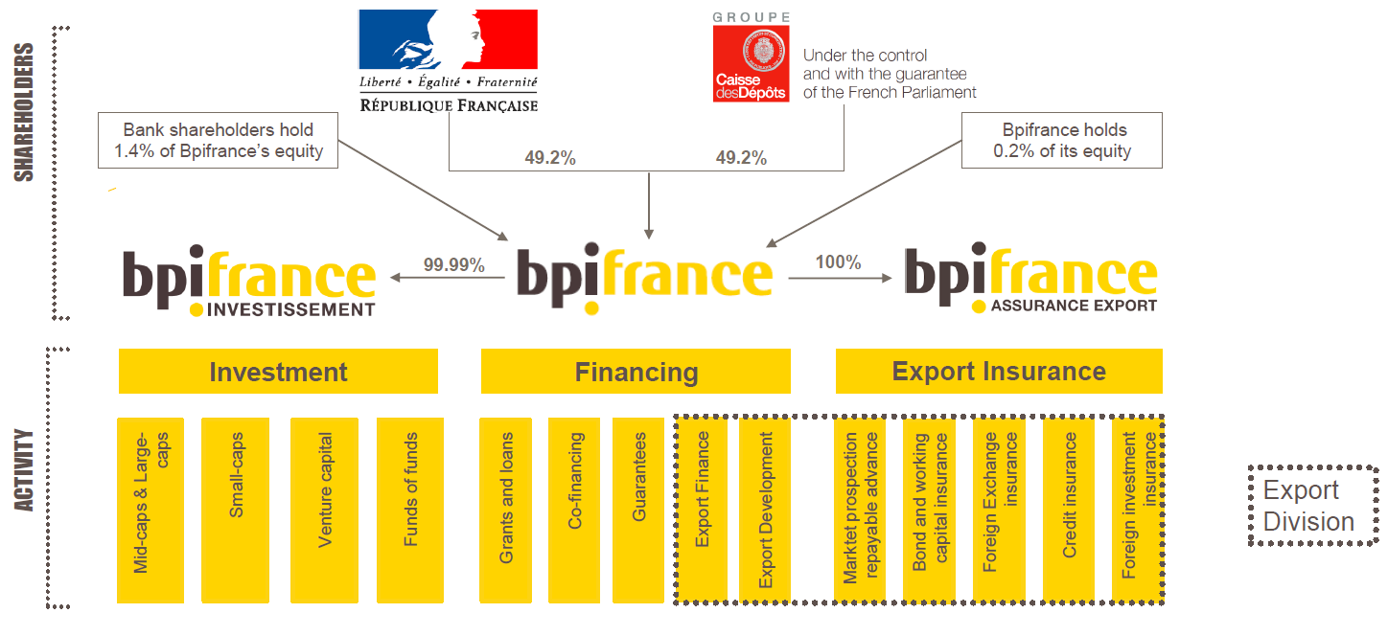
Bpifrance, the French Public Investment Bank, is the trusted partner of entrepreneurs, banks and investors
4

Slide 5
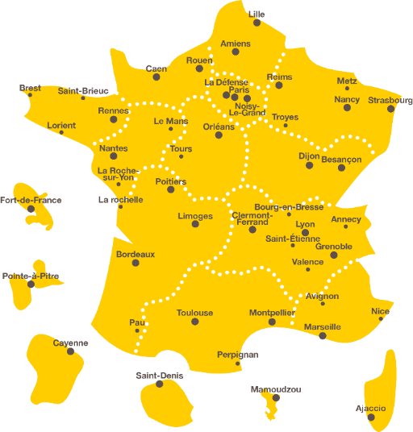
Bpifrance in figures
50
regional
offices
3,200 employees
87,000
companies backed
Our core values:
Proximity
Simplicity
Willingness
Optimism
Our Export activities:
Financing
Insurance
Innovation
Investment
Consulting
5

Slide 6
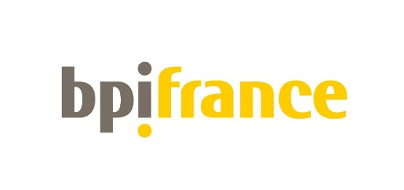
Export lending bank
« Bpifrance Financement »
French Export Credit Agency
« Bpifrance Assurance Export »
French sovereign wealth fund
Serving and supporting companies
based in France
3

Slide 7
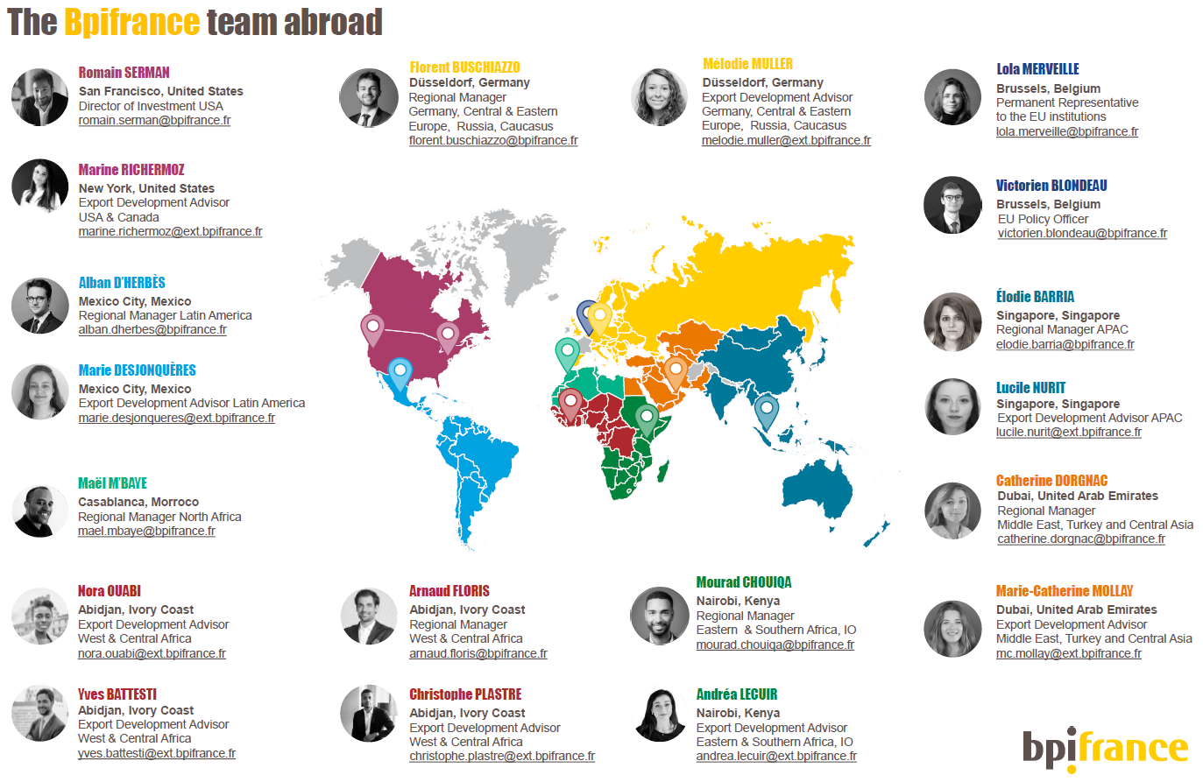

Slide 8
Turkish focus: key figures
Main turkish buyers
Outstanding amount to date: 730M€
4th country in terms of insurance activity in the area, after the UAE, Qatar and Egypt
Prospection Insurance delivered in Turkey:
Since 2020 : 27 (top 5 countries in the area, after
the UAE, KSA, Qatar and Israel)
Credit Insurance: Turkey is ranked 3rd country in the Middle East in 2020
Main sectors of activity
Aviation,
aeronautics
Textile industry
Engineering
Defense

Slide 9
02.
Financial solutions for buying French goods
Bpifrance Financement
9

Slide 10
Buyer Credit guidelines
Objective: to offer financing to a foreign buyer who wishes to finance infrastructure projects, acquire capital goods or services from a French exporter (alone or in a banking pool)
Minimum amount 5M€
Up to 25M€ alone
From €25M to €75M in pool
Foreign buyers:
private,
public or parapublic
Advantages for the foreign buyer:
Have a financing solution
Benefit from French banking rates
Make the relationship with the supplier durable
CIRR
FIXED RATE
or
VARIABLE RATE
Main features:
Financing only in Euro
Buyer's credit covered by Bpifrance Assurance Export (BAE) up to 95%
French content required:
For companies with a turnover < 150M€, French content of minimum 20% in the commercial contract
For companies with a turnover > 150M€, French content of minimum 50% in the commercial contract
Financed portion:
85% of the repatriable content (French content + foreign content)
Eligible local content up to 50% of the repatriable content
Progressive drawdowns to the benefit of the exporter during the execution period (generally over 6 months)
Repayment by the foreign buyer: semi-annual installments over 2 to 10 years, subject to BAE's agreement
Possibility of on-lending operation

Slide 11
Buyer Credit guidelines
19%
Turkish
policy rate
Pays the exporter during the execution of the contract
2
Pays back Bpifrance by installments once receiving the goods
3
French exporter
Turkish buyer
Sign export contract with minimum 20% French content
1

Slide 12
03.
Insurance solutions for buying French goods
Bpifrance Assurance Export
12

Slide 13
Buyer Credit Insurance guidelines
Objective: to cover the bank, French, Turkish or else, against the risk of non-payment of the buyer credit by the Turkish buyer, and facilitate contracts between French exporters and Turkish buyers
Your commercial contract with French small, mid size and large companies
Foreign buyers:
private,
public or parapublic
We cover the bank against nonpayment from the buyer. That helps foreign buyers get loans
Covered portion:
95%
Premium simulator
here
No threshold
Main features:
We cover financing in Euro, US dollars and other strong currencies. On a case-by-case basis, operations may be covered in local currency
Realization of an event generating a commercial loss (default or insolvency of the debtor), political or catastrophic (general moratorium, occurrence outside France of a war, revolution or riot, natural disasters, etc.)
French content required:
For companies with a turnover < 150M€, French content of minimum 20% in the commercial contract
For companies with a turnover > 150M€, French content of minimum 50% in the commercial contract
All countries except for the exclusion of the Credit Insurance Policy and prohibited countries by Bpifrance

Slide 14
Bpifrance: what you should remember…
Turkish buyers contracting with French exporters are eligible to our solutions
Bpifrance
provides you with
financing:
Buyer Credit
Commercial contract
Minimum loan: 5M€
20% French content
Contract in euros
Industrial goods/services
Bpifrance very active in Turkey
You wish to buy from a French exporter
Bpifrance is close to Turkish buyers
In France and from Dubai
Bpifrance guarantees and secures actions abroad:
Guarantee of the buyer credit

Slide 15
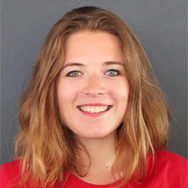
CONTACTS
Marie-Catherine MOLLAY (UAE)
Export Development Advisor
Middle East, Turkey and Central Asia
mc.mollay@bpifrance.fr
Catherine DORGNAC (UAE)
Regional Manager
Middle East, Turkey and Central Asia
catherine.dorgnac@bpifrance.fr
15

Slide 16
This document is for information purposes only. It does not constitute and should not be construed as a contractual document issued by Bpifrance. Bpifrance makes every effort to ensure that the information provided in this document is up-to-date. This document does not take into account the specific needs and requirements applicable to your project and does not exempt you from seeking professional advice. For more information on the products and services offered by Bpifrance, please contact assurance-export@bpifrance.fr
Bpifrance Export Insurance
Agit au nom, pour le compte et sous le contrôle de l’Etat en vertu de l’art L. 432-2 of « Code des assurances »
SAS au capital de 30 000 000 euros – 815 276 308 RCS Créteil - N° TVA FR 29 815 276 308 ORIAS N°17003600
Siège social : 27-31, avenue du Général Leclerc - 94710 Maisons-Alfort Cedex - Tél. : +33 1 41 79 80 00 - Fax : +33 1 41 79 80 01- bpifrance.fr
16

Slide 17
Thank you!

Slide 18
SERVIR
L’AVENIR
18

