Slide 1

Cushman & Wakefield Qatar
Capability Statement
July 2020

Slide 2
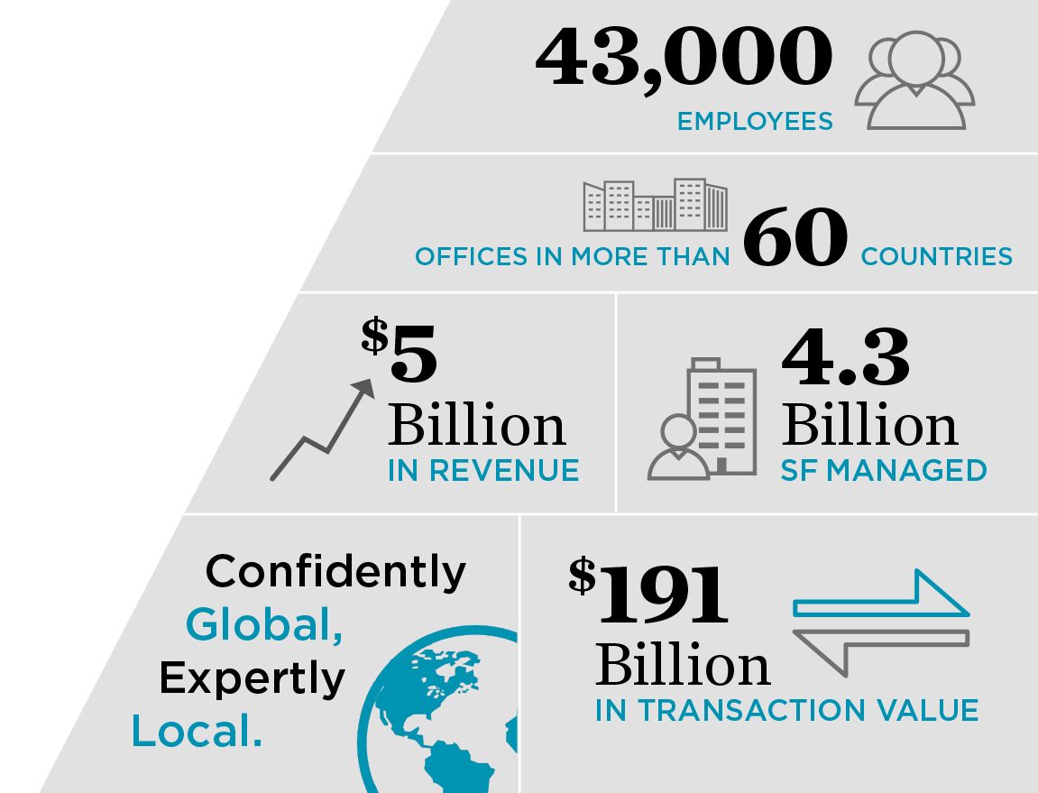
Key Statistics
WELCOME TO
CUSHMAN & WAKEFIELD
Cushman & Wakefield is one of the largest commercial real
estate services firms
in the world.
Visit: www.cushmanwakefield.qa

Slide 3
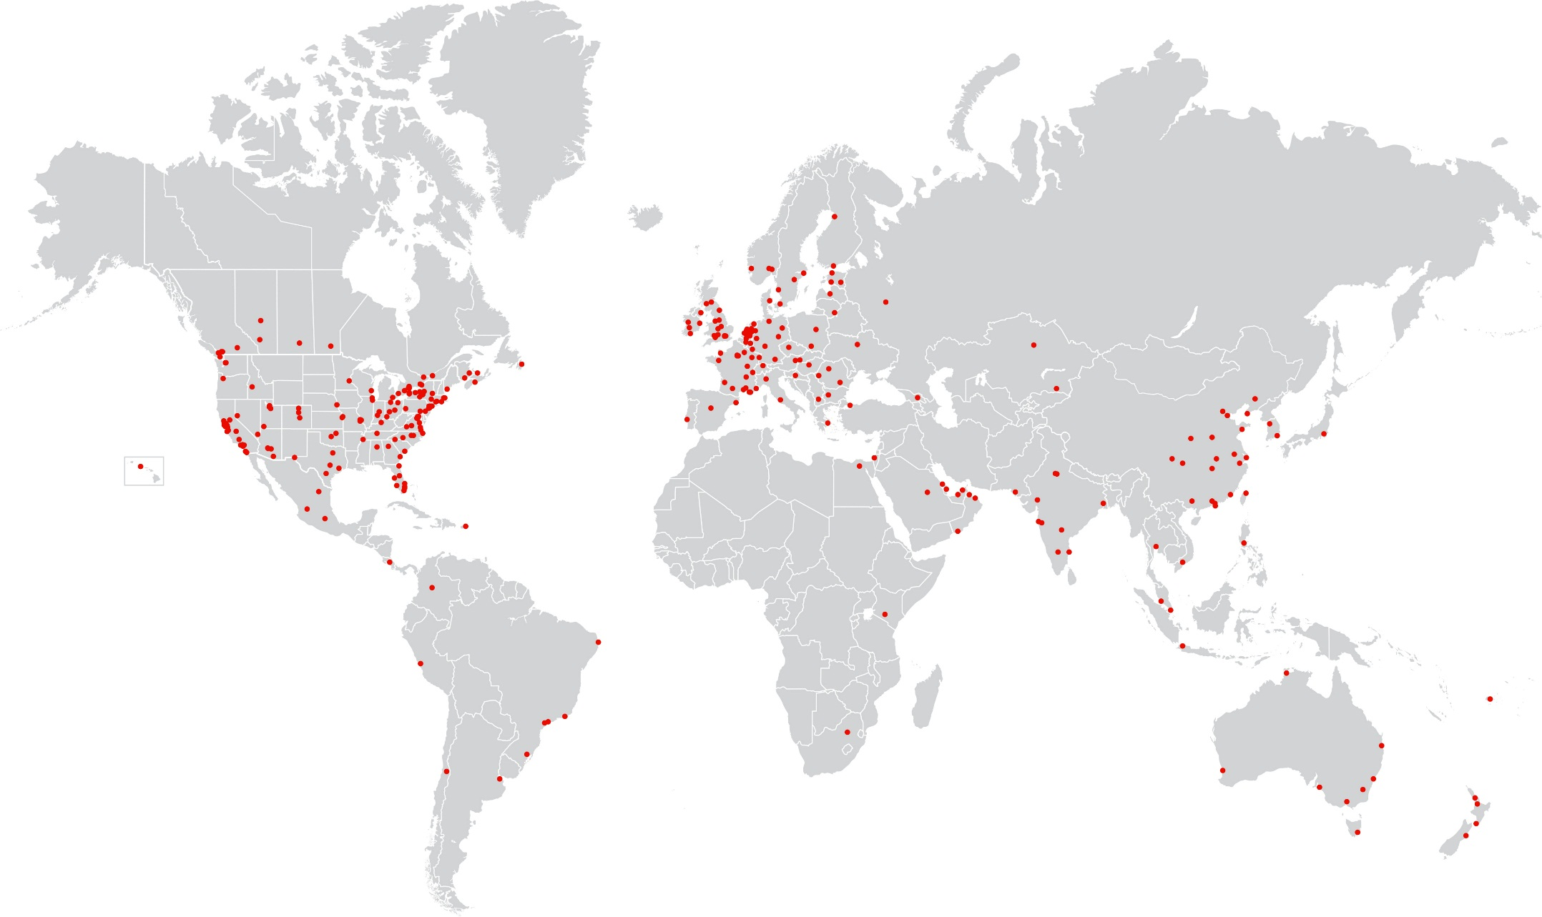
Global Offices and Country Coverage
Offices in 200+ cities
Notes:
Includes “alliance” and “affiliate” locations
Parts of Canada and Russia intentionally omitted

Slide 4
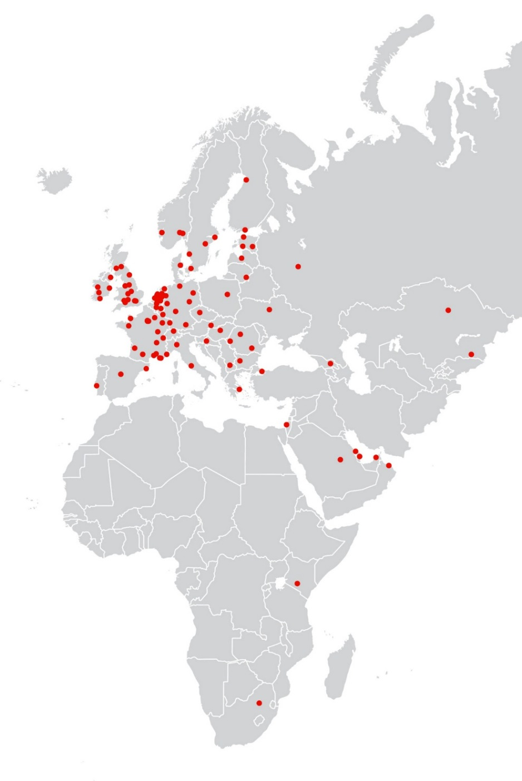
EMEA
Europe, Middle East, and Africa
45
countries
90+
offices
5,000
people
COUNTRY COVERAGE
Austria
Bahrain
Belgium
Bulgaria
Channel Islands
Croatia
Czech Republic
Denmark
Egypt
Estonia
Finland
France
Georgia
Germany
Greece
Hungary
Israel
Italy
Kazakhstan
Kenya
Latvia
Lithuania
Luxembourg
Macedonia
Netherlands
Norway
Oman
Poland
Portugal
Qatar
Republic of Ireland
Romania
Russia
Saudi Arabia
Slovakia
South Africa
Spain
Sweden
Switzerland
Turkey
Ukraine
United Arab Emirates
United Kingdom

Slide 5

About Cushman & Wakefield
WHAT WE BELIEVE
Deep local and global knowledge creates significant
value for our clients
Relentless curiosity delivers unseen opportunities
Every touch point is an opportunity to deliver an exceptional experience for clients
Diverse backgrounds, cultures, and expertise inspire breakthrough innovation
Our brand and our people will be the envy of the industry
Alone we are good; together we are great
WHAT YOU CAN EXPECT FROM US
A strong bias for action
A rigorous focus on results
Value created through insight
The right people powered by the right platform

Slide 6










































Global Clients

Slide 7
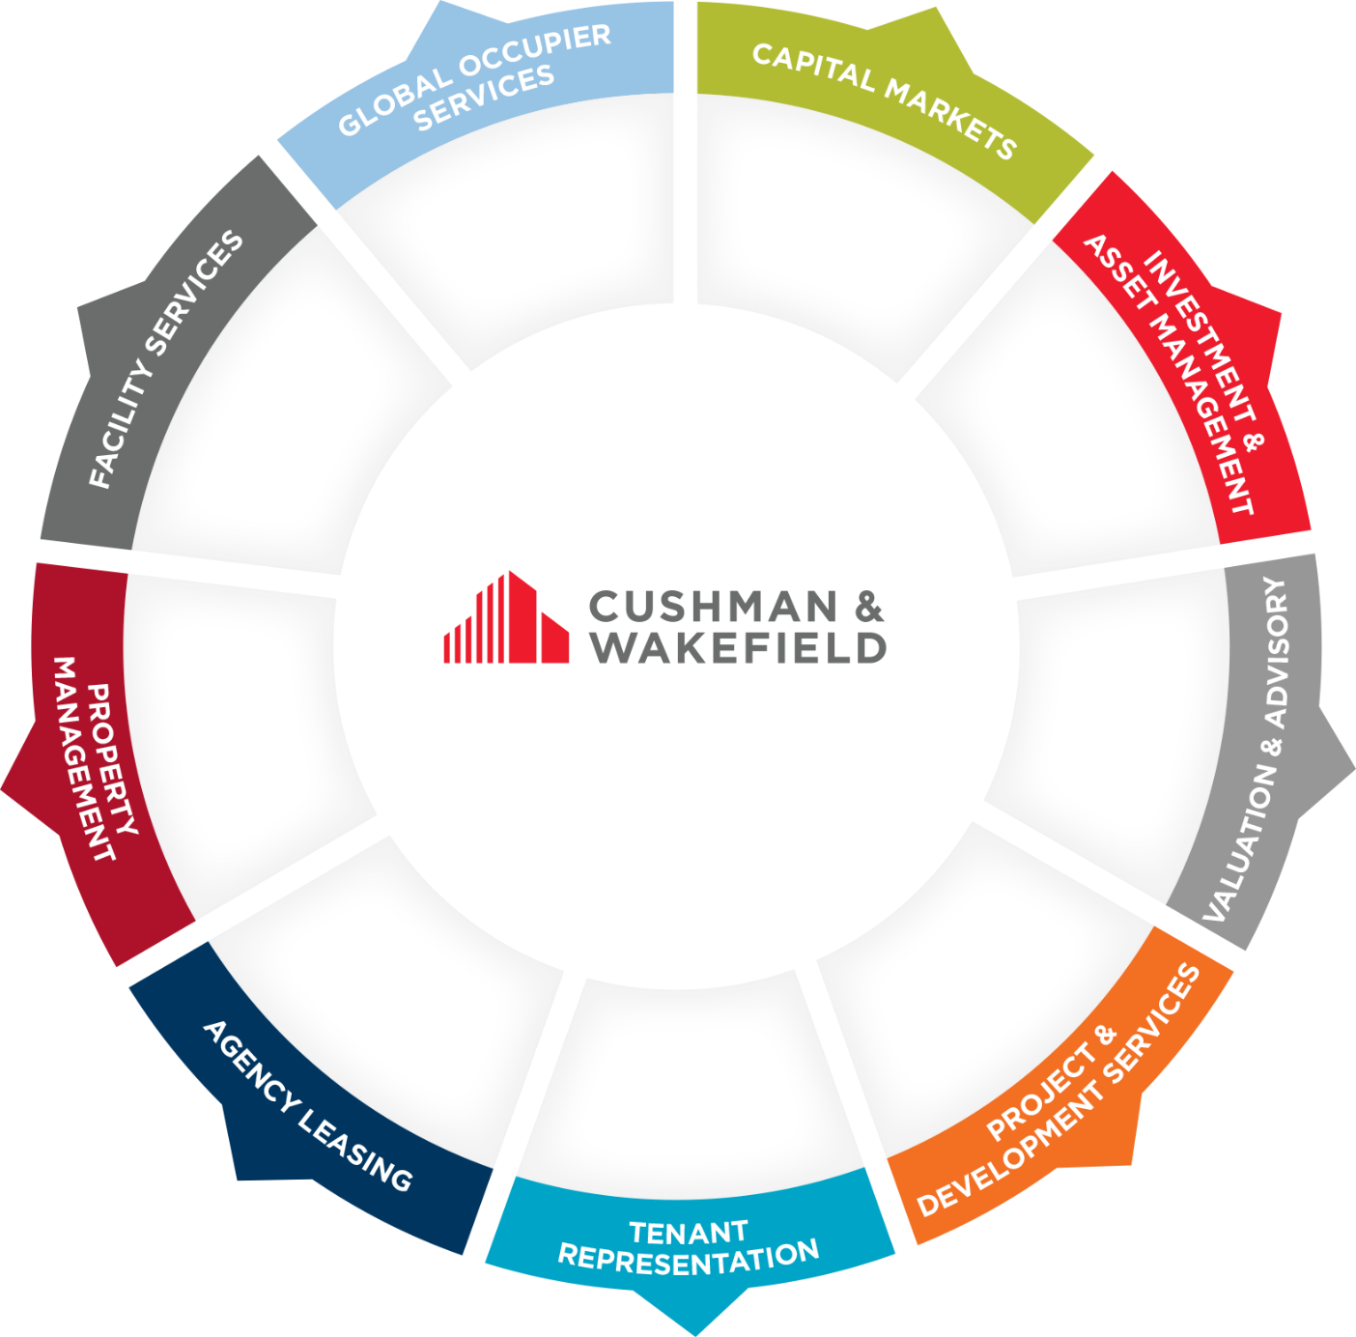
Core Services

Slide 8

Qatar Service Line
Valuation & Advisory
CORE SERVICES
Loan Security Valuations
Financial Reporting
Development Appraisals
Valuation Review
Acquisition & Disposal Advice
Expert Witness
Cushman & Wakefield’s Valuation & Advisory (V&A) team provides sophisticated advice on real estate equity and debt decisions to clients. Our capabilities span valuation and advisory services relating to acquisition, disposition, financing, and financial reporting.
Access to real-time market data, the insights of Cushman & Wakefield Qatar’s leasing, research and capital markets experts, and long-term market experience ensure the application of best practices and proven, successful methodologies.
Professionally qualified staff and a rigorous quality control system ensure our clients receive the highest quality service and product.
Consistent delivery across multi-market client portfolios
Timely delivery of value conclusions
Compliance with financial regulatory requirements
Valuations based on access to constantly updated market data

Slide 9

Qatar Service Line
Consulting & Research
WHAT DOES THIS MEAN
TO YOU?
We collaborate
with clients to identify risk and opportunity and establish the feasibility of development proposals.
Cushman & Wakefield Qatar form part one of the largest and most respected real estate advisory services in the industry.
We offer access to real-time market data and insights into Qatar’s real estate market, including commercial and residential leasing, sales, and capital markets.
Our on-the-ground experience in Qatar offers clients with unrivalled market insights and allows us to combine the best of research analytics and real estate consulting experience.
We provide strategic development advise, tailored to the unique characteristics, risks and opportunities that exist in Qatar, and throughout the Middle East.
Offer clients insight into otherwise opaque real estate markets
Collaborative approach with clients to identify market opportunities
Research driven property positioning that drives optimum financial results
Identify the highest and best use real estate solutions for development sites
Financial feasibility assessment of proposed developments to establish potential profitability

Slide 10
Qatar Service Line
Global Occupier Services
WHAT DOES THIS MEAN
TO YOU?
Greater diversity and more bench strength mean more informed, creative solutions.
Tenant advisory experts provide strategic occupancy solutions that support and enhance your company’s bottom line by aligning real estate needs with your business strategy, financial goals, and operational objectives.
Occupancy Strategy Development
Negotiations for Acquisitions, Dispositions, and Build-to-Suits
Market, Demographic & Labor Analysis
Lease Renewals and Rent Review
Lease Restructuring and Surrenders
Transaction Strategy and Planning
Analytical approach to occupancy strategy, market analysis, and site selection, backed by
comprehensive financial modelling
We leverage our market-leading research to uncover hidden opportunities and collaborate with our colleagues to provide creative solutions to our clients’ real estate requirements

Slide 11

Qatar Service Line
Agency Leasing
WHAT DOES THIS MEAN
TO YOU?
Our fingers are on the pulse of the market —we know the active occupiers and bring them to you.
We provide strategic expertise to commercial property owners, working to maximize asset awareness, leasing activity, rental rates, occupancy, and overall investment value. We deliver customized solutions for office leasing services by analyzing each asset’s unique attributes—investment goals, tenant mix, financing structure, building strengths, submarket conditions, and competition.
Strategic Asset Analysis
Positioning and Marketing Plans
Broker Relationship Campaigns
Prospective Tenant Canvassing & Analysis
Lease Negotiation
Regular Reporting on Market Activity & Trends
Asset strategies enhanced by experience in
Capital Markets and Tenant Representation
Enhanced asset values
Reduced risk and exposure
Property positioning that supports premium pricing

Slide 12
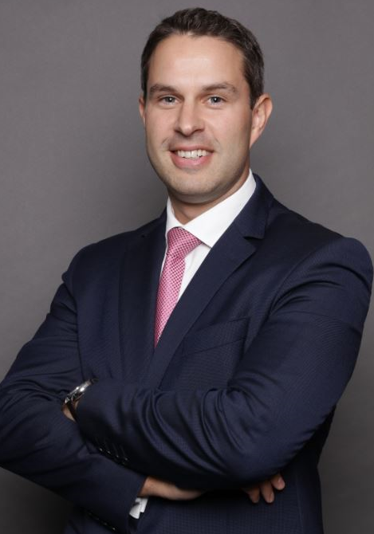
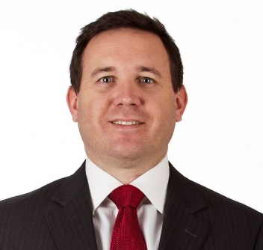
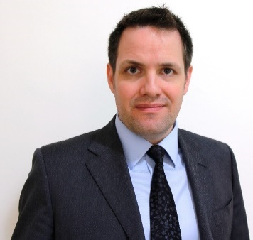
Our Team
Adam Stewart MRICS, Partner, Head of Valuation & Advisory, Cushman & Wakefield Qatar
Adam Stewart has been with Cushman & Wakefield Qatar since October 2010 where he started working in Cushman & Wakefield’s London office. Adam moved to Cushman & Wakefield Qatar in January 2014 as Head of Valuation Advisory before being appointed as Head of Valuation Advisory for the Middle East Region in January 2017.
He specialises in valuing large scale development projects having worked extensively on projects such as The Pearl Qatar, Msheireb Downtown Doha & Lusail City.
Johnny Archer MRICS, Partner, Head of Consulting & Research, Cushman & Wakefield Qatar
Johnny Archer is a Partner with C&W Qatar having joined in July 2014. Previously Head of Valuations, Research and Consultancy with Asteco Qatar, Johnny has been responsible for undertaking a range of Real Estate Market studies for clients in Qatar. Johnny’s clients include; The Supreme Committee for Delivery and Legacy, QNB Capital, AECOM, Qatari Diar, Qatar Rail, MME, Katara Hospitality, Commercial Bank of Qatar, Qatar Insurance Company, Barwa Bank, Seef Properties and QEWC. Johnny has gained substantial knowledge of the market through extensive property valuation and consulting instructions throughout Qatar as well as commercial leasing and acquisition instructions.
Mark Proudley MRICS, Partner, Head of Commercial, Cushman & Wakefield Qatar
Mark Proudley is a Partner with C&W Qatar and since joining in May 2006 has been responsible for undertaking a range of market and Real Estate Market studies for clients in Qatar. During this period Mark has worked on Real Estate Market studies across all real estate sectors in Qatar. Mark’s clients include; Msheireb, Qatari Diar on Commercial Boulevard and Lusail Towers, Majid Al Futtaim on Downtown District, Entertainment City, AKI on Katara Hills and Hotels, Meraas on Dubai Towers Doha and Barwa on numerous projects in Qatar. Mark has gained substantial first-hand knowledge of the market through direct sales and leasing experience.

Slide 13












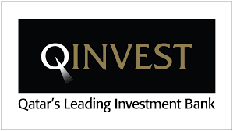




Cushman & Wakefield Experience in Qatar
Clients in Qatar
WHAT DOES THIS MEAN FOR YOU?
Assurance that Cushman & Wakefield consistently act on behalf of some of the most prominent corporate real estate companies, semi-state bodies and corporations in Qatar.

Slide 14

Contact Details
  Edd Brookes
  International Partner / Heads of Middle East
  Tel: 44837395
  mark.proudley@cushwake.qa
Mark Proudley
Partner: Occupier Services & Agency Leasing
Tel: 44837395
mark.proudley@cushwake.qa
  Adam Stewart
  Partner: Valuation & Advisory
  Tel: 44837395
  mark.proudley@cushwake.qa
  Johnny Archer
  Partner: Consulting & Research
  Tel: 44837395
  johnny.archer@cushwake.qa

