Slide 2
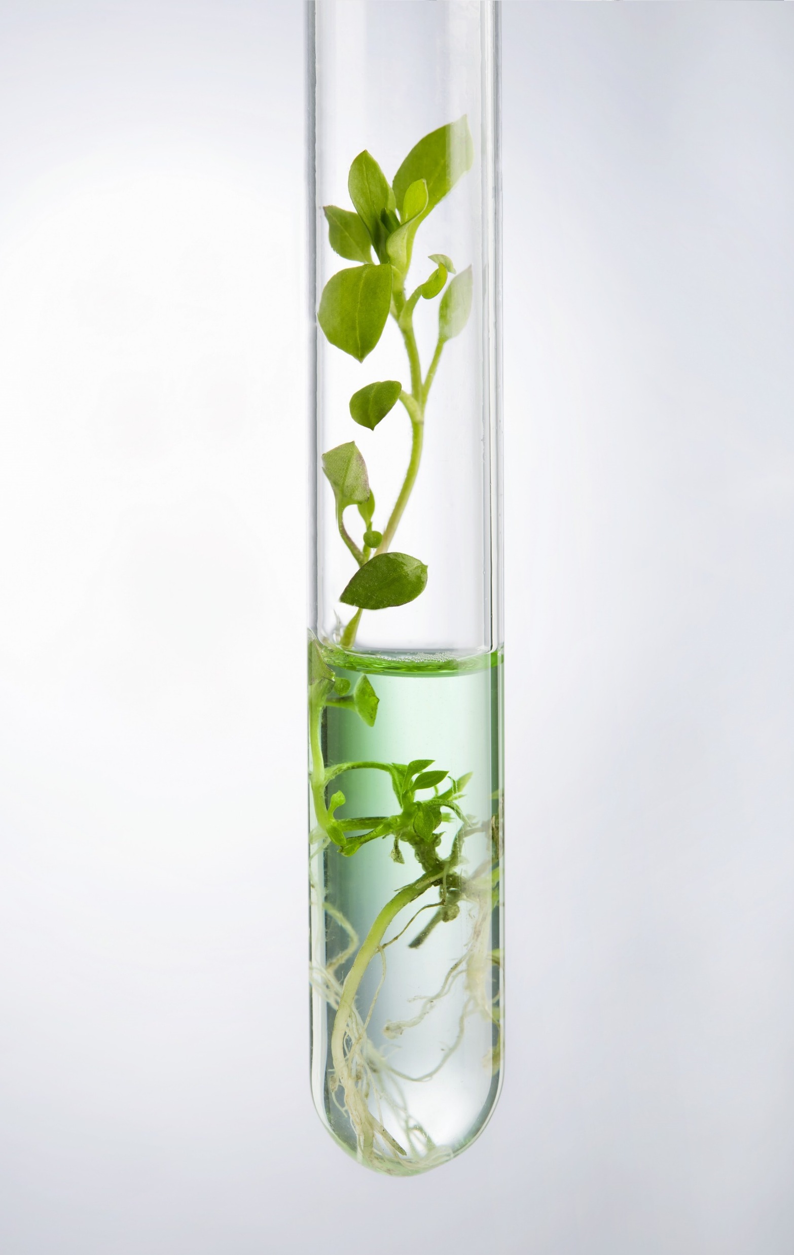
SUSTAINABLE DEVELOPMENT AT L’ORÉAL : A LONG-STANDING COMMITMENT
Since 1979, L’Oréal aware of the urgent need to act.
In 1995, we opened our first environmental research laboratory.
In 2009, we formalized our first industrial environmnental targets.
In 2013, we launched our first sustainability program, reinventing completely our way of doing business.
In 2020, and based on our tangible results, we have launched our second phase of our sustainable transformation,
L’ORÉAL FOR THE FUTURE
Date
Footer can be personalized as follow: Insert / Header and footer
Notes:
We started in 1979 with a commitment to work on reconstructed skin to avoid animal testing.
By 1995, we had already created an environmental research laboratory.
In 2009, we set our first environmental targets to reduce the footprint of our industrial activity.
In 2013, we launched our first comprehensive sustainability program.
This program was called Sharing Beauty With All. It was ahead of its time.
In 2020, this led us to renew this vision, that we had to be continuously ahead of the curve,
and anticipate the sustainability challenges that are now before us.
We wanted to be even more committed, more determined.
This is the purpose of our second generation of sustainability commitments: L'Oréal for the Future.

Slide 3
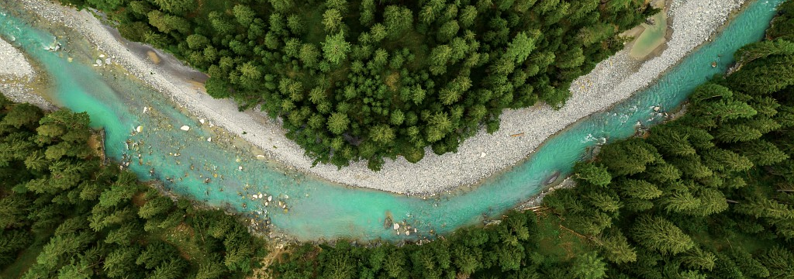
Our PILLARS in
Corporate responsibility
TRANSFORMING OURSELVES AND RESPECTING PLANETARY BOUNDARIES
EMPOWERING OUR BUSINESS ECOSYSTEM HELPING IT TRANSITION TO A MORE SUSTAINABLE WORLD
HELPING SOLVE THE CHALLENGES OF THE WORLD BY SUPPORTING SOCIAL AND ENVIRONMENTAL NEEDS
1
2
3
Notes:
So we defined our objectives with scientists, based on the concept of planetary boundaries that you see on the screen. Any limit that is exceeded puts the ability of humanity to survive at risk. We decided that our activities will be within these limits.
This thinking has led to the development of the L'Oréal for the Future program, built on three pillars
a first one based on transforming ourselves,
a second aimed at involving our ecosystem in our transformation: we know that even if we are small when looking at the immensity and complexity of the issues at stake, we all have a role to play together, by cooperating to find solutions,
and finally, a third pillar to contribute to solving urgent environmental and social challenges.

Slide 4
L’oréal for the future
Onboarding our suppliers & consumers
Notes:
So we defined our objectives with scientists, based on the concept of planetary boundaries that you see on the screen. Any limit that is exceeded puts the ability of humanity to survive at risk. We decided that our activities will be within these limits.
This thinking has led to the development of the L'Oréal for the Future program, built on three pillars
a first one based on transforming ourselves,
a second aimed at involving our ecosystem in our transformation: we know that even if we are small when looking at the immensity and complexity of the issues at stake, we all have a role to play together, by cooperating to find solutions,
and finally, a third pillar to contribute to solving urgent environmental and social challenges.

Slide 5
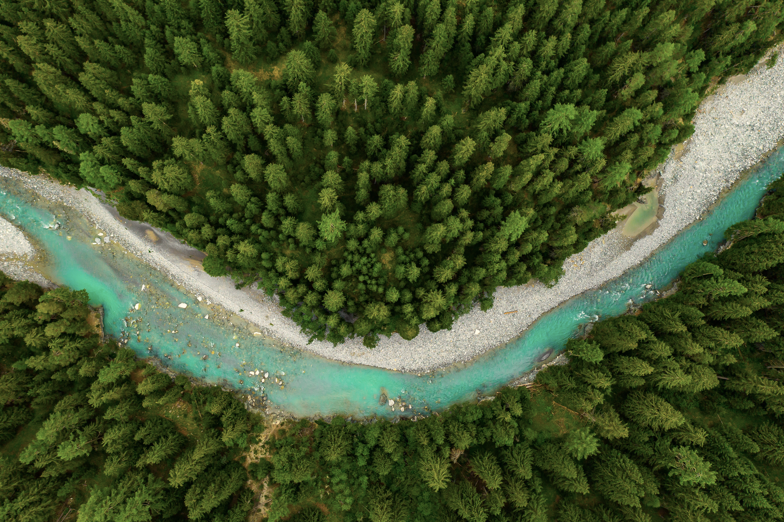
Thank you

