Slide 1
The Migration Advisory Committee (MAC)
MAC presentation to the French chamber of Commerce
Presented by: Sheena Kerr, Hetal Hirani

Slide 2
Introduction to the MAC
Formed in 2007: “…an independent, non-statutory, non-time limited, non-departmental public body that advises the government on migration issues.”
Why do we exist?
Which means…
Provide
Inform
Enable
Allow
We make recommendations
We do not create policy
We do not implement policy

Slide 3
Introduction to the MAC
Who are we?
What do we do?
Ministerial Commissions
Committee Led Research
Committee
Economics
Education
Social & Political Science
Migration
Secretariat
Research & Evaluation
Stakeholder Engagement
Economics & Data
Devolved Administrations
How do we do it?
Call for evidence
Expert Panels
Quantitative Analysis
Qualitative research and analysis
Framework Document

Slide 4
Commissions
Commissioned by HO Ministers
Limited resource
Other government departments cannot directly commission
MAC led Work
Since 2019 the MAC can also conduct its own work outside of commissions
AR 2020/2021
Building the evidence base: Data matching, progression of migrants, employer attitudes

Slide 5
ICT Route
Commissioned September 2020, published October 2021
Main findings:
Route working well
Salary thresholds should be reviewed and update annually
ICT should be a route to settlement (not accepted)
New rules around subsidiaries to replace the Representative of an Overseas Business route: up to 5 team members, no more than 2 year visa period, after which switching be allowed
A secondment route should be created to allow overseas businesses under contract with a UK business to second staff to the UK

Slide 6
Annual Report 2021
The Pandemic Labour Market and the new Immigration System
Asylum and Integration
Immigration and Social Care
Costs of the Immigration System
Indeed Data Exploration
Forward Look

Slide 7
Impact of EU exit on the labour market
The COVID-19 pandemic and going forward
EEA migrants were not restricted to certain occupations prior to the EU exit, and could migrate to work in RQF 1-2 jobs, but since this most can only arrive in the UK to work in skilled occupations (RQF 3 and above) or via other specific immigration routes.
Because the ending of freedom of movement occurred during the COVID-19 pandemic, the effects of each are difficult to distinguish from one another.
During the pandemic, labour shortages in some RQF 1-2 roles such as HGV drivers led to the introduction of bespoke short term visa schemes for EU workers.
More substantial changes in the proportions of EEA workers may be expected going forward, as the effects of the pandemic wane but the impact of a decreasing flow of EEA nationals into the UK is observed.
7%
The share of the UK workforce who are EEA migrants
9%
Share of workers in RQF 1-2 jobs who are EEA migrants – they are slightly overrepresented in these roles.
30%
Share of workers in food manufacturing and warehousing who are EEA migrants – these sectors may be most affected by the new immigration system

Slide 8
Qualitative research with employers
Semi-structured interviews with 28 employers in 3 sectors (construction, IT, manufacturing)
Aim to understand how they experienced and responded to shortage
How migration fits into the response to skill/personnel shortage
Key findings
Migrants are driving their own recruitment: as recruitment moves online they can apply more easily in existing recruitment rounds
The use of social networks to recruit can embed migrant recruitment
Immigration fees considered in context against the overall value/impact of the hire
Combination of COVID and ending of Freedom of Movement has been a major shock; COVID has been difficult short-term but has also created opportunities whereas the impacts of Brexit may be experienced later
Continuing shortage leaves a vacuum for potentially illegal recruitment practices
Employers are trying to broaden recruitment pool, upskill and retain their staff: skills pipeline important in all sectors
Sometimes hard to get uptake for progression/upskilling below RQF6
LINK: Skills shortages and employers of migrant workers - GOV.UK (www.gov.uk)
Notes:
Link to research:

Slide 9
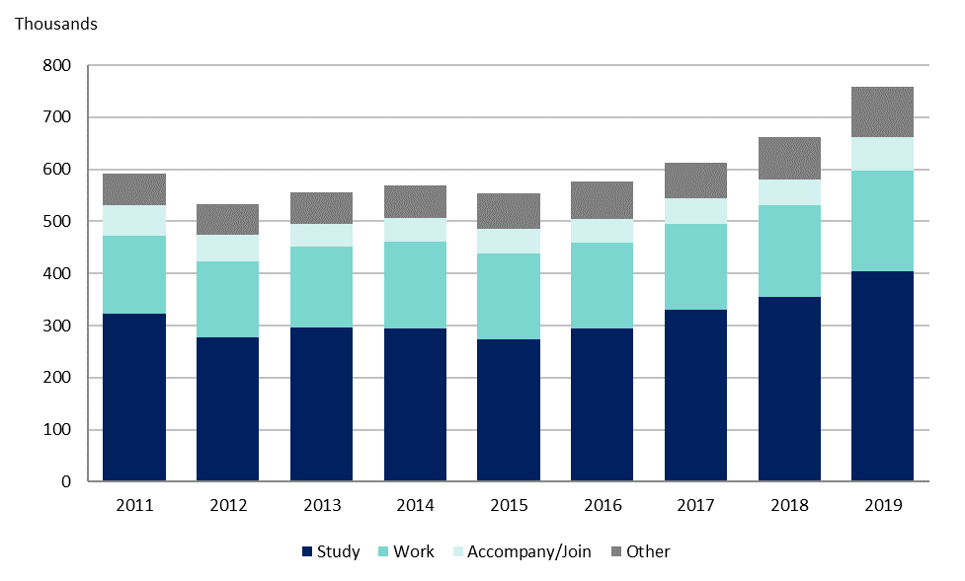
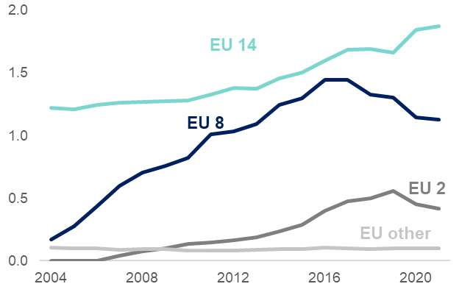
Annual Report 2021 Labour Market Context
Visas issued by reason, 2011-2019
No. of EU migrants estimated to be living in the UK by place of birth, 2004 – 2021 (millions)
The primary reason for non-EEA citizens pre-pandemic and under the previous immigration system migrating to the UK was for study purposes.
EEA citizens will now need a visa to migrate to the UK and work in certain occupations – where previously they could work in any job.
Population of those born in all EU 28 countries living in the UK increased to a peak in 2017 and has fallen each year since.
Significant uncertainty due to data sources and COVID-19
Census should fil the data gap
Notes:
Sources: Home Office Immigration stats for visa data, ONS Population of the UK by country of birth and nationality dataset for EU migrant numbers

Slide 10
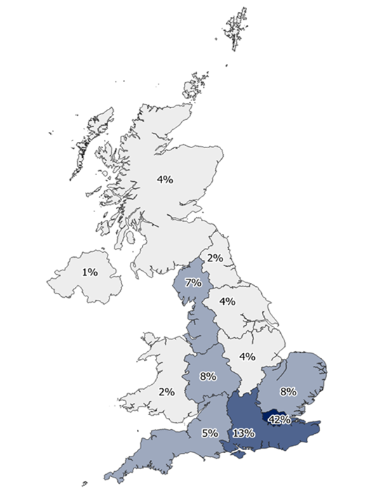
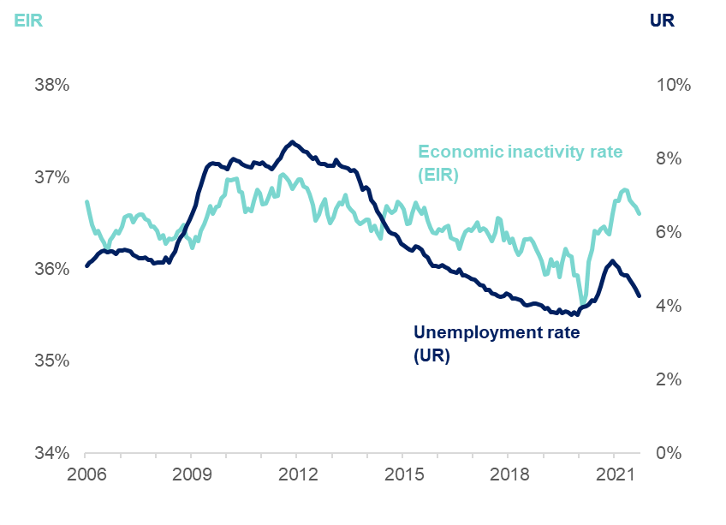
Annual Report 2021 Labour Market Context
SWR Applications by Government Office Region, 2021
Economic inactivity rate & unemployment rate
The highest share of SW applications in 2021 are in London.
This may be reflective of the occupation skill mix – London has a higher share of RQF 6+ occupations.
The salary threshold is relatively cheaper for London based companies, where wages tend to be higher.
Unemployment rose in 2020 after a sustained fall, coinciding with the pandemic, but the most recent data report that it is almost back to pre-2020 levels.
High economic inactivity rates suggesting that some individuals have chosen to leave the labour force throughout the pandemic.
Notes:
Sources: Map is using data from Home Office Management information, Certificate of Sponsorship (CoS) data 01 Jan 2021 to 30 Sept 2021.
EIR and UR chart uses data from ONS Labour Market Statistics.

Slide 11
The Shortage Occupation List (SOL)
The MAC recommends occupations for the SOL
Stakeholder evidence and data are collected to inform the recommendation
Expecting a commission from the HO to review which occupations are included on the SOL
Judgement Criteria:
Skilled
Shortage
Sensible
Recommendation

Slide 12
SOL Analysis
A Call for Evidence (CfE)
Questionnaire
Aim
Supporting guidance
Research
Sampled qualitative research to understand why and how sectors use the SOL
Indicators
Reviewing our methodology
Labour Market Statistics: Vacancy, Wage rates
Dashboard alongside CfE

Slide 13
Any Questions?

