Slide 1
Write Faster, Better, Cheaper!
www.copianto.ai
Daniella Darlington, COO.

Slide 2
It’s hard to create all the content needed to grow your business.
Time Consuming
Expensive
Writer's Block
Limited Creativity

Slide 3
Solution
Create better quality content, faster and
at lower cost using AI.

Slide 4
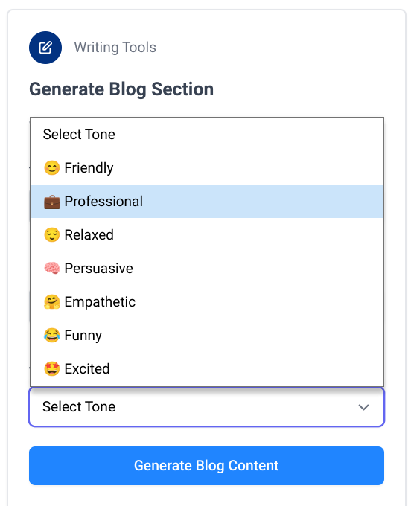
Value Proposition
Faster
Create content in minutes
Better
Create targeted & high converting copies
Cheaper
No need to be a pro writer

Slide 5
Our TAM is huge,
we only focus on a small portion of it today.
$133B
TAM
$12B
SAM
$1B
SOM
Source: MarketsandMarkets, Statista.

Slide 6
Business Model
Subscription
Pay Per Use
Starter $17/M Pro $37/M
$1 / 40 credits

Slide 7
Traction
60K
Copies Generated

Slide 8
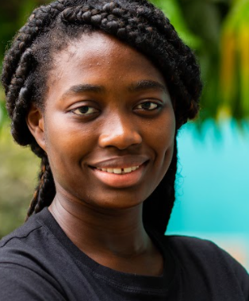
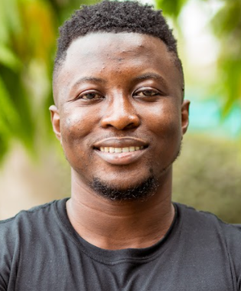
We know what we’re doing, we are here for the same reason.
Timothy Afrane Wuo-Asare (BSc. CS)
Daniella Darlington (LLB)
Chief Executive Officer
Chief Operations Officer
7+ years product management exp.
3+ years business development exp.
Alex Boateng (BSc. PA)
Sosu Alfred (BEng. CE)
Chief Technology Officer
Chief Product Officer
7+ years software development exp.
4+ years software engineering exp.

Slide 9
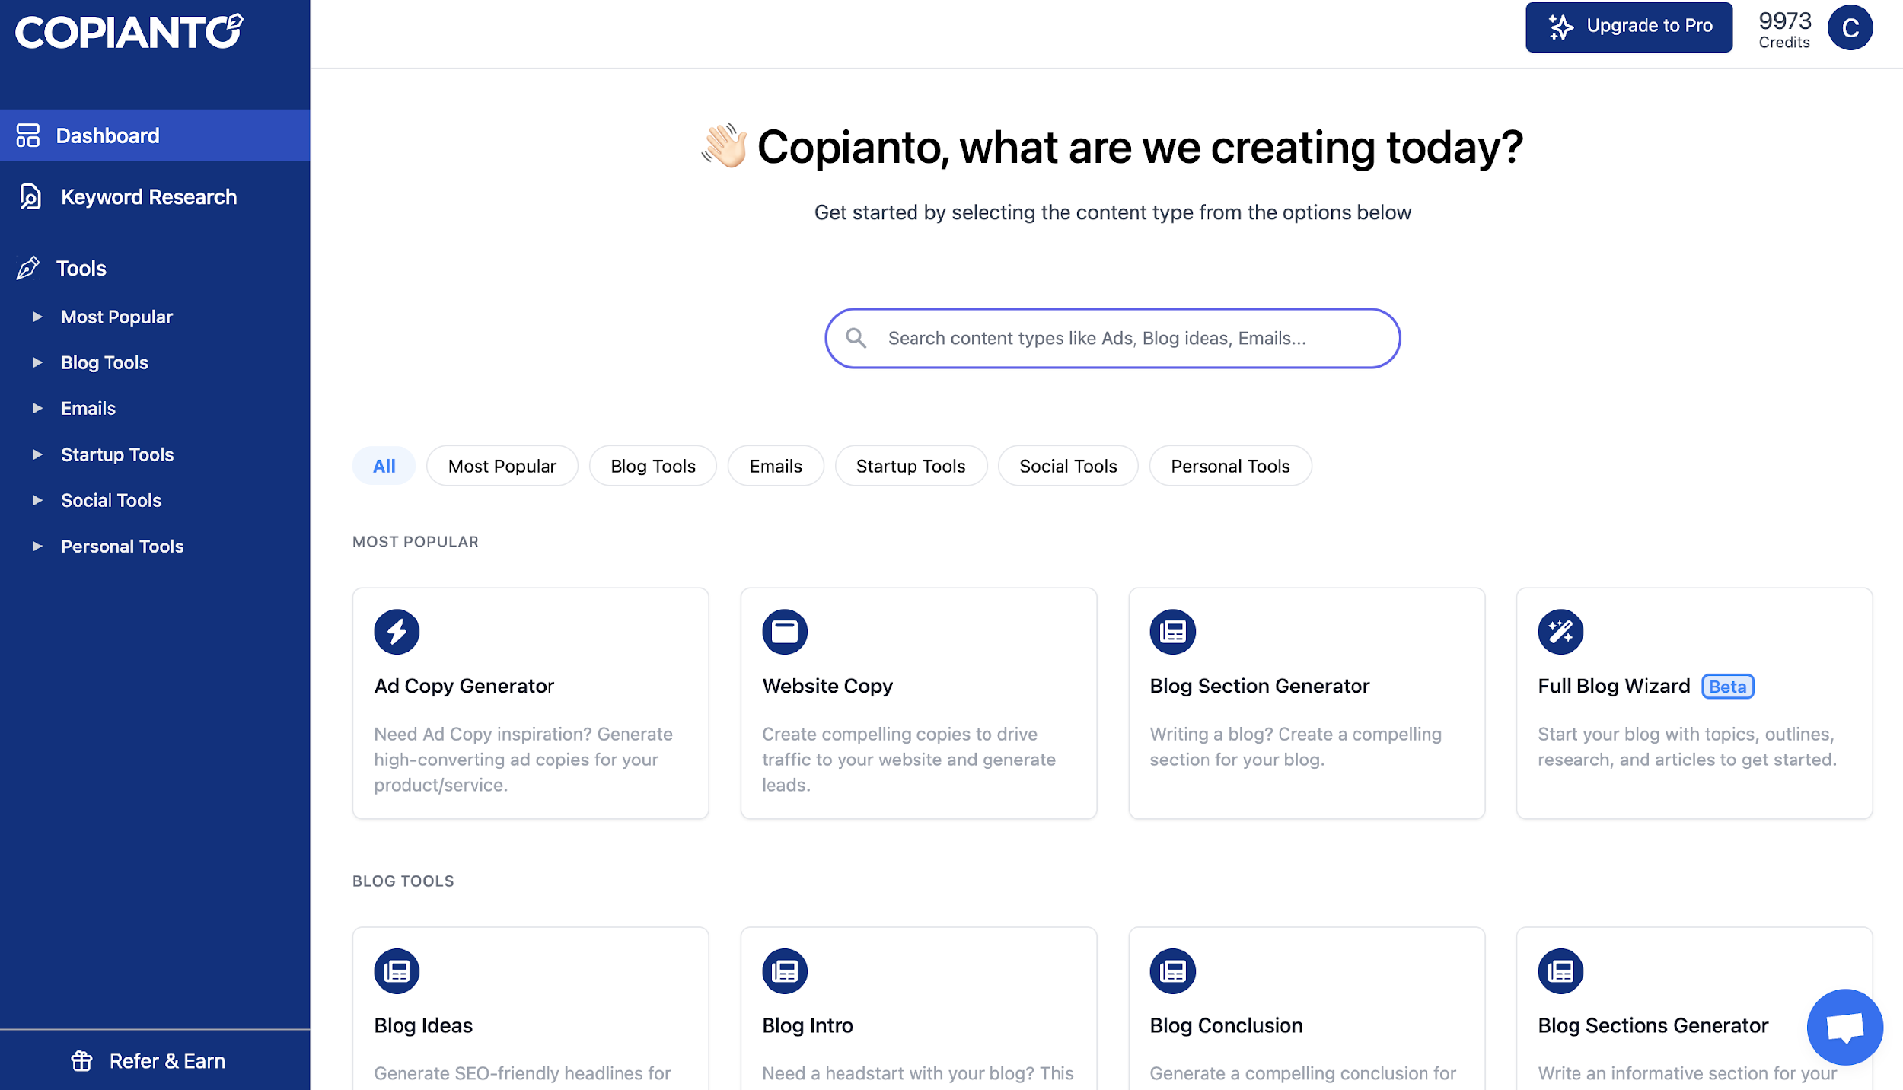
Write Faster!
http://copianto.ai

