Slide 6
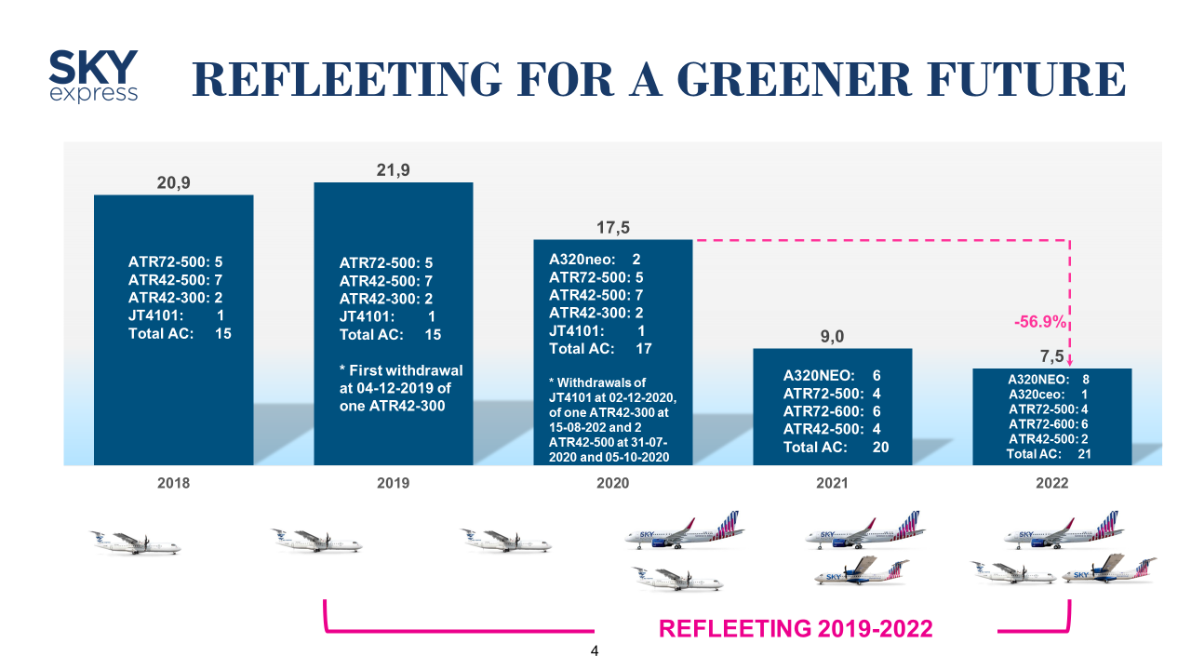

Slide 7
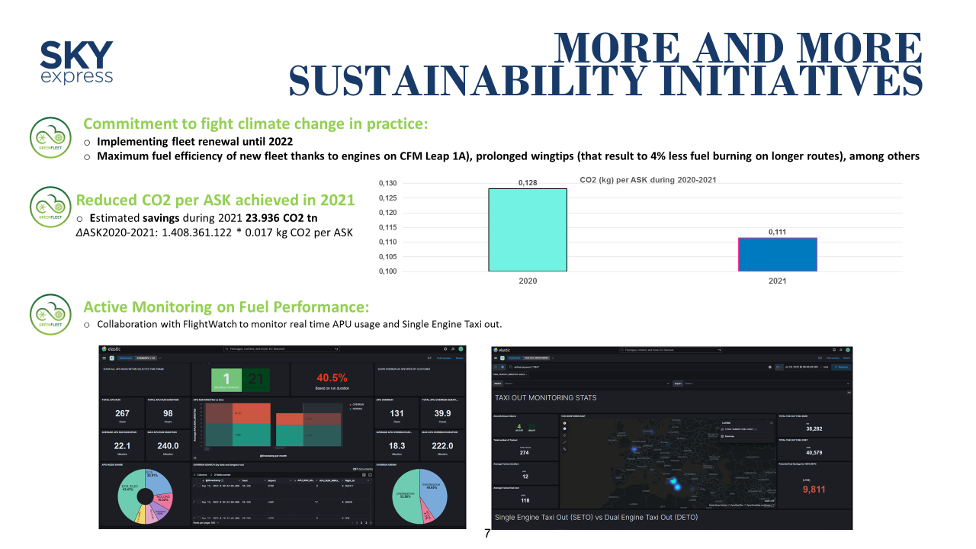

Slide 9
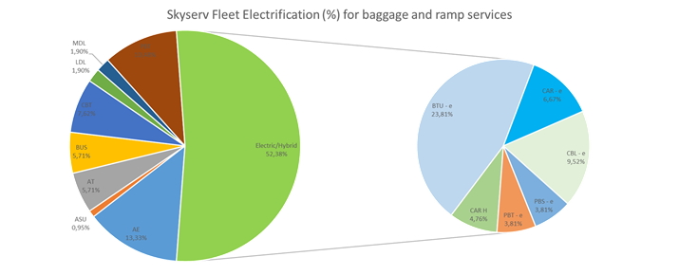
Going Green on the ground
Drastic Fleet Renewal based on IATA’s AHMs 1001-1005 (going from 14.9y to 2.2 years average fleet age)
Mitigating unabated emission through offsetting units
Mapping Scope 3 Corporate Value Chain CO₂ emissions by implementing GHG Protocol and verifying
Scope 1 and 2 CO₂ emissions under the same
Ground Handling to be included in ACI’s ACA – Important partner for Net Zero Airports
Serving airlines’ ramp | passenger | cargo operations in 37 commercial Airports of all size in Greece and 2 in Cyprus

Slide 10
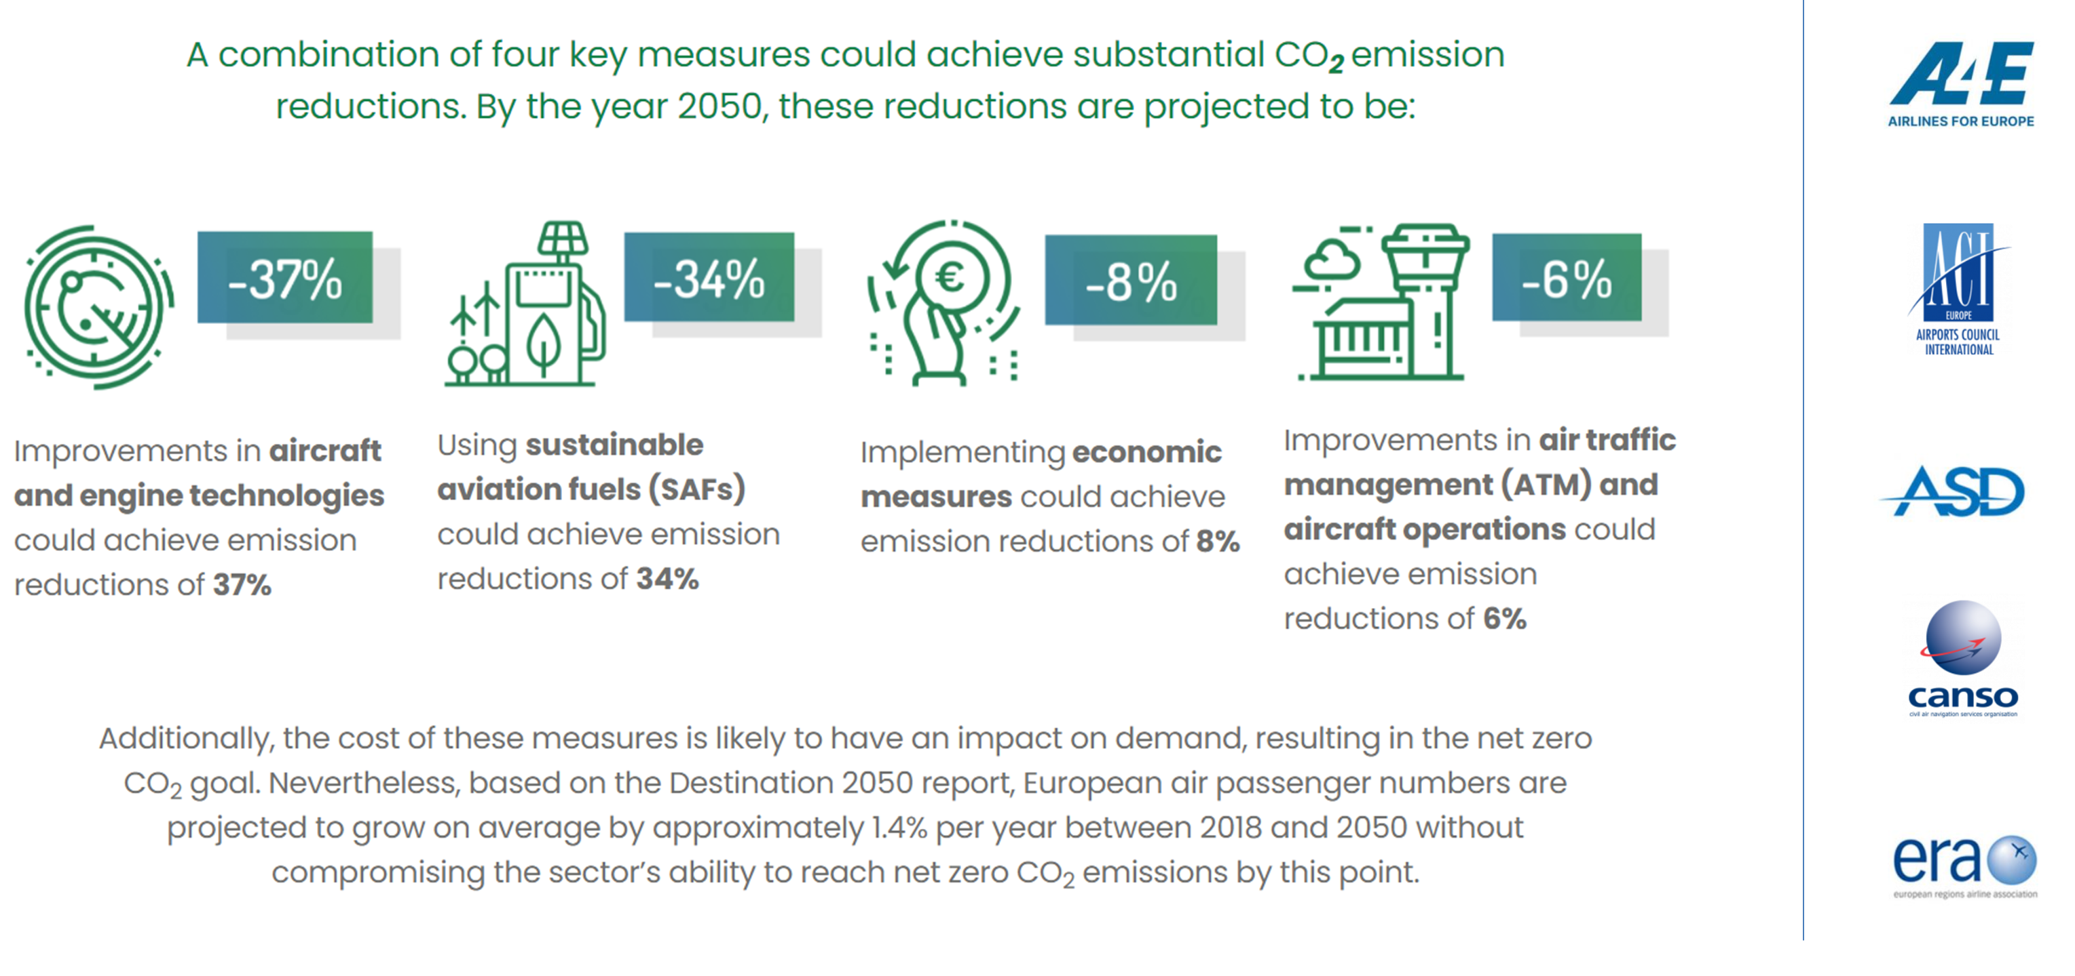
Fit for the future

