Slide 1
Sustainable Railway Transportation
13/12/2021

Slide 2
Sustainable Transportation
During the latest years European Union has emphasized the significance of Railway transportation highlighting its sustainability aspect since rail is the most eco-friendly means of transportation of passengers as well as of freight.
Sustainability Competitive Advantages of Rail Transportation
Railway transportation has multiple competitive advantage over the other modes of transport in various aspects, among which are:
Railway is the most fuel-efficient land means of transportation
Trains have fewer greenhouse gas emissions
Railroads reduce highway congestion and pollution

Slide 3
Cross Border Rail Transportation
Obstacles for cross-border transportation in Europe
In the last decades transport policies in nearly all EU countries have favored road transportation. The railway sector in Europe still suffers from a variety of problems caused from a lack of necessary investment in railway infrastructure. Some of the most important obstacles for the cross-border rail transportation in Europe are:
Different national regulations
Different signal and security systems
Different track gauges
Different voltage systems
Lack of common railway language

Slide 4
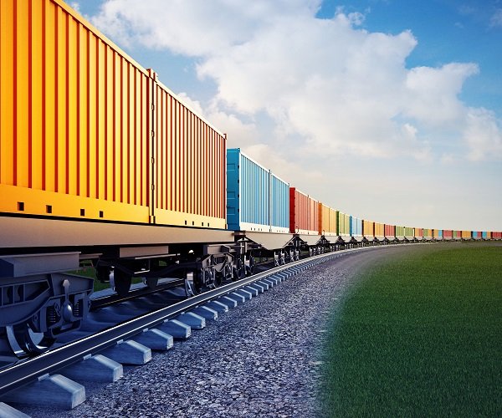
Rail Freight Transportation
Important Facts Regarding the Rail Freight Transportation
Despite that initiative, still the road transport has the largest share (72.1%) of EU freight transport performance among the three inland transport modes.
The CO2 emissions of freight trains are 80% less than heavy goods vehicles per tonne-kilometer.
It is noticeable though that, although the rail freight traffic between Asia and Europe has grown six-fold over the last five years, it still captures around 2% of the respective modal share.
European Union’s transport policy has identified that by 2030 30% of freight traffic over 350 km will be conducted by rail

Slide 5
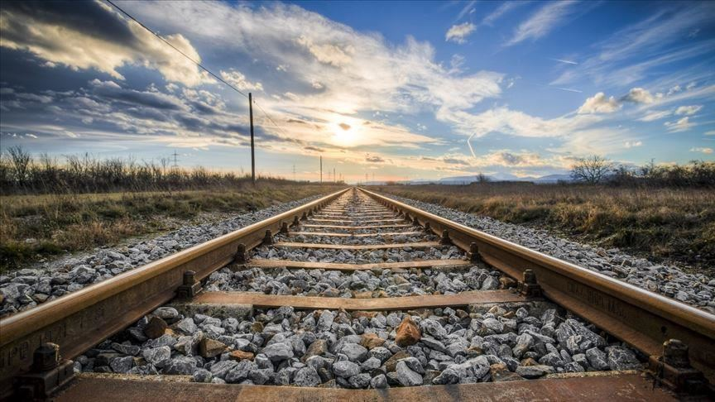
Rail Passenger and Freight Transportation
The Contribution of TRAINOSE
TRAINOSE, as the largest railway passenger and freight operator in Greece, plays a crucial role in the continuous development and improvement of the rail freight transport sector in Greece.
Freight activity of TRAINOSE is expected to grow substantially over the years utilizing the upgrade of the Greek Railway Network, its connection through the international corridors Orient-East Med and Corridor X as well as the foreseen expansion of Greek Ports’ activities over the next years.
Through systematic actions and strategic collaborations, TRAINOSE aims to enhance its position within the freight transportation and the logistics sector, contributing to the transition of Greece into a dynamic and modern hub in Southeast Europe.
TRAINOSE also aims to increase the outreach of passenger rail transportation supplementing the improvements of the Greek infrastructure network with increased efficiency in order to reach the target of offering offering safe, affordable and environmentally friendly passenger transportation.

Slide 6
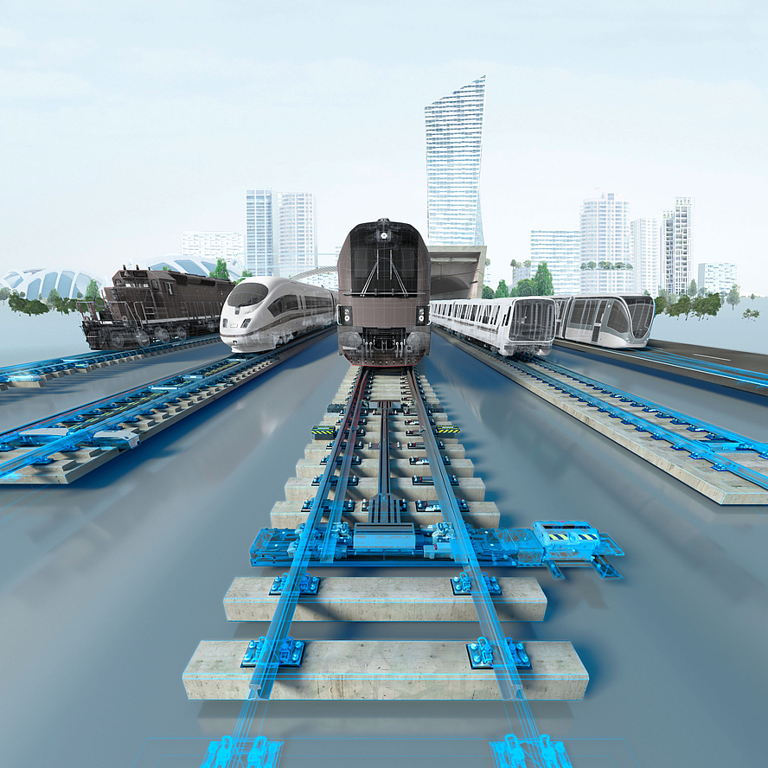
Railway Systems
Railway Systems’ Contribution
The security and remote-control systems are of great importance for the smooth operation of the rail sector both in the Greek and European railway network.
For many years Greece had a railway network that was characterized as outdated with lack of state-of-the-art safety systems and without the possibility of remote-control capabilities and monitoring systems capable of preventing accidents.
The absence of the aforementioned systems had a negative impact in terms of capacity and punctuality and the conditions created did not allow the railway to be competitive against other means of transport.

Slide 7
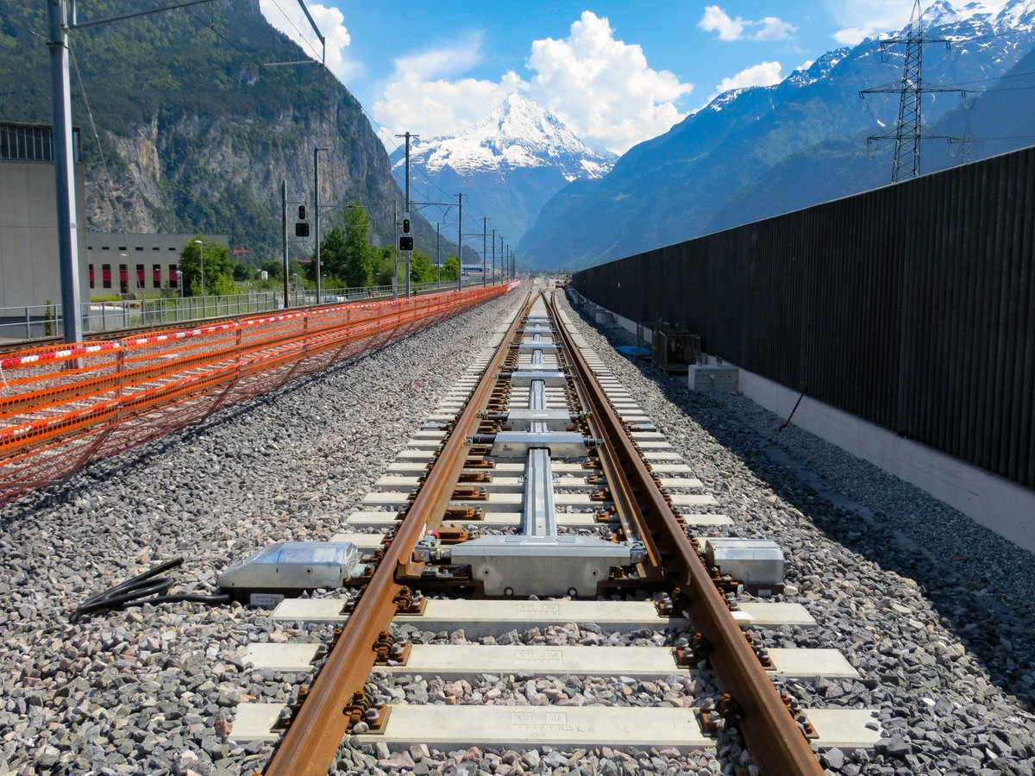
Railway Systems
Railway Systems’ Contribution
However, the foreseen installation of the aforementioned systems in the greatest part of the Greek rail network, will allow for the benefits and advantages of rail transportation to be realized as follows:
Offering efficient and safe transportation to passengers and goods.
Strengthening the role and the importance of rail transport in Greece.
Contributing to the transformation of Greece into the logistics hub of South-Eastern Europe.

Slide 8
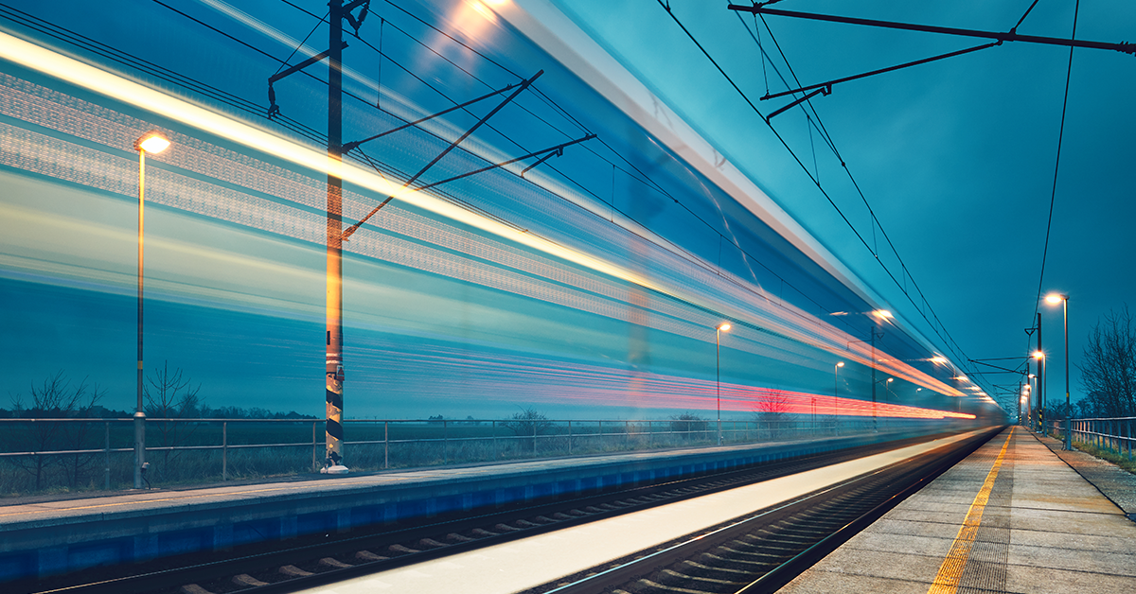
Digital Transformation of Railways
Digital Transformation’s Impact in Railways
Like most industries over the last few years, rail transport is experiencing a wave of digital transformation with significant impact.
Technological improvements like artificial intelligence, big data and cloud computing, connectivity and autonomous driving will impact the industry.
The aforementioned technological improvements are creating a new environment in which railway companies need to be more agile, continuously adaptive and to commit to innovation in order to promote the rail sector’s attractiveness.

Slide 9
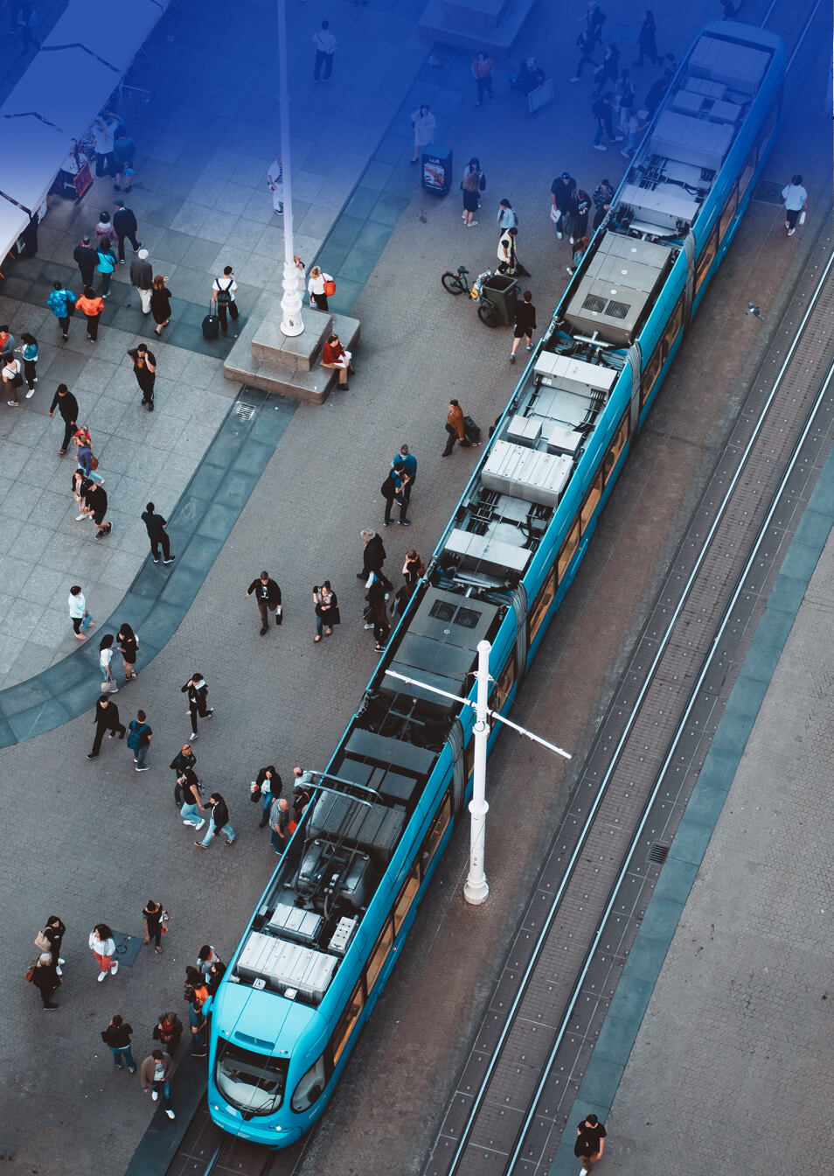
Digital Transformation of Railways
Digital Transformation’s Impact in Railways
The most important actions proposed from the rail sector to the European Commission for helping the digital transformation process are the following:
Developing connected railways: Reliable and better connectivity will provide safe, efficient and attractive railways both for customers and staff
Enhancing customer experience: Digitalization of railways will enhance customer experience
Increasing capacity: The use of the internet of things as well as the implementation of automatic train operations will increase the capacity, efficiency, and consequently the performance of railways
Boosting rail competitiveness: The utilization and analysis of transport data to boost the competitiveness of railways

Slide 10
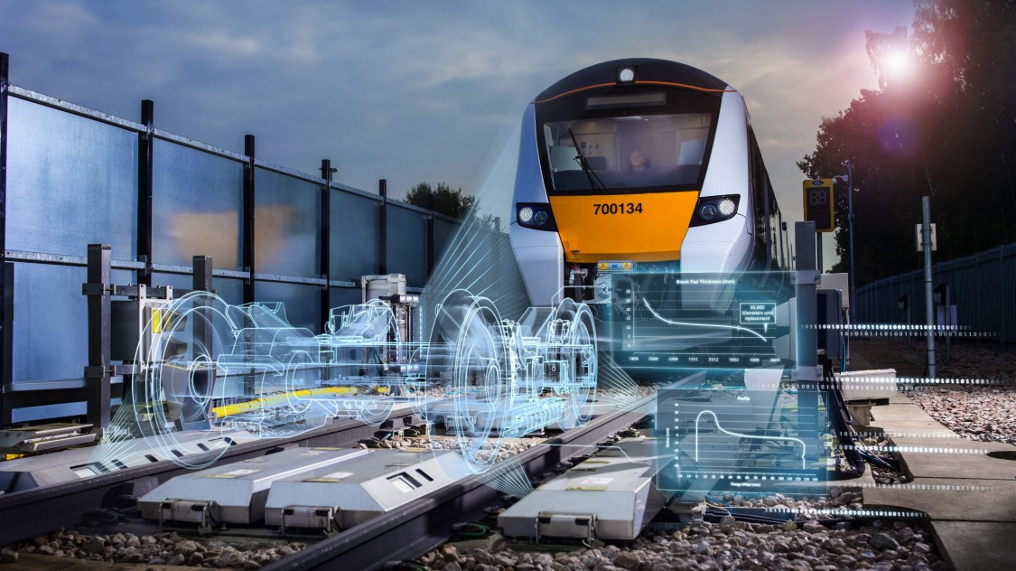
Digital Transformation of Railways
Digital Transformation’s Impact in Railways
In Greece an innovative breakthrough digitization agenda is promoted by the respective authorities expected to boost Greek economy, creating at the same time new investment and development opportunities.
The digital transformation of transport sector is a necessary condition for the development of the country.
TRAINOSE following the aforementioned principles continuously adopts innovative technologies in order to improve the experience of its customers for both passenger and freight transportation.

