Slide 1
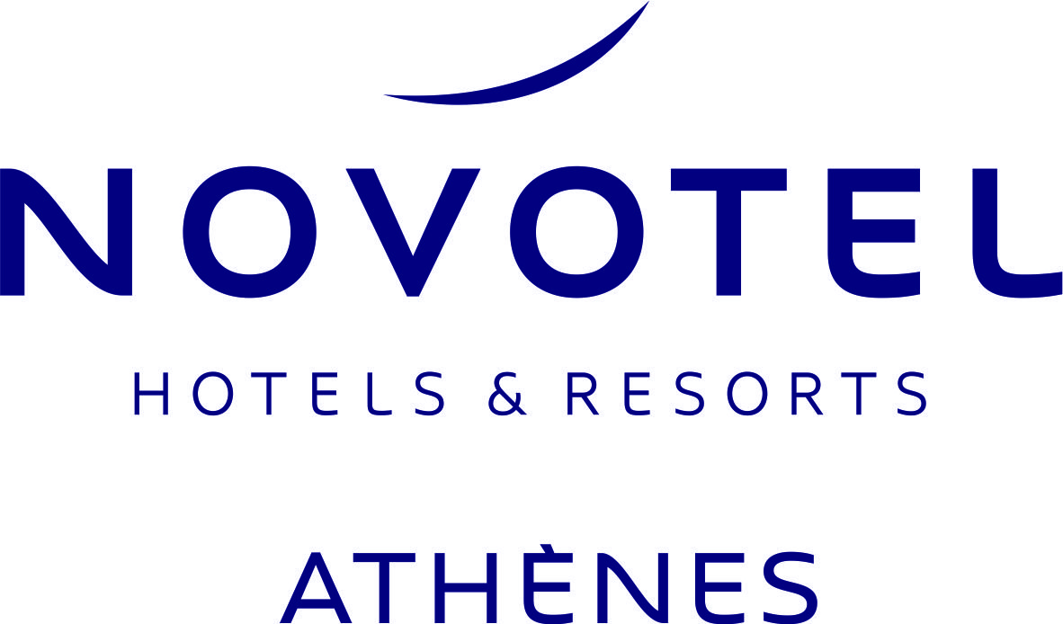
Novotel Athènes will Stay Open !
At Welcoming, safeguarding and taking care of others is at the very heart of what we do and who we are. For that reason we will currently Stay Open and continue offering our best services, prioritizing the health and safety of our Guests and Employees.
To ensure guest well-being, we follow all the Legislative Health Protocols and even further, we have increased our cleaning standards by launching the ALLSAFE Cleanliness and Prevention Label by SGS, which represents some of the most stringent cleaning standards and operational protocols in the world of hospitality.
Additionaly, through the partnership announced between ACCOR and AXA, we have the possibility to provide medical support across to all our guests who need medical assistance during their stay.
At Novotel Athènes, during these difficult circumstances, we will continue to offer a safe and pleasand stay or business meeting.
We do remain at your disposal for any question or any accommodation and meeting needs may have.
Keep Safe – Keep Healthy

