Slide 1
DIGITIZATION AT THE SERVICE OF CANCER PATIENTS
Ioannis Kotsiopoulos
Secretary General for Health Services, Ministry of Health
PhD, MPhil, MSc, PMP
NHS Digital Academy Alumni

Slide 2
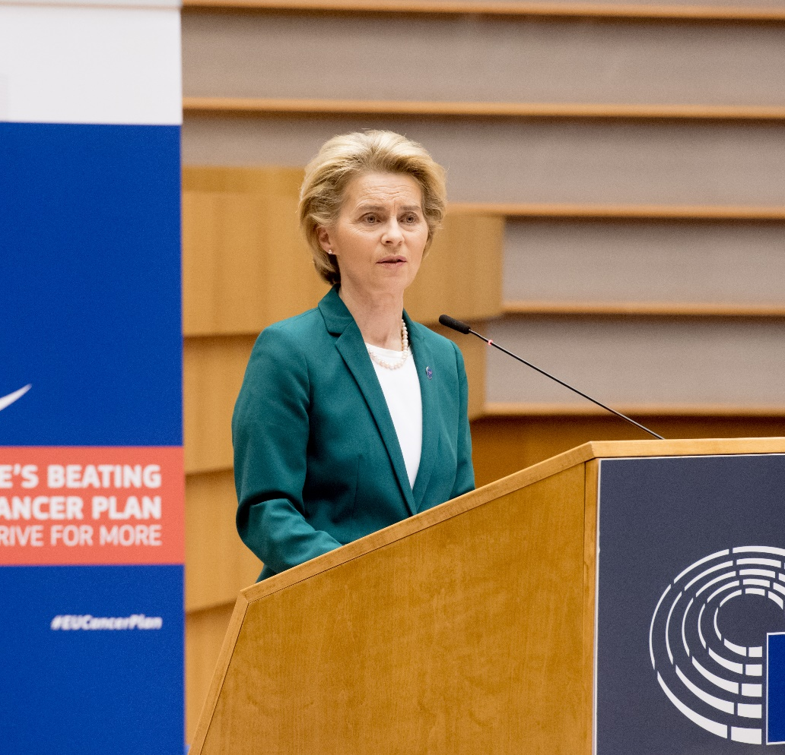
The fight against cancer….
“The use of artificial intelligence can significantly improve the precision of early diagnosis. It can be a powerful tool to reduce false positives and negatives”, she explained.
“We are now setting up a Common Health Data Space, an infrastructure where scientists and medical clinicians will be able not only to store clinical and research data, but also to access other scientists' data.”
“We know that some battles we simply cannot win. But together we can make a difference”,
Ursula von der Leyen, 4/2/2020

Slide 3
“A MODERN APPROACH TO CANCER:
NEW TECHNOLOGIES, RESEARCH AND INNOVATION AT THE SERVICE OF PATIENT-CENTRED CANCER PREVENTION AND CARE “
1. Driving change through knowledge and research
2. Making the most of data and digitalisation in cancer prevention and care

Slide 4
From plans to action….
With multiple available funding instruments supporting it, including the new EU4Health programme, Horizon Europe, and the Digital Europe programme, the Plan promises new technologies, innovation, and well-funded research

Slide 5
Best Practices….

Slide 6
Patient involvement in cancer care
Today’s cancer patients desire more than merely treatment for their disease, they want a cancer program that:
• Includes them in the decision-making process
• Educates them about their treatment options
• Keeps them updated on the progress of their care
• Treats them with a high level of respect and dignity.

Slide 7
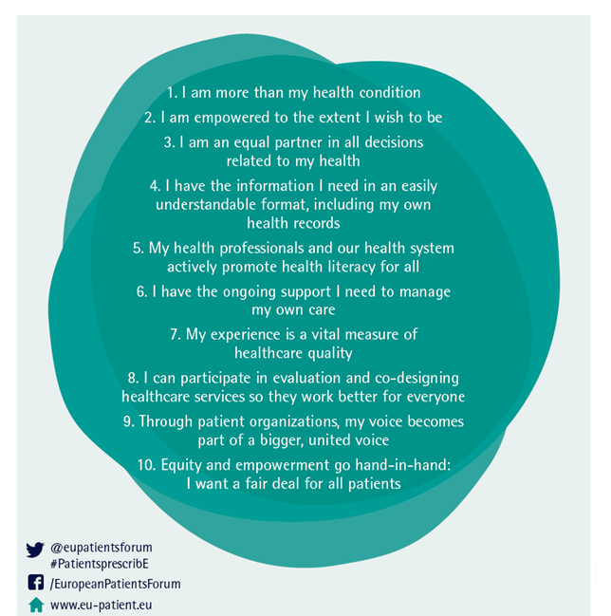
Patient involvement, engagement and empowerment have the potential to improve not only patient satisfaction with care but also the quality of care provided, and also improve patient outcomes
In such activities, patients and healthcare professionals work in equal partnership to promote and support patients’ active involvement in advancing their health and healthcare and also research and innovation.
‘Engagement’ expresses the commitment and actions of healthcare professionals to include patients in discussions and decisions about their care as individuals and in the development (‘coproduction’) of plans for healthcare services and research.
The aim is to ensure that care delivery is always responsive to people’s physical, emotional, social, and cultural needs.

Slide 8
Digital tools reinforcing patients’ engagement
Engage Patients in Ways That Are Meaningful to them
Engage Patients in Progress Reports
“….we will use tools that answer our questions and solve our problems. We will avoid tools that help us do what you think we should do and we won’t use tools that add to the work of caring for ourselves…..”
Engaging patients means keeping them informed of the results of engagement.
Engage Patients Early in the Design Process
Engage Patients as Equal Partners
“Co-design,” does not mean showing a finished product to someone and asking for ‘feedback.’” It’s about involving patients right from the start of the design process.
“patients can work as hard as anyone else in the health professions, and yet they are the only ones at the table who are not being rewarded for their efforts”

Slide 9
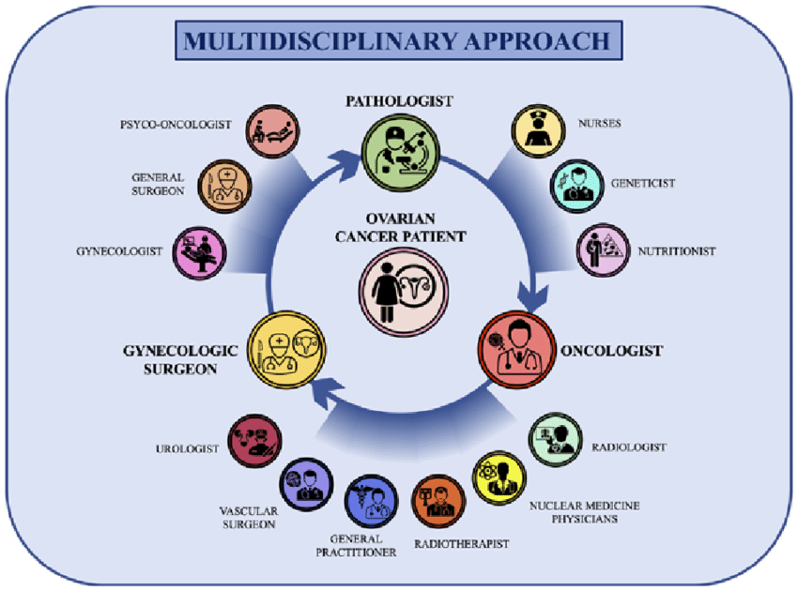
Multidisciplinary Tumor Boards (MDT)
The composition is variable, depending on the type of tumor discussed. As an organizational tool, MDTs are thought to optimize patient outcomes and to improve care performance.
Tumor Boards (TBs) are Multidisciplinary Team (MDT) meetings in which different specialists work together closely sharing clinical decisions in cancer care.
However, it is a challenge that requires organizational and cultural changes and must be led by competent health managers who can improve teamwork within their organizations.

Slide 10
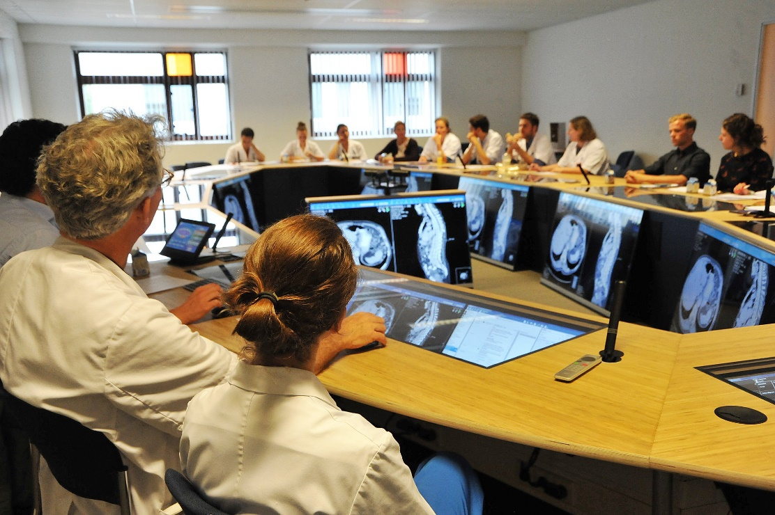
Technology supporting MDT…
Technology provides
easy access to patient data from multiple sources
data visualization
virtual meetings that increase tumor board participation and quality
To support quick and optimal decision making
The National Digital Program for Cancer Treatment will provide high technology MDT equipment to 10 Greek Hospitals
Without the support of digital tools, tumor boards can be labor intensive and add additional administrative burden. Navigating among multiple systems, meeting participants can lose time and focus from achieving consensus on patient treatment.

Slide 11
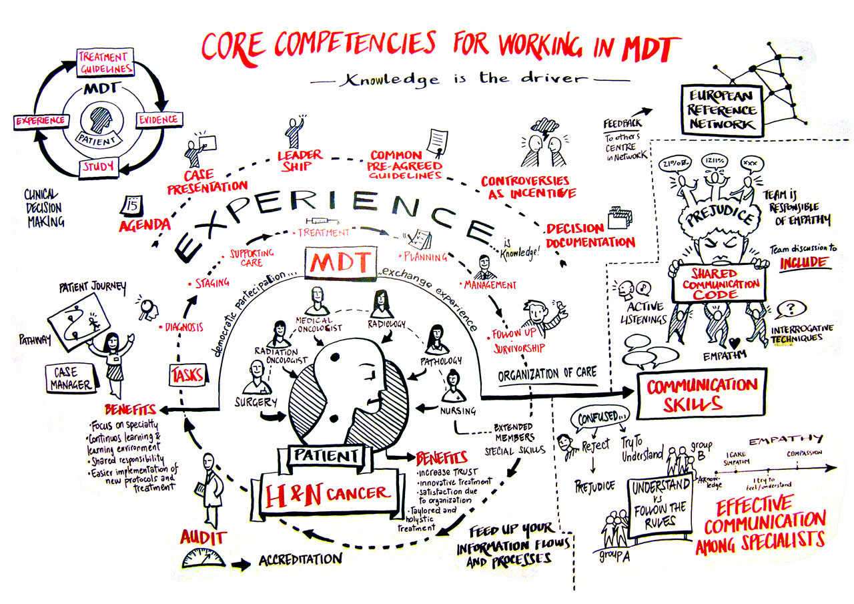
The human factor

Slide 12
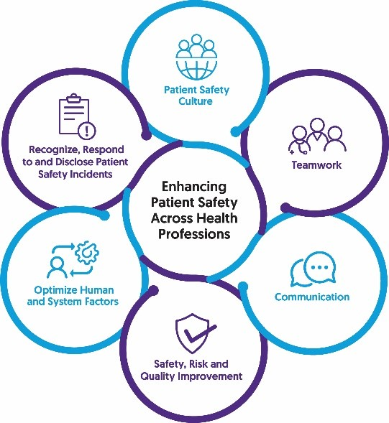
Cancer Patient Safety
Care for cancer patients is very complex with many treatments involving drugs that can be toxic outside of the therapeutic range. As such, cancer patients are a particularly vulnerable population within the healthcare system, with any error potentially being harmful to a population whose health is already compromised.
patients safety with cancer in the administration of antineoplastic therapy occurs when there is implementation of evidence-based protocols, continuing education of nurses and implementation of safety standards and processes, as a strategy to prevent errors in drug administration.
Self-reported patient safety events can provide a window into healthcare, revealing areas of care that require improvement.
Across all events, adverse drug reactions and intravenous-related events were the most common.

Slide 13
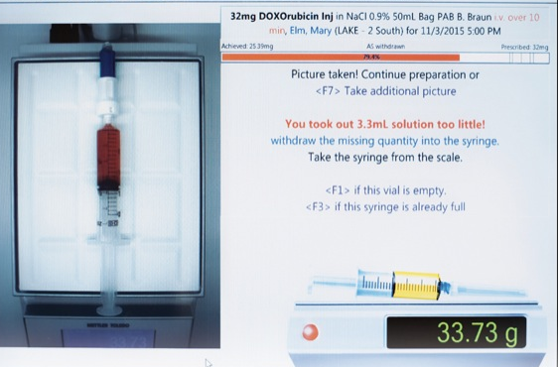
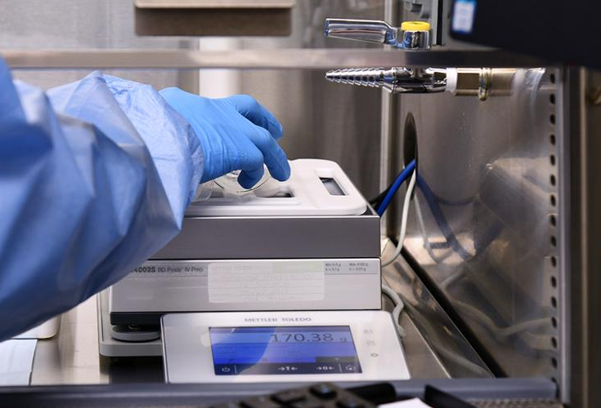
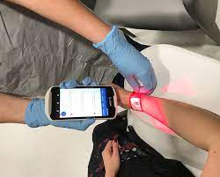
The dosage and production of drugs for chemotherapy requires utmost precision.
Digital tools may assist the whole production process from prescription aligned to therapeutic regimens to accurate drug preparation and administration
The National Digital Program for Cancer Treatment will provide such tools to 10 major Greek hospitals

Slide 14
Thank you….

